Slide 1

St. MARTIN'S ENGINEERING COLLEGE
CSE Dept.
BY:-
Y. KESHAV (12K81A05H9)
Y. PRANEETH (12K81A05J0)
G. VAMSHI KRISHNA (12K81A05D9)
L. ESWAR REDDY (12K81A05E8)

Slide 2

MAJOR
PROJECT

Slide 3

QuantiCo

Slide 4
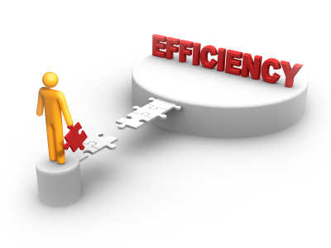

Efficient with
updated currency
Values!
Very User friendly
with high
Performance!

Slide 5
ABSTRACT
QuantiCo is an Android application that draws the latest currency values from the Internet and converts them into the type of currency of user’s choice.
The name QuantiCo is loosely derived from the two words , “ Quant “ which means ‘numbers’ and “ Co” which means ‘Converter’.
It is designed in such a way that the user can obtain the value of an amount of one type of currency in another type of currency irrespective of the location.

Slide 6
The Application provides the user with numerous currencies he can choose from.
Without any secondary interaction from the user, the application calculates the change and directly displays on the screen.
The drop-down boxes that are present in the base activity allow the user to select the currencies that he needs to change from and to.

Slide 7
Modules
1.Base Activity
2.Disclaimer Activity
3.Preference Activity

Slide 8
Base Activity
Main activity is the integration of front end and back end logic. Front end contains User Interaction with the application. Back end contains the conversion logic and the logic that involves retrieving currency information from the internet.
It also provides the time at which all the currency values have been updated.

Slide 9
Disclaimer Activity
It is the first activity that runs when the app is installed and opened for the first time.
It contains a caution message for the user stating that application is not responsible for any inaccurate results.
The user need to accept the terms before proceeding.

Slide 10
Preference Activity
It allows the user to customize the app according to his preferences like..
Default currencies that are considered in the conversion.
And it allows us to set an update interval and choose between automatic update or manual update.

Slide 11
Architecture
I
N
P
U
T
O
U
T
P
U
T
I
N
T
E
R
N
E
T
User Input
Application Logic
Android Framework
Phone

Slide 12
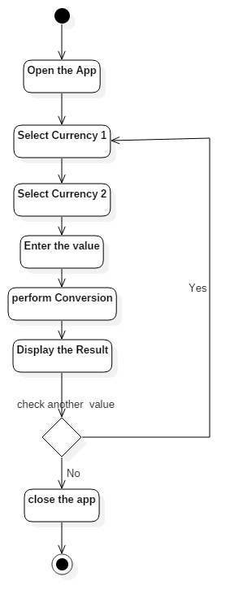
ACTIVITY DIAGRAM

Slide 13
Advantages of the application
According to the latest values in the financial market, QuantiCo gives accurate and timely results.
When accessing the application in an Android device, the location of the user is not important nor considered.
Numerous types of currencies are present within this application.
It can be operated while offline as well.

Slide 14
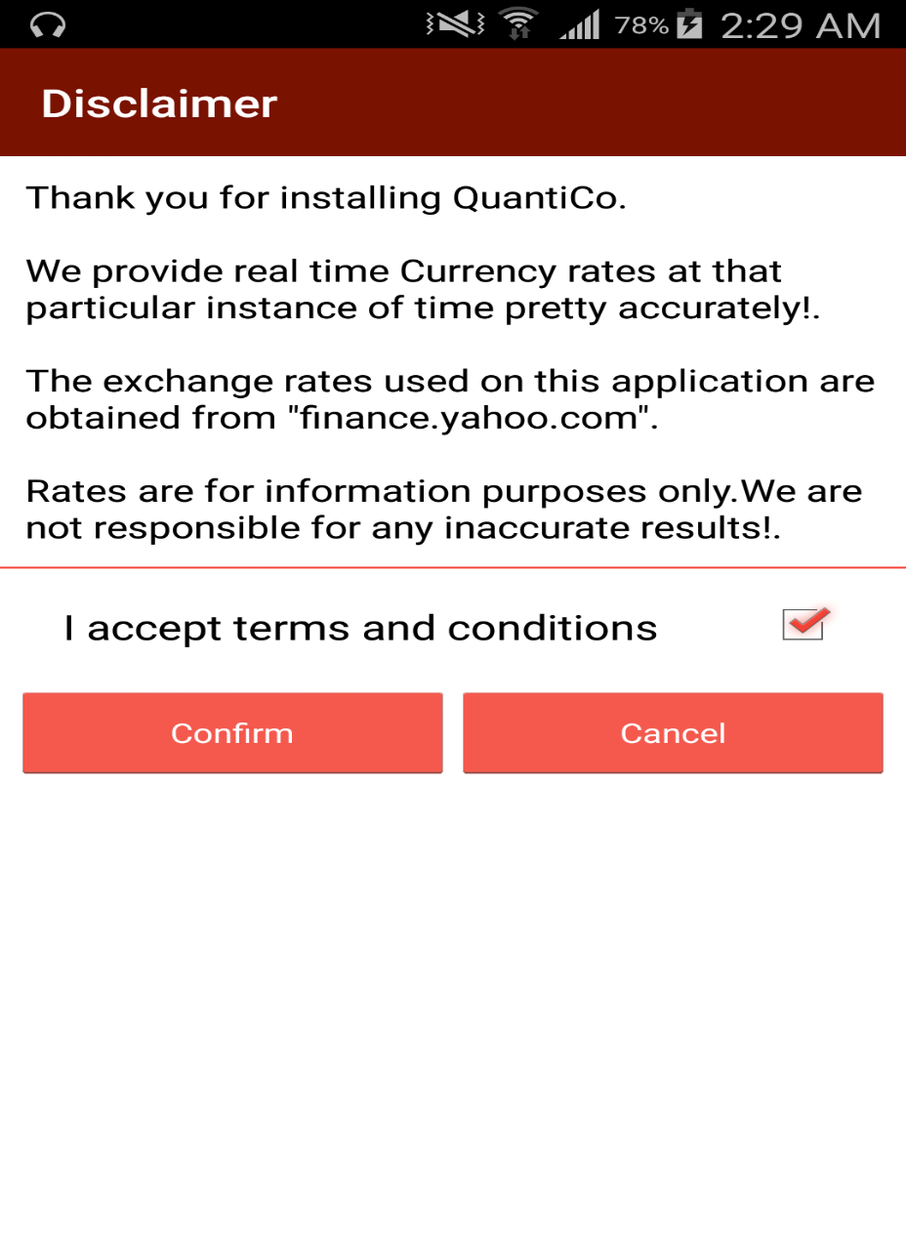
Disclaimer Activity

Slide 15
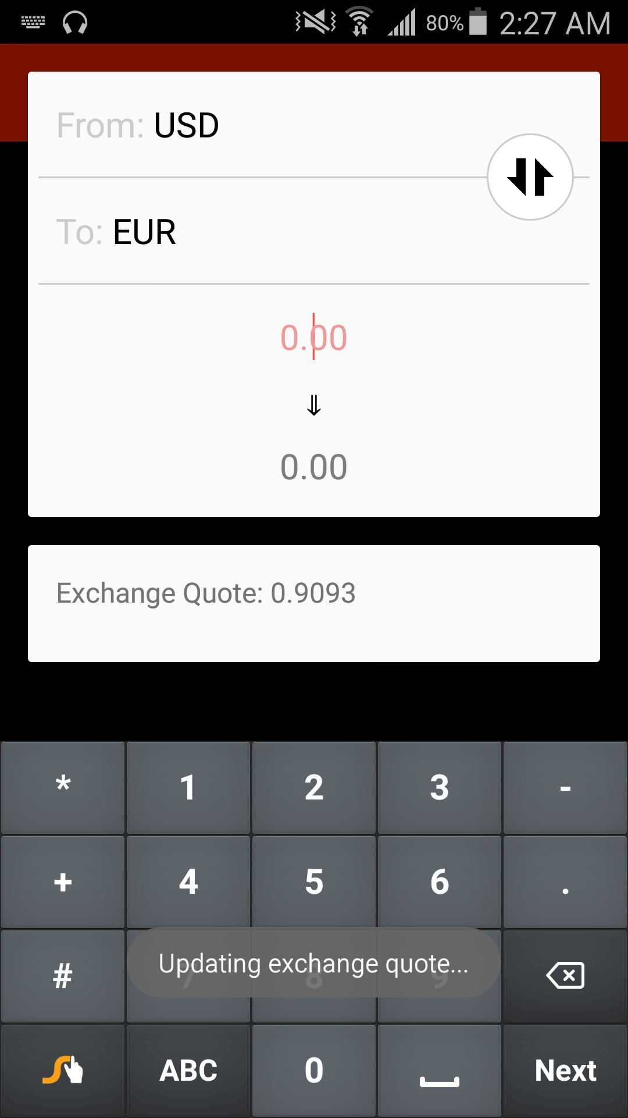
Updating values

Slide 16
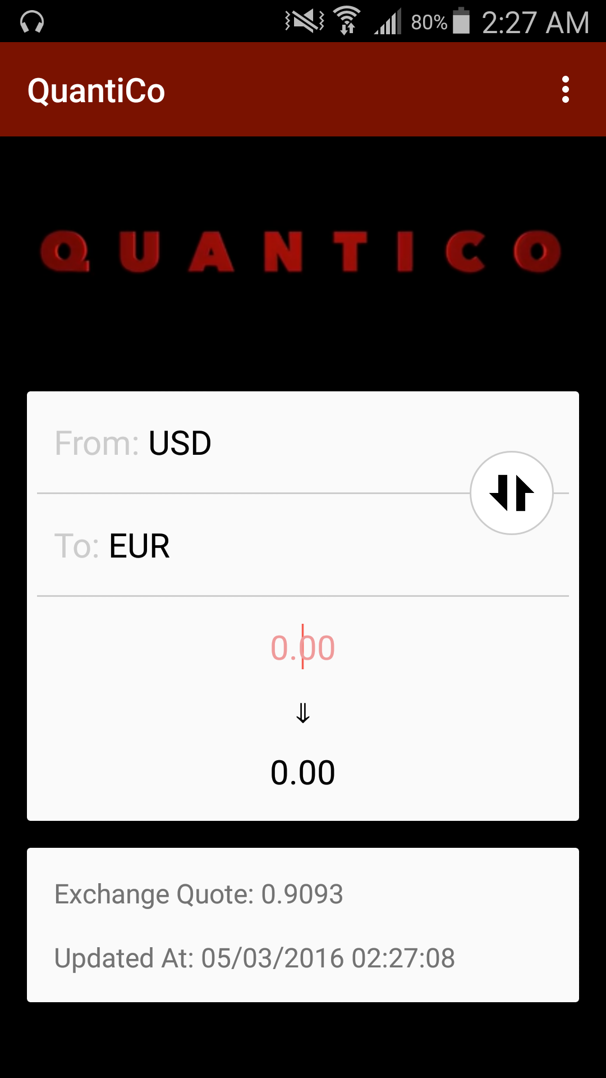
Main Screen

Slide 17
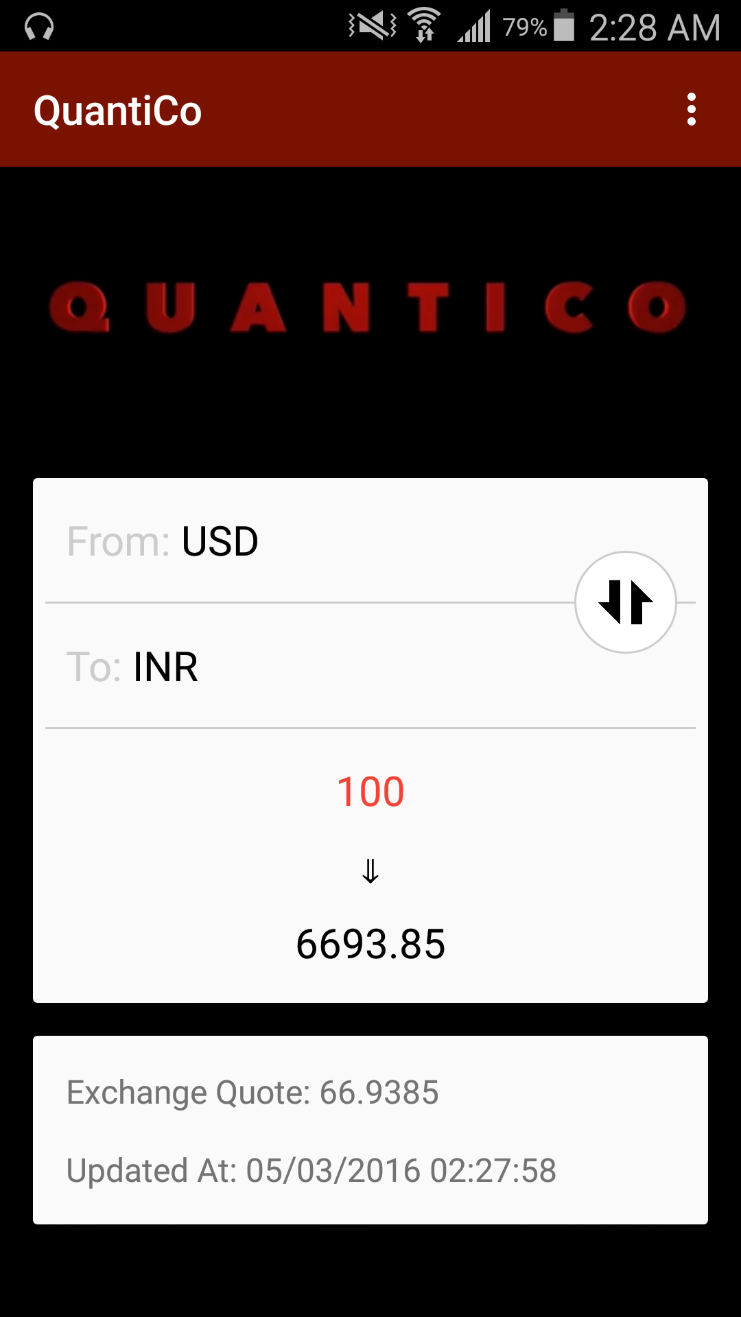
Converted Values

Slide 18
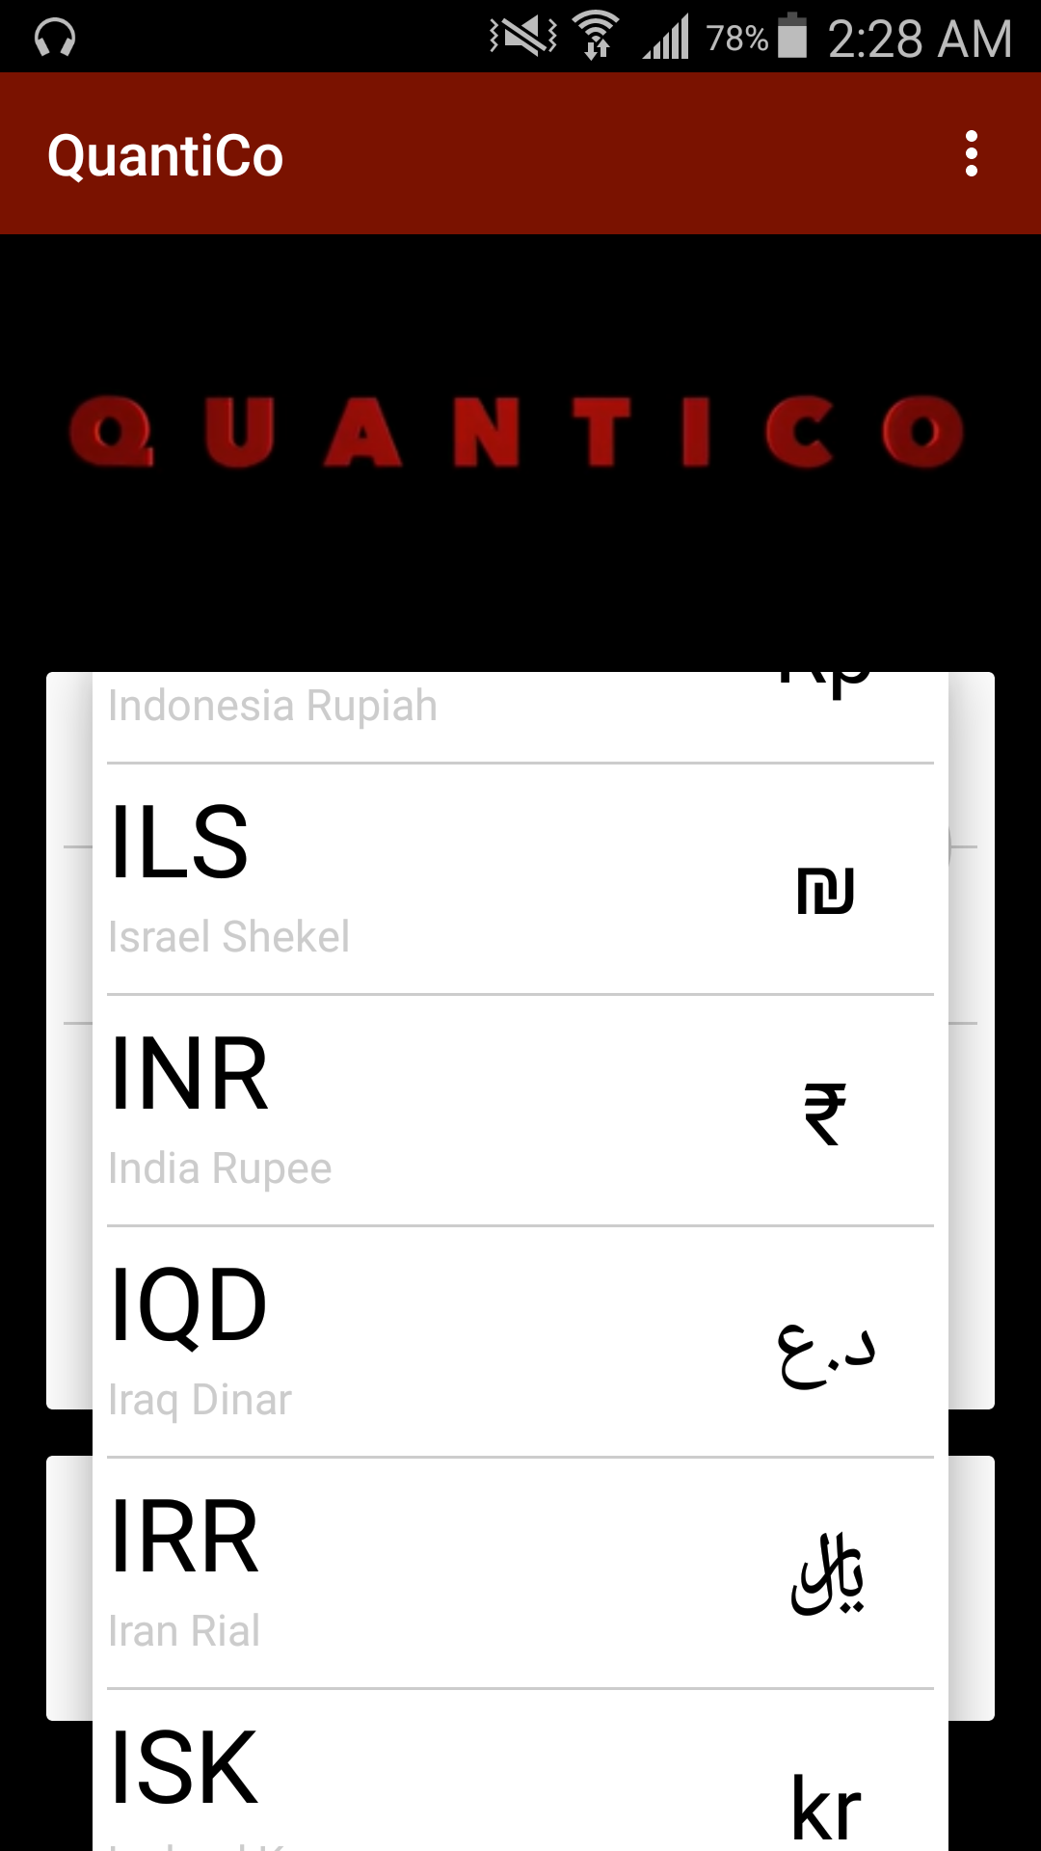
Currency list

Slide 19
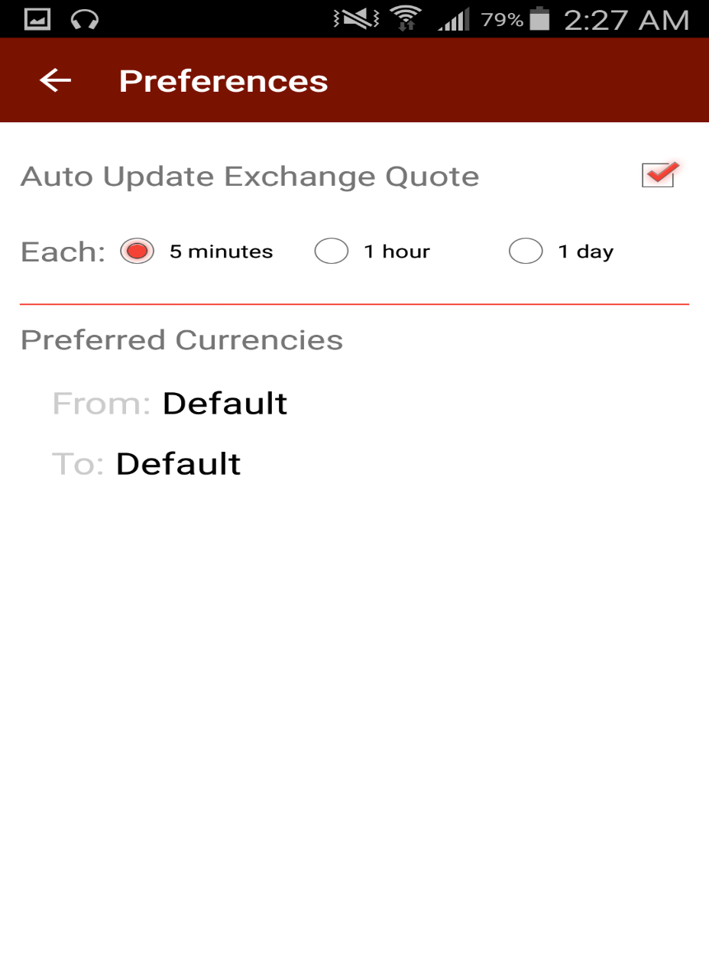
Preference Activity

Slide 20
Operating System Recommended
Android Operating system is the Operating system on which the Application is based.
following are the versions of Android OS which support the application:
Jelly Bean(4.1 – 4.3.1)
KitKat(4.4 – 4.4.4)
Lollipop(5.0 – 5.1.1)
Marshmallow(6.0 – 6.0.1)

Slide 21
SOFTWARE REQUIRMENTS
Operating system of minimum of version 4.1 .
HARDWARE REQUIRMENTS
Processor is not less than 500MHZ.
RAM is not less than 512MB.
SD card with minimum of 1GB.
Resolution is not less than 480*800pixs.

Slide 22
CONCLUSION
This Application is a tool that helps every user in everyway possible in the process of conversion.
QuantiCo only runs on an android device that has the version 4.1 or above.
The conversion is very fast that the application doesn’t need a secondary interaction.
It is very reliable and completely dependable for the currency conversions.

