Slide 1
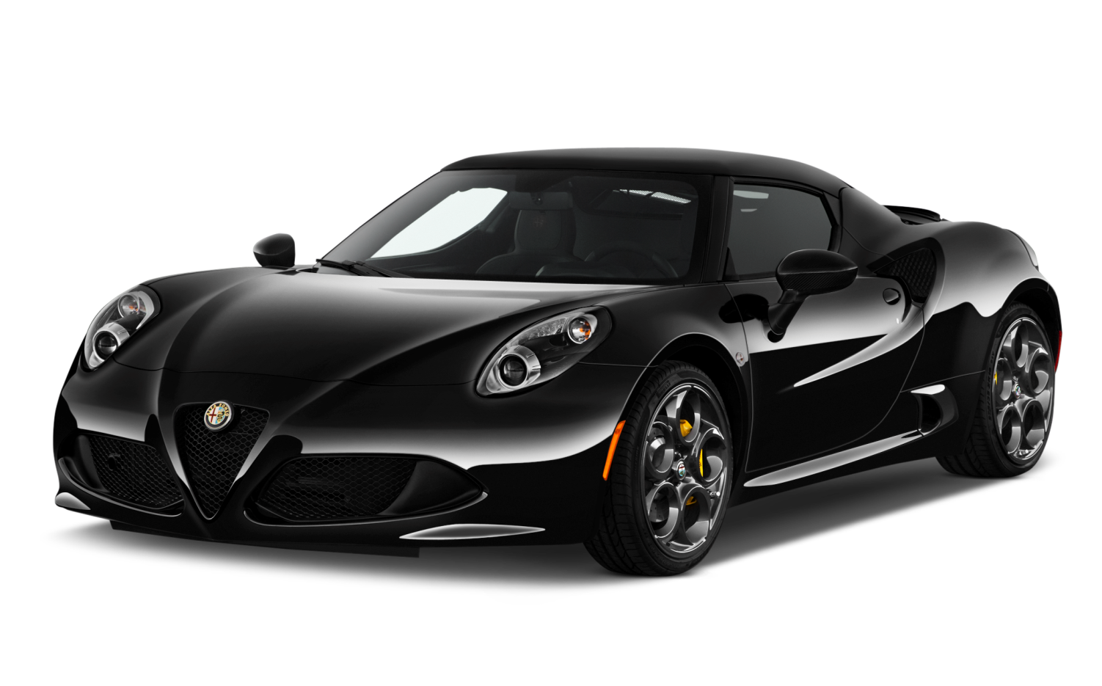


Exploratory data analysis on Automobile data
Praneet Rane
https://github.com/praneetrane/EDA_Automobile-data.git

Slide 2
About data
This dataset contains information about cars
Data Volume- 205 records , 26 variables
Data Attributes
Attribute | Attribute Range | Attribute | Attribute Range
1. symboling | 3, -2, -1, 0, 1, 2, 3.
2. normalized-losses | continuous from 65 to 256.

Slide 3

Steps involved
Loading Data
Data profile report before data cleaning
Variable identification
Cleaning of data
Standardizing data
Data profile report after data cleaning
Univariate analysis
Bi-variate analysis
Conclusion

Slide 4
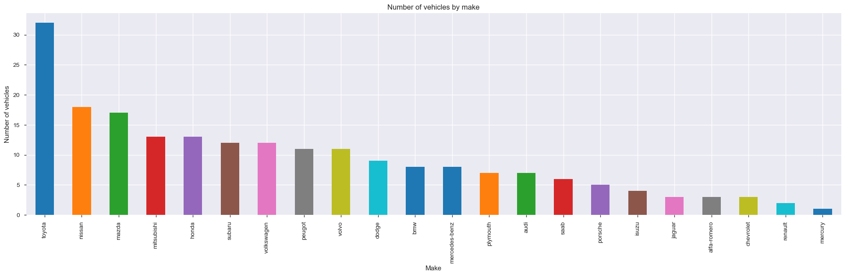
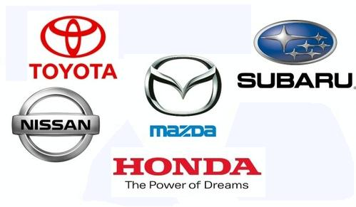
Top brands analysis
Which are popular car brand ?
Top popular brands- Toyota, Nissan, Mazda, Honda and Mistubishi
Toyota has most number of cars

Slide 5
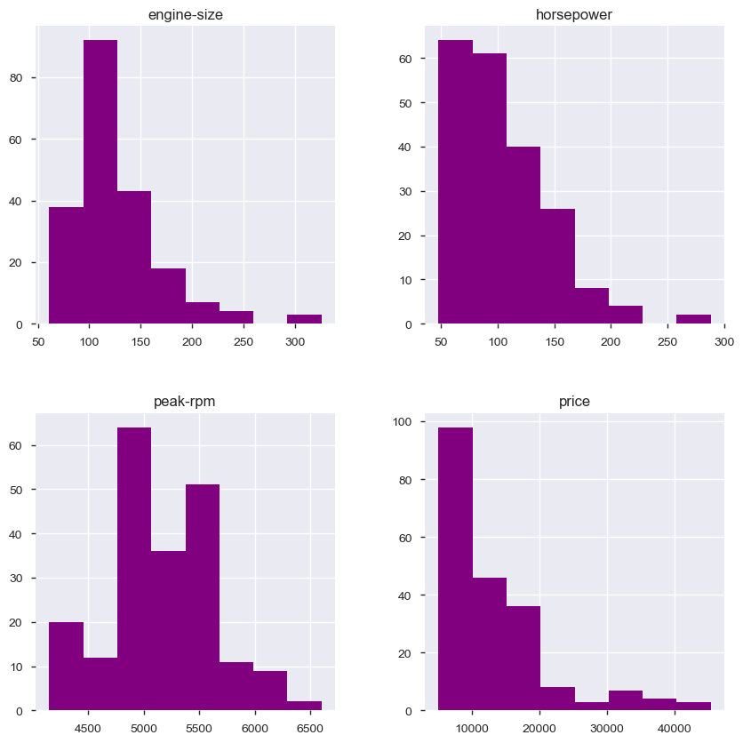

Data Distribution
Most of the vehicle's engine size ranges between 60 to 160.
Most of the vehicle's horse power is in between 40 to 120.
Most of the vehicle's peak-rpm ranges between 4750 to 5700.
Most of the vehicle's price ranges between 2000 to 20000.

Slide 6
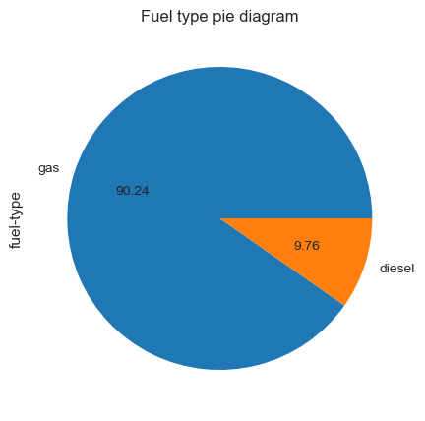
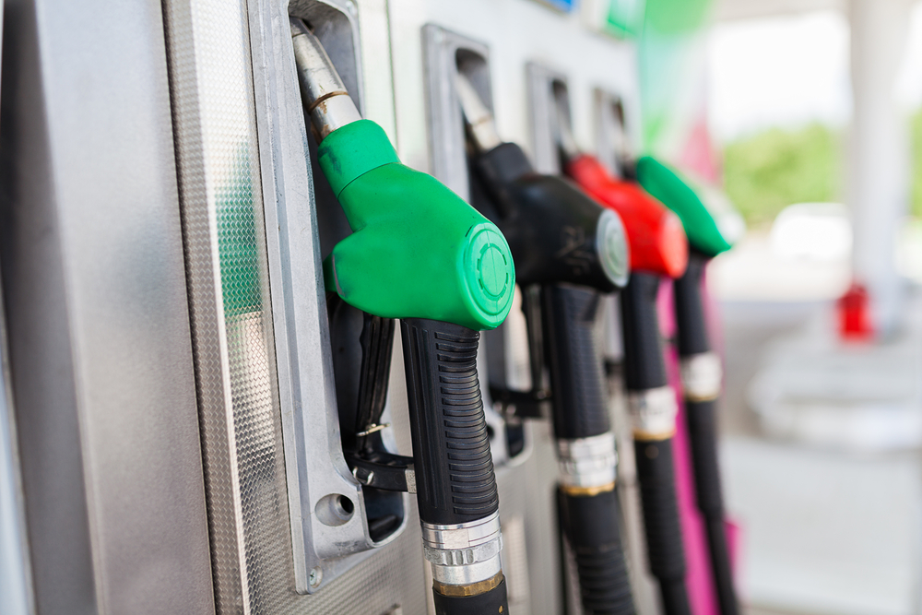
Fuel Type
Which is the popular fuel type ?
Gas is popular fuel type. More than 90% vehicles run on gas.

