Slide 1
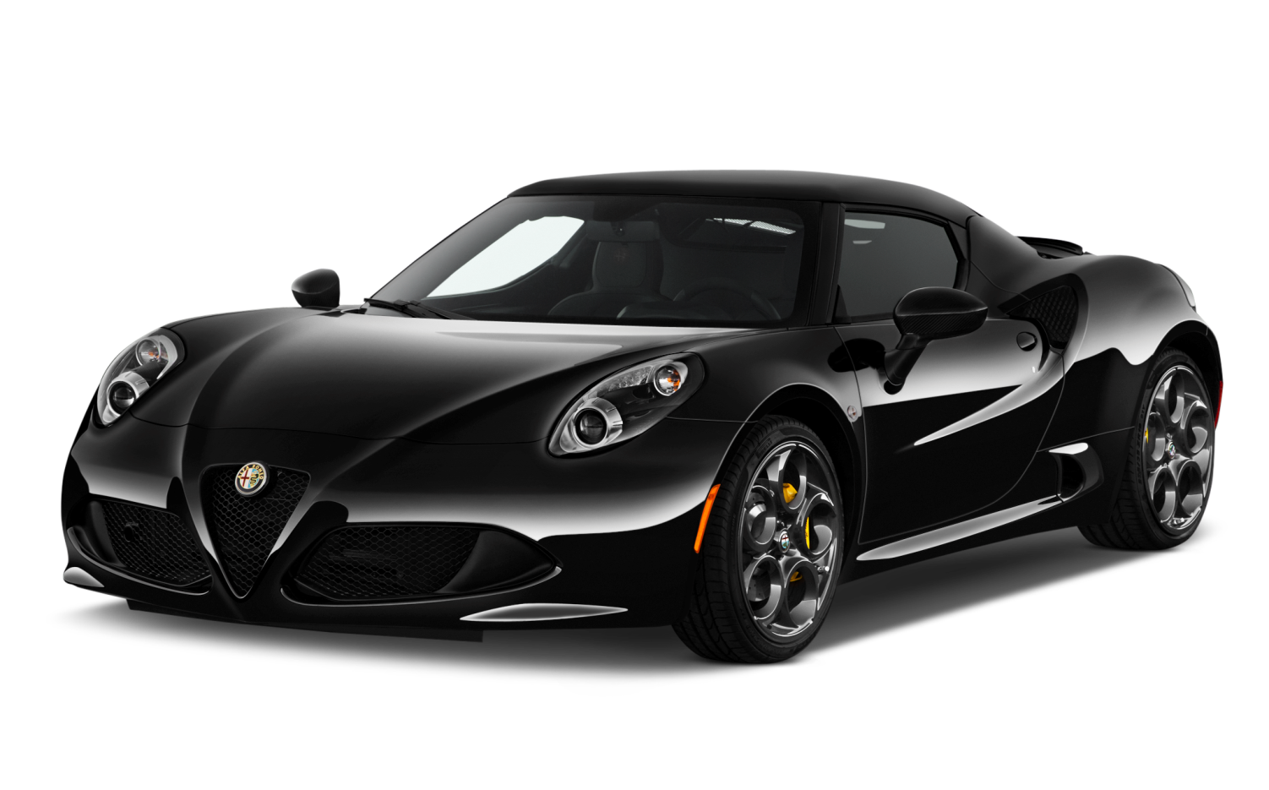


Exploratory data analysis on Automobile data
Praneet Rane
https://github.com/praneetrane/EDA_Automobile-data.git

Slide 2
About data
This dataset contains information about cars
Data Volume- 205 records , 26 variables
Data Attributes
Attribute | Attribute Range | Attribute | Attribute Range
1. symboling | 3, -2, -1, 0, 1, 2, 3. | 14. curb-weight | continuous from 1488 to 4066.
2. normalized-losses | continuous from 65 to 256. | 15. engine-type | dohc, dohcv, l, ohc, ohcf, ohcv, rotor
3. make | alfa-romero, bmw, chevrolet,...volvo etc. | 16. num-of-cylinders | eight, five, four, six, three,twelve, two.
4.fuel-type | diesel, gas. | 17. engine-size | continuous from 61 to 326.
5. aspiration | std, turbo. | 18. fuel-system | 1bbl, 2bbl, 4bbl, idi, mfi, mpfi, spdi, spfi.
6. num-of-doors | four, two. | 19. bore | continuous from 2.54 to 3.94.
7. body-style | hardtop, wagon, sedan, hatchback, convertible. | 20. stroke | continuous from 2.07 to 4.17.
8. drive-wheels | 4wd, fwd, rwd. | 21. compression-ratio | continuous from 7 to 23.
9. engine-location | front, rear. | 22. horsepower | continuous from 48 to 288.
10. wheel-base | continuous from 86.6120.9. | 23. peak-rpm | continuous from 4150 to 6600
11. length | continuous from 141.1 to 208.1. | 24. city-mpg | continuous from 13 to 49.
12. width | continuous from 60.3 to 72.3. | 25. highway-mpg | continuous from 16 to 54.
13. height | continuous from 47.8 to 59.8. | 26. price | continuous from 5118 to 45400.

Slide 3

Steps involved
Loading Data
Data profile report before data cleaning
Variable identification
Cleaning of data
Standardizing data
Data profile report after data cleaning
Univariate analysis
Bi-variate analysis
Conclusion

Slide 4
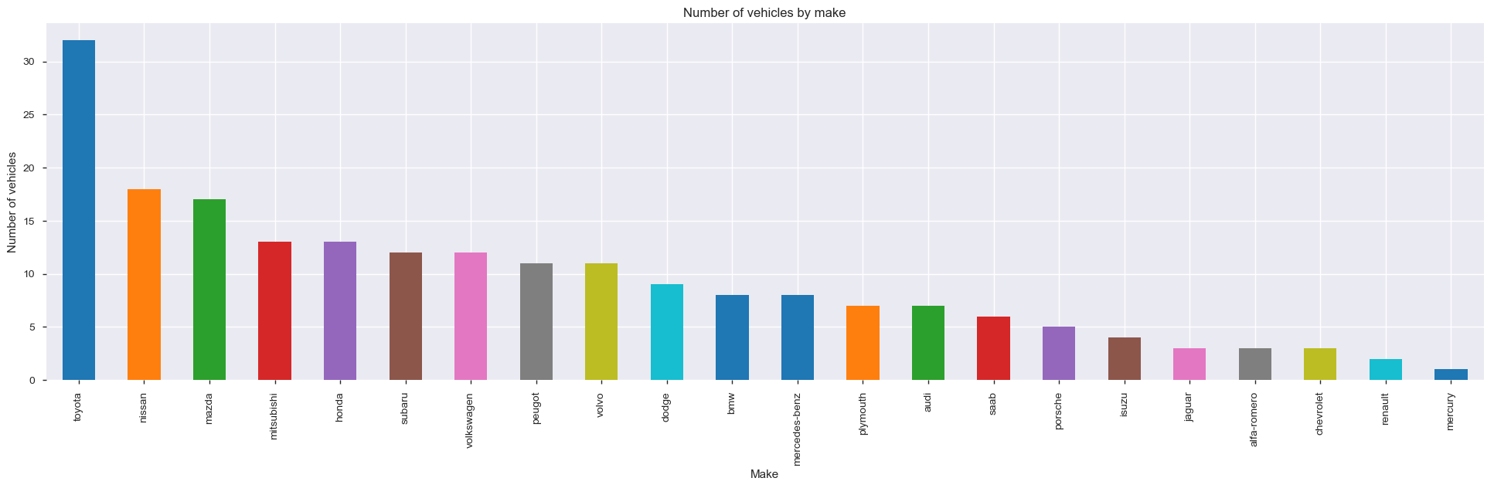
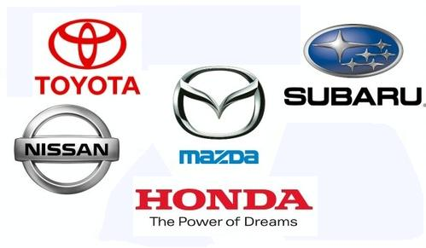
Top brands analysis
Which are popular car brand ?
Top popular brands- Toyota, Nissan, Mazda, Honda and Mistubishi.
Toyota has most number of cars.

Slide 5
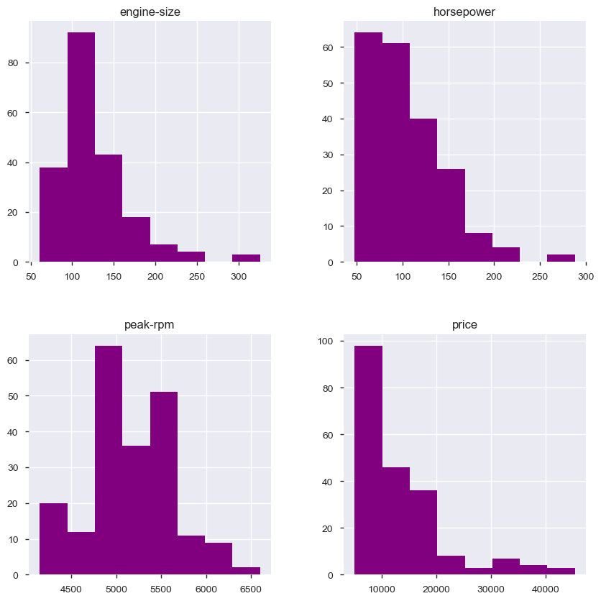

Data Distribution
Most of the vehicle's engine size ranges between 60 to 160.
Most of the vehicle's horse power is in between 40 to 120.
Most of the vehicle's peak-rpm ranges between 4750 to 5700.
Most of the vehicle's price ranges between 2000 to 20000.

Slide 6
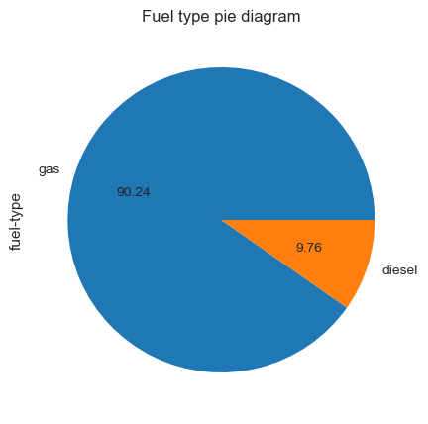
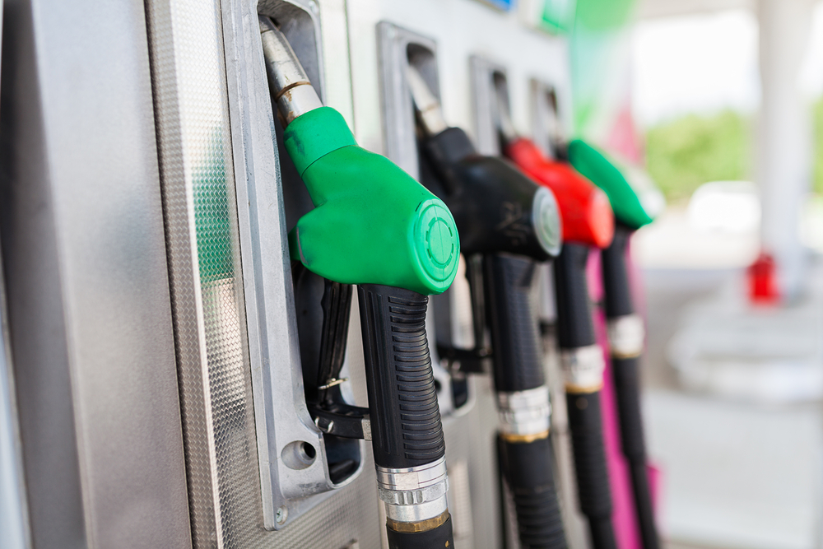
Fuel Type
Which is the popular fuel type ?
Gas is popular fuel type. More than 90% vehicles run on gas.

Slide 7
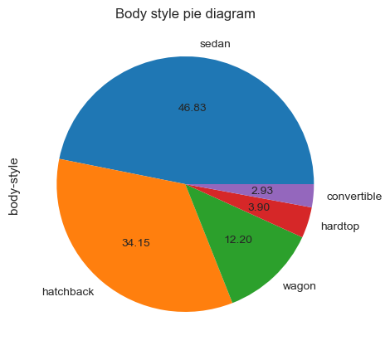
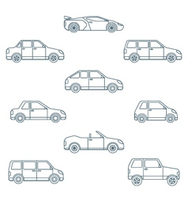
Body style
Which is the popular body style?
Sedan and hatchback are popular body style.
More than 80% vehicles are of Sedan and hatchback body style.

Slide 8
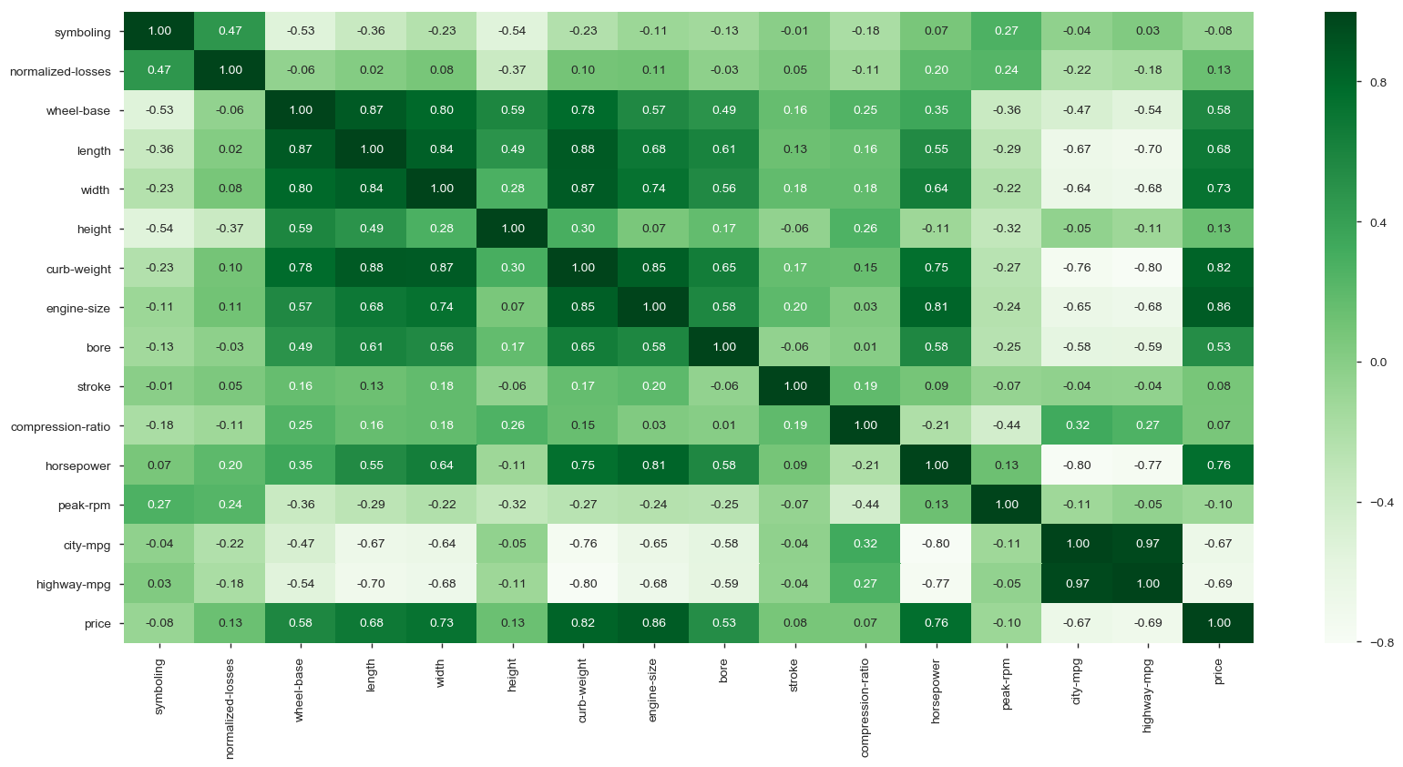

Correlation Analysis
Car price is positively correlated with engine size, curb weight.
Curb weight is mostly correlated with engine size, length and width.

Slide 9
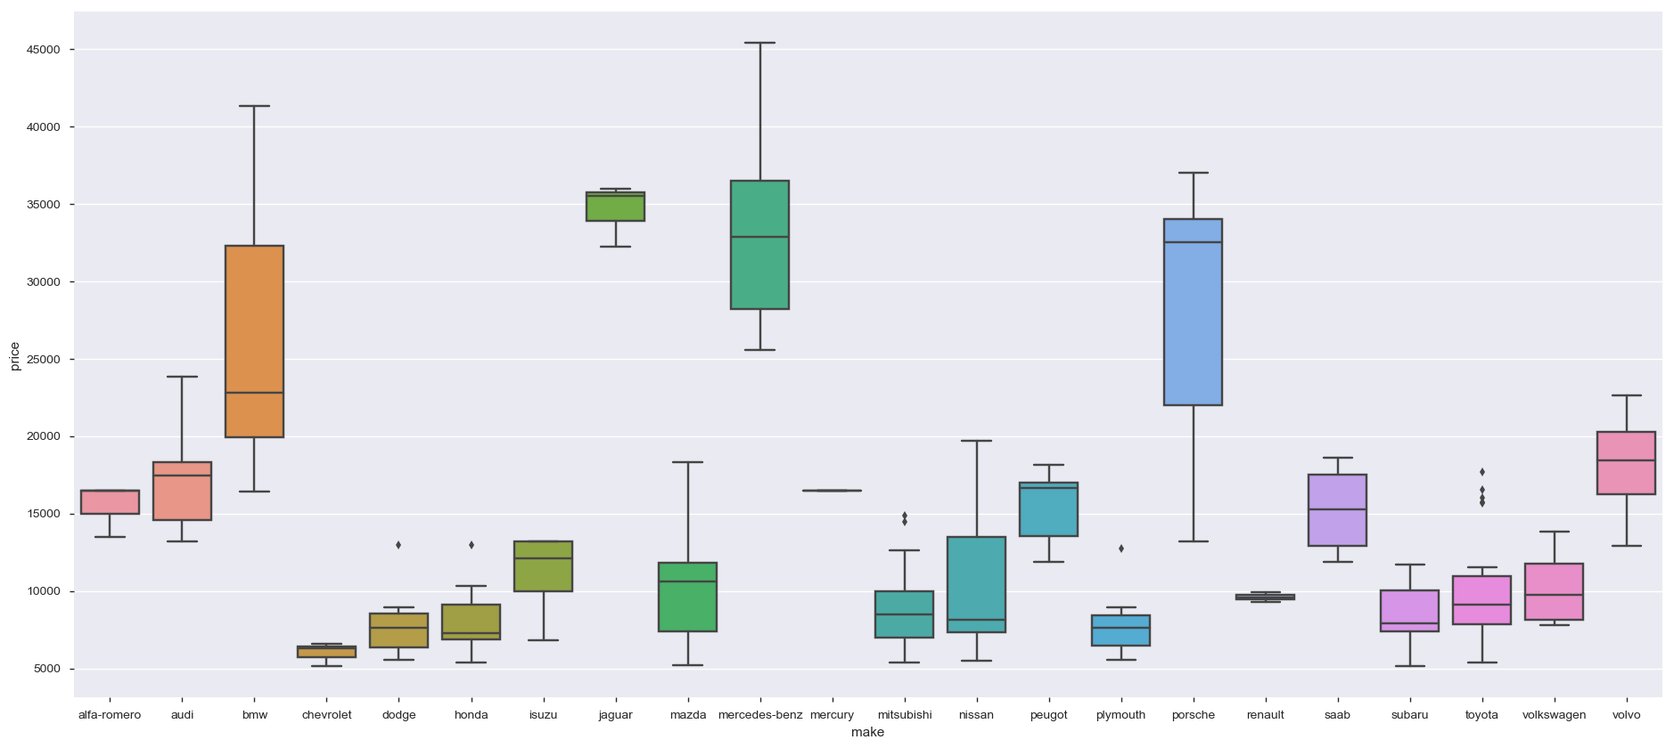
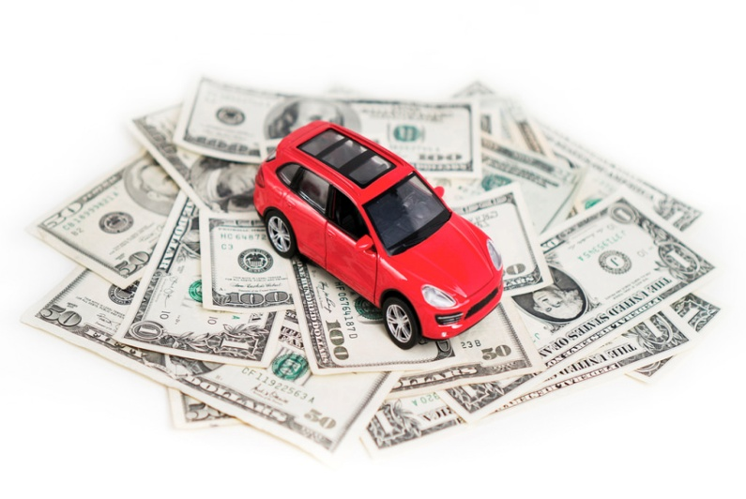
Car make and price
Most expensive cars are of make-Mercedez benz and least expensive cars are of make- chevrolet.
Price ranges Premium Cars-20000+ Mid range-10000 to 20000 and Budget cars- less than 10000.
Premium car makes- BMW,Jaguar, Mercedez Benz and Porche.
Budget car makes are- Chervolet, Dodge, Honda, Mistubishi, Plymouth and Renault.

Slide 10
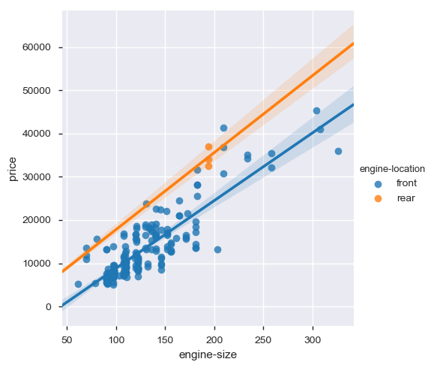
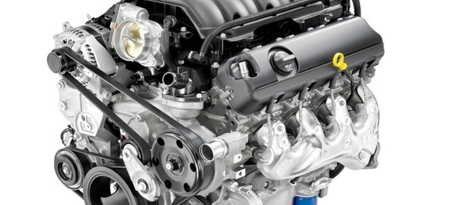
Price and Engine size
Car is costlier when engine size is more.
Font engine cars are less expensive compare to Rear engine cars

Slide 11
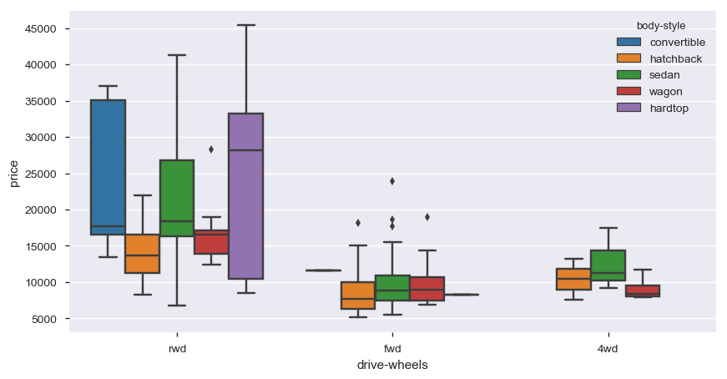
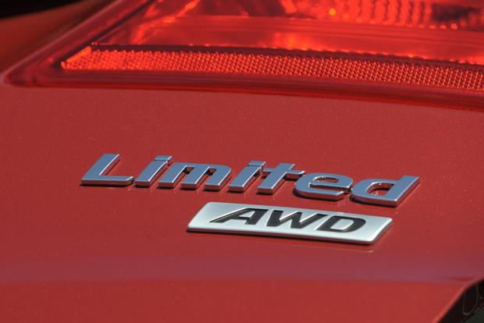
Drive wheels, Body Style and Price
Convertible and Hardtop comes with Rear wheel drive and they are expensive.
Font engine cars are less expensive compare to Rear engine and four wheel drive cars.
Four wheel drive cars are little expensive than front wheel drive cars.
Hatchback cars are least expensive in all drive wheel categories.

Slide 12
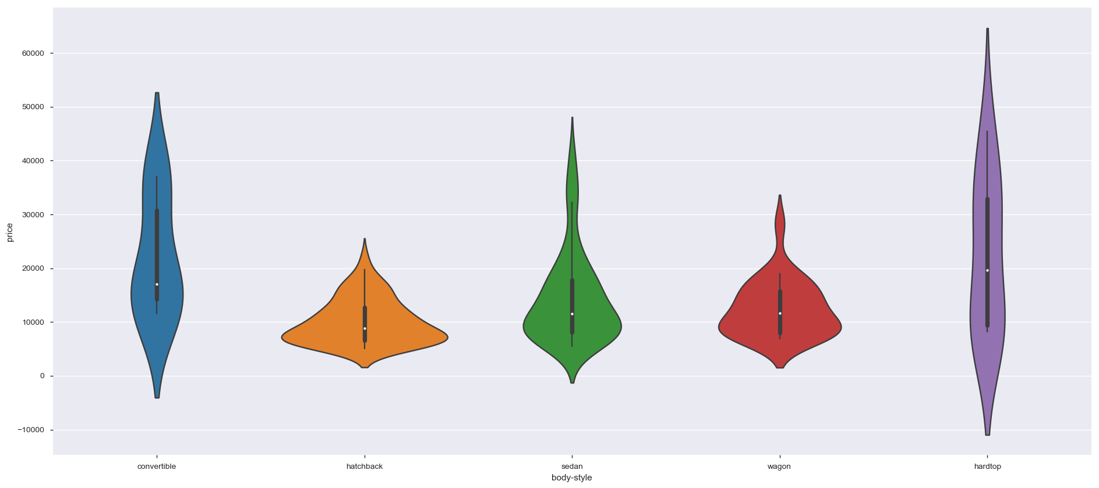
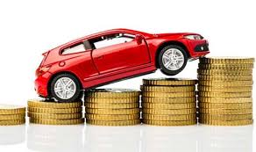
Prices by body type
Hardtop and convertible body type cars are expensive.
Hatchback cars are budget cars.

Slide 13
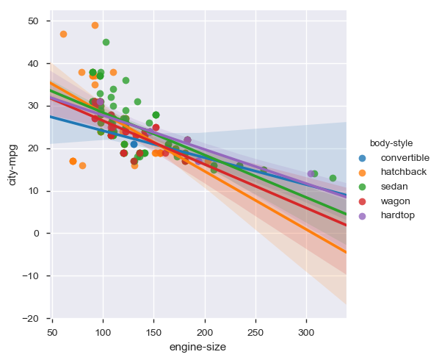
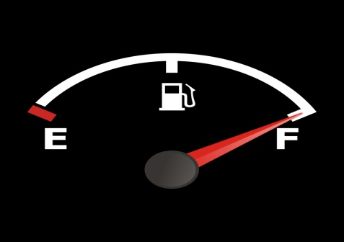
Car mileage based on body style
Hatchback cars have smaller engine but they are better in mileage.

Slide 14
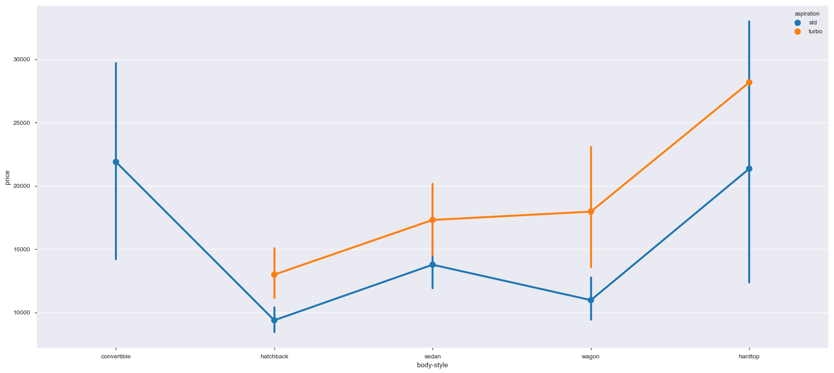

Price based on aspiration
Turbo models have higher prices than for the standard model.
Convertible cars don't have Turbo models.

Slide 15

Conclusion
Based on the analysis we understand:
Data distribution
Factors affecting Car prices
Budget friendly and performance car and Body styles
Popular make, body styles and fuel type

Slide 16


