Slide 1

BTC(Bitcoin)
PricE
Prediction
Using Machine Learning & Data analytics (in R)
Praneet Shekhar
Roll 1706065

Slide 2

Problem Statement
The aim of this project is to examine the effectiveness of Machine Learning models to predict future BTC prices based on given historical BTC prices.
Here, this will be achieved with the help of Recurrent Neural Networks, which is a Supervised Learning Model.

Slide 3
Can we predict BTC/cryptocurrency Prices with
Machine Learning?

Slide 4
Top firms hire
Quantitative Analysts to build
Predictive Models.
Today crypto-currencies have created a great deal of interest among even the top firms as they do not want to be caught behind.

Slide 5
Data Points
Historical trends
Volatility
Adoption – rate of adoption
Sentiment/ Social Media feed analysis
#Transactions on the ledger
#Users on the ledger
#blocks

Slide 6
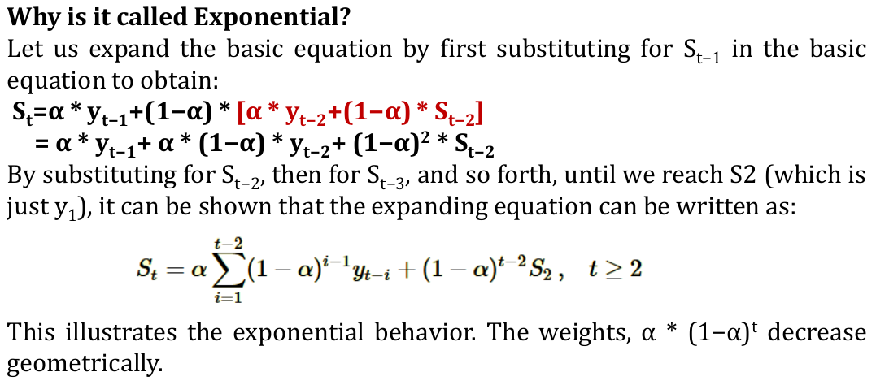
Simple Exponential Smoothing
Alpha(dampening coefficient) is chosen so that error term is minimised. E=(actual-smooth),then sum->mean of all E, mean squared→ MSE(Mean Squared Error) is least.

Slide 7
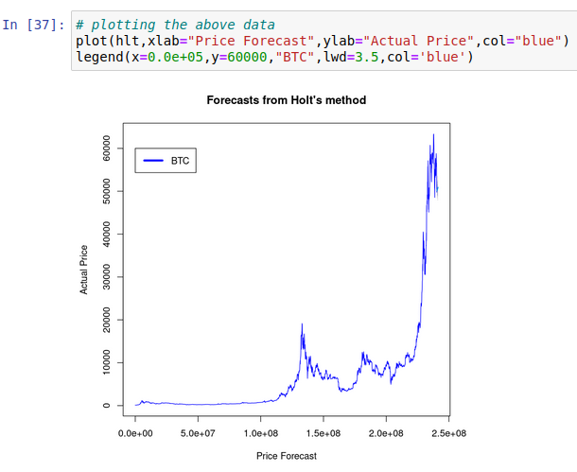
Holt’s Method
Extends the simple exponential smoothing method by including seasonal and trend equations.
Beta is the Holt’s smoothing parameter.

Slide 8
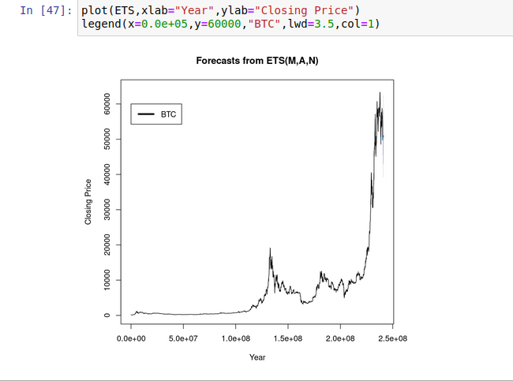
ETS Method
Can be seen as multiplicative Holt’s Method as here weighted error is calculated and it is used to give better results.

Slide 9
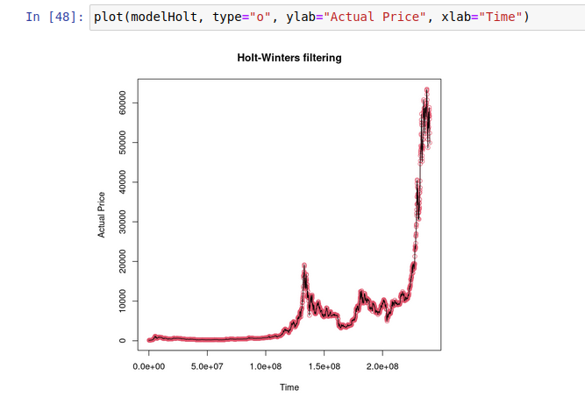
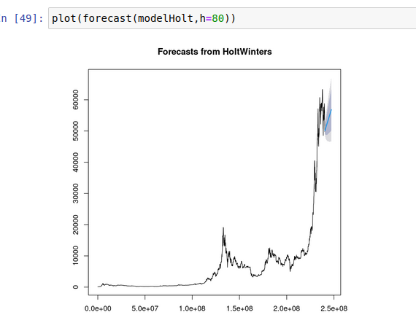
Fitting to Holt’s-Winter Method

Slide 10
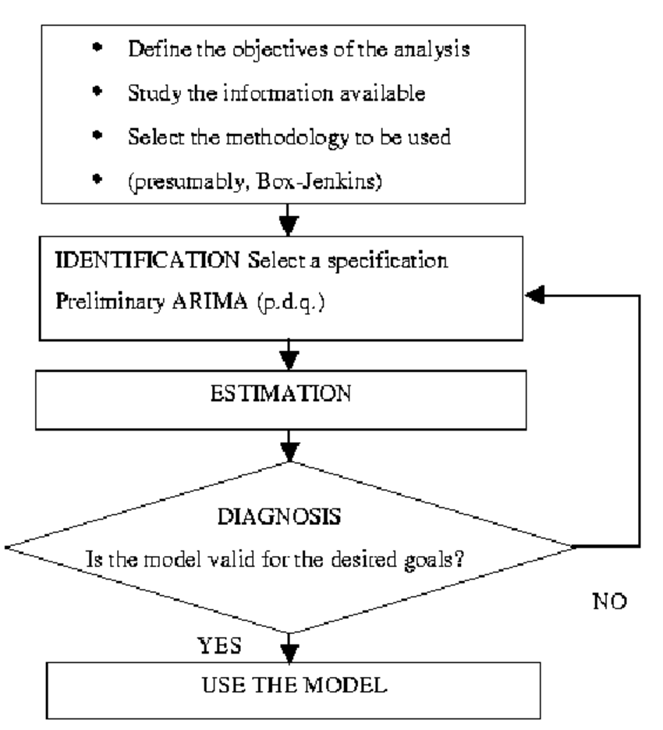
More possible indicators:
Such as Autoregressive Moving Average (ARMA)
Named after the statisticians George Box and Gwilym Jenkins.
Made in 1970.
Autoregressive Integrated Moving Average (ARIMA) and many more

Slide 11
Neural Networks
Neural Networks have been commonly used to predict stock prices. Hence its application can be extended to cryptocurrencies too.
Many academic papers have come out each with varying degrees of success.
Development is limited to academics since coding Neural Networks is very complex.

Slide 12


Slide 13
Why Recurrent Neural Networks?

Slide 14
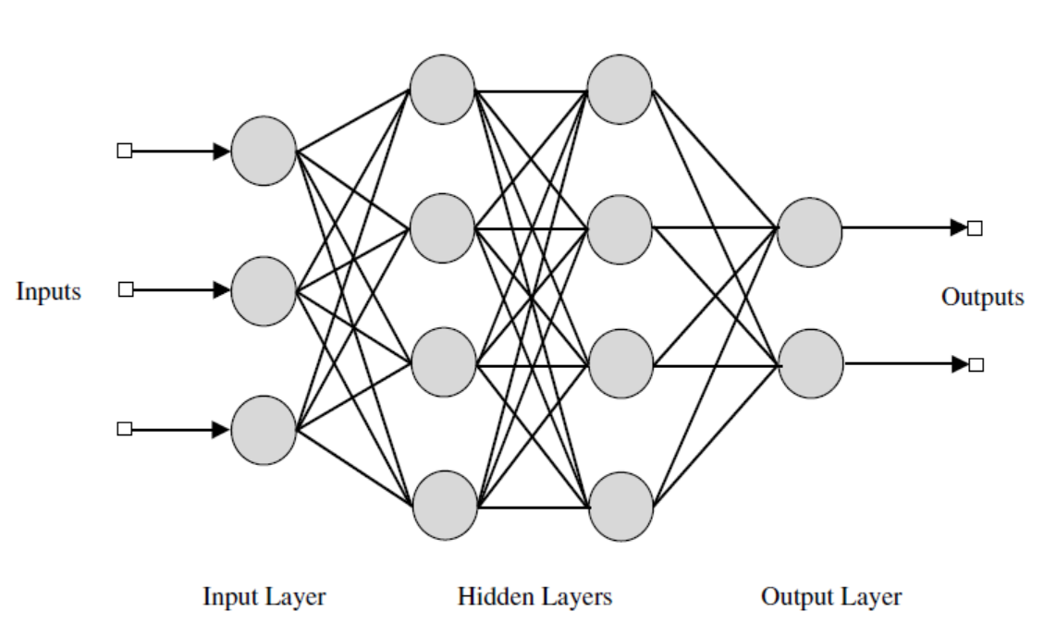
Conditional Memory
Straight - “The quick brown fox jumps over the lazy dog”
Reverse - “Dog lazy the over jumps fox brown quick the”
Feed Forward Neural Networks do not have memory, while Recurrent Neural Networks do.

Slide 15

Recurrent Neural Networks

Slide 16
h_{t} = (Wx_{t} + Uh_{t-1})
x_{t} - Inputs to Neural Network
h_{t} - Hidden state at time-step t.
W- Weights for Neural Network
U – hidden state to hidden state matrix (transition matrix)

Slide 17
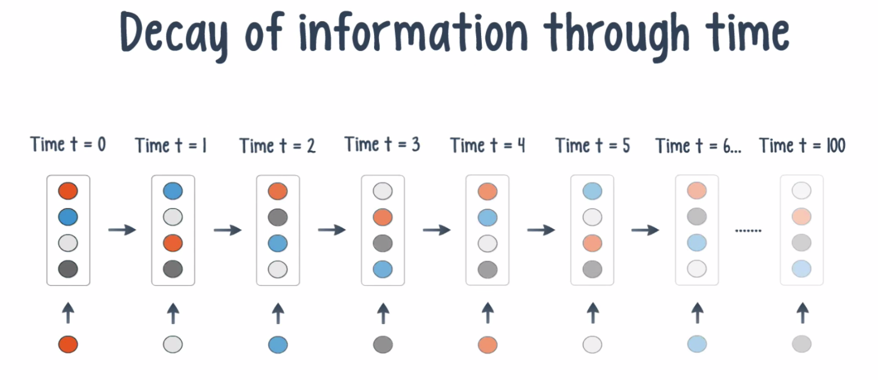
Decay of Information through time

Slide 18
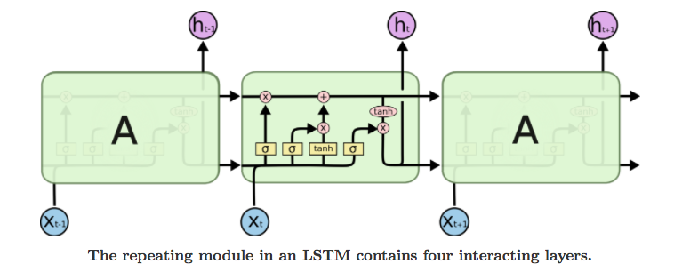
Long Short Term Memory

Slide 19
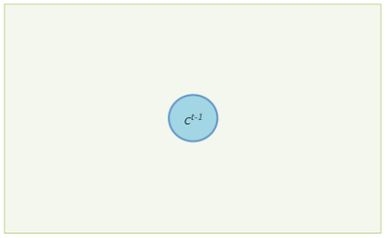

Slide 20
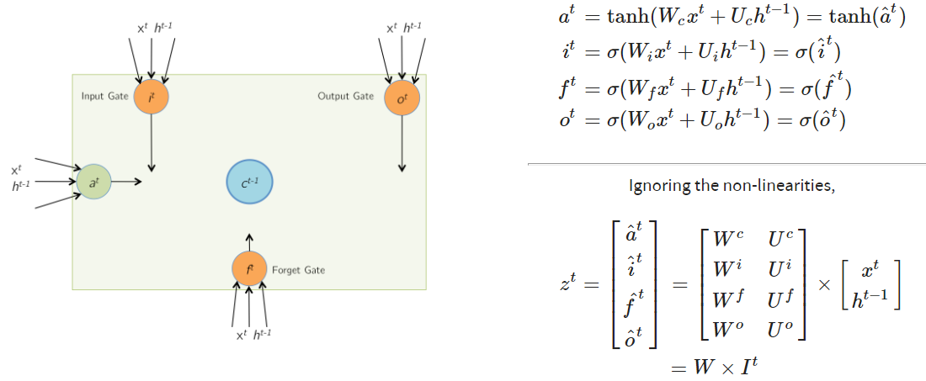

Slide 21
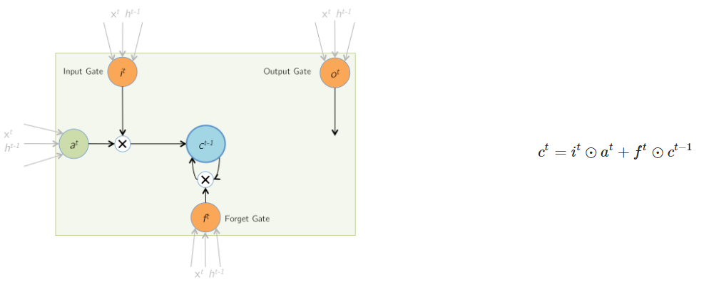

Slide 22
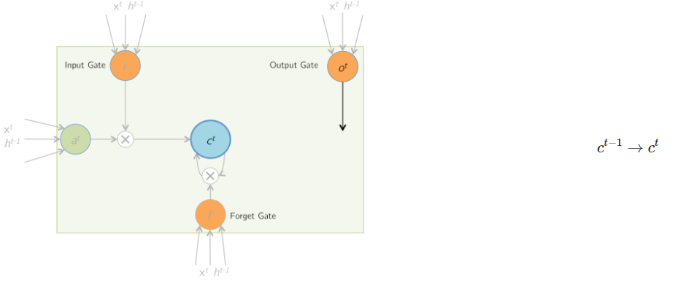

Slide 23
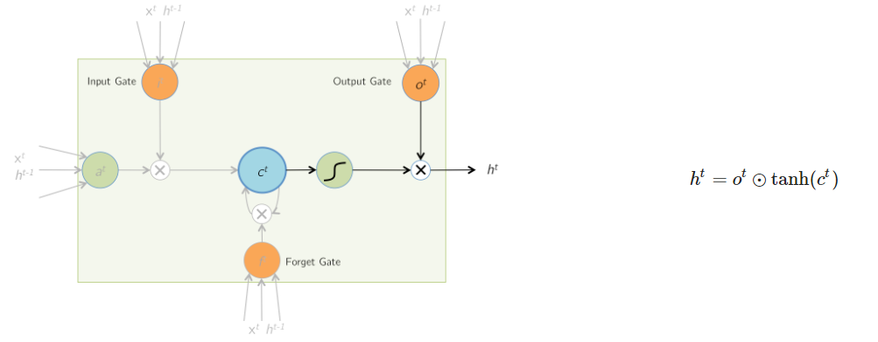

Slide 24
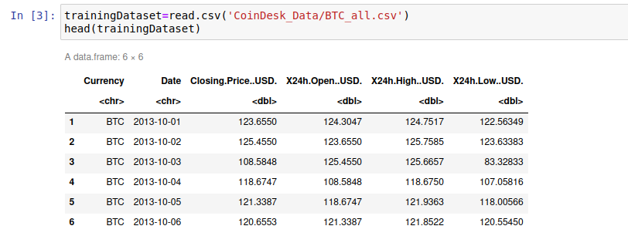
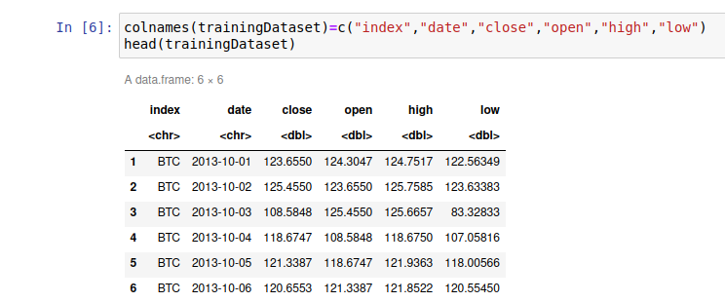
Data Collection
Historical data for the BTC stock was collected using CoinDesk.
This data comprised of 6 features of BTC from its inception on April,28th 2013 to present day.

Slide 25
Data Pre-processing
The unrequired features were removed. Only 4 features – Open, High, Low and Close prices for each day were kept.
#Market Cap data could be sourced from other non-open source datasets which will actually make the forcasting significantly more accurate

Slide 26
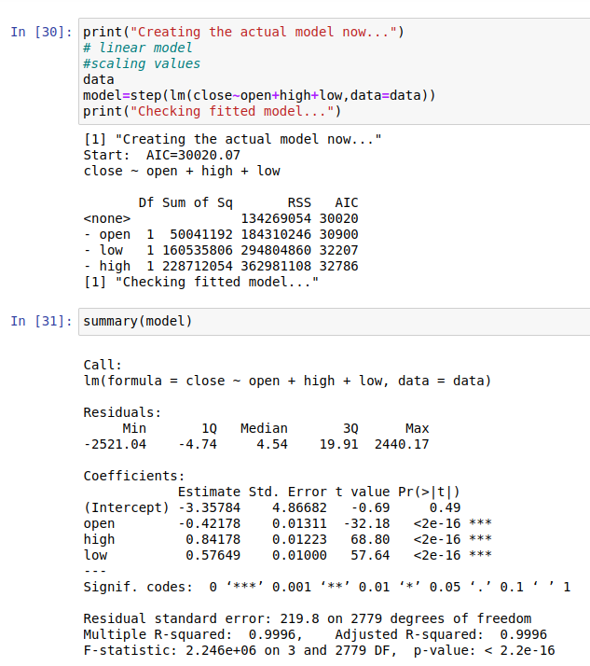
Model

Slide 27
Data Splitting
The model can be further trained/retrained by splitting into two parts – Training and Testing.
Training dataset consisting of ~80% of the total data, while Testing dataset consisting of the remaining ~20%.
This will help in locally testing without handling external data feed

