Slide 1
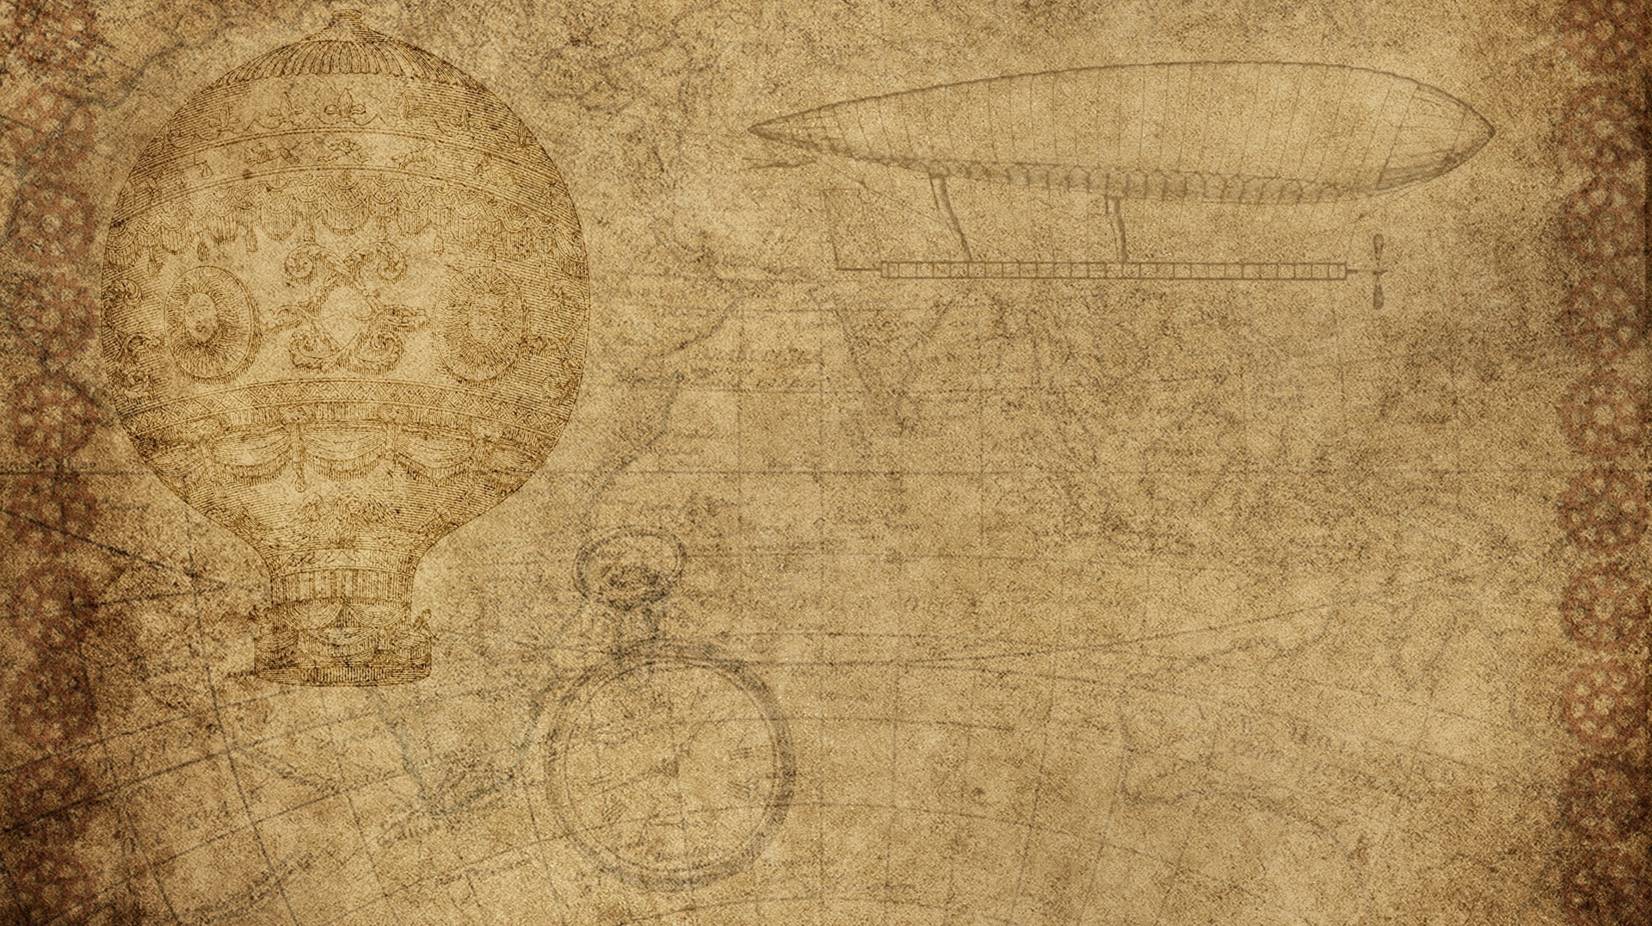

Team Akatsuki
PRANESH GUPTA – IIITU17209
RAJEEV RANJAN MAURYA – IIITU17229
Utkarsh Tiwari – IIITU17233
Ankit Thakur – IIITU17234

Slide 2

Who will use my invention
Modern Day softwares like SolidWorks and rendering and simulation softwares use scanned 3D models.
In order to achieve accurate models, techniques like triangulation are used for scanning.

Slide 3

Project Materials
Materials used for project are:
Servo Motor
Arduino
Line Laser
Camera
Laptop(Python)

Slide 4

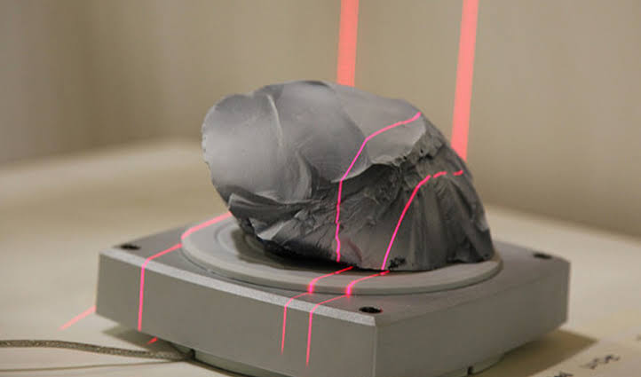
3D Scanner using TrianguLATION
This project helps us to obtain 3D model of objects. These models can be used for various purposes like: studying the architecture, of object, teaching with detailed illustration, engineering, video games, movies etc.

Slide 5
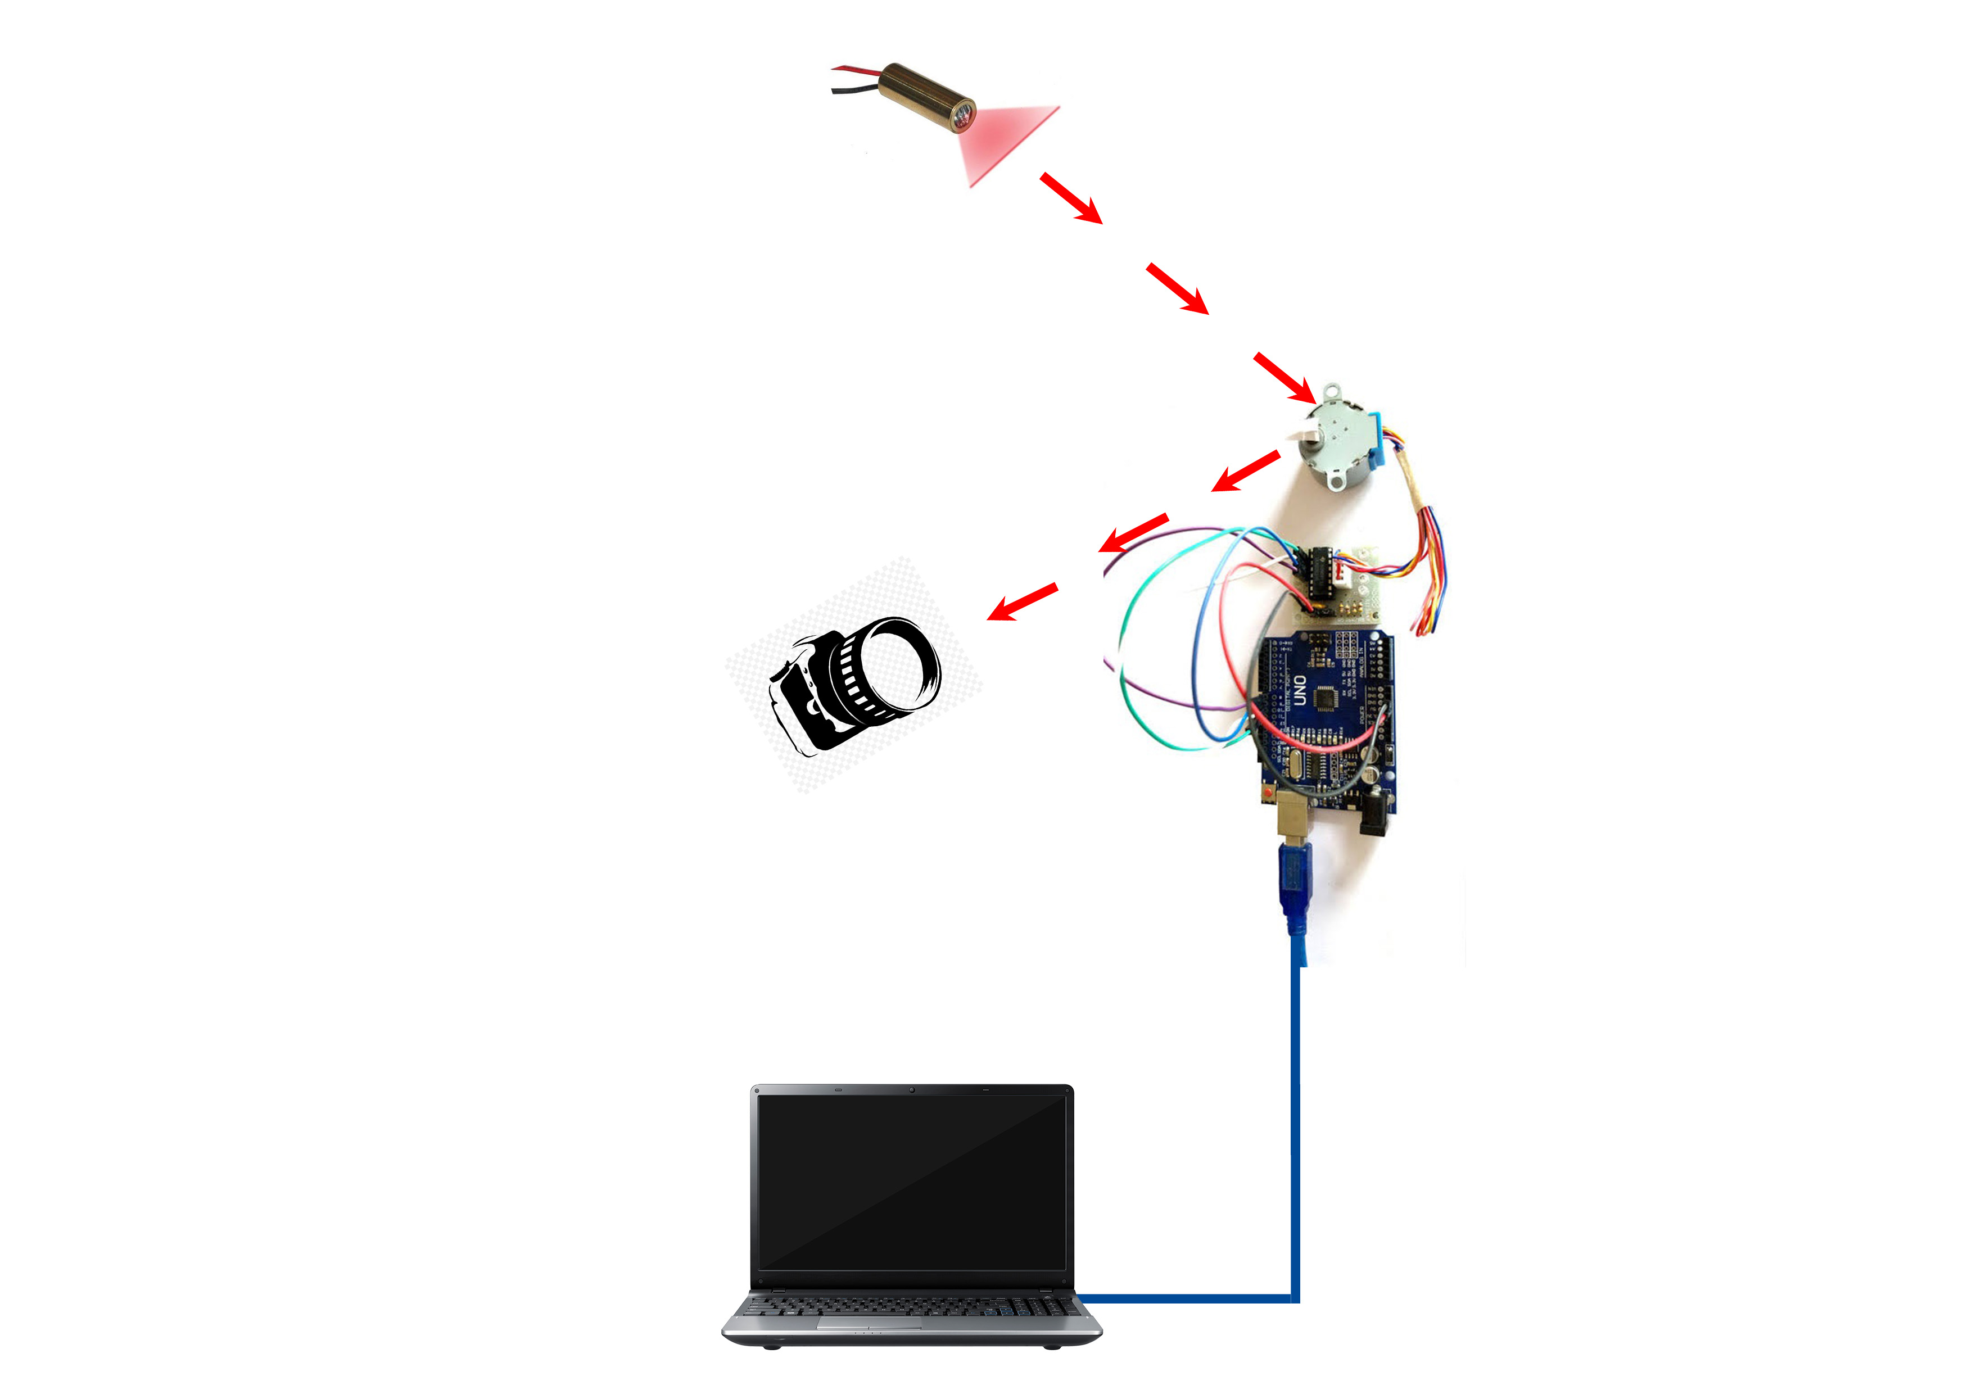
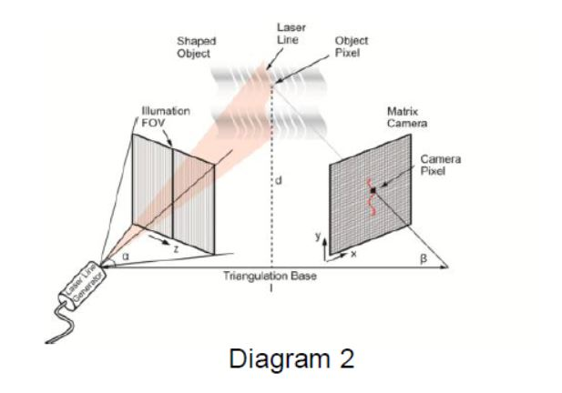
Working

Slide 6
Project working
The project works on the process of triangulation. It identifies the height or position of a point or an object in arbitrary space.
Line Laser is used as illumination source.
Building a coordinate map of a surface point-by-point is inefficient. Looking at slices or multiple slices provides a more efficient and accurate representation of the object under test. The accuracy of the coordinate map – and thus decisions made against it – are related to how thin a slice you can take.

Slide 7
Reference
https://www.coherent.com/assets/pdf/3D-Laser-Scanning-White-Paper-Structured-Light-Lasers_FORMFIRST.pdf
https://www.artec3d.com/portable-3d-scanners/laser-ray

