Slide 1
Project PRESENTATION
UIT2211 Software Development Project

Slide 2
Clinic Management System
A project by Clinesco

Slide 3
TEAM MEMBERS
Name Register Number
Padmapriya C 3122225002089
Palle Sai Sowjanya 3122225002090
Paranthagan S 3122225002091
Piriyadharshini A 3122225002092
Pranaav U 3122225002093
Pranesh Kumar S P 3122225002094

Slide 4
PROBLEM STATEMENT
A small clinic wants to develop a system to manage their out-patients. The receptionist should be able to retrieve a patient record (with just the basic information) or create a new record when a new patient visits for the first time. The receptionist should be able to assign patients to available doctors based on the nature of the problem and manage the queues. A doctor should be able to view the complete history of a patient and enter current diagnosis and prescriptions. The system should then generate an invoice and track the payments.

Slide 5
OBJECTIVE
To streamline the management of out-patients in a small clinic by providing the receptionist with the ability to retrieve or create patient records, assign patients to doctors based on their needs, manage queues, enable doctors to access complete patient histories, record diagnoses and prescriptions, generate invoices, and track payments.

Slide 6
CLIENT DETAILS
Client complete affiliation
9444668903
Sri Gnana Nandha Dental Clinic
270A Velachery Main Road,
KVIC nagar , Sembakkam
Chennai 600073
Dr.Radhika G

Slide 7
REQUIREMENT ENGINEERING
REQUIREMENT COLLECTION
List of Requirements:
STORING
Name
Age
Email
Sex
Ph no.
Address
Medical history
Allergy
Examination
Dental caries
Missing teeth
Calculus
Abrasions
Treatment advice
Treatment
Treatment charges

Slide 8
FUNCTIONAL REQUIREMENTS
Patient Management
Queue Management
History and Records
Communication and Notifications
Billing and Transactions

Slide 9
NON - FUNCTIONAL REQUIREMENTS
Usability
Scalability
Reliability
Robust
Secure
Extendable
System Independent

Slide 10
OTHER IMPLEMENTATION DETAILS
Bank end used:
  Data Structures used
  Other files used
Front end used: HTML, CSS, Javascript
Total Number of sprints taken
Sprint #no scheduled for --- weeks

Slide 11
DESIGN DETAILS
Users:
Admin
Patient
Doctors
Receptionist

Slide 12
ADMIN
Admin
Doctor
Receptionist
Adds the details of doctors and receptionists

Slide 13
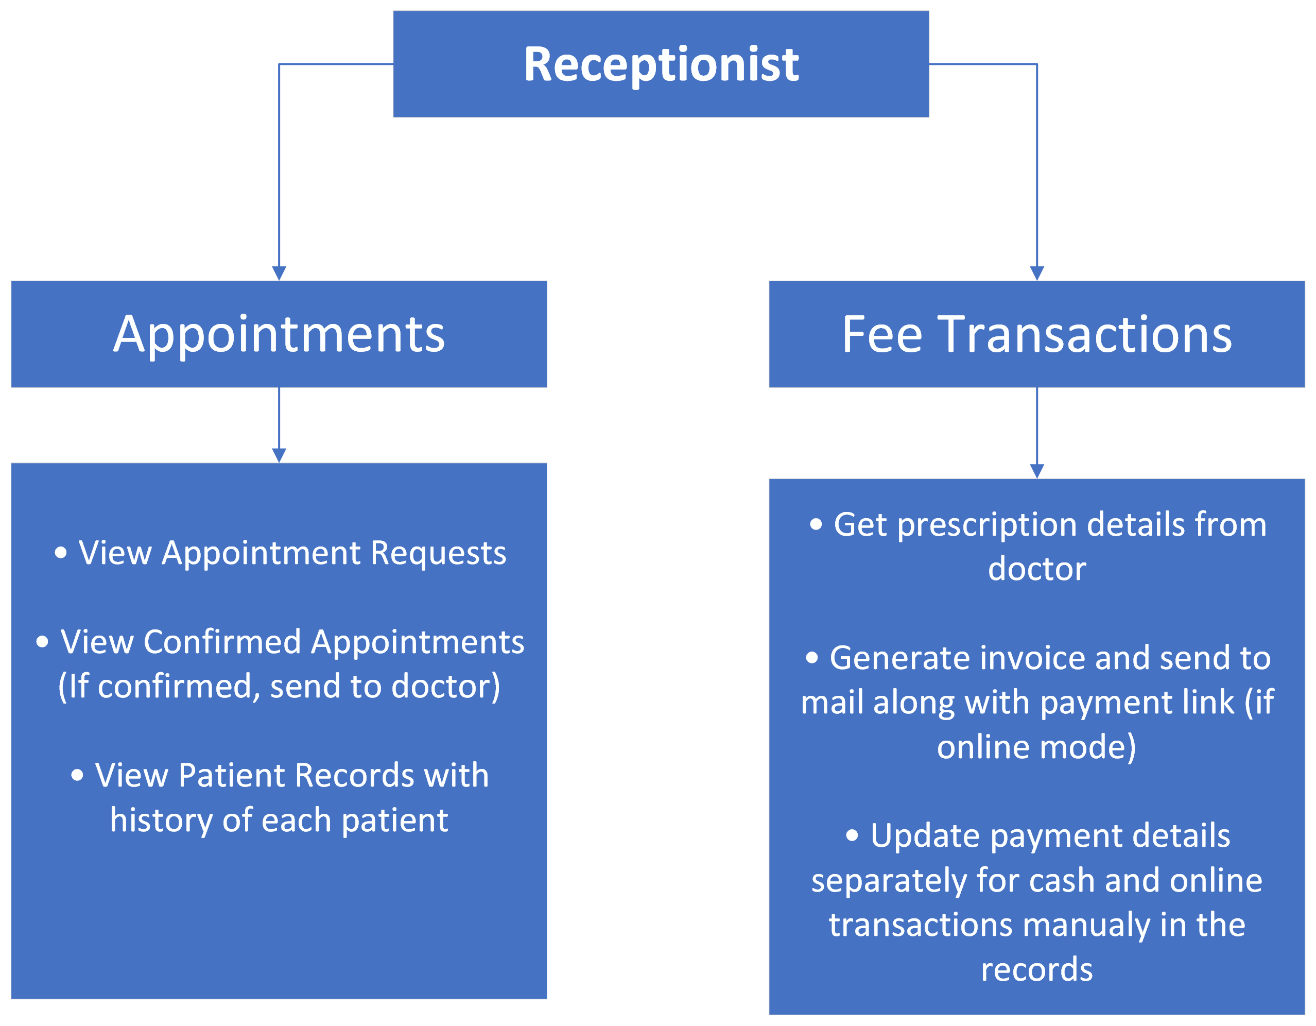
RECEPTIONIST

Slide 14





DOCTOR
PATIENT DETAILS STATUS
NAME :
NAME :
NAME :
4. NAME :
Current
Current
Upcoming
Upcoming
Patient History:
Name, Age, Email, Sex, Ph No.,
Address, Medical History, Allergy
(From the sign-up page)
Date& Time:(from the receptionist in the appointment conformation Page.)
Examination, Dental Caries, Missing teeth, Calculus, Abrasions, Treatment Advice, Treatment
Prescription:
Only view
To be filled

Slide 15
Patient
SIGNUP/LOGIN PAGE:Signup for a new patient and login for already existing patient
PATIENT MAIN PAGE-The dashboards: appointment ,Fee Transaction,can view his profile
APPOINTMENT PAGE : Previous appointments page, book appointment page
PREVIOUS APPOINTMENT PAGE: Doctor details, issue, date, time, fees paid, treament prescriptions
BOOK APPOINTMENT PAGE :preferred time and date
APPOINTMENT CONFIRMATION PAGE: Doctor details, date and time[options: confirm or cancel]
CONFIRMED APPOINTMENT PAGE:Online booking payment

Slide 16
INDIVIDUAL CONTRIBUTION
Team member name:
Work description:
Modules worked:

Slide 17
IMPLEMENTATION DETAILS
Sprint # | Epic | User Story # | Remarks on implementation

Slide 18
Risk Management

Slide 19
Test Log Report

Slide 20
SCREENSHOTS OF USER INTERFACES AND TEST CASES OUTPUTS

Slide 21
WORKING WITH JIRA
SPRINT #

Slide 22
MEETING NOTES

Slide 23
CREATING REPOSITORY
Code integrated with JIRA tool using bit bucket

Slide 24
FEEDBACK FROM CLIENT

Slide 25
REFERENCES

Slide 26
Thank You!

