Slide 1
A TWO-DIMENSIONAL DIFFERENCE HISTOGRAM EQUALIZATION WITH FUZZY CUMULATIVE DISTRIBUTION CORRECTION FOR DARK IMAGES
Team Members : Bhanu Pranaswi Sai P(S20210020309) Srinidhi M (S20210020323) Jahnavi Onteddu (S20210020301)

Slide 2
Abstract :
A novel algorithm for enhancing dark images by leveraging a two-dimensional difference histogram equalization (2DDHE) with fuzzy cumulative distribution correction.
This approach addresses over-enhancement, detail loss, and poor subjective visual effects, improving contrast and detail visibility.

Slide 3
Introduction :
• Addresses over-enhancement and detail loss in dark image enhancement.
• Combines 2D histogram equalization with fuzzy clustering.
• Provides better subjective visual effects and detail preservation.

Slide 4
Methodology :
1. Construct a 2D difference histogram to enhance dark area details.
2. Apply fuzzy C-means clustering to the cumulative distribution.
3. Correct the cumulative distribution via membership matrix modification.
4. Perform histogram equalization using the corrected distribution.

Slide 5
Key Components:
• Two-Dimensional Difference Histogram:
- Reduces detail loss by focusing on neighborhood differences.
• Fuzzy Cumulative Distribution Correction:
- Clusters and adjusts cumulative distributions for better contrast and visual effects.

Slide 6
Experimental Results:
• Metrics: Mean Value (MV), Measure of Enhancement (EME), and Natural Image Quality Evaluator (NIQE).
• Proposed method outperformed other techniques, achieving higher contrast and better subjective visual effects.

Slide 7

Comparison with other methods:
• Proposed: Superior detail enhancement and visual effects.
• HE: Over-enhanced brightness, contrast distortion.
• BBHE: Contrast improvement but detail loss.
• CLAHE: Limited contrast improvement.
• 2DDHE: Better balance of brightness and contrast.
• LECARM: A method based on the Retinex theory, which enhances the image by improving the contrast in low-light regions, making the details more visible.

Slide 8
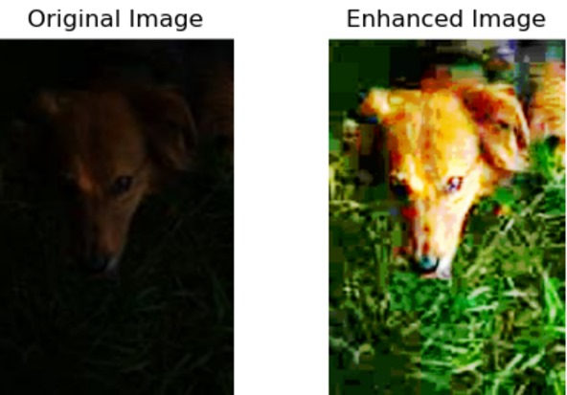
Results:
Image 1:

Slide 9
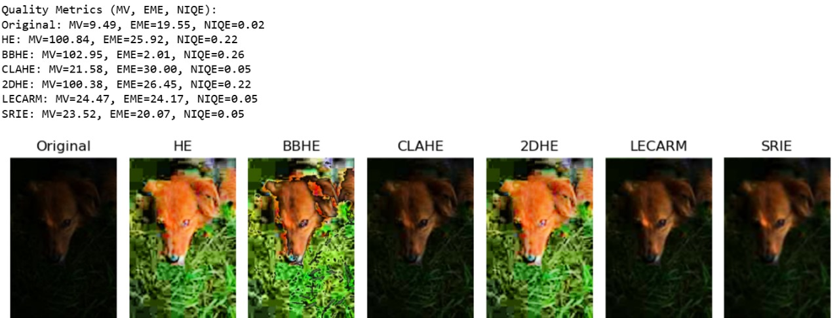
With Metrics:

Slide 10
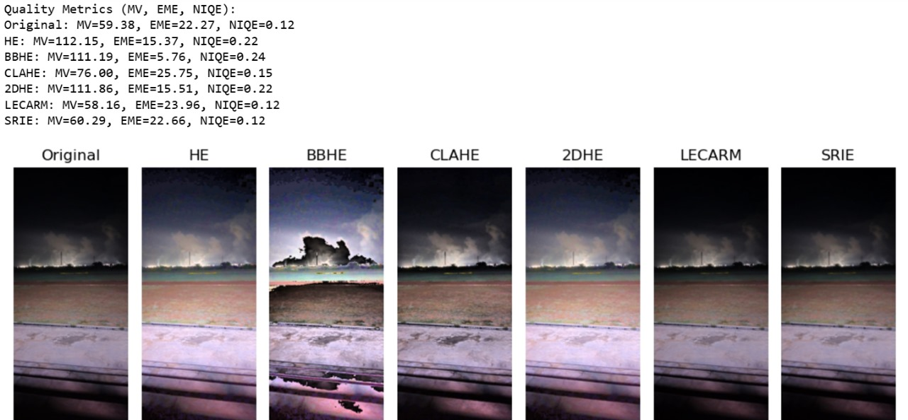
Image 2 :

Slide 11
Conclusion:
• 2DDHE with fuzzy cumulative distribution correction effectively enhances dark images.
• Avoids over-enhancement, improves contrast, and preserves details.

Slide 12
THANK YOU

