Slide 1
Comparative Evaluation of Quality of Uncertainty Quantification of Bayesian Neural Networks
Pranav Narendra Gopalkrishna
Student Number: 231052045
Project Supervisor: Paulo Rauber

Slide 2
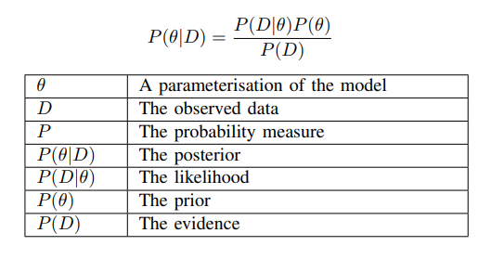
Conceptual Progression…
Bayesian Inference (BI)
Computational BI Methods
Stochastic Neural Networks (SNN)
Bayesian Neural Network (BNN)
A kind of ensemble learning wherein model parameterisations are probabilistic.
A kind of SNN where model parameterisations are distributed by a posterior.

Slide 3
Problem Statement…
How to go from BI to BNN?
What are the fundamental ways to approach BNNs?
How to evaluate the performance of BNNs?
How do different BNN implementations differ in performance?

Slide 4
Broad Areas of Focus…
Exact BI methods
Approximate BI methods
Link between BI and BNNs

Slide 5
Specific Areas of Focus…
Markov Chain Monte Carlo (MCMC) (a class of exact BI methods)
Hamiltonian Monte Carlo (HMC) (a class of MCMC methods)
Variational Inference (VI) (a class of approximate BI methods)

Slide 6
Hamiltonian Monte Carlo (HMC)

Slide 7
Hamiltonian Monte Carlo (HMC)… uses ideas from Hamiltonian mechanics!
Class of MCMC methods with superior sample proposal method
Explore the posterior by using gradients to travel its contours NOTE: “Momentum” is applied to ensure such “motion”
Reach points with similarly high acceptance probabilities
Propose a sample that may have similarly high acceptance probability

Slide 8
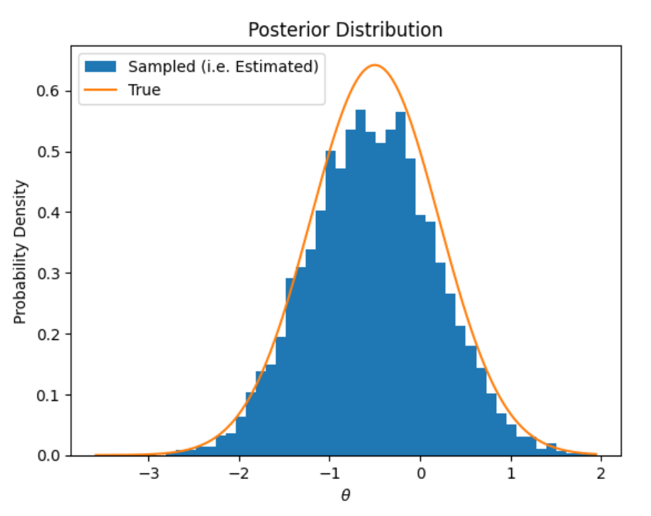
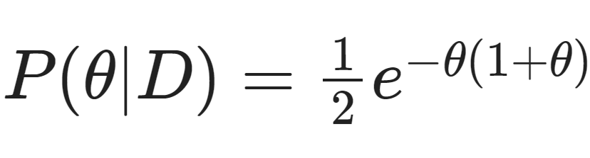
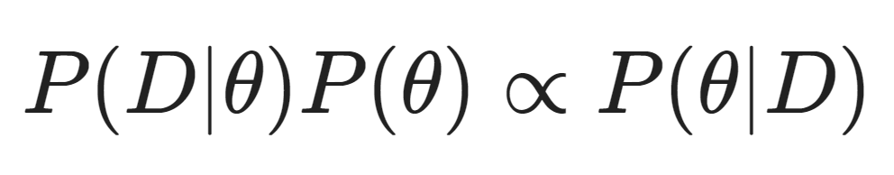
Simple Demonstration of HMC Sampling…
Target distribution to estimate…
Estimated using…

Slide 9
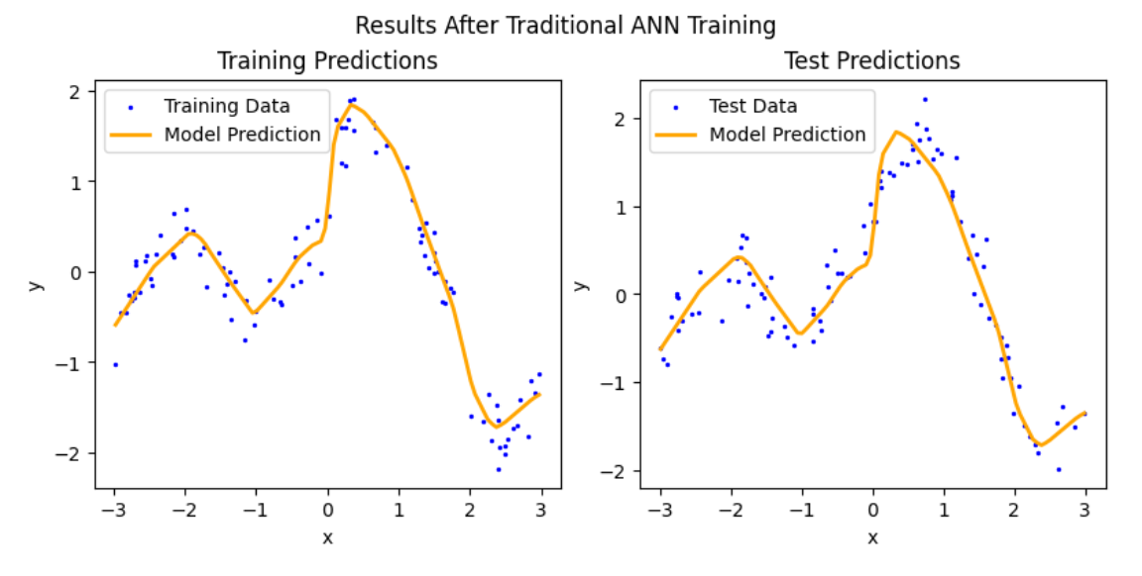
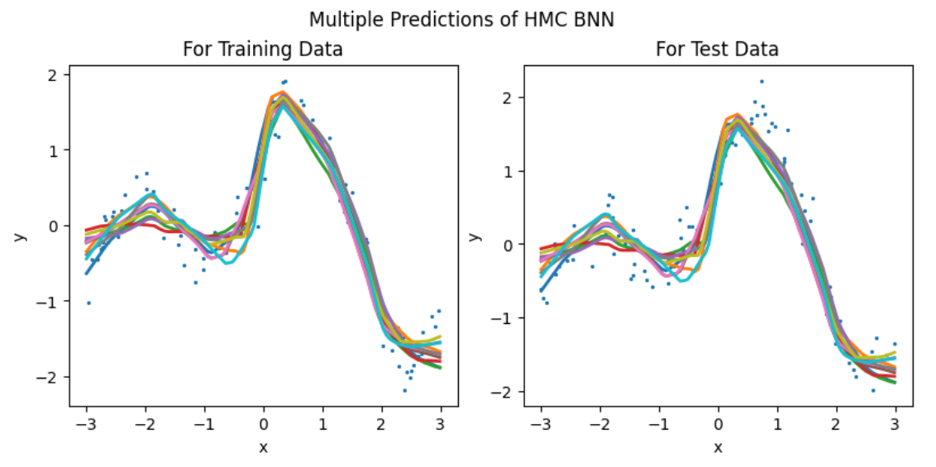
From ANN to BNN…
HMC distributes the parameters of the ANN, and each parameterisation leads to a different prediction…

Slide 10
Variational Inference (VI)

Slide 11
Variational Inference (VI)… using a method inspired from adversarial BNNs
Approximates posterior using a surrogate distribution … i.e. the variational distribution (VD)
Optimising for KL-divergence + MSE, wherein … VD parameterised by mean and standard deviation of weights! … KL-divergence between prior and VD akin to regularisation
Predictions made using optimised VD as a data generation function … essentially a pseudo-random probability distribution simulator

Slide 12
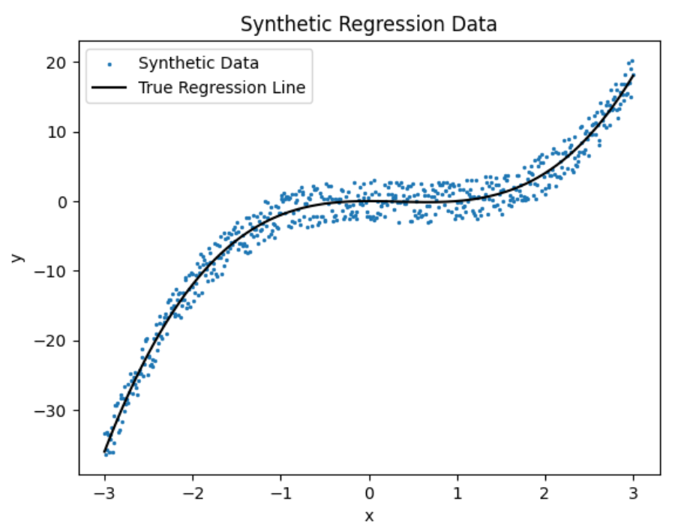
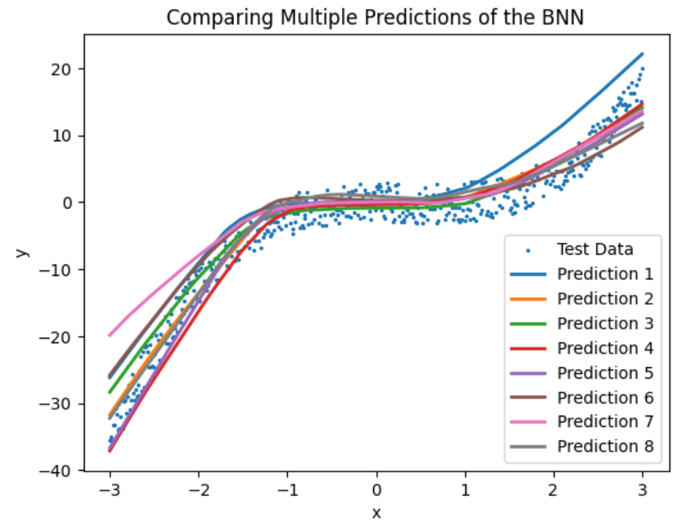
Regression with VI…
VI trains the parameterisations of the VD; the predictions are then made probabilistically using the VD…

Slide 13
Data

Slide 14
Synthetic Regression Problems!
Allows for theoretical comparison of empirical results
Creates a relatively simple domain for playing with BNNs
Customisable level of complexity, noise and data sparsity

Slide 15
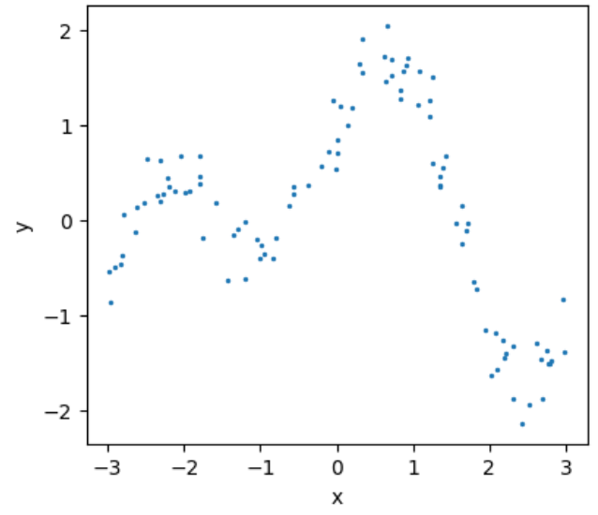
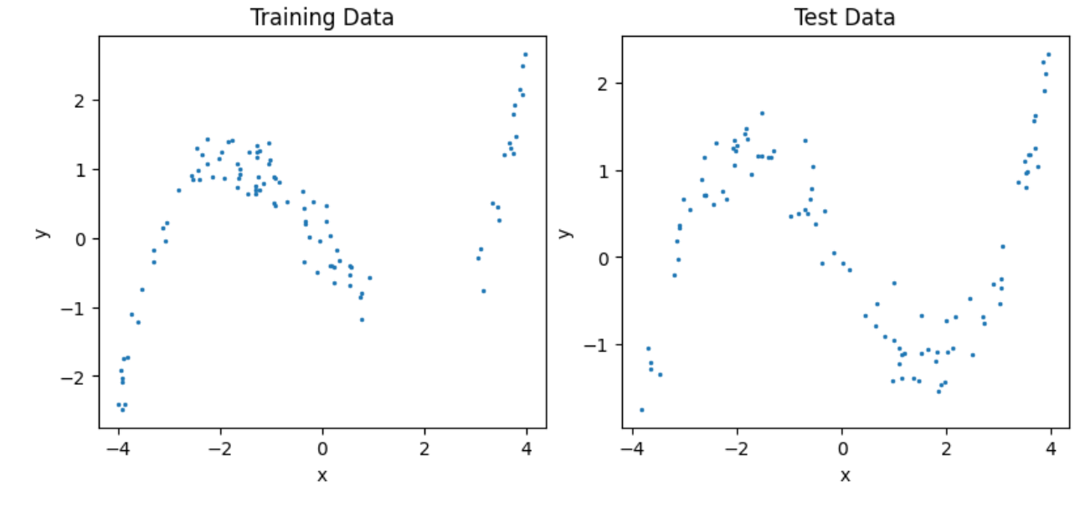
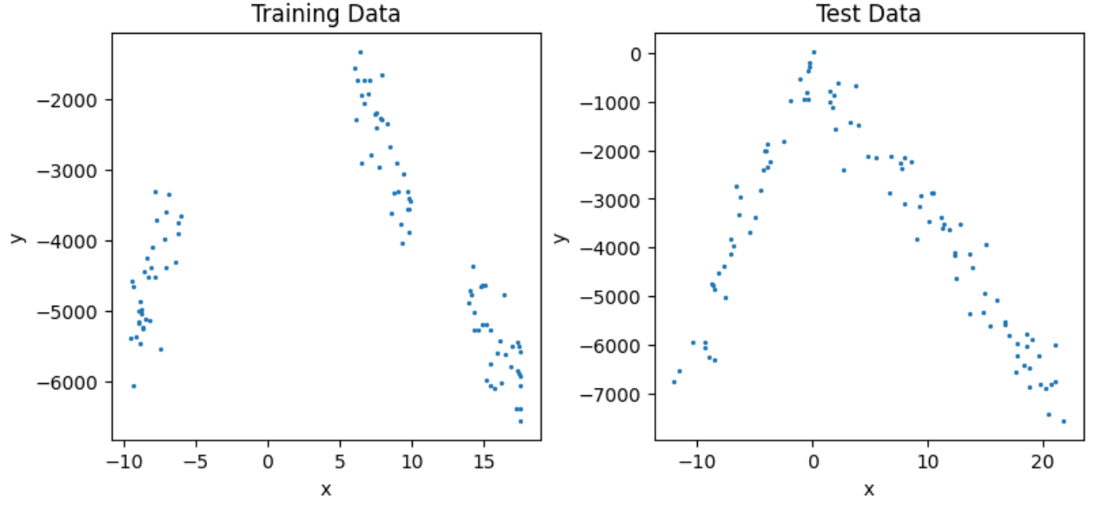
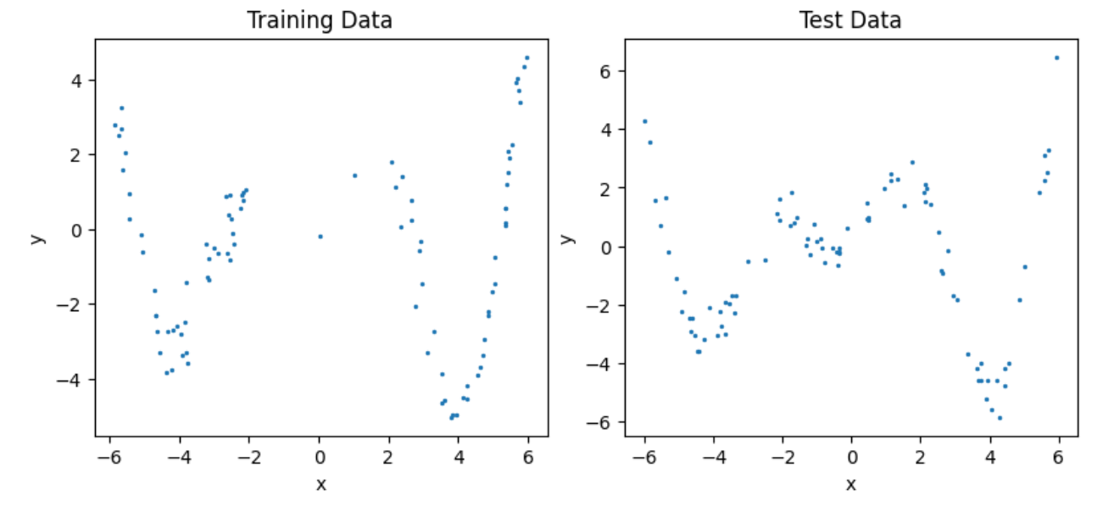

Slide 16
Experiments

Slide 17
Model Predictions for 100 Data Points…
Are gaps in the data accounted for?
Do noisiness and complexity lead to greater predictive uncertainty?
How does each model perform?

Slide 18
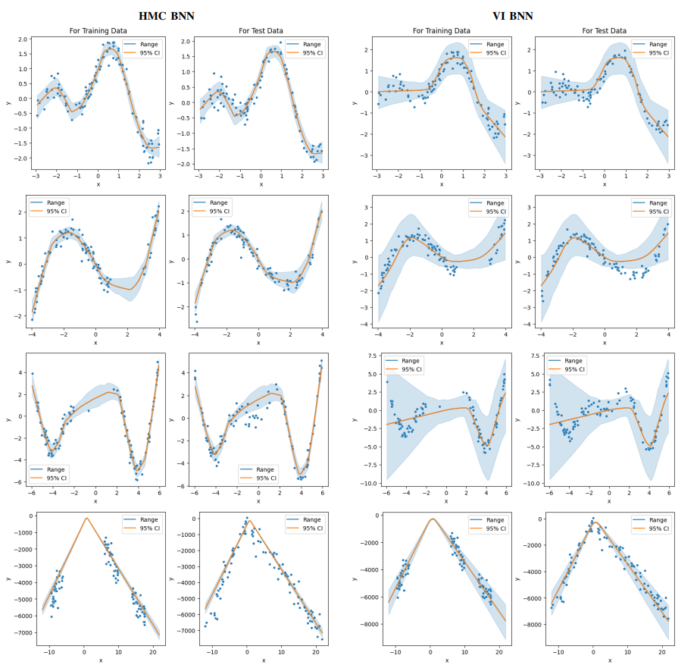

Slide 19
Model Predictions for 15 Data Points…
How does each method react to such sparsity?
Does predictive uncertainty should increase? How?

Slide 20
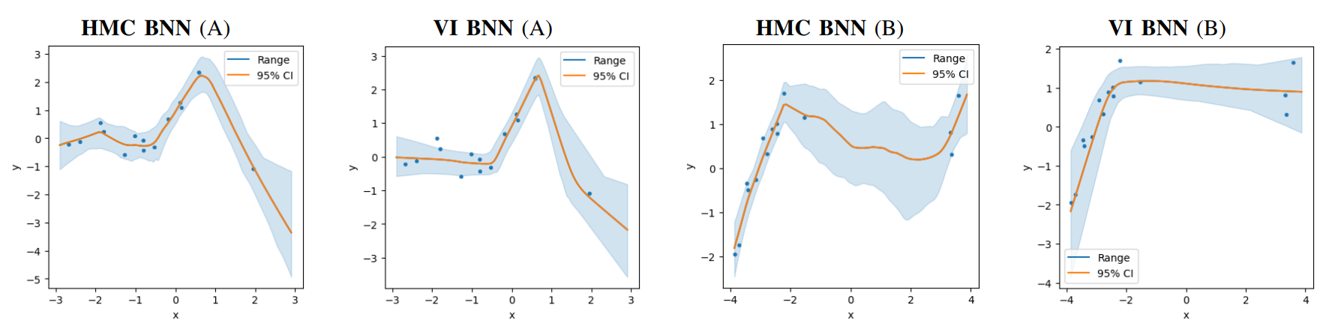

Slide 21
Other Miscellaneous Experiments… check out the dissertation!
Increasing number of training epochs for VI BNN
Increasing VI BNN model complexity for problem D
Using KS-test to evaluate model predictive performance

