Slide 1
Under The Guidance of Professor: DR. Sibarama panigrahi
Sign Language recognition using Machine Learning
Presented and done by:
Pratyush Mahapatra (18btcse42)

Slide 2
About this Project
Sign language is a language through which communication is possible without the means of acoustic sounds, i.e. with sign patterns, i.e., body language, orientation and movements of the arm to facilitate understanding between people
There has always been a communication barrier between deaf and mute people and the speaking community, as apart from the deaf and mute, only few people know sign language.
This limits the interaction between the deaf and mute community and the rest of society. My project, “Machine Learning Model to detect characters from American Sign Language” aims to eliminate this barrier. The task is accomplished using Image processing in OpenCV and Machine learning.

Slide 3
Need for this project
This project will improve the interaction of deaf and mute people with society
Will eliminate the need of human translators for communicating with deaf and mute people.
It can be deployed in potential places like hospitals and police stations where emergency communication is of at most important
In the forms of portable device, websites and mobile applications, it can increase the preparedness of public places for people with disablilities

Slide 4
Our approach to build this model:
1. Explore the dataset and Data Augmentation
2. Building a CNN model
3. Train and validate the model
4. Test our model with test dataset
5. Predicting using webcam with OpenCV.

Slide 5
What is CNN ?
A Convolutional Neural Network (ConvNet/CNN) is a Deep Learning algorithm which can take in an input image, assign importance (learnable weights and biases) to various aspects/objects in the image and be able to differentiate one from the other. The pre-processing required in a ConvNet is much lower as compared to other classification algorithms. While in primitive methods filters are hand-engineered, with enough training, ConvNets have the ability to learn these filters/characteristics.
The architecture of a ConvNet is analogous to that of the connectivity pattern of Neurons in the Human Brain and was inspired by the organization of the Visual Cortex. Individual neurons respond to stimuli only in a restricted region of the visual field known as the Receptive Field. A collection of such fields overlap to cover the entire visual area.

Slide 6
Working of CNN
CNNs have similar performance to the ordinary fully connected Neural Networks.
These convolutional networks have weights that can learn from the input and biases. Every neuron connected in the network receives an input and performs a dot product on it. This proceeds in a non-linear fashion.
There is a singular differentiable score function at the end. This function consists of scores that we obtain from the various layers of the neural network.
Finally, a loss function at the end to evaluate the performance of the model.

Slide 7
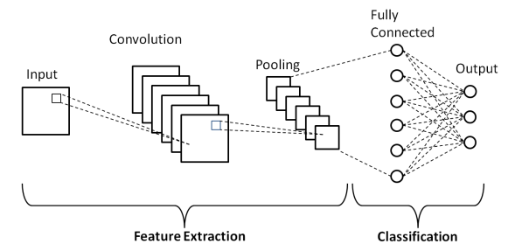
Block Diagram of CNN

Slide 8
CNN Architecture explained
INPUT –A typical image in the Sign Language MNIST data will hold images of 28x28x1 dimension with grayscale values between 0-255.
CONV - layer is responsible for computing the dot product between the weights of the neuron and the region of the input image to which share a connection.
Similar to the Convolutional Layer, the Pooling layer is responsible for reducing the spatial size of the Convolved Feature. This is to decrease the computational power required to process the data by reducing the dimensions.
Fully Connected Layers form the last few layers in the network. The input to the fully connected layer is the output from the final Pooling or Convolutional Layer, which is flattened and then fed into the fully connected layer. This Flattened vector is then connected to a few fully connected layers which are same as Artificial Neural Networks.

Slide 9
What is Keras ?
Keras is an open-source deep learning framework developed in python.
Keras is a high-level API and uses TensorFlow as its backend. It provides a very clean and easy way to create deep learning models.

Slide 10
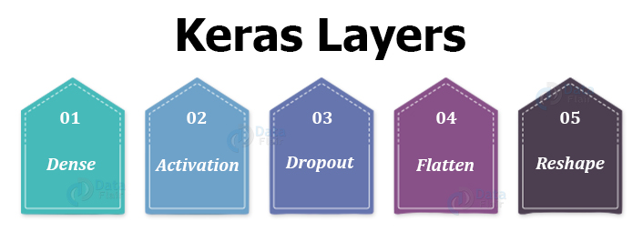

Slide 11
Keras layers explained:
Dense Layer: It implements the function.
Activation Layer: It is to apply a specific activation function to the output.
Dropout Layer: This is to prevent the model from overfitting. It randomly sets a fraction of input to 0 at each update.
Flatten Layer: To convert the higher dimension input into one dimension,i.e flatten the input.
Reshape Layer: To reshape the output to a particular shape. Gives output.

Slide 12
About the Dataset:
The Sign Language MNIST dataset used here contains data in a CSV format with labels and pixel values in single rows. The American Sign Language letter database of hand gestures represent a multi-class problem with 24 classes of letters (excluding J and Z which require motion).
The training data (27,455 cases) and test data (7172 cases) are approximately half the size of the standard MNIST but otherwise similar with a header row of label, pixel1,pixel2….pixel784 which represent a single 28x28 pixel image with grayscale values between 0-255.

Slide 13
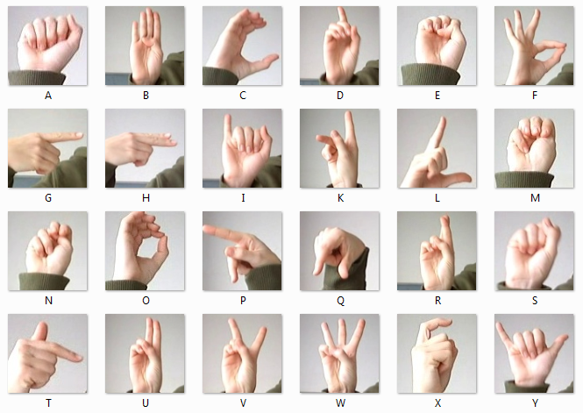
The 24 characters of dataset

Slide 14
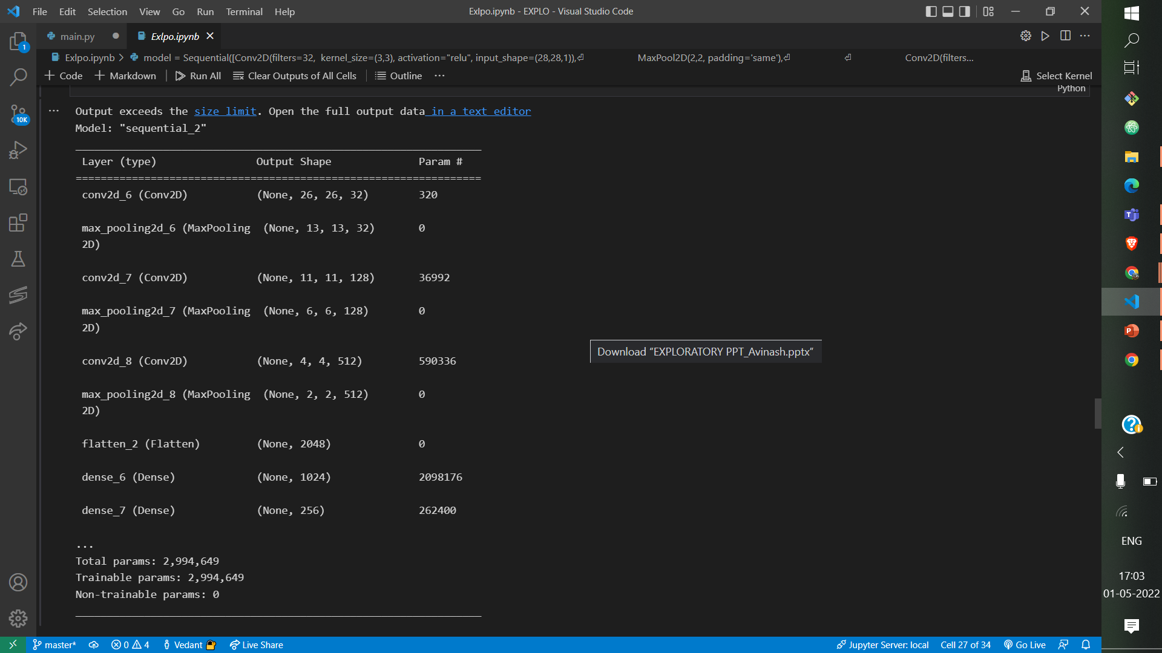
Model Summary:

Slide 15
What is OpenCV ?
OpenCV is the huge open-source library for computer vision, machine learning, and image processing and now it plays a major role in real-time operation which is very important in today’s systems.
By using it, one can process images and videos to identify objects, faces, or even handwriting of a human. When it is integrated with various libraries, such as NumPy, python is capable of processing the OpenCV array structure for analysis.
To Identify image pattern and its various features we use vector space and perform mathematical operations on these features.

Slide 16
Pre-processing the captured Image
The captured image was pre-processed using the following operations:
Converting the image to grayscale
Applying Gaussian Blur
Resize the image to (28x28) pixels using cv2.INTER_AREA

Slide 17
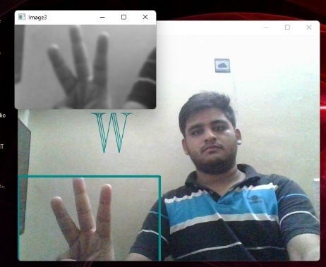
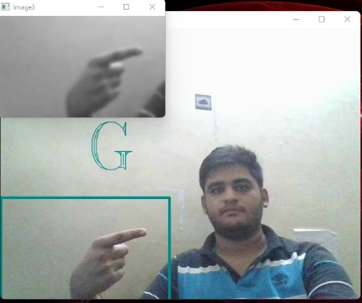
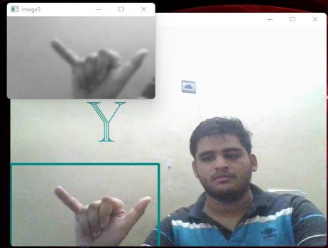
Working of our model using OpenCV:
I used OpenCV to capture live image from the device.
We cropped the region from (0,300) pixels to (300,600) pixels for capturing the hand gesture for prediction.

Slide 18
Results and conclusions
I have successfully classified the hand gestures with 99.5% accuracy and also visualized how our accuracy and loss changes with time, which is pretty good from a simple CNN model.
This sign language detection model can be used in translation devices for interacting deaf and the mute people, and thus further bridge the gap between the deaf and mute

Slide 19
References:
https://towardsdatascience.com/introduction-to-convolutional-neural-network-cnn-de73f69c5b83#:~:text=Dense%20Layer%20is%20simple%20layer,on%20output%20from%20convolutional%20layers
https://keras.io/about/
Coursera- Machine Learning by Andrew Ng
https://www.youtube.com/watch?v=Z78zbnLlPUA&list=PLQVvvaa0QuDdttJXlLtAJxJetJcqmqlQq
https://www.kaggle.com/datasets/datamunge/sign-language-mnist?select=amer_sign2.png
https://www.nidcd.nih.gov/health/american-sign-language

