Slide 1

JMeter assignment for Performance Testing Role
Pranil Sunil Chaudhari

Slide 2
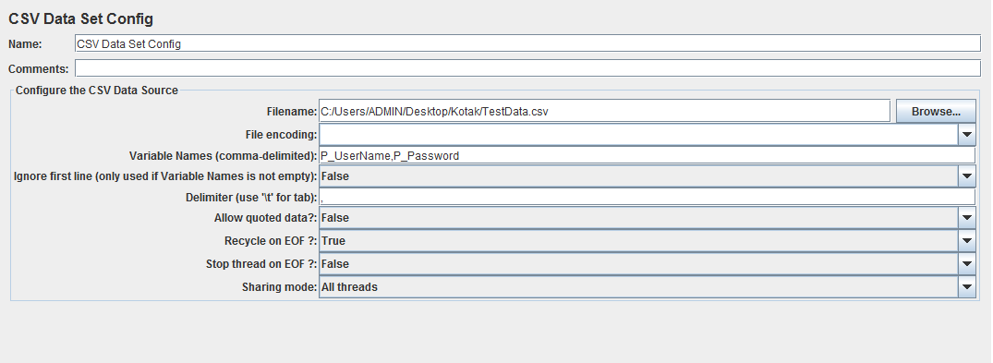
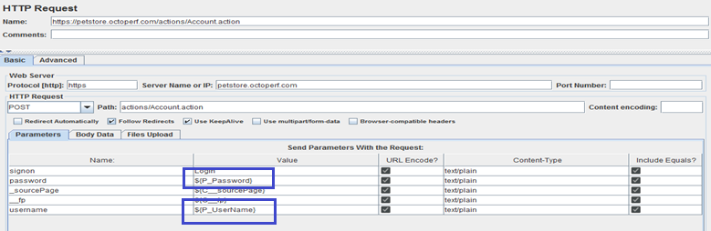
Task 1 – Scripting
Task: Create JMeter Scripts of any sample application show below implantation in that
[URL: https://petstore.octoperf.com/actions/Catalog.action]
Test Data loaded from external sheet
Parameterization (Example)
Please refer GIT repo for complete script

Slide 3
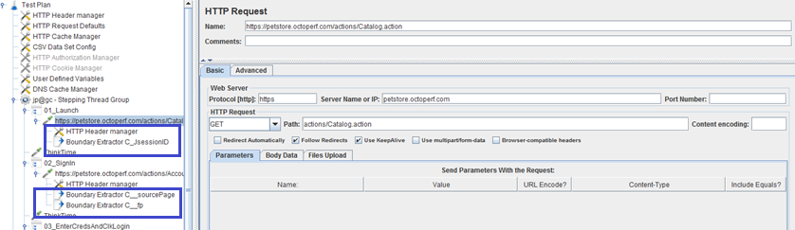
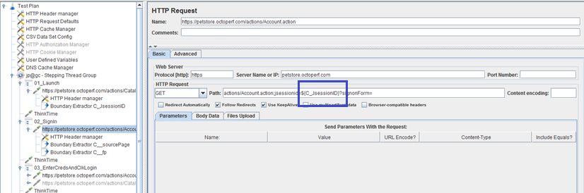
Task 1 – Scripting
Correlations (Example)
Please refer GIT repo for complete script

Slide 4



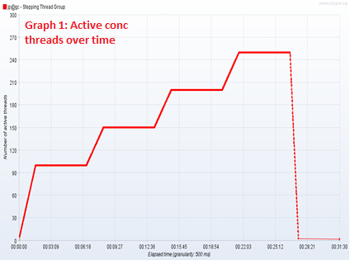
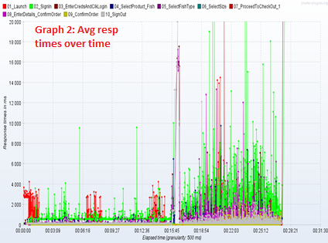
Task 2 – Execution & Observations
Objective / Task:
Put 100 concurrent loads in application analysis graph and keep on increasing until you find bottleneck.
Scenario setup:
Execution started with initial 100 users. Furthermore 50 users were added after the interval of 5 minutes. Graph (1) indicating concurrent threads simulated to achieve scenario
Observations:
Overall response time for all transactions within 2 - 4 seconds till 150 active concurrent users.
After adding 200 concurrent users observed exponential increase in response times
When checked manually, test users were unable to login into application.

Slide 5
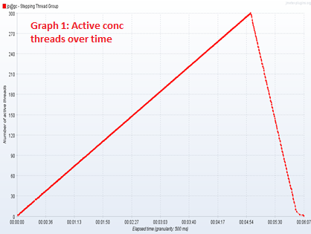
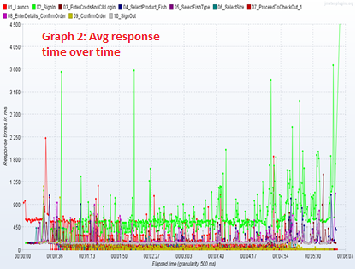
Task 2 – Execution & Observations
Objective / Task:
How much load application can Handel within 5 min time span
Scenario setup:
Execution initiated with ramping up 1 user per second till 5 mins. Graph (1) indicating concurrent threads simulated to achieve scenario
Observations:
Application was able to sustain load of 300 concurrent users for 5 mins of time span.
Overall response times were within the range of 2 - 4 seconds
No major issues observed.

Slide 6


