Slide 1
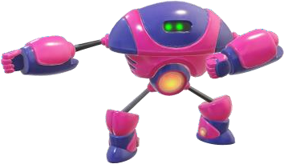
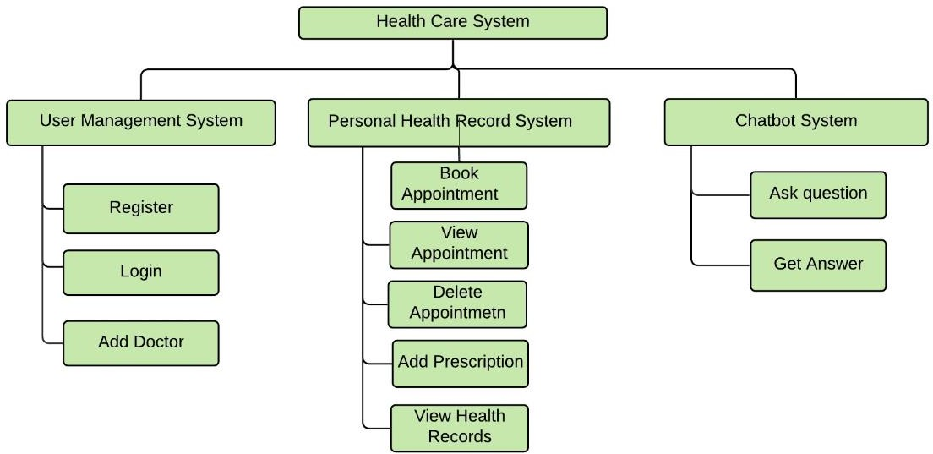
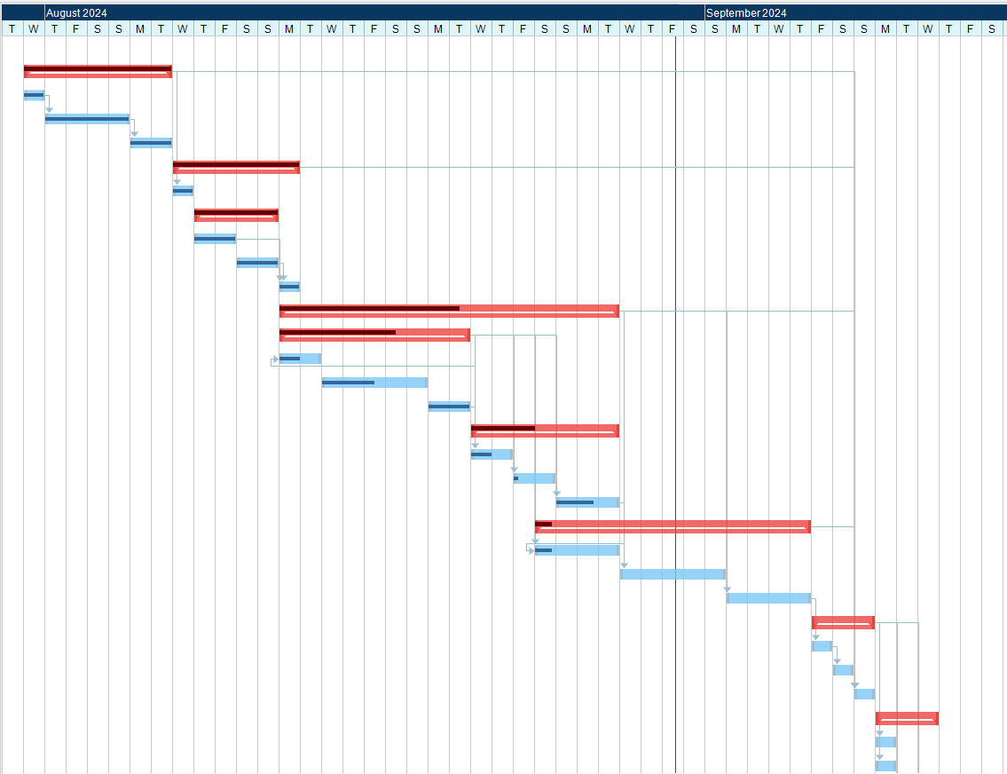
Jitendra Shrestha
Pranish Acharya
Health Care Chatbot System
Supervisor : Fakhra Jabeen
Artifact
INTRODUCTION
Literature Review
Service that provides to the user/client through interpreting natural language.
Fast and convenient
SN | Authors | Algorithm | Accuracy
1 | Deshpande, Mrs. Rashmi Dharwadkar & Dr.Mrs. Neeta A. | Support Vector Machine Algorithm (SVM). | 92%
2 | Vipasha Chandwani, Sandeep Kumar & Parikshit Kishor Singh | LSTM model | 83%
3 | Ming-Hsiang Su, Chung-Hsien Wu, Kun-Yi Huang, Qian- Bei Hong, Hsin-Min Wang | LSTM-based Multi- Layer Embedding | 79%
4 | Md. Moshiur Rahman, Ruhul Amin, Md Nazmul Khan Liton and Nahid Hossain | Different algorithms (SVM, KNN, LSTM) | 98%
Academic Question
Does the System overcome the traditional way of disease prediction from the symptoms provided or does it replace the demand of doctors in future?
How are you going to fetch medical data for the chatbot system?
Aims and Objectives
Accuracy
The aim is to provide a fast and convenient way to manage Health Queries.
Collecting data sets
To integrate chat interface with web application.
To provide health queries
To provide easy way to maintain health record.
To diagnose disease based on symptoms provided
Tracking Gantt Chart
Confusion Mattrix
Features
Can predict disease based on symptoms provided
User can book appointment
View health records
Doctors can provide prescription to booked appointment
Future Escalation
Conclusion
Used to predict all types of disease.
Used to recommend medicine.
Used to track heartrate, steps using sensor.
Psychological doctor bot
Popularity of the chatbot is increasing day by day
Different algorithm can be used .
AI has changed the way of communicating.
Huge scope in case of health care.

