Slide 1

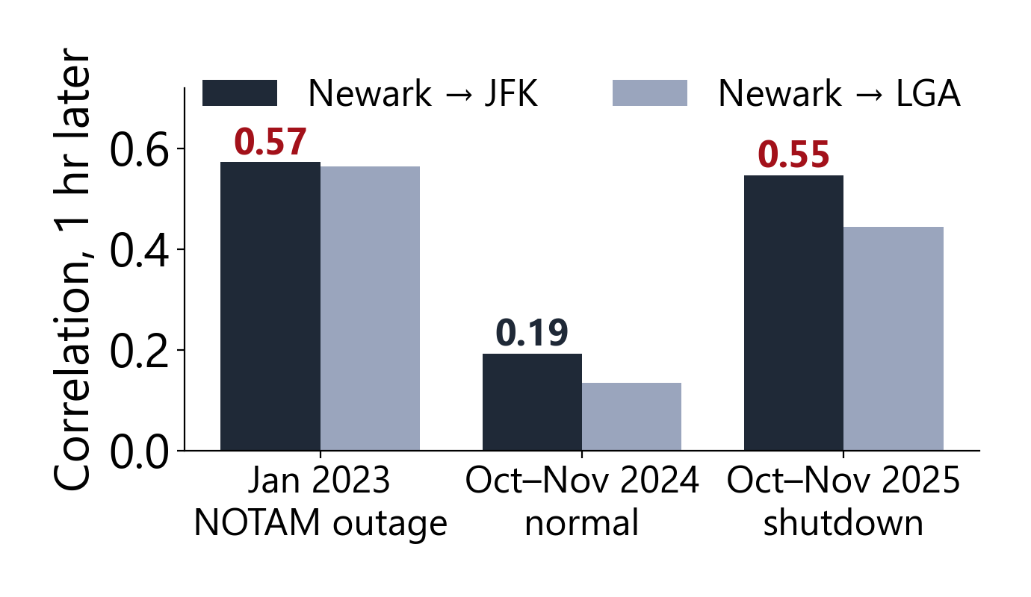
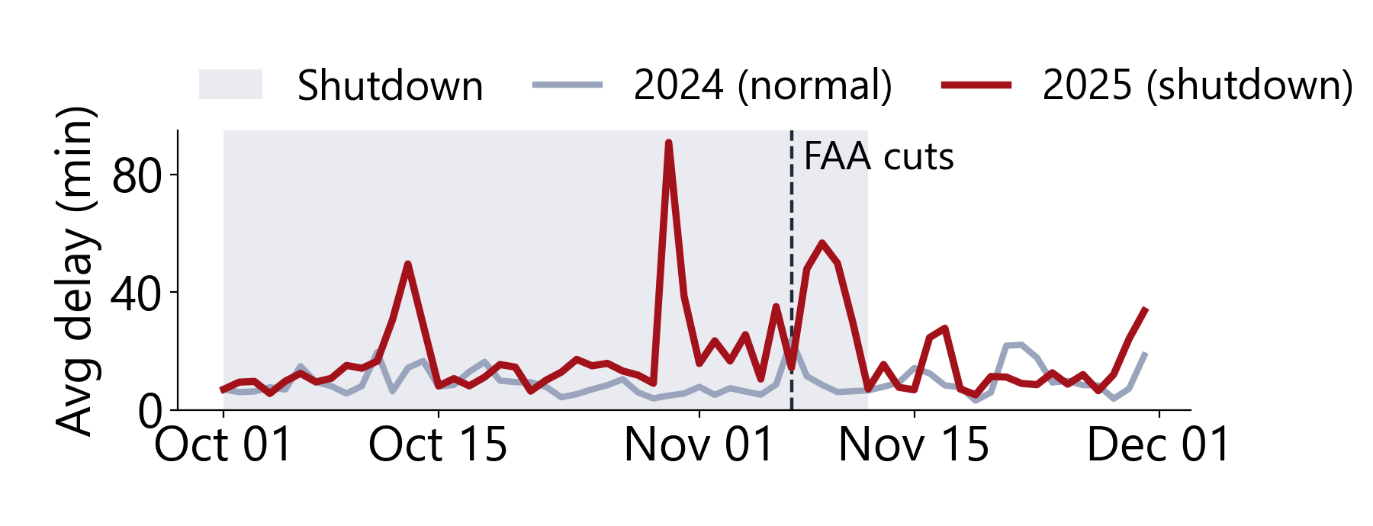
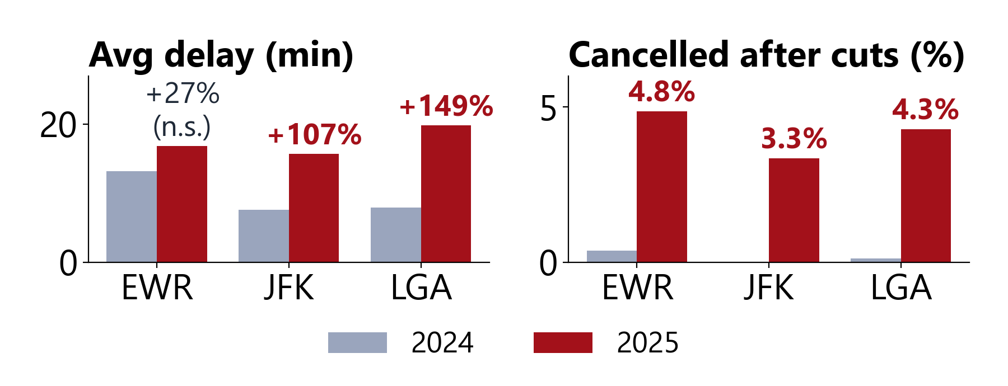
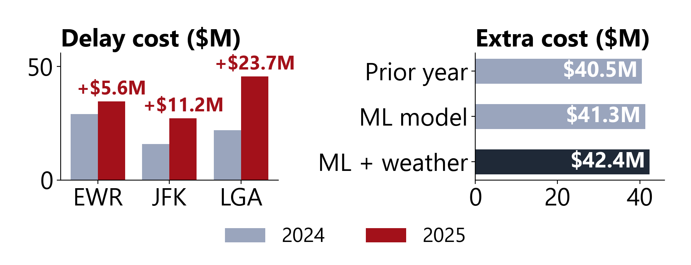
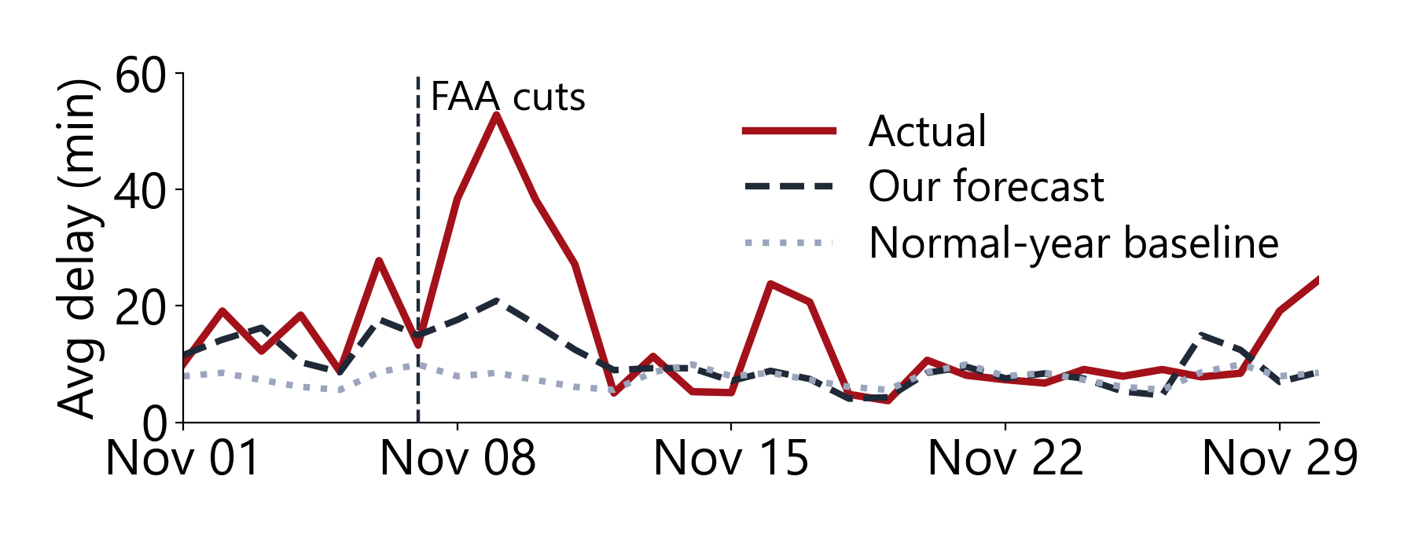

Quantifying and Forecasting the Impact of the 2025 U.S. Government Shutdown on New York–Metro Flight Delays
Pranish Uprety | Advisor: Dr. Sushil Poudel | Department of Computer Science, Caldwell University
Objective
Methodology
Result 5: Coupling
Measure how the 2025 shutdown affected New York–Metro air travel:
1 DATA
2 PREPROCESSING
3 PANEL
4 ANALYSIS
5 RESULT
Under stress, Newark's delays moved with JFK and LGA
Quantify the change in delays and cancellations
BTS On-Time
310K flights
8 airports
Keep EWR, JFK, LGA + 5 corridor airports
Remove cancelled flights
Average delay per airport-hour
Join hourly weather
Significance
Welch t-test, 2024 vs. 2025
p < 0.001
1
2
Test whether weather explains the change
Airport-hour panel
Oct–Nov
2024 and 2025
Extra cost
3 baselines × $100.76/min
≈ $41M
3
Forecast delays from information known in advance
Forecast
calendar + schedule + flag
R² up to 0.23
METAR Weather
hourly reports
wind, visibility
Background
Coupling
lead–lag correlation
r 0.19 → 0.55
43
shutdown days
40
airports cut
3
airports studied
1-hour lagged correlation (does not imply causation)
Result 1: Delays Over Time
Result 2: By Airport
Conclusions
WHAT HAPPENED
Delays spiked during the shutdown
JFK and LGA delays more than doubled
JFK +107%, LGA +149%; EWR +27% not significant
≈ $41M extra cost, not from weather
Partly predictable from public data
Airports more linked under stress
Longest U.S. shutdown on record
Air-traffic controllers worked without pay; staffing shortages grew
Nov 7
FAA cuts flights [3]
Limits: departures only; one prior year
Next: targeted vs. blanket flight cuts
Oct 1
Shutdown
begins
Nov 12
Shutdown
ends
Daily average departure delay, EWR + JFK + LGA
JFK, LGA: p < 0.001 · EWR: p = 0.07 (n.s.)
WHY IT MATTERS
Result 3: Extra Delay Cost
Result 4: Forecast
References
NY has the most congested U.S. airspace
Delay costs airlines $100.76 per minute [1]
Delays spread between airports [2]
[1] Airlines for America, Delay Costs, 2025.
[2] Fleurquin et al., Sci. Reports 3:1159, 2013.
[3] FAA Emergency Order, Nov. 6, 2025.
[4] BTS, On-Time Performance data.
[5] Iowa Environmental Mesonet, ASOS/METAR.
≈ $41M extra, not explained by weather
Our forecast beat the normal-year baseline
Research Repository
Code, data & figures
github.com/pranishuprety/stemadvance2026
Research gap: no data-driven estimate of the shutdown's effect on New York–Metro flights
Cost at $100.76 per delay minute [1]
R², forecast vs. baseline: EWR .23/.09 · JFK .12/−.01 · LGA .15/−.04

