Slide 1
Lead Management System (Mini CRM)
Streamlining Real Estate Lead Capture and Conversion
Notes:
Speaker Notes:
Welcome everyone. Today we present EstateFlow CRM, a complete full-stack lead management system tailored for the real estate industry.

Slide 2
Requirements & Assumptions
JWT Auth implemented for secure access to the system.
Lead phone numbers are strictly validated as 10-digit Indian numbers.
Deleting a lead triggers a hard cascade delete of all its notes.
Conversion Rate = (Closed Leads / Total Leads) in dashboard metrics.
Optimized for rapid data entry with responsive design.
Notes:
Speaker Notes:
Our system is built on solid requirements. We enforce strict phone validations and maintain database integrity via cascading hard deletes for notes.

Slide 3
Tech Stack & Rationale
Frontend: Next.js (React) - robust SPA routing and modular architecture.
Backend: NestJS - scalable, heavily structured REST API out of the box.
ORM: Prisma - type-safe schema modeling and seamless migrations.
Database: PostgreSQL - relational integrity, enums, and reliability.
Styling: Pure CSS modules - zero dependencies, custom polished aesthetic.
Notes:
Speaker Notes:
We selected a modern TypeScript stack. Next.js and NestJS provide a highly structured ecosystem, while PostgreSQL + Prisma handles our relational data.

Slide 4
System Architecture
Next.js
Frontend SPA
REST API
NestJS
Backend
Prisma
PostgreSQL
Database
Notes:
Speaker Notes:
The architecture is a classic decoupled client-server model. The Next.js frontend communicates via REST APIs to a NestJS server, which interfaces with PostgreSQL via Prisma.

Slide 5
Database Schema & Design
Leads Table: 1-to-N relationship with Lead_Notes table.
Enums used for strict constraints: PropertyType (1BHK-4BHK, Plot, Commercial).
LeadSource (Google, Facebook, Referral, etc.) and LeadStatus.
Performance Indexes: B-Tree indexes on [status] and [created_at].
Referential Integrity: onDelete: Cascade removes notes when a lead is deleted.
Notes:
Speaker Notes:
Our schema strictly enforces data types using native PostgreSQL Enums. We mapped relationships carefully, ensuring orphaned notes never exist by using cascade deletions.

Slide 6
API Design & Endpoints
POST /api/auth/login, POST /api/auth/register - JWT Token generation.
GET /api/leads - Paginated, searchable, and filterable list.
POST /api/leads - Validates incoming DTOs before creation.
GET /api/dashboard/summary - Aggregates metrics (Total, Closed, Revenue).
Standardized JSON response wrapper with generic error exception filters.
Notes:
Speaker Notes:
The REST API is designed to be predictable. We leverage NestJS validation pipes to guarantee payloads match our DTOs, and global exception filters to format errors uniformly.

Slide 7
Backend Layers (NestJS)
Controllers: Handle HTTP routing, payload parsing, and returning responses.
Services: Contain core business logic, hashing passwords, and validations.
Prisma Service: Abstracts database queries and acts as our repository layer.
Validation Pipes: Uses class-validator to enforce constraints (e.g., 10-digit phone).
Global Error Mapping: Prisma constraint errors gracefully translated to HTTP 400/409.
Notes:
Speaker Notes:
We follow the Controller-Service-Repository pattern natively via NestJS and Prisma. This separation of concerns ensures unit-testability and clean code maintenance.

Slide 8
Frontend Structure (Next.js App Router)
/app Directory: Defines file-based routing and lazy-loaded page boundaries.
Components Layer: Reusable UI elements (Sidebar, ClientLayout).
Context API: AuthContext manages global JWT state and localStorage persistence.
API Utils (lib/api.ts): Wraps fetch requests with interceptors for Authorization headers.
Strict Typing: Shared TypeScript interfaces for API responses and payload structures.
Notes:
Speaker Notes:
The frontend takes full advantage of Next.js App Router. We modularized API calls, shared contexts, and components for highly maintainable view layers.

Slide 9
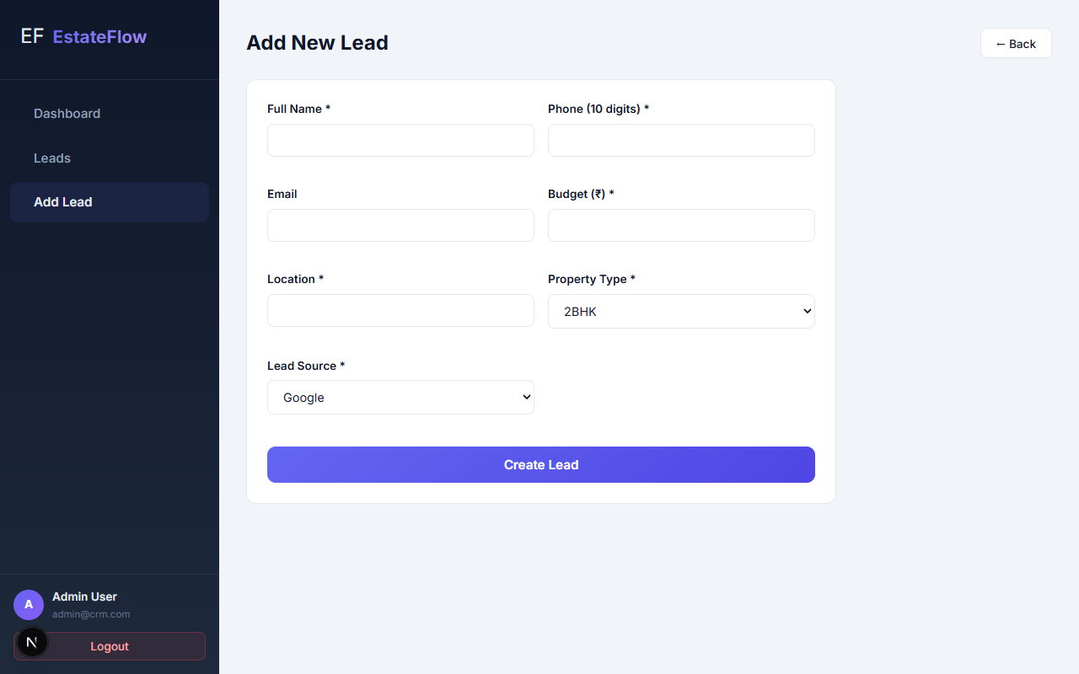
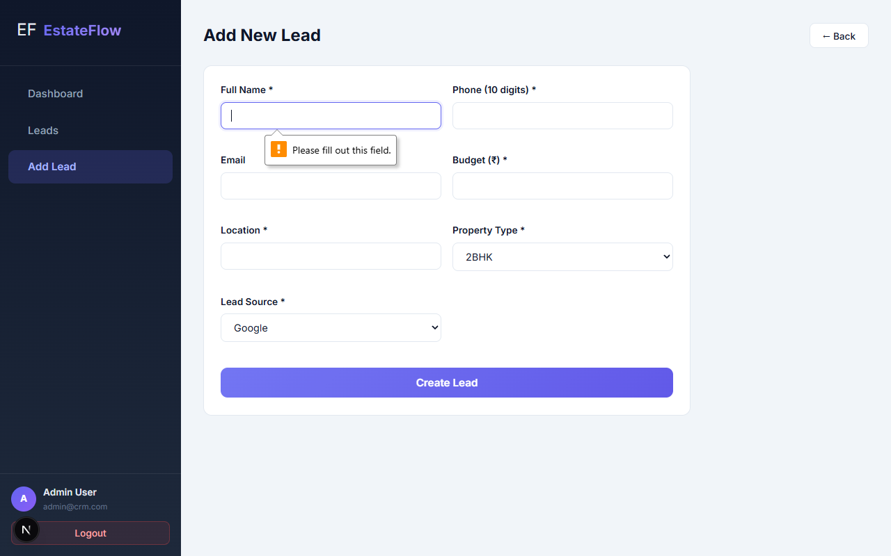
Lead Capture & Validation
Client-side & API-level validation prevents bad data.
Notes:
Speaker Notes:
Form validations block submissions of invalid phone numbers or empty fields on the frontend, while the backend mirrors these checks for bulletproof security.

Slide 10
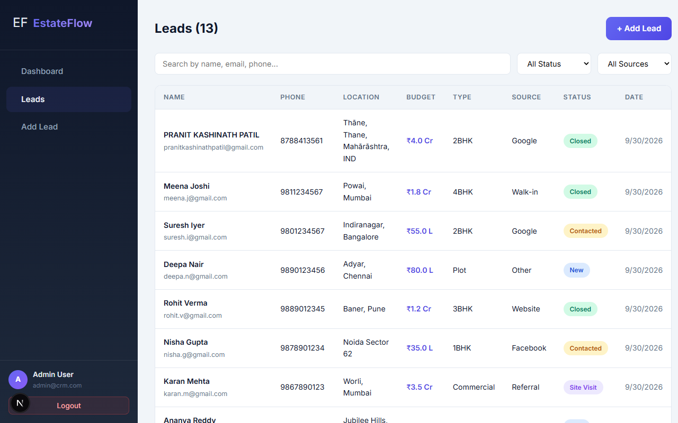
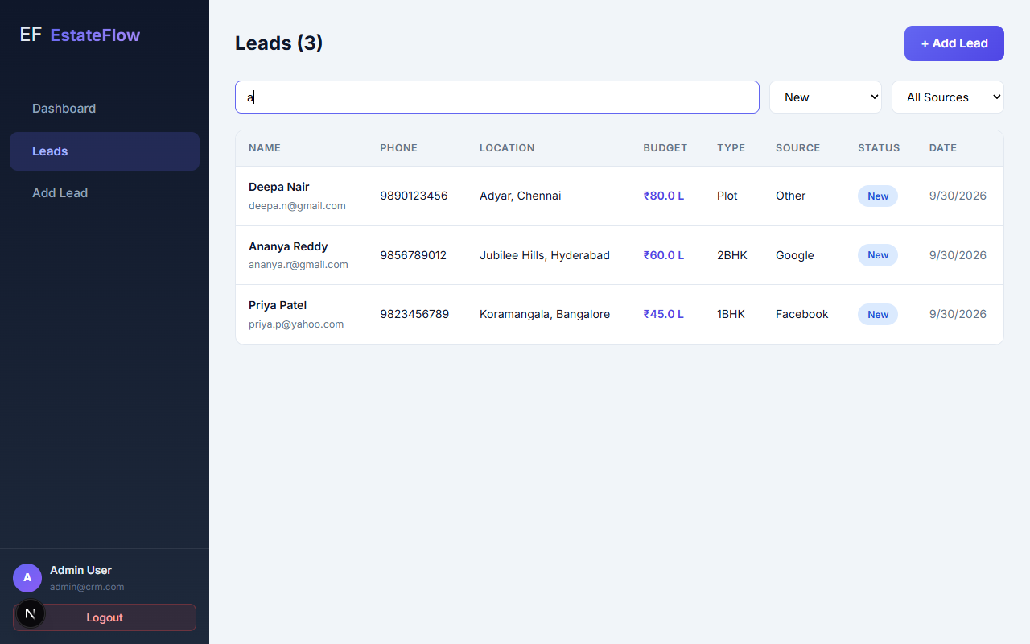
Dynamic Lead Listing & Filters
Server-side pagination, search by name/email, and status filtering.
Notes:
Speaker Notes:
The leads list handles large datasets via server-side pagination. Real-time search and filtering make it trivial to locate specific high-value prospects.

Slide 11
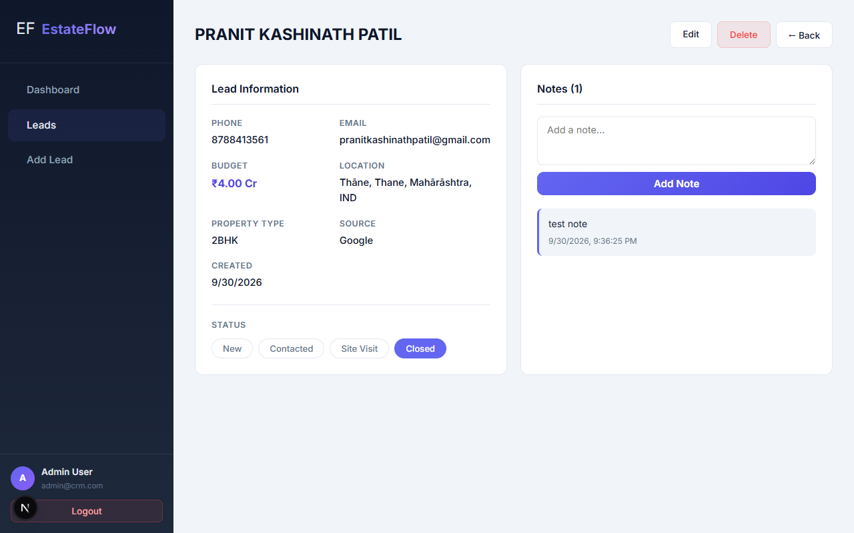
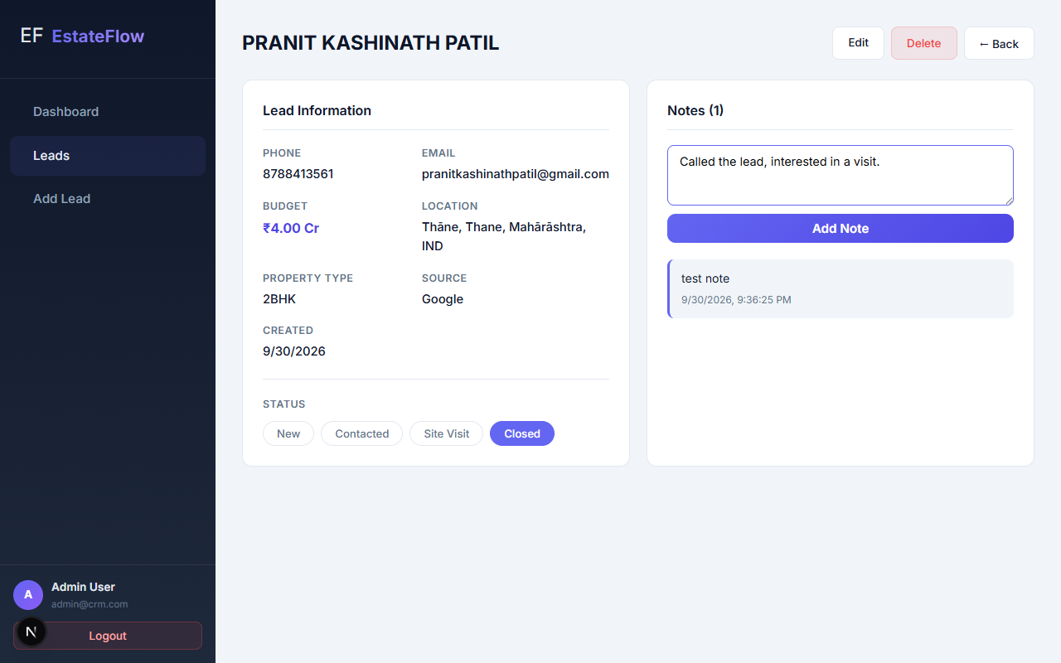
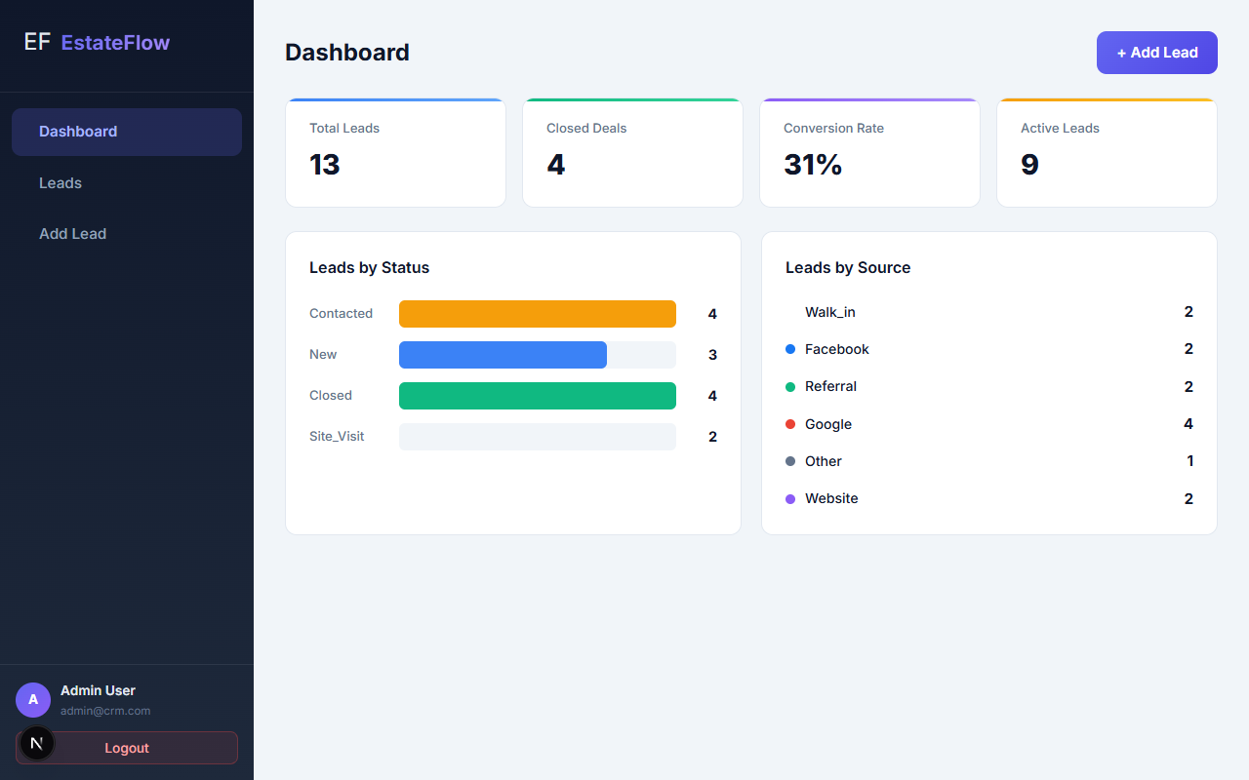
Lead Details & Analytics Dashboard
Granular views of interaction history alongside high-level KPI metrics.
Notes:
Speaker Notes:
Individual lead pages track all historical notes and status changes. The central dashboard provides instant visibility into overall conversion health.

Slide 12
Challenges, Future Scope & Setup
Challenges: Handling hydration mismatch and client-side AuthContext race conditions.
Future: Agent assignment, CSV import, automated WhatsApp/Email reminders.
Setup: npm install -> set DATABASE_URL -> npm run prisma:push -> npm run start:dev.
Testing: Unit tests coverage expansion with Jest and e2e UI tests via Playwright.
Demo & Repo: Available live via provided GitHub repository link.
Notes:
Speaker Notes:
Going forward, we plan to implement automated messaging and agent assignments. Running the app locally is as simple as installing packages and pushing the Prisma schema.

