Slide 1
Introduction
There are 36,000 to 45,000 cases each year in Hungary.
We intend to examine the Chickenpox dataset and make forecast for the next period.
Our objective is to incorporate the illustrative investigation, appropriate perception, model particular, model fitting and determination, analytic checking, and understanding of the Hungary Chickenpox dataset.

Slide 2
Dataset
We have selected Hungarian Chickenpox Dataset
Data Source: https://archive.ics.uci.edu/ml/datasets/Hungarian+Chickenpox+Cases

Slide 3
Data Exploration
Properties of Dataset:
Trend
Changing Variance
Behaviour
Change Point
Seasonality

Slide 4
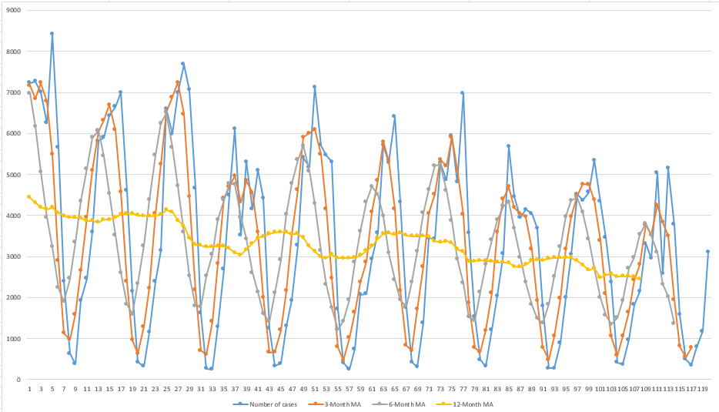
Moving Average

Slide 5
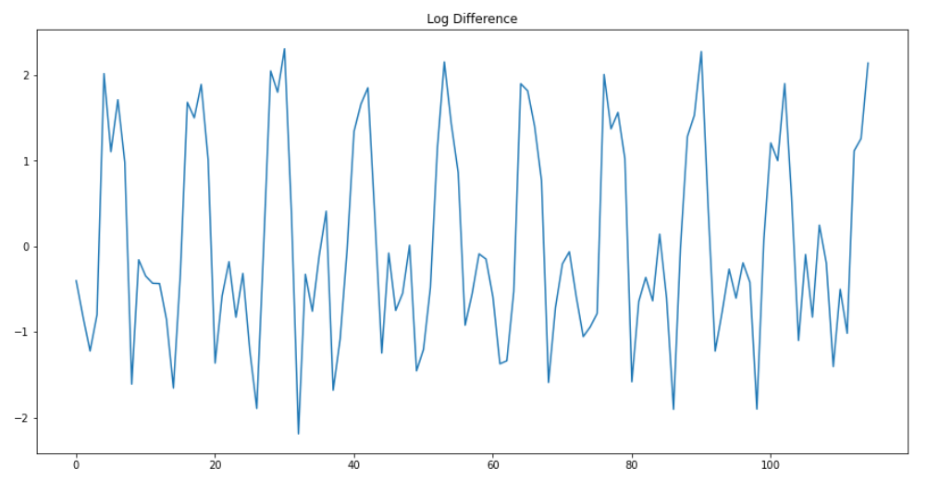
Testing the Stationarity of the Dataset
Augmented Dickey Fuller test (ADF Test) is taken of the dataset
Taking Log and differencing:

Slide 6
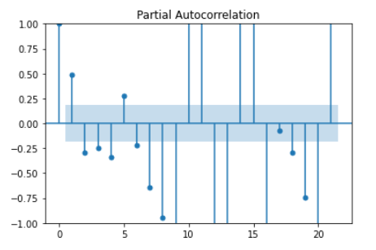
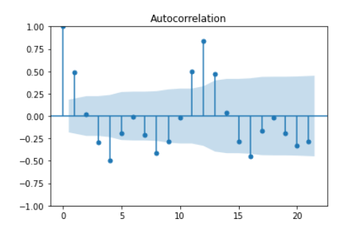
Partial Autocorrelation and Autocorrelation
To identify pattern and trend in data Partial Autocorrelation and Correlation done.

Slide 7
SARIMA Model
The model’s notation is SARIMA(p, d, q) (P, D, Q)lag.
These three parameters account for seasonality, trend, and noise in data.
After performing multiple iterations, the model that gives AIC and BIC values lowest is the best combination. Below given are the values of p and q for which we have done iteration in code.
Table-A
SARIMA (p,0,q)x(2,1,1)12 | AIC | BIC | MSE | RMSE
SARIMA (1,0,2)x(2,1,1)12 | 64.244 | 82.687 | 0.128 | 0.358
SARIMA (2,0,2)x(2,1,1)12 | 65.202 | 86.280 | 0.128 | 0.358
SARIMA (0,0,2)x(2,1,1)12 | 76.129 | 91.937 | 0.154 | 0.392
SARIMA (0,0,3)x(2,1,1)12 | 72.132 | 90.575 | 0.137 | 0.371
SARIMA (1,0,0)x(2,1,1)12 | 95.853 | 109.026 | 0.199 | 0.446
SARIMA (1,0,1)x(2,1,1)12 | 75.407 | 91.215 | 0.153 | 0.392

Slide 8
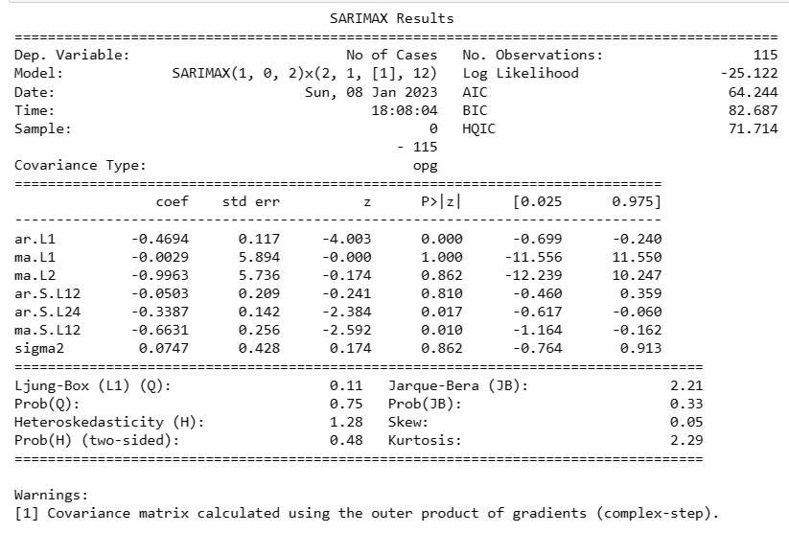
Result of SARIMA Model after running Python Code

Slide 9
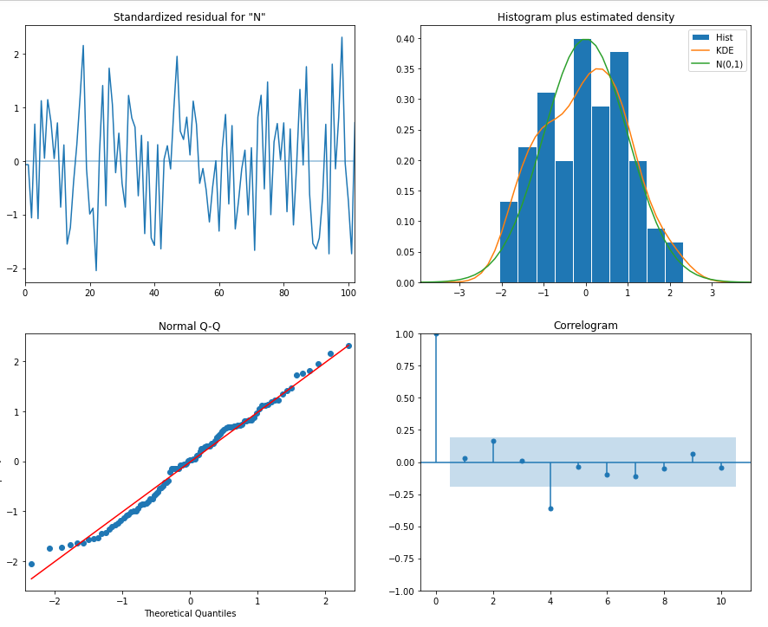
Visualization of Result

Slide 10
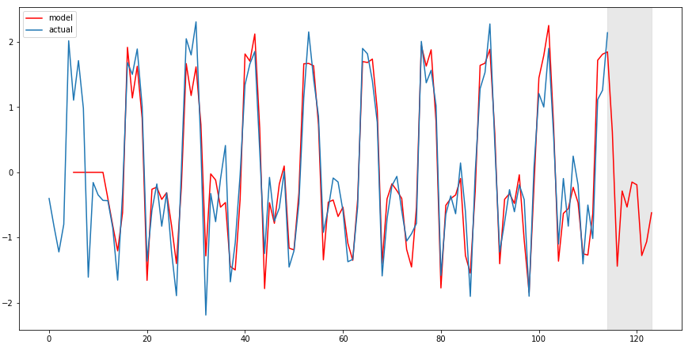
Model Forecast

Slide 11

Validating the Forecast

Slide 12
Conclusion
Based on the r2_score, which arrived at 89.76%, we concluded that the model selected by us has 89.76% accuracy.
The RMSE value of 0.3586 which is not high.
We can be confident about the model’s ability to predict Hungarian Chickenpox in future.

Slide 13

Thank you!

