Slide 1

Pranita Sharma
Mphasis Nextlabs
Date : 3rd March 2017

Slide 2
Solving Kinematics Word Problems: A Machine Learning and NLP based approach

Slide 3
Approach to tackle a Kinematics word problem
A car starts from rest at an acceleration of 3 m/s2 for 15 s. Find the displacement of the car during this period.
Equations:
v = u + a*t
v * v = u * u + 2*a*s
s = u*t + 0.5*a*t*t
Selection
Given Physical Quantities:
Initial Velocity : 0 m/s
Acceleration : 3 m/s2
Time taken : 15 s
To be computed:
Displacement
Selected Equation:
s = u*t + 0.5 *a * t *t

Slide 4
Extracting Physical Entities
A car starts at an acceleration of for Find the
of the car during this period.
from rest
3 m/s2
15 s
displacement
u = 0 m/s
a
t
s
s = u *t + 0.5 * a * t * t

Slide 5
Breakdown of word problem
Question
Semantic Parsing
Proximity analysis for words
Dictionary of Units
Words in proximity : Acquire associations to terms of equations of internal language.
For example : Prepositions such as “from”, ”to”, ”in”
Proximity analysis of words will serve the purpose of deciding the state of a particular value of Physical entity
For example: A car accelerates from 8 m/s to 12 m/s.
In this case, the value 8 m/s belongs to initial state and hence it is initial velocity and 12 m/s belongs to final state and is final velocity.

Slide 6
Supervision
For Supervising the machine, Recurrent Neural Network models were created with LSTM cells
It contains the Long Short Term Memory cells for controlling the amount of memory content that is seen or used by other units in the network and allows to retain the context of the text over the complete neural iteration
The machine training was done twice :
The first training was done for extracting physical entities and finding out the value of the physical entity to be computed
The second training was done to supervise the machine selection of equation by understanding the given values of physical entities and the value to be found by feeding the machine custom data set which has labelled each question with its equation translation for arriving at the required answer

Slide 7
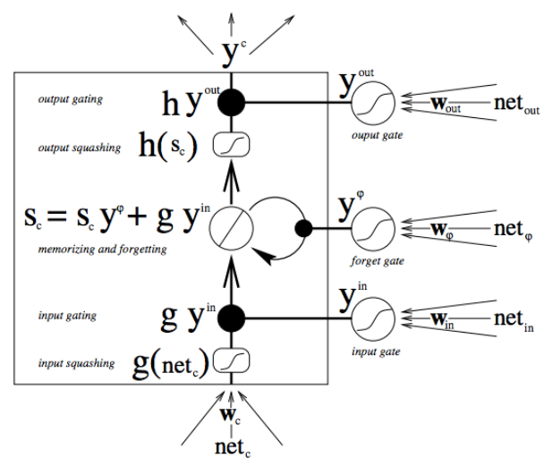
Motivation for selecting RNN with LSTM cell

Slide 8
Specifications of RNN network
Cost function used while training was Softmax Regression with weight decay. This selection of function is determined by the number of classes in which the dataset need to be classified. In this particular case, it is three, as there are 3 equations
Optimizer used is the Adam Optimizer
The number of hidden layers for both the models is three. The learning rate was set to 0.01
The number of units per layer was about 300, length of context i.e. Word embedding was 50 and size of document vector was 20

Slide 9
Complete Flow
RNN for training properties and state of Physical entities in the question
Semantic Parsing and Analysis
Equation Solver
Question
Answer
RNN for training the selection of the appropriate equation

Slide 10
Results
The dataset consists of 50 unique word problems and it was extrapolated to 1500 word problems.
The percentage distribution of training and test data set was 90% and 10% respectively
The classification ratio of labeling the sample with the correct and incorrect equation is 4:1 of the final model run

Slide 11
Applications
The work could lead to educational tools that identify errors in students’ reasoning or evaluate the difficulty of word problems
The solver can be extended by considering more complex physical situations, including additional forces, three-dimensional motion, multiple objects, and so on
The dynamical system can be extended to represent those situations and/or use a collection of dynamical systems
It may also point toward systems that can solve more complicated problems in geometry, physics, and finance — problems whose solutions don’t appear in the back of the teacher’s edition of a textbook

Slide 12
Thank you !

