Slide 1
PRESENTATION
Online shopping

Slide 2
Introduction:
Computer plays an important role in our daily life. Anything we want we can get only in one mouse click. Speed, reliability and accuracy of the computer make it a powerful tool for different purposes.
A very important and basic need of today’s modern business world is the quick availability and processing of information using computer. One can easily get the type of required information within a fraction of a second.
The project that we have taken is also in this category which is used in our daily life whenever we want to purchase some items we can easily get them at our home.

Slide 3
OBJECTIVES:
The search engine provides an easy and convenient way to search for products where a user can Search for a product interactively and the search engine would refine the products available based on the user’s input.
The user can then view the complete specification of each product. They can also view the product reviews and also write their own reviews.
The objective of project on Online Shopping Portal is to developing a GUI based automated system, which will cover all the information Related to the all products which is used in our daily life. For example – Mobiles Phones, Laptops, Clothes, Books, Electronic Items and many more. So by this GUI based automated system a user want to purchase something then it only a mouse click away to purchase these products.

Slide 4
Need of ONLINE SHOPPING PORTAL
The “ONLINE SHOPPING ” is developed according the current need in different Fields. This is online shopping Website which provides facility for purchasing Mobiles, Laptops, Camera and many more items. So by using this Online Shopping Portal users which want to purchase some products will first Register an account on this portal then Login through their Username and Password, and then Select items which they want to purchase and add them to cart and finally checkout by giving payment details. So by using this portal users can easily purchase products from their home.

Slide 5
STRUCTURE OF PROJECT
Before Login
Login
Register
Forget Password
Administrator Login
About Us
Contact Us
After Administrator Login
Edit Website Details
Add Brands
Add Category
Add Items
Delete Brands
Delete Category
Delete Items

Slide 6
.
Manage User
See Users
Users Shopping
Add Users
Delete Users
Logout
After User Login
My Profile
Edit Profile
Change Password
Buy Products
Categories (Controlled by Admin. Which can be add it dynamically according to their needs)
My Cart
My Shopping’s
Checkout
Logout

Slide 7
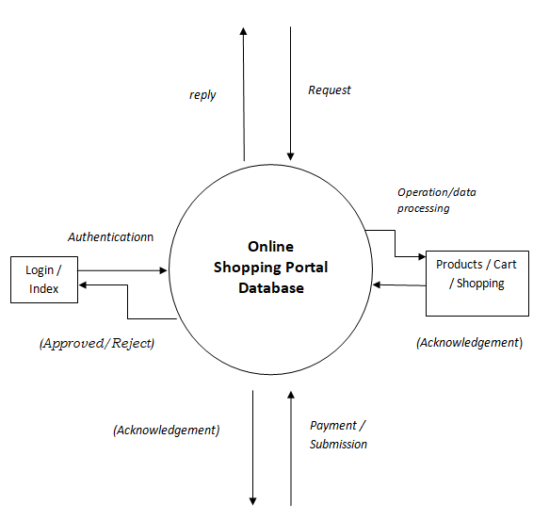
Flowchart

Slide 8
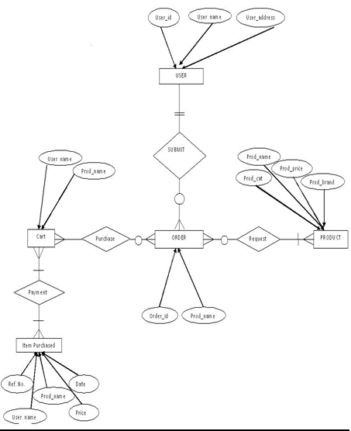
E-R Diagram :

Slide 9
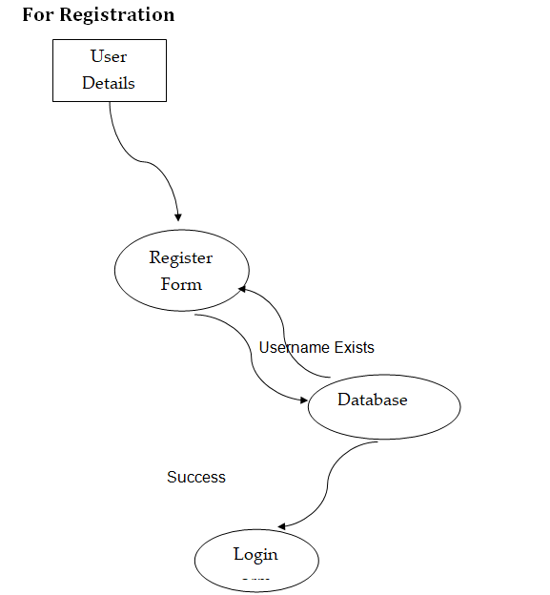

Slide 10
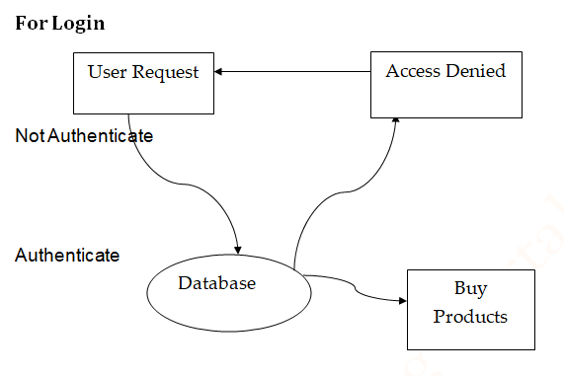

Slide 11
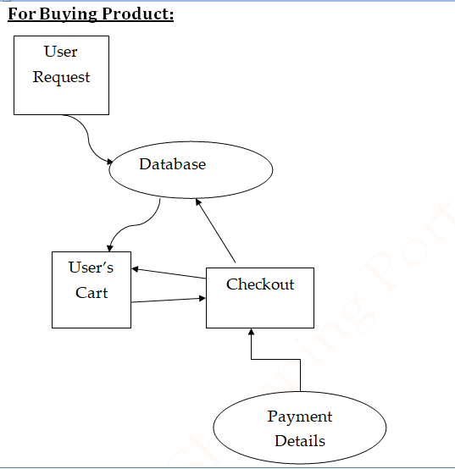

Slide 12
Database and Tables of project

Slide 13
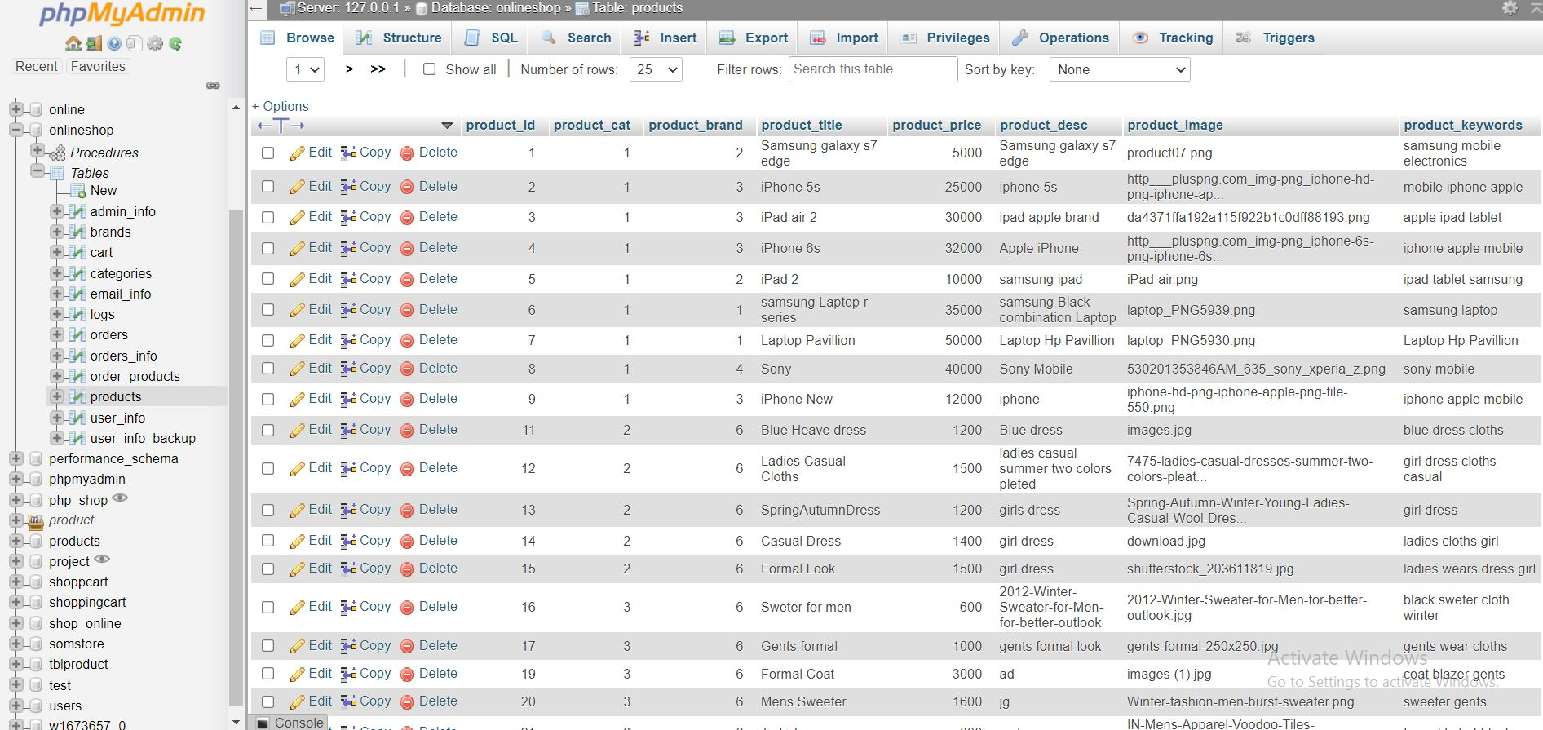

Slide 14
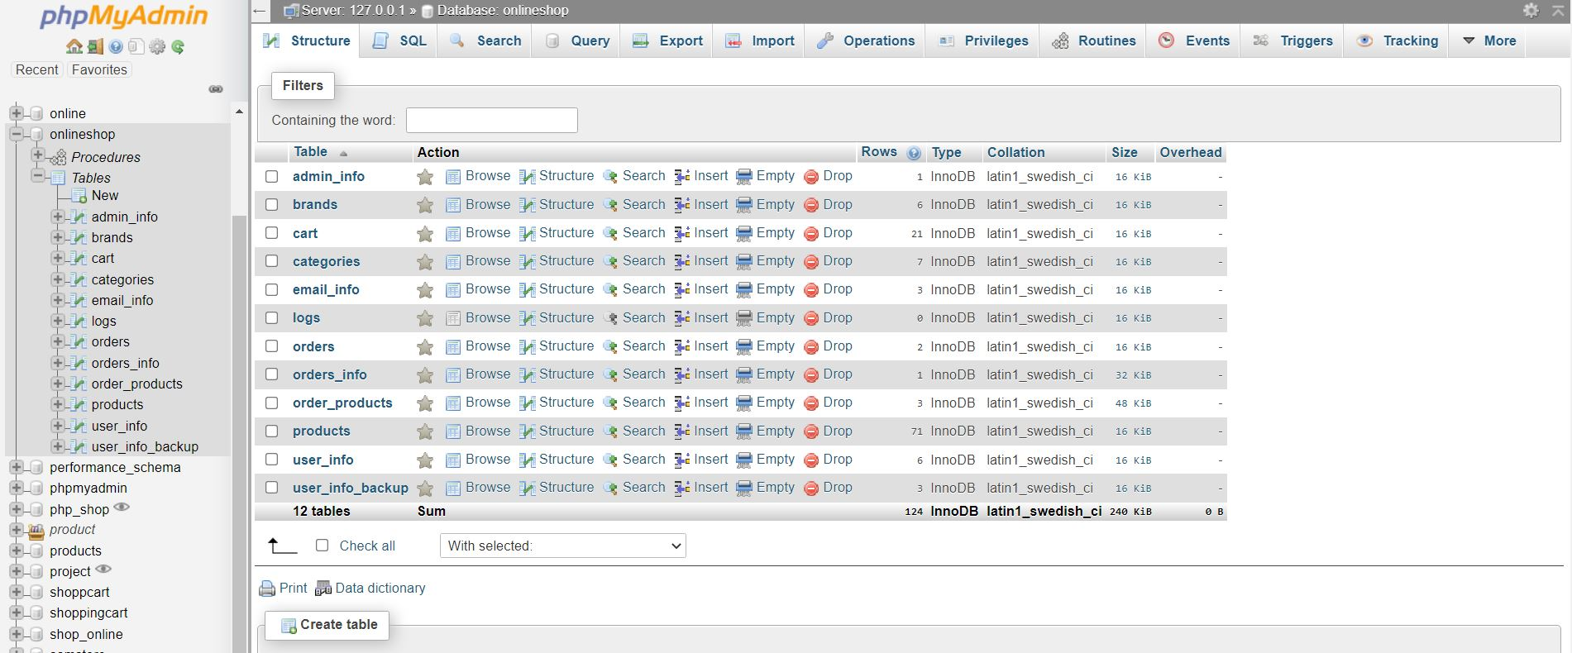

Slide 15
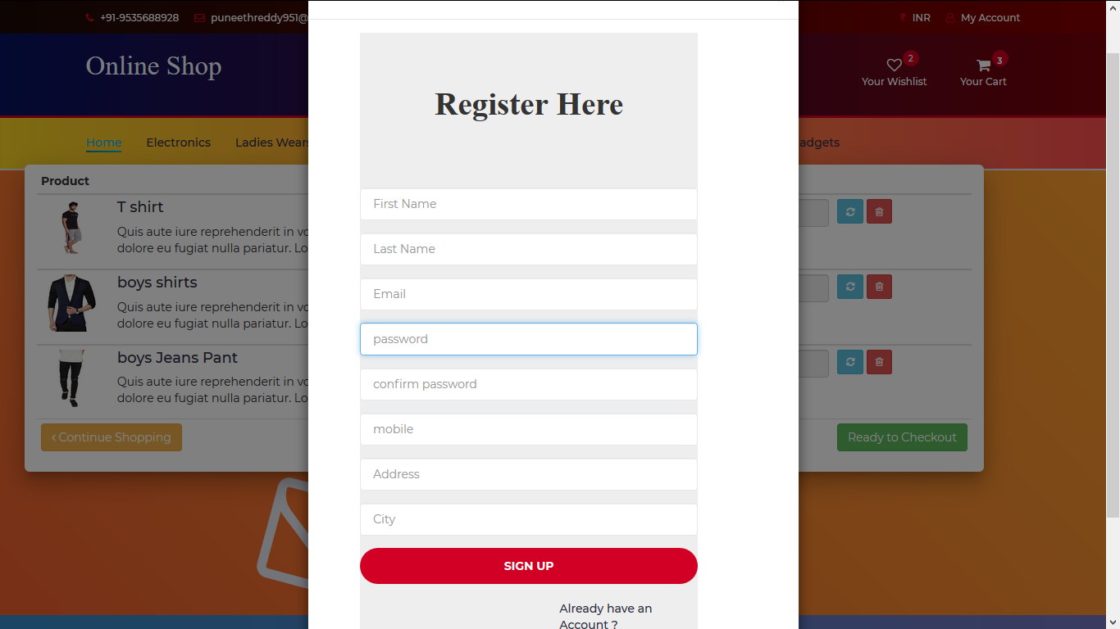
SNAPSHOTS:

Slide 16
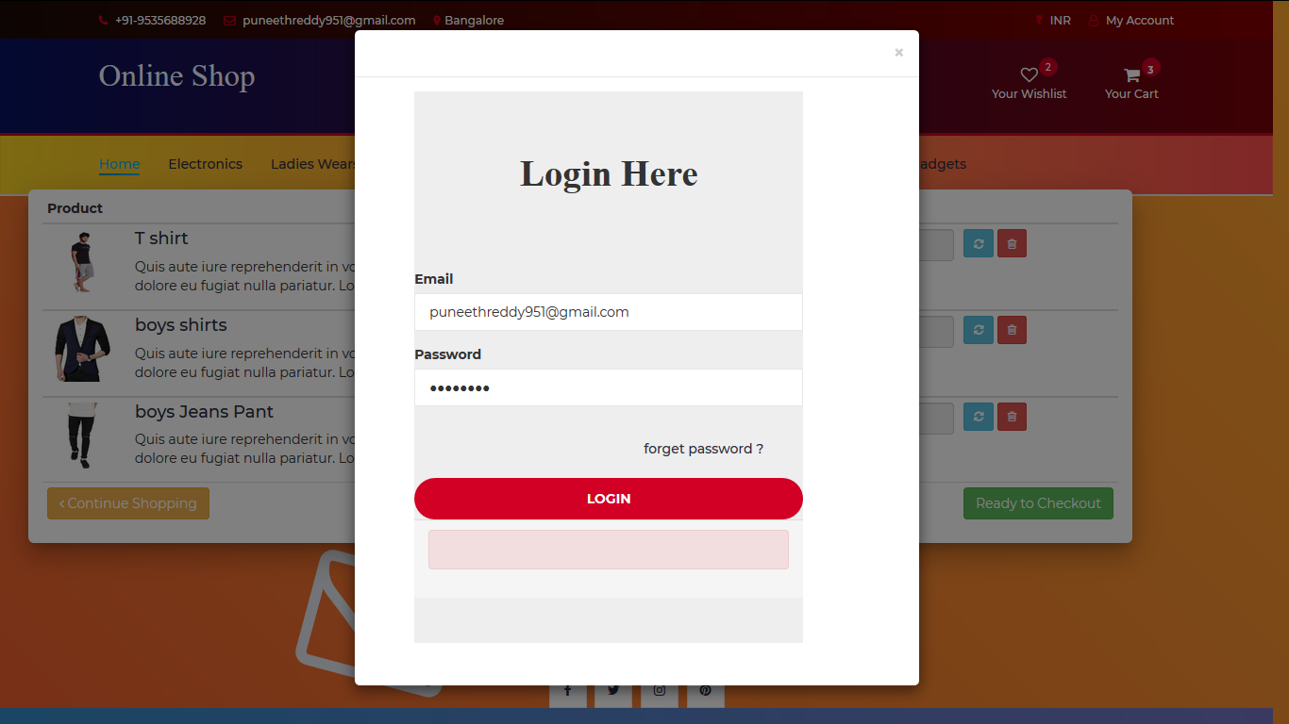

Slide 17
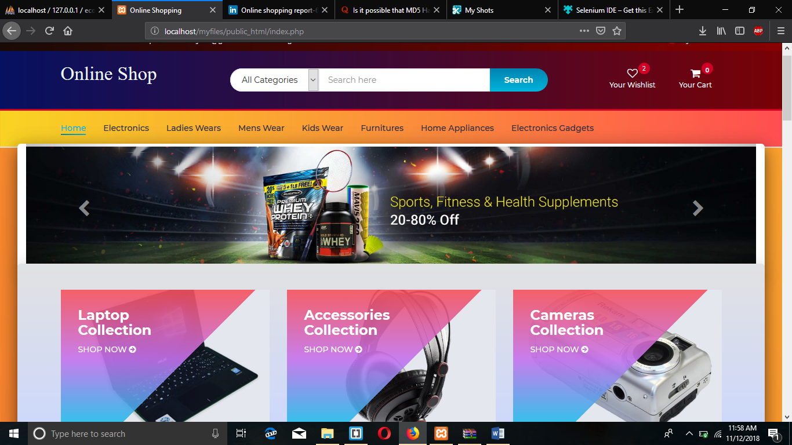

Slide 18
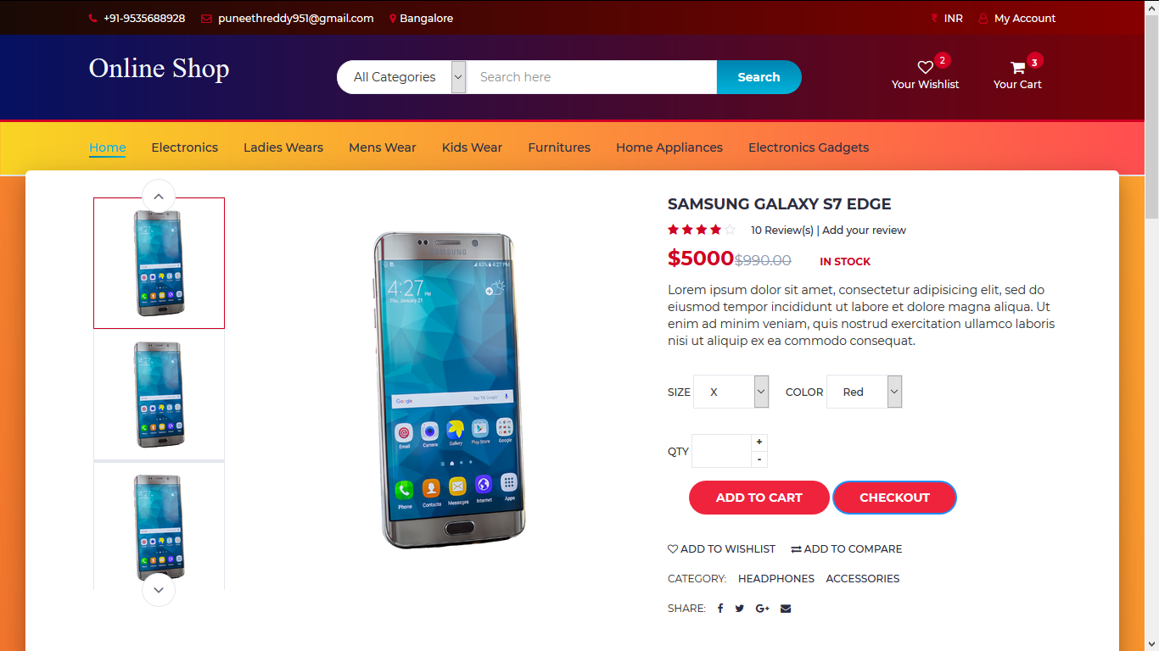

Slide 19
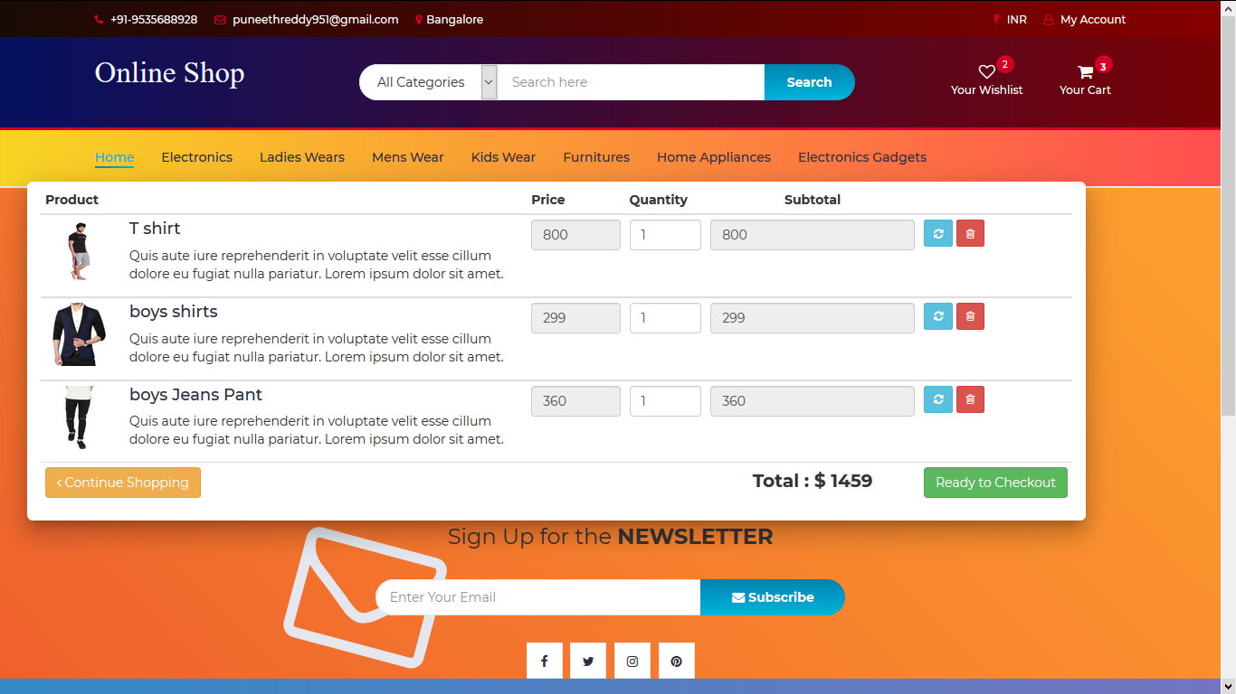

Slide 20
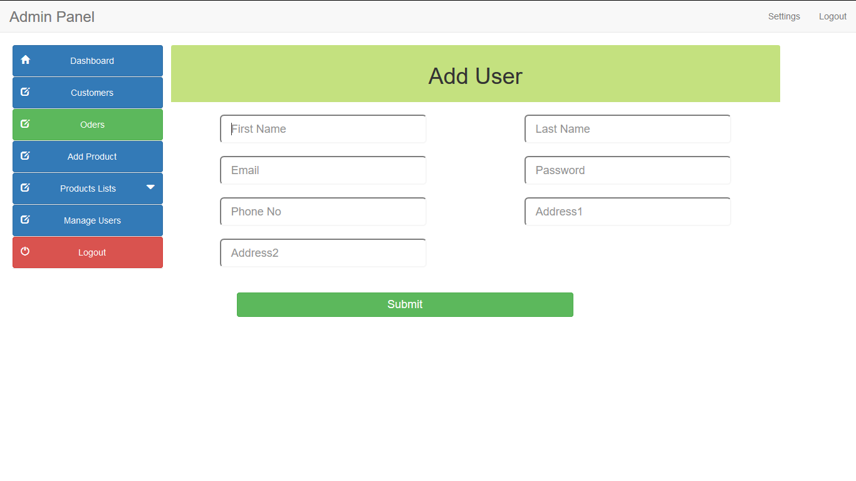

Slide 21
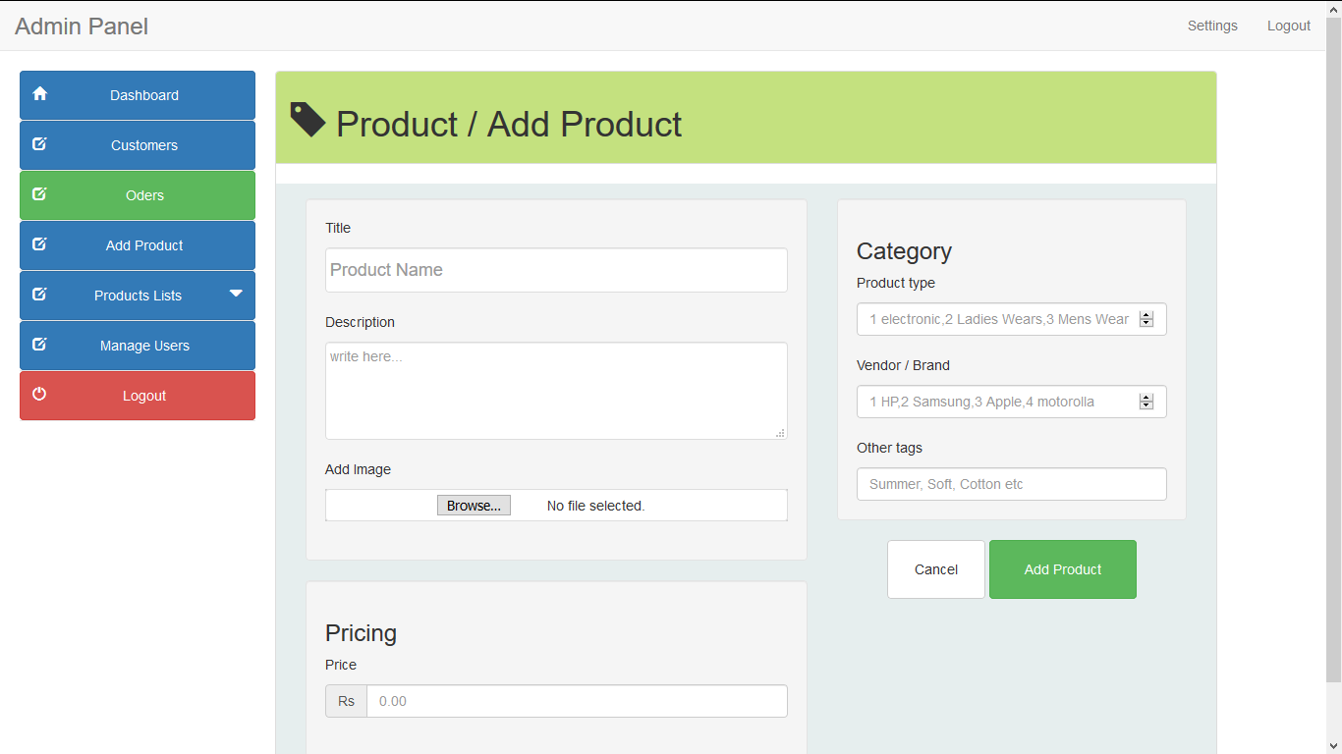

Slide 22
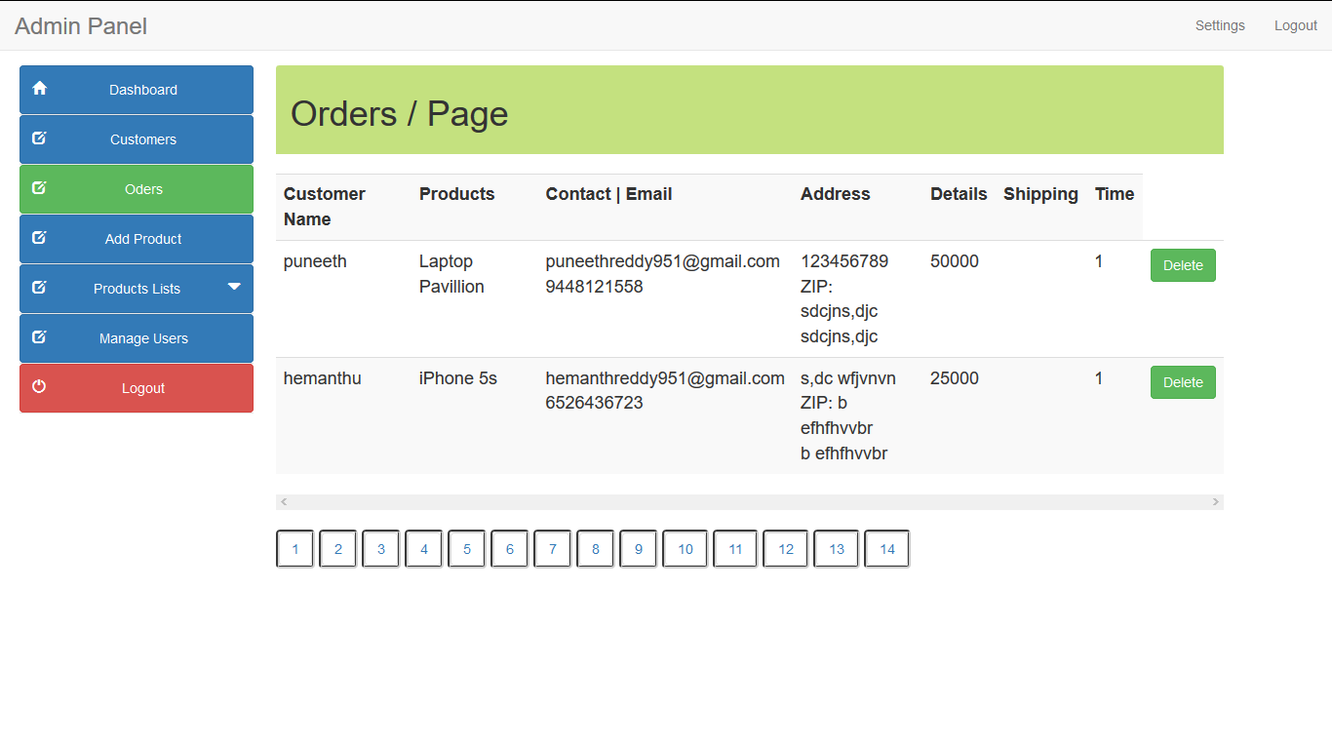

Slide 23
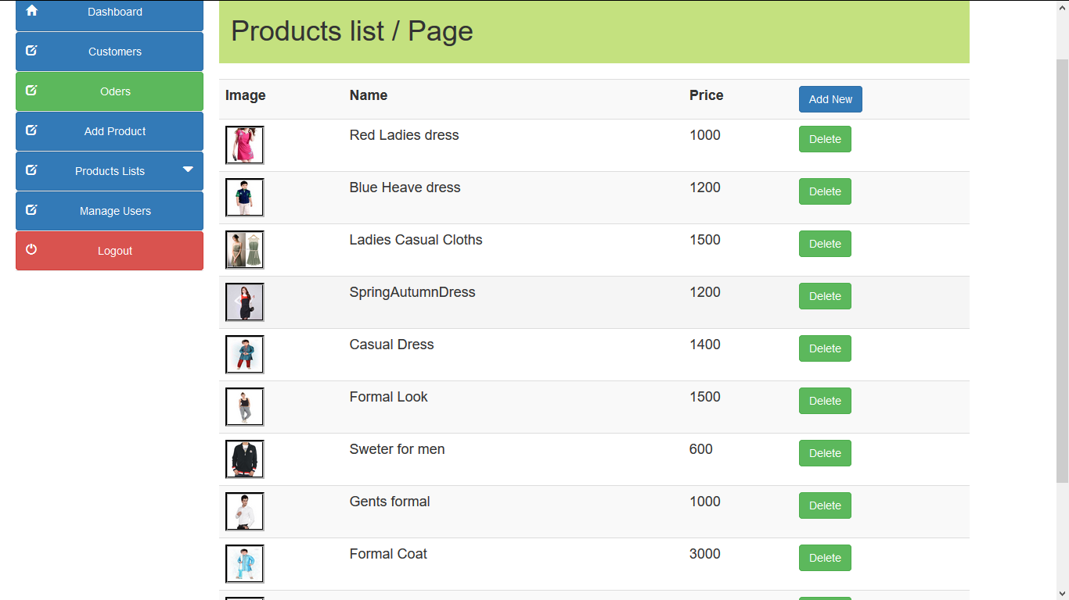

Slide 24
Advantage of Online Shopping Portal: 1.This online program will take less time and gives better results. 2.It reduces the tedious jobs Like (Redundant work, long procedures, Up to Date Information). 3.It will improve the online shopping system, since all the information is available whenever required. 4.It provides quick processing thus helps in transaction and updating in Edit personal view can perform in few seconds. 5.It provides accurate Output. 6.It gives fast answer of queries. 7.The amount of paper work is reduced. 8.Better Control.

Slide 25
Thank you!!!

