Slide 1

Machine Learning - CA IV
Daily Coal Stocks in Indian Thermal Power Stations
Pranita Dadhe
Sem: VII C
PRN: 22070521099
Under the guidance of
Dr. Piyush Chauhan
Symbiosis Institute of Technology, Nagpur Campus

Slide 2

Problem Statement
Coal is the primary source of fuel for India’s thermal power plants, contributing significantly to national electricity generation.
The sector often faces irregular coal supply and transportation bottlenecks, leading to fluctuations in coal availability.
These challenges result in critical or super-critical stock levels, affecting power generation and energy security.
There is a need to analyze daily coal stock data to uncover trends, patterns, and influencing factors.
The study aims to identify critical plants and predict future coal stock levels using data analytics and machine learning.
Insights from the analysis can help optimize coal distribution, prevent shortages, and support sustainable energy management.

Slide 3
Objective
To study coal availability and consumption trends across different thermal power plants in India.
To identify plants operating under critical or super-critical coal stock levels.
To analyze the impact of factors such as sector type (Central, State, Private) and mode of transport on coal stock management.
To develop a predictive model using Machine Learning for forecasting daily coal stock levels.
To support data-driven decision-making and enhance coal supply management efficiency for uninterrupted power generation.

Slide 4

Dataset Overview
Dataset Overview
Source: India Data Portal (https://indiadataportal.com/p/power/r/mop-coal_stock-pl-dl-aaa )
Dataset Name: Daily Coal Stocks in Indian Thermal Power Stations
Records: 3,62,035 rows
Columns: 22 attributes (15 retained after cleaning)
Data Types: Dates, floats, categorical, integers
Initial Missing Values: Found in columns like daily_receipt, remarks, is_critical

Slide 5
Tools & Libraries Used
python – Core programming language
Jupyter Notebook – For analysis and visualization
Libraries:
pandas, numpy – Data cleaning and processing
matplotlib, seaborn – Data visualization (EDA & results)
scikit-learn – Machine Learning (Regression, Clustering)
prophet – Time series forecasting
tensorflow / keras – Deep Learning (LSTM model)
Environment: Anaconda

Slide 6
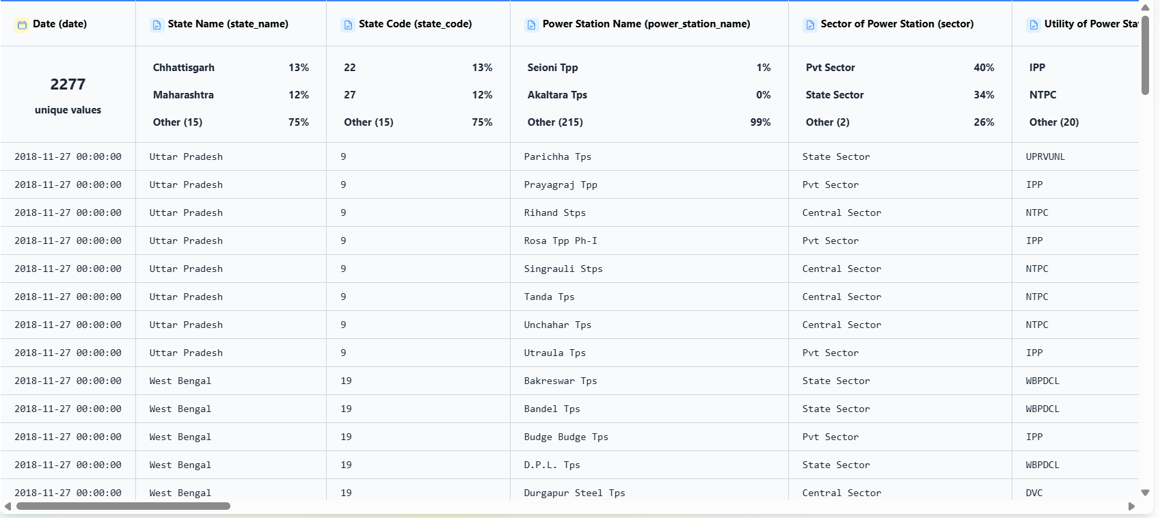
Dataset Overview

Slide 7
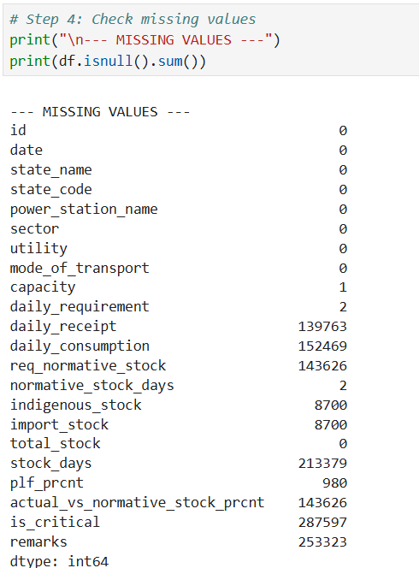
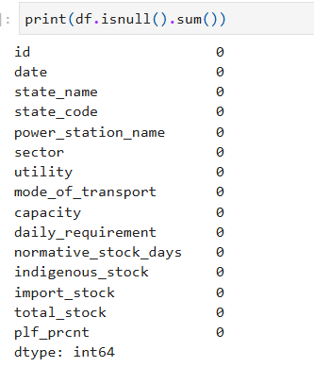

Data Preprocessing
Handled missing values using median imputation.
Dropped columns with >30% null values.
Converted date to datetime format.
Removed duplicates and sorted data chronologically.
Final Clean Dataset: 362,035 × 15 columns

Slide 8
Exploratory Data Analysis (EDA)
Categorical Analysis:
Most plants in Chhattisgarh, Maharashtra, Uttar Pradesh.
Rail transport dominates (≈72%) followed by Pithead and Road.
Private sector has the highest number of plants.
Numerical Analysis:
Normative Stock Days: Cluster around 15–30 days.
PLF: Two groups – idle (0%) and active (40–80%).
Total Stock: Varies widely across plants – multiple outliers found.

Slide 9
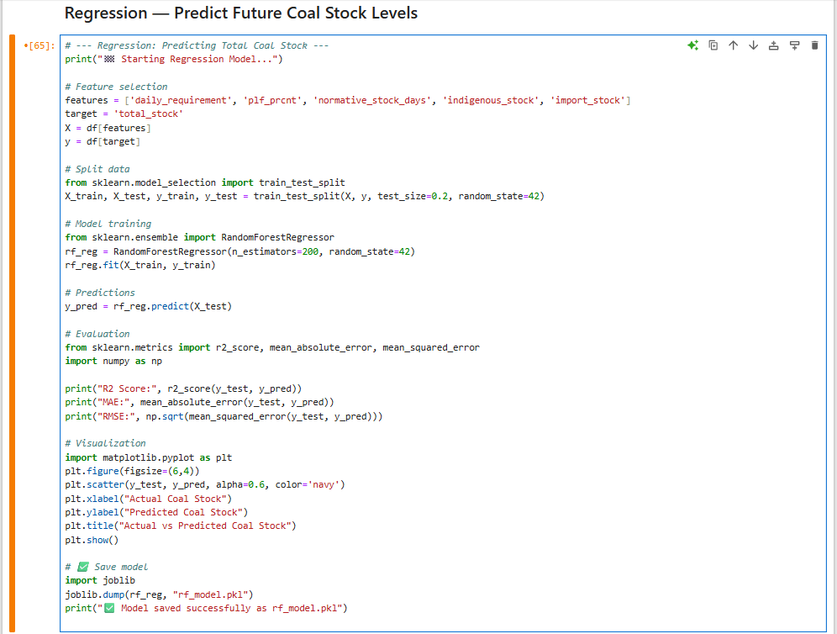
Machine Learning Approach
Goal: Predict total coal stock (total_stock) using operational parameters.
Algorithm Used:
Random Forest Regressor – chosen for high accuracy and robustness
Features:
daily_requirement, plf_prcnt, normative_stock_days, indigenous_stock, import_stock
Performance Metrics:
✅ Model achieved excellent predictive accuracy, capable of forecasting stock with minimal error.
Metric | Score
R² | 0.9996
MAE | 0.55
RMSE | 4.42

Slide 10
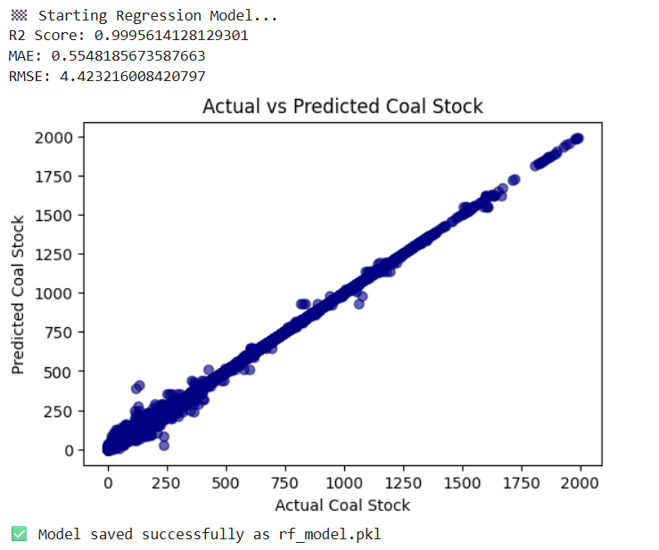
Machine Learning Approach
The Random Forest Regression model accurately predicts total coal stock with an R² score of 0.9995, showing excellent alignment between actual and predicted values.

Slide 11
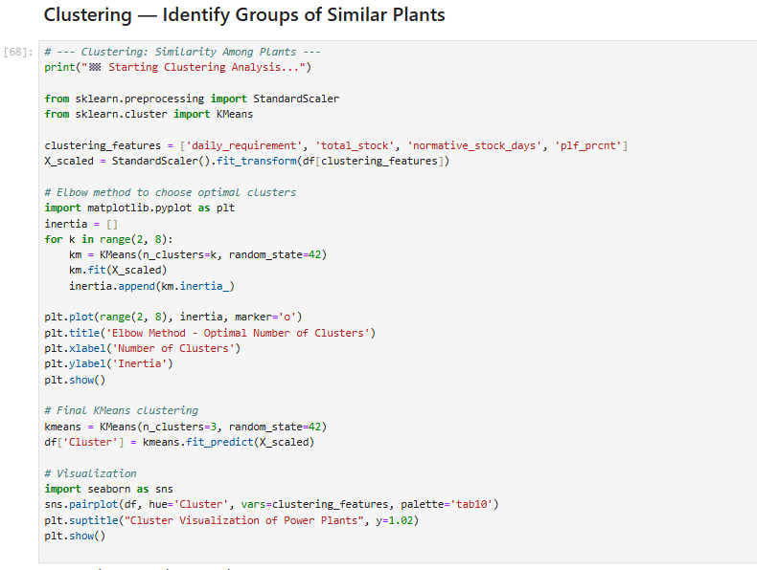
Clustering Analysis
Algorithm: K-Means (k = 3)
Features Used:
daily_requirement, total_stock, normative_stock_days, plf_prcnt
Cluster Insights:
Cluster 0: High capacity & stable stock → Healthy Plants
Cluster 1: Moderate stock & fluctuating needs → At-Risk Plants
Cluster 2: Low PLF & low stock → Critical Plants

Slide 12
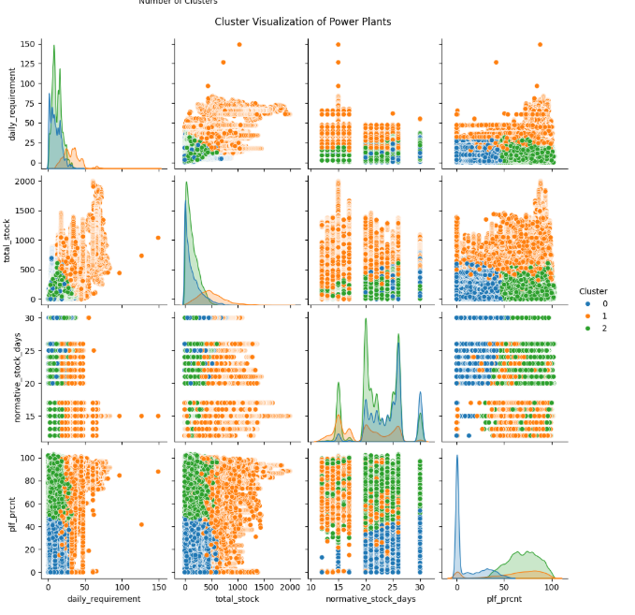
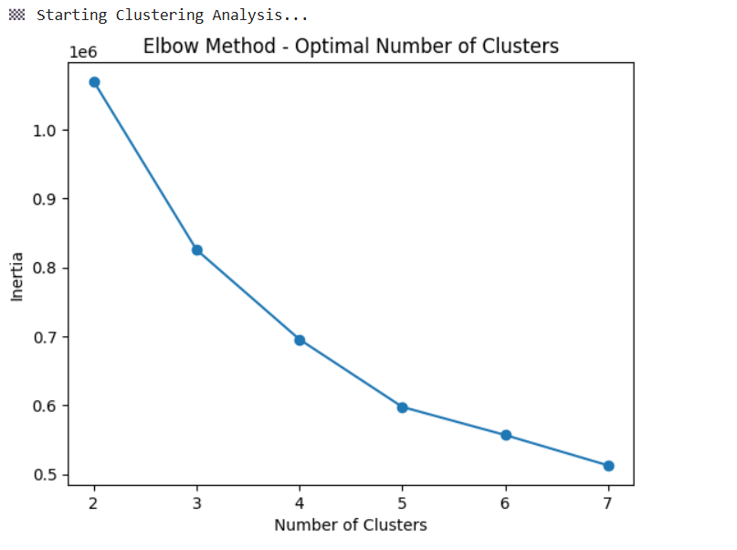
Clustering Analysis
This graph uses the Elbow Method to find the optimal number of clusters for K-Means, showing that k = 3 gives the best balance between model simplicity and performance.
This image is a pairplot visualization showing the cluster distribution of power plants after applying the K-Means algorithm (k=3).

Slide 13
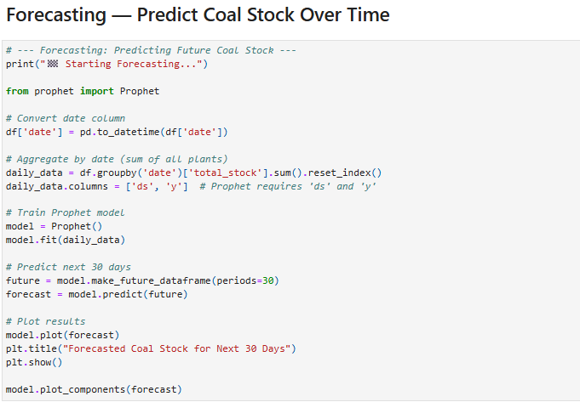
Forecasting: Prophet Model
Goal: Predict future coal stock levels for the next 30 days.
Model Used: Facebook Prophet (Time-Series Forecasting)
Process:
Aggregated daily total stock (date, total_stock).
Trained Prophet model and generated 30-day forecast.
Key Output:
Clear upward/downward trend in coal stock.
Components plot shows seasonal and weekly variations.
Insight: Helps in anticipating shortages and improving supply planning.

Slide 14
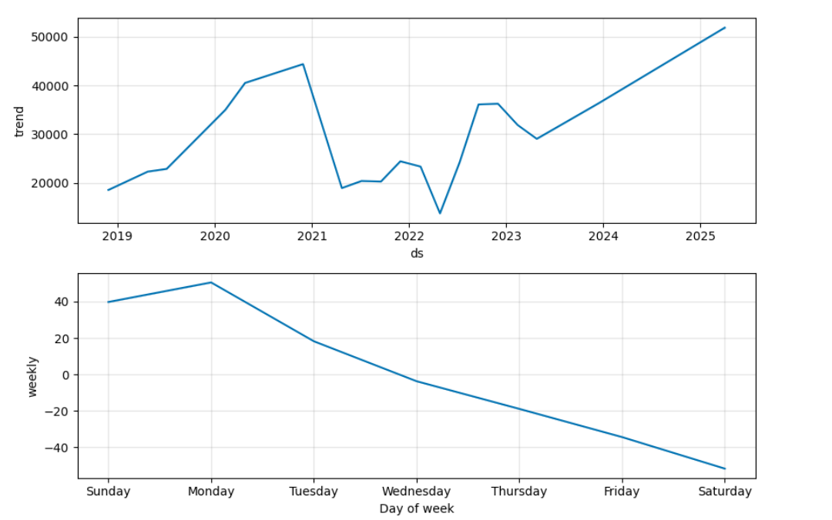
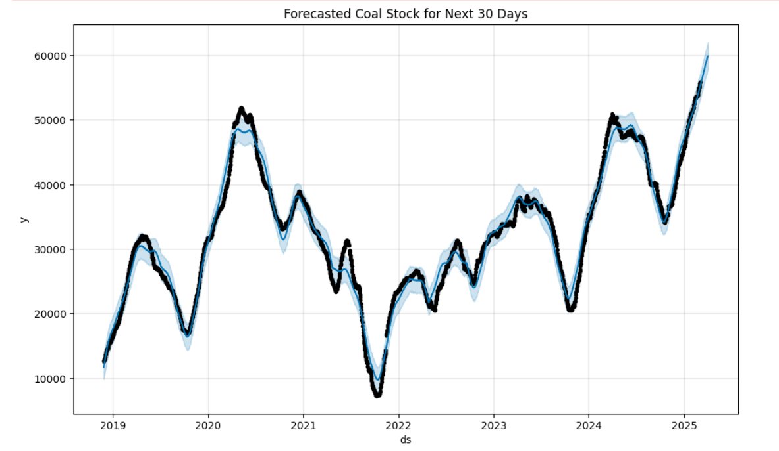
Forecasting: Prophet Model
The graph shows the forecasted coal stock levels for the next 30 days, indicating an expected upward trend in overall coal availability.
The graph shows the trend and weekly seasonality of coal stock — overall stock levels are rising over time, with higher stocks typically observed early in the week and declining toward the weekend.

Slide 15
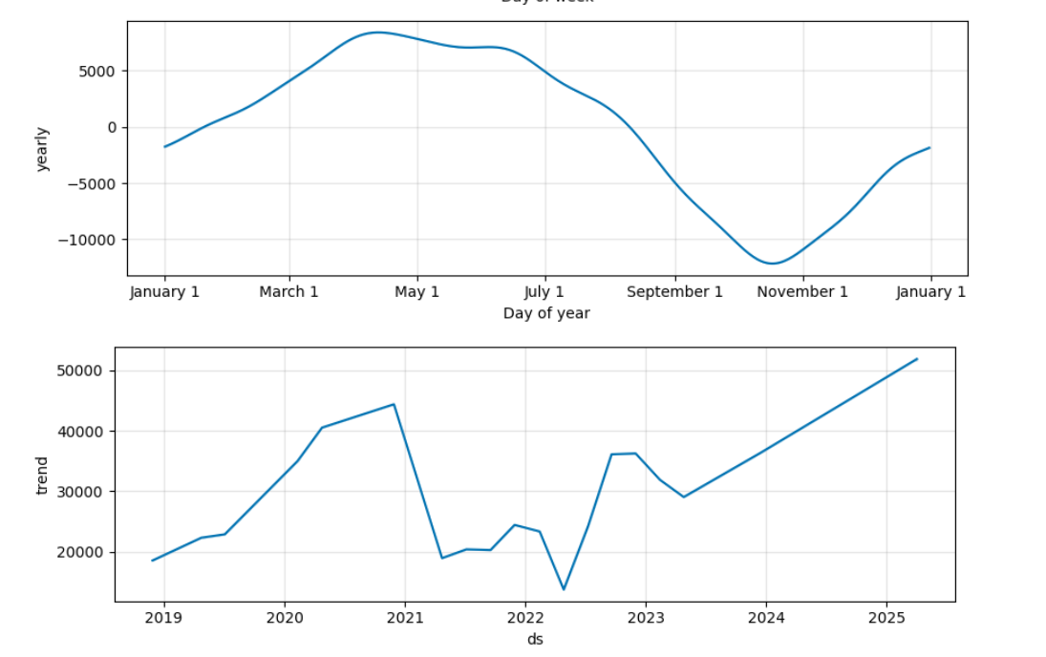
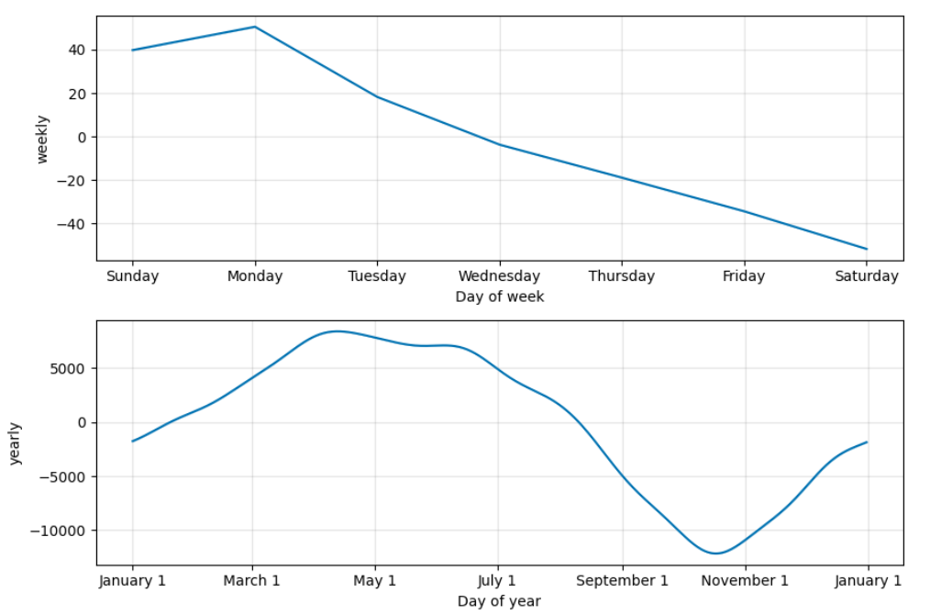
This graph shows yearly and overall trend components — coal stock levels typically rise around mid-year and dip toward the end of the year, indicating seasonal demand and supply variation
This chart shows weekly and yearly seasonal trends — coal stock levels peak around March–May and decline toward October–November, while Monday shows the highest weekly stock levels and Saturday the lowest.

Slide 16
Conclusion
The project successfully analyzed coal stock patterns and optimized predictions using Machine Learning.
Regression (Random Forest) achieved excellent performance with R² = 0.9995, accurately forecasting total coal stock.
Clustering analysis helped identify different categories of power plants based on operational and stock parameters.
Deep Learning models (LSTM, CNN) were explored but showed limited improvement, highlighting the adequacy of traditional ML models for this dataset.
The developed model can support better coal management, planning, and decision-making in power generation.

Slide 17
References & Acknowledgment
Dataset Source: India Data Portal
Tools Used: Python, Scikit-learn, TensorFlow, Seaborn
Guidance: Dr. Piyush Chauhan
Institution: Symbiosis Institute of Technology, Nagpur
Project By: Pranita Dadhe

Slide 18
THANK YOU:0

