Slide 1
Diabetes Risk Prediction using data-driven decision support through integrated visualization and predictive analytics
Phase 1: Problem Definition & Phase 2: Data Collection
Project Scope
Phases Covered
A rigorous, data-driven academic investigation into diabetes risk stratification using predictive analytics and interactive clinical visualization tools.
01
Phase 1 — Problem Definition
Research questions, objectives, and clinical context
02
Phase 2 — Data Collection
Dataset sourcing, variable selection, and structural overview

Slide 2

PHASE 1 — PROBLEM DEFINITION
Problem Statement & Objectives
The Problem
Primary Objective
Diabetes management in telemedicine settings lacks integrated, data-driven decision support. Clinicians need real-time, evidence-based tools that combine predictive analytics with actionable visualization to identify high-risk patients before complications arise.
Without such infrastructure, telemedicine platforms cannot deliver the precision care required at population scale.
Build a robust predictive model capable of stratifying diabetes risk across patient populations, and deploy an interactive clinical dashboard that translates model outputs into decision support for healthcare providers.
Dual Deliverables
Predictive Model
Interactive Dashboard
Identify high-risk patients using validated health indicators
Visualize risk predictions and factor relationships for clinical use

Slide 3
PHASE 1 — RESEARCH DESIGN
Research Questions
Four targeted research questions anchor the analytical framework, each mapping to a distinct clinical risk dimension and corresponding data variable.
1
Age & Prevalence
2
BMI & Risk Elevation
Which age groups carry the highest diabetes prevalence? Age-stratified analysis will reveal demographic risk concentration and inform targeted screening priorities.
Does high BMI significantly increase diabetes risk? Regression analysis across BMI categories will quantify the magnitude of this relationship within the dataset.
3
Hypertension & Cholesterol
4
Physical Activity as a Protective Factor
How are hypertension and elevated cholesterol co-associated with diabetes diagnosis? Correlation matrices will surface multivariate relationships among these comorbidities.
Does physical activity reduce diabetes prevalence? Comparative analysis will assess whether activity levels act as a statistically significant protective variable in the population.

Slide 4
PHASE 2 — DATA COLLECTION
Data Source & Dataset Overview
Dataset at a Glance
Source: Diabetes Health Indicators Dataset
250K
A large-scale, structured public health dataset providing comprehensive patient-level records suitable for binary classification modeling and population-level risk stratification.
Records
Variable Schema
Total patient observations in the dataset
Variable
Type
Role
6
Age
Demographic / Categorical
Predictor
BMI
Continuous / Numeric
Predictor
Key Variables
Blood Pressure
Continuous / Numeric
Predictor
Core health indicators selected for analysis
Cholesterol
Continuous / Numeric
Predictor
2
Glucose Level
Continuous / Numeric
Predictor
Physical Activity
Ordinal / Categorical
Predictor
Target Classes
Diabetes Diagnosis
Binary (Yes / No)
Target
Binary outcome: Diabetes Yes / No

Slide 5
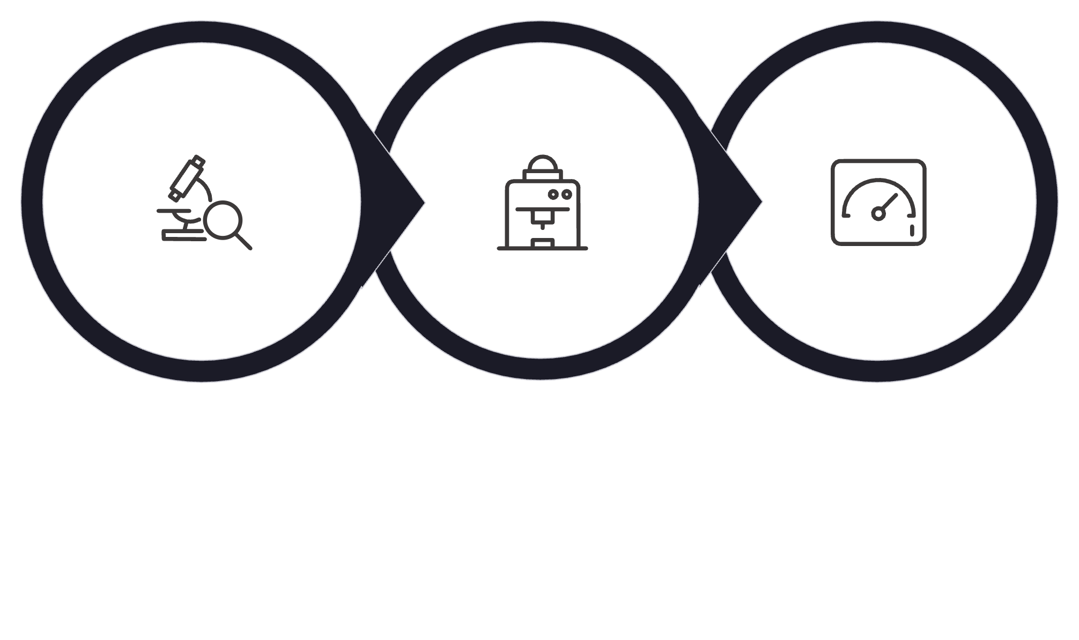

ANALYTICS FRAMEWORK
Analytics & Visualization Strategy
The project follows a three-stage analytics pipeline — from raw data exploration through predictive modeling to interactive clinical deployment — each stage building directly on the last.
Exploratory EDA
Predictive Model
Interactive Dashboard
Exploratory Data Analysis
Predictive Modeling
Interactive Dashboard
Statistical summaries and distribution analysis will characterize each of the six predictor variables. Correlation matrices will surface relationships between risk factors — particularly between BMI, cholesterol, blood pressure, and the diabetes outcome — establishing the empirical foundation for model development.
Supervised classification algorithms will be trained on the 250,000-record dataset to stratify diabetes risk. Model performance will be evaluated using standard metrics including accuracy, sensitivity, and specificity to ensure clinical reliability across patient populations.
A real-time decision support dashboard will translate model outputs into clinically actionable visualizations — displaying risk predictions, factor relationships, and population-level insights to empower telemedicine providers with evidence-based guidance at the point of care.
Core Theme: Data analytics and visualization are not secondary outputs — they are the primary methodology driving clinical value in this project.

Slide 6




VALUE PROPOSITION
Differentiating Factors: Our Unique Approach
Our interactive dashboard is specifically designed to overcome the limitations of existing solutions, offering a more integrated, interpretable, and actionable decision support system.
Dynamic, Real-time Risk Scoring
Explainable AI for Clinicians
Actionable Intervention Pathways
Leveraging live data streams to provide continually updated, individualized diabetes risk assessments, adapting to changes in patient health status instantly.
Each risk prediction is accompanied by transparent insights into contributing factors, allowing providers to understand *why* a risk is elevated, fostering trust and informed decisions.
Beyond identifying risk, the dashboard integrates directly with clinical guidelines, suggesting personalized intervention strategies and next steps tailored to each patient's profile.

