Slide 1
CMPE 255 · SHORT STORY ASSIGNMENT
AT A GLANCE
Deep Learning Advancements in Anomaly Detection
180+
studies reviewed
mostly 2019–2024
3
families of methods
reconstruction · prediction · hybrid
A Comprehensive Survey — Huang et al., arXiv:2503.13195v1, March 2025
99.4%
FastFlow AUC
MVTec AD, industrial defects
AUTHOR
Pranith Varma Pakalapati
> 0.90
UNIVERSITY
San Jose State University
Chest CT AUROC
18 abnormalities
PAPER
arXiv:2503.13195v1 · March 2025
Huang et al. (2025)
IEEE Internet of Things Journal
A survey of deep learning for anomaly detection — what works, and why.
Notes:
Hello, my name is Pranith Varma, and this is my short story for CMPE 255, on Deep Learning Advancements in Anomaly Detection, a comprehensive survey by Haoqi Huang and colleagues, published on arXiv in March 2025.
[Pause]
In the next seventeen minutes, I am going to do three things. First, I will explain what anomaly detection is, and why the rare events in a dataset are usually the ones that matter most. Second, I will walk you through the survey's map of the field — reconstruction methods, prediction methods, and the hybrid ideas that combine deep learning with traditional data mining. And third, I will give you my own reading: what actually works, what the numbers do and do not prove, and what I would test first if I had to build one of these systems tomorrow.
Everything I cite comes from the survey itself. Where a number comes from a different dataset, I will say so, because that distinction is half the story.

Slide 2
01 FOUNDATIONS
02 / 18
Roadmap
Five parts — the one slide to remember is the map (slide 9)
1
2
3
4
5
Foundations
Data
Applications
Methods
Evidence & outlook
Slides 3–5
Slides 6–7
Slide 8
Slides 9–14
Slides 15–18
Foundations
Data
Applications
Methods
Evidence & outlook
Slides 3–5
Slides 6–7
Slide 8
Slides 9–14
Slides 15–18
What an anomaly is, why it matters, and the paper at a glance.
Data types, anomaly types, and the data problems that make this hard.
Where it is used: traffic, power grids, healthcare, finance, cyber.
Reconstruction, prediction and hybrids — in depth, with trade-offs.
Results, ablations, open issues and the conclusion.
Pranith Varma Pakalapati · SJSU · Huang et al., arXiv:2503.13195v1 (2025)
02 / 18
Notes:
Here is the roadmap, so you always know where we are. We start with the definition and the stakes — what an anomaly is, and why it matters. Then the paper at a glance: who wrote it, what it covers, and why it is a useful survey rather than just a long list of papers.
Then the foundations: the kinds of data and the kinds of anomalies, and the data problems that make this task hard. After that, the applications — traffic, power grids, healthcare, finance, cybersecurity, medical imaging. Then the core of the talk: the three families of methods. Then results, ablations and trade-offs, open issues, and a short conclusion.
[Point] If you remember only one slide, remember slide 9, the big map. Everything else in the talk hangs off it.

Slide 3
01 FOUNDATIONS
03 / 18
What is an anomaly?
A rare observation — with outsized consequences
1
Definition
2
Rare, but critical
An observation that deviates significantly from expected behaviour in a system. The survey's starting point, Section I.
Usually a tiny fraction of the data — often under 1% — yet frequently the most important part of it.
3
Examples
4
Output = a decision
One fraud in a million transactions · one drifting sensor · one lesion on a scan · one attack in a log file.
Investigate this, stop this, fix this now. Accuracy without action in time is a failure.
5
Why it is hard
6
Key point
Normal behaviour is broad and shifting, so 'different' is not the same as 'wrong' — context decides.
This is not classification for its own sake. The model exists to trigger a decision, in time.
Pranith Varma Pakalapati · SJSU · Huang et al., arXiv:2503.13195v1 (2025)
03 / 18
Notes:
Start with the definition. An anomaly is an observation that deviates significantly from what a system expects. It is usually a tiny fraction of the data — often less than one percent — but it is frequently the most important part.
Think of the examples on this slide. A single fraudulent transaction in a million legitimate ones. A sensor reading that quietly drifts away from normal in a factory. A lesion on a scan that looks almost, but not quite, like healthy tissue. A cyberattack hidden in a log file full of ordinary traffic.
The survey puts it simply: anomaly detection is the process of finding those observations, so that a decision maker can act before the failure, the fraud, or the breach gets worse.
[Pause]
And that is the first thing to notice. This is not classification for its own sake. The output is a decision: investigate this, stop this, fix this now. If your model is accurate but nobody can act on its output in time, it has failed at the job it was built for.

Slide 4
01 FOUNDATIONS
04 / 18
Why it matters: the stakes
Missing it costs far more than a false alarm — until false alarms cost trust
1
Cost of missing
2
Cost of false alarms
A missed anomaly can mean a factory shutdown, a fraud loss, a delayed diagnosis, or a cyberattack.
A thousand false flags and the team stops trusting the system — then the real alerts get ignored too.
3
The metric tension
4
Why now
That trade-off runs through the whole survey, and it is why the choice of metric matters so much.
IoT put sensors everywhere: massive, high-dimensional, noisy, streaming data. Old methods broke on it.
5
Data got harder
6
What changed
Images, video, logs, vital signs — not small clean tables. Traditional methods assumed the opposite.
Deep learning learns representations directly from that data, instead of relying on hand-crafted features.
Pranith Varma Pakalapati · SJSU · Huang et al., arXiv:2503.13195v1 (2025)
04 / 18
Notes:
Why does this deserve a whole survey? Because the cost of missing an anomaly is asymmetric. Missing a normal event costs you almost nothing. Missing an anomaly can cost a factory a shutdown, a bank a fraud loss, a hospital a delayed diagnosis, or a power grid a cyberattack.
At the same time, false alarms are expensive too. If a system flags a thousand normal transactions as fraud, the fraud team stops trusting it, and the real alerts get ignored. That tension — between missing the rare event and crying wolf — runs through the entire survey, and it is why the choice of metric matters so much. We will come back to that on slide 15.
[Pause]
There is a second reason this field is moving fast. The data got harder. The Internet of Things put sensors everywhere, so we now have massive, high-dimensional, noisy, streaming data — images, video, logs, vital signs — and the traditional methods that worked on small, clean, tabular data started to break. That is the gap deep learning stepped into.

Slide 5
01 FOUNDATIONS
05 / 18
The paper at a glance
A survey, not a single model — and that is its strength
1
180+ studies
2
Authors
Mostly 2019–2024. Earlier surveys mostly stopped around 2020 and missed the newer models entirely.
Huang & Wang (York University) · Pei (HUST) · Wang & Niyato (NTU Singapore) · Alexanian (York).
3
Venues
4
Gap it fills
IEEE, ACM, Springer, Elsevier journals · AAAI, CCS, ICCV conferences — top-tier sources throughout.
New GAN variants — conditional, cycle-consistent, GAN + VAE — and hybrid models older surveys missed.
5
Contribution
6
My focus
Organisation: a taxonomy, structured comparison tables, and a full section on hybrid methods.
The gist, the architecture, the ablations and the metrics — not the maths in depth.
Pranith Varma Pakalapati · SJSU · Huang et al., arXiv:2503.13195v1 (2025)
05 / 18
Notes:
So what is this paper? It is a survey, not a single new model — and that is a strength, not a weakness. The authors are Haoqi Huang and Ping Wang from York University, Jianhua Pei from Huazhong University of Science and Technology, Jiacheng Wang and Dusit Niyato from Nanyang Technological University, and Shahen Alexanian, also from York.
They review over 180 recent studies, mostly from 2019 to 2024, from IEEE, ACM, Springer and Elsevier journals, and from top conferences like AAAI, CCS and ICCV. Earlier surveys, they argue, mostly stopped around 2020, and they missed the newer GAN variants and the hybrid models. This survey covers that gap.
Their contribution is organisation. They sort deep learning anomaly detection into reconstruction-based and prediction-based methods, compare them in structured tables, and then show how traditional methods — clustering, normalising flows, and support vector data description — can be combined with deep learning. My focus in this talk is the gist, the architecture, the ablations and the metrics, not the maths in depth.

Slide 6
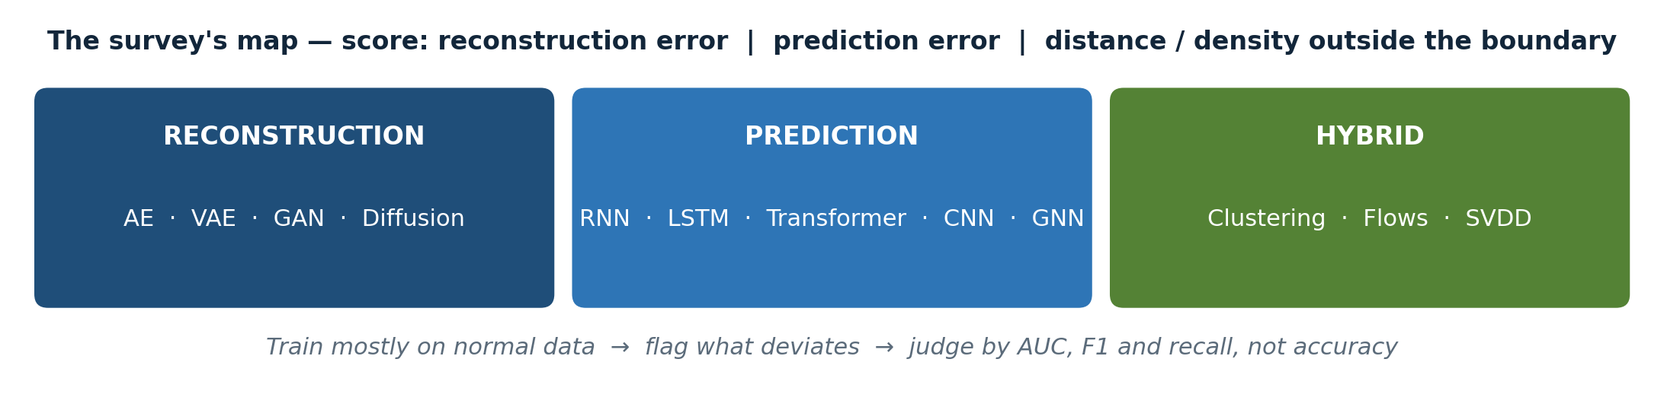
02 DATA
06 / 18
Data types & anomaly types
Name the data and the anomaly — before you pick a model
1
Text & audio
2
Image & video
3
Time-series
Text: incoherent word sequences, missing words in logs. Audio: distortion, frequency shifts, missing segments.
Image: spatial defects, lesions. Video adds time: unusual movement, scene changes, motion inconsistency.
Order matters. Point: one strange value. Sequence: a strange stretch. Group: a strange cluster together.
Checklist before any code: data type, anomaly type, then model — in that order.
Pranith Varma Pakalapati · SJSU · Huang et al., arXiv:2503.13195v1 (2025)
06 / 18
Notes:
Before any model, the survey asks what kind of data you have, because that decides everything else. Text, audio, image, video and tabular data all behave differently. A text anomaly might be an incoherent word sequence in a system log, or a missing word. An audio anomaly might be a distortion or a frequency shift. An image anomaly is spatial — a defect, a lesion. Video adds time, so the anomaly becomes an unusual movement or a scene change.
Then there is a second split: time-series versus non-temporal data. In a time series, order matters. So you get point anomalies — a single strange value; sequence anomalies — a strange stretch of values; and cluster or group anomalies — a strange group of points together. In non-temporal data, observations are treated as independent, so you are looking for points or groups that simply do not belong.
[Point] The lesson is practical, and I want to underline it: if you pick a model before you name your data type and your anomaly type, you have already made your first mistake. The taxonomy on this slide is the checklist I would use before writing any code.

Slide 7
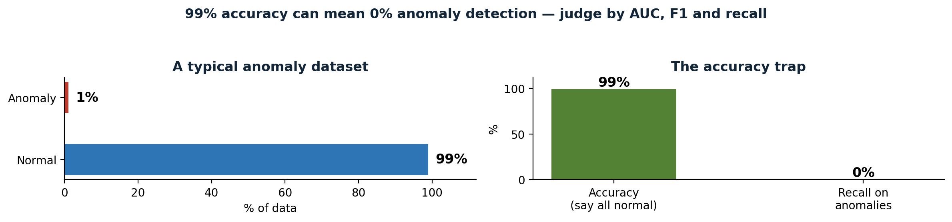
02 DATA
07 / 18
Why the data makes this hard
Real projects fail on data, not on architecture
1
Dimensionality
2
Class imbalance
3
Noise & missing data
Curse of dimensionality: distances stop meaning much, so the model must learn a lower-dimensional representation itself.
Anomalies are rare, so high accuracy can hide terrible recall. Judge by AUC, F1 and recall, not accuracy.
Noisy training data teaches an autoencoder to reconstruct the noise. Sensor data is also sparse and missing.
If accuracy is your only metric on imbalanced data, your model can be 99% right and 100% useless.
Pranith Varma Pakalapati · SJSU · Huang et al., arXiv:2503.13195v1 (2025)
07 / 18
Notes:
The survey spends a whole section on data processing, and it is worth slowing down here, because these are the reasons real projects fail — not the architecture, the data.
First, dimensionality. High-dimensional data suffers from the curse of dimensionality: distances stop meaning much, everything looks equally far apart, and the model has to learn a lower-dimensional representation itself.
Second, class imbalance, shown on this slide. Anomalies are rare, so a model can get 99 percent accuracy by simply saying everything is normal, while its recall on anomalies is zero. That is why we judge these models by AUC, F1 and recall on the anomaly class, never by accuracy alone.
Third, noise. Train an autoencoder on noisy data and it learns to reconstruct the noise, not the signal. It overfits, and the real anomalies slip through. And fourth, missing and sparse values, which are common in sensor data.
The fixes the survey discusses are oversampling, synthetic data generation, and conditional GANs, which create extra minority-class examples. But the authors are honest: synthetic data may not capture the true diversity of real anomalies, and augmentation can still leave the model biased toward normal data.

Slide 8
02 APPLICATIONS
08 / 18
Where it is used
Three worlds: time-series, non-temporal, visual
1
Time-series
2
Non-temporal
Traffic monitoring with loop sensors · power grids — MENSA IDS detects cyberattacks · healthcare vitals, monitored continuously.
Finance: fraud detection, credit scoring, trading activity. Cybersecurity: intrusion detection, unauthorised access.
3
Visual
4
Proof point
Medical imaging: X-ray, brain, CT scans · video surveillance in public spaces · manufacturing defects on the line.
Chest CT: AUROC > 0.90 for 18 abnormalities — but anomalies often look like normal tissue, so subtle cases are hardest.
5
Finance in detail
6
Cybersecurity
Bank fraud, insurance fraud, financial statement fraud and cryptocurrency fraud — each a different pattern.
Early work used autoencoders, deep belief networks and RNNs; newer work adds far more sophisticated models.
Pranith Varma Pakalapati · SJSU · Huang et al., arXiv:2503.13195v1 (2025)
08 / 18
Notes:
Where does this actually get used? The survey groups applications three ways, and the range is the point.
In time-series data: traffic monitoring, where loop sensors predict volume and flag unusual patterns; power systems, where the MENSA intrusion detection system detects operational anomalies and cyberattacks in smart grids; and healthcare, where vital signs like heart rate and blood pressure are monitored continuously, so an abnormal change triggers a fast response.
In non-temporal data: finance, where fraud detection looks at individual transactions, credit scores and trading activity; and cybersecurity, where intrusion detection flags unauthorised access and malicious behaviour in networks.
And in visual data: medical imaging — X-rays, brain images, CT scans; video surveillance in public spaces; and manufacturing, where defects on a production line are caught automatically.
One number stuck with me: in chest CT volumes, a machine learning approach reported an AUROC above 0.90 for 18 different abnormalities. But note the caveat in the survey — in medical images, anomalies often look very similar to normal tissue, so the subtle cases are genuinely hard to separate.

Slide 9
03 METHODS
09 / 18
The big map: three families
Reconstruction · Prediction · Hybrid
1
Reconstruction
2
Prediction
3
Hybrid
Learn what normal looks like, rebuild the input, and flag large reconstruction error. AE · VAE · GAN · diffusion.
Learn the sequence, predict the next value, and flag large prediction error. RNN · LSTM · Transformer · CNN · GNN.
Deep features + a traditional, explainable boundary. Clustering · normalising flows · Deep SVDD.
Reconstruction: does it look normal? Prediction: does it follow? Hybrid: both, with a boundary you can explain.
Pranith Varma Pakalapati · SJSU · Huang et al., arXiv:2503.13195v1 (2025)
09 / 18
Notes:
Now the core of the survey, the map. Deep learning anomaly detection falls into three groups, and almost every paper in the survey fits somewhere in it.
Reconstruction-based methods learn what normal looks like, rebuild the input, and flag anything with a large reconstruction error. Prediction-based methods learn the sequence, predict the next value, and flag anything where the prediction is badly wrong. Hybrid methods combine the two, or combine deep learning with a traditional method.
[Point] The difference between the first two is a design choice, and it is worth stating plainly. Reconstruction asks: does this look like normal data? Prediction asks: does this follow from what came before? If your data has no time order, reconstruction is the natural fit. If it does, prediction can use that order as extra signal — but it also has to earn it, because a sequence model is heavier to run.
The next four slides walk through each family, one at a time.

Slide 10
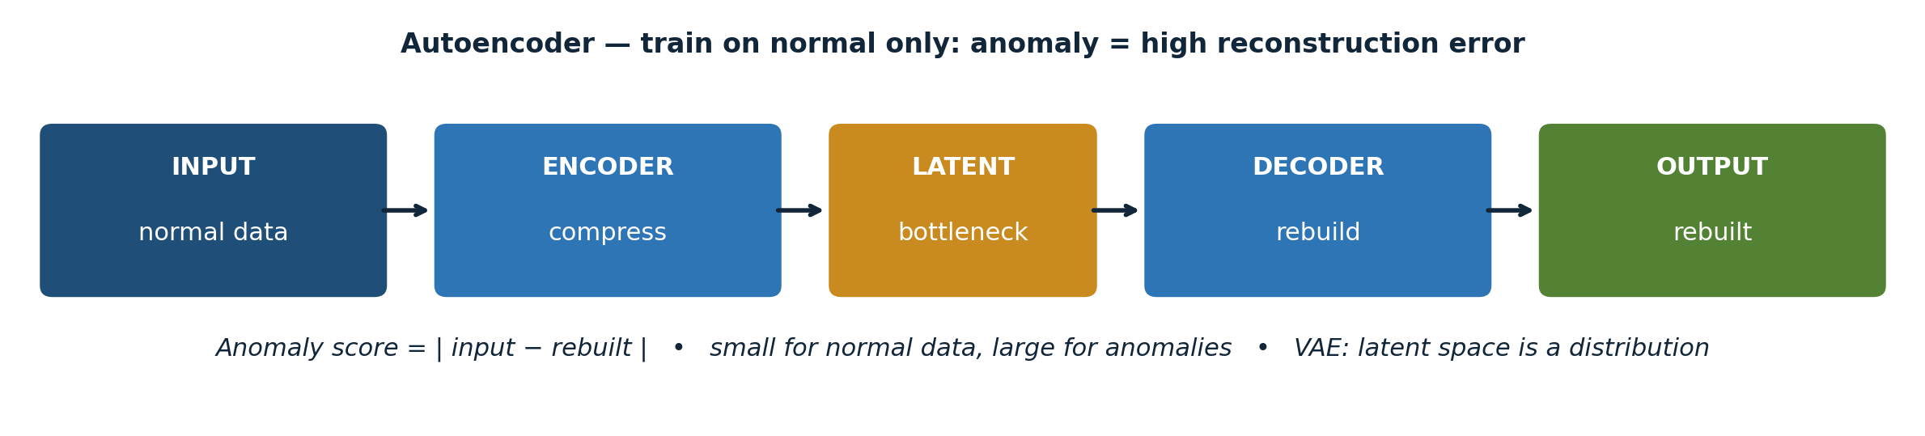
03 METHODS
10 / 18
Reconstruction 1: autoencoders & VAEs
Train on normal only — anomaly = high reconstruction error
1
Autoencoder
2
VAE
3
Strength
Compress → bottleneck → rebuild. Trained only on normal data, so an anomaly rebuilds badly and its error is high.
Latent space is a distribution (mean + variance). More principled score, and the model can generate new samples.
Works unsupervised, on high-dimensional data, with no labelled anomalies at all — the common real-world case.
Train on normal only. An anomaly is whatever rebuilds badly.
Pranith Varma Pakalapati · SJSU · Huang et al., arXiv:2503.13195v1 (2025)
10 / 18
Notes:
Reconstruction, part one. The diagram on this slide is the whole idea in one picture. An autoencoder compresses the input into a small latent representation — the bottleneck in the middle — and then tries to rebuild the original input from it. You train it only on normal data. So when an anomaly arrives, the model has never learned how to compress it, it rebuilds it badly, and its reconstruction error is high. That error is your anomaly score.
A variational autoencoder, or VAE, adds a probabilistic latent space: instead of a single point, the encoder outputs a mean and a variance, so the model learns a distribution over normal data. That gives a more principled score, and it lets the model generate new, plausible normal samples.
The strength of this family is that it works well unsupervised, on high-dimensional data, with no labelled anomalies at all. The weakness — and the survey is clear about this — is that reconstruction error alone can be fooled. If an anomaly happens to reconstruct well, the model will miss it, and you will never know from the error alone.

Slide 11
03 METHODS
11 / 18
Reconstruction 2: GANs & diffusion
More expressive — and harder to tame
1
GAN
2
New variants
Generator creates realistic normal data; discriminator judges real vs generated. Either side can signal an anomaly.
Conditional GANs, cycle-consistent GANs, GAN + VAE, GAN + self-supervised learning — missed by older surveys.
3
Diffusion
4
GAN + VAE hybrids
Learn to denoise step by step. An anomaly is a sample that does not denoise cleanly. Powerful, and the most expensive.
Combining the two covers each other's weaknesses — a recurring pattern in the survey's later papers.
5
Training cost
6
Failure mode
GANs can be unstable: generator and discriminator can fall out of balance, and tuning is fiddly.
Reconstruction error alone can be fooled — an anomaly that happens to reconstruct well is missed.
Pranith Varma Pakalapati · SJSU · Huang et al., arXiv:2503.13195v1 (2025)
11 / 18
Notes:
Reconstruction, part two: GANs and diffusion models, the newer and more powerful members of the family.
A GAN has two networks. A generator tries to create realistic normal data, and a discriminator tries to tell real data from generated data. They train against each other. Once trained, either the generator's failure to reproduce an input, or the discriminator's judgement that an input looks fake, can signal an anomaly.
The survey's coverage here is what separates it from earlier surveys. It includes conditional GANs, cycle-consistent GANs, and GANs combined with variational autoencoders or self-supervised learning — variants that older reviews missed.
Diffusion models are the newest addition. They learn to remove noise step by step, and an anomaly is a sample that does not denoise cleanly. They are powerful, but they are also the most expensive to train and to run, and GANs can be unstable — the generator and discriminator can fall out of balance. So the trade-off is clear: more expressive, but harder to tame.

Slide 12
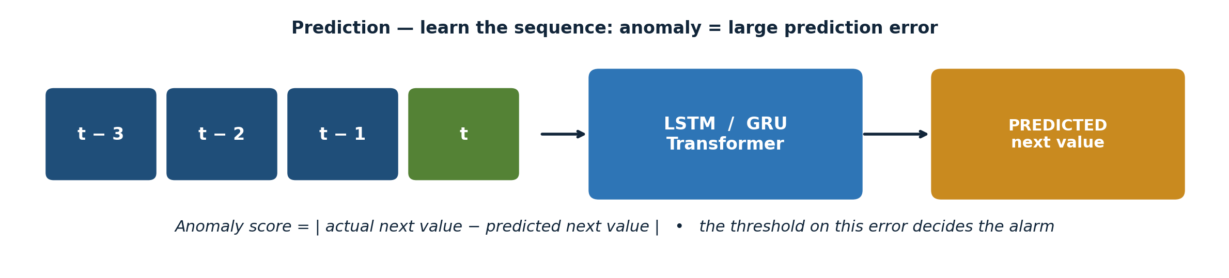
03 METHODS
12 / 18
Prediction 1: RNNs, LSTMs & Transformers
Look at the past, predict the next value, measure the surprise
1
LSTM / GRU
2
Transformer
3
Results
Hidden state remembers what came before. Gates control what to remember and forget — still the workhorse.
Attention weighs time steps directly, instead of squeezing everything through a hidden state.
F1 > 0.96 in one multimodal setting · up to +17% F1 from better inference in another study.
A good forecast is not a good anomaly score. The threshold decides.
Pranith Varma Pakalapati · SJSU · Huang et al., arXiv:2503.13195v1 (2025)
12 / 18
Notes:
Prediction, part one. These models are built for sequences, and the diagram shows the idea: look at the past, predict the next value, and measure the surprise.
Recurrent networks, LSTMs and GRUs keep a hidden state, so they remember what came before. The LSTM, with its gates controlling what to remember and what to forget, is still the workhorse for time-series anomaly detection in this survey.
Transformers replace recurrence with attention, which lets the model weigh different time steps directly, instead of squeezing everything through a hidden state. The survey reports strong results here, including an F1 score above 0.96 in one multimodal setting, and up to a 17 percent F1 improvement from better inference in another study.
[Pause]
But a good forecast is not automatically a good anomaly score. You still need a threshold on the prediction error, and thresholds are where many deployments quietly fail — set it too low and you drown in false alarms, set it too high and you miss the event you built the system to catch.

Slide 13
03 METHODS
13 / 18
Prediction 2: CNNs & graph neural networks
An anomaly can be a broken relationship, not just a strange value
1
CNN
2
GNN
Local spatial / temporal patterns — a short sensor window, an image patch. Often combined with recurrent layers.
Sensors as a graph. A sensor fine alone but suddenly disagreeing with all its neighbours is a graph anomaly.
3
Strength
4
Combinations
Temporal and relational modelling — the two things reconstruction alone cannot do.
CNN + RNN is common: local detail from the CNN, long-term context from the recurrent layer.
5
Cost
6
When not to use
Heavier to run in real time, and needs sequential or relational data to be useful at all.
Static, independent data → use reconstruction. A graph model there is overkill, slower, and harder to debug.
Pranith Varma Pakalapati · SJSU · Huang et al., arXiv:2503.13195v1 (2025)
13 / 18
Notes:
Prediction, part two: the two architectures that extend prediction beyond a single sequence.
Convolutional networks capture local spatial or temporal patterns — a short window of sensor readings, a patch of an image — and they are often combined with recurrent layers, so the model gets both local detail and long-term context.
Graph neural networks are the newest piece, and the most interesting to me. They model relationships between sensors or entities as a graph, so an anomaly can be a broken relationship, not just a strange value. A sensor that is fine on its own, but suddenly disagrees with all of its neighbours, is a graph anomaly.
The strength here is temporal and relational modelling. The weakness is the same as before: these models need sequential or relational data to be useful at all, and they are heavier to run in real time. If your data is static and independent, do not reach for a graph network — a reconstruction model will do the job better, faster, and with less to go wrong.

Slide 14
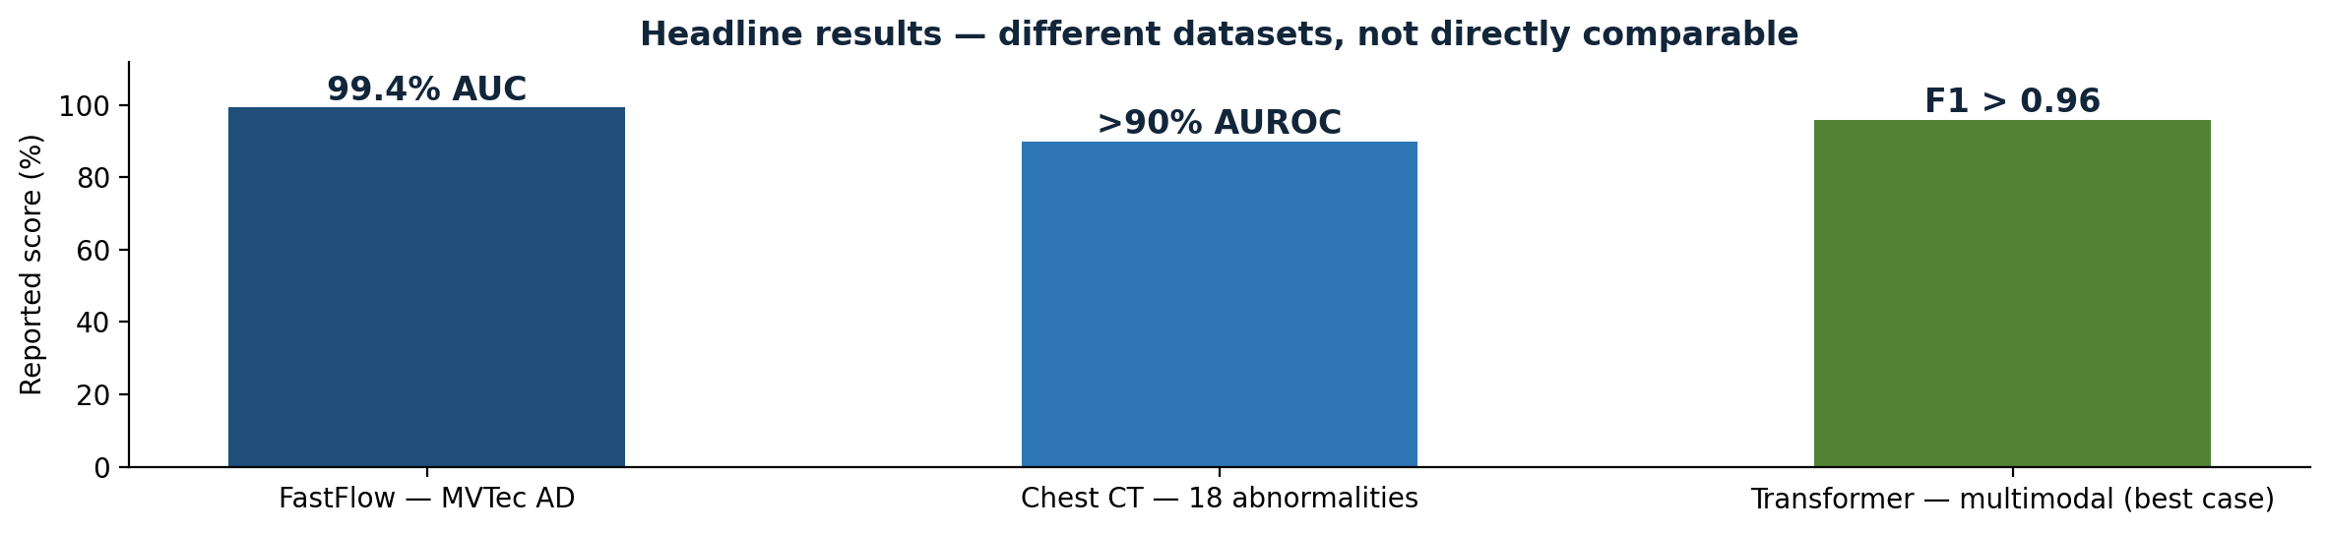
03 METHODS
14 / 18
Hybrids: old ideas, new power
Deep learning gives features — the traditional method gives a boundary
1
Clustering + deep
2
Normalising flows
3
Deep SVDD
Extract features with a network, then cluster them. Keeps clustering's interpretability, gains deep representations.
Invertible transforms estimate the exact density of normal data. Anomaly = low probability. FastFlow: 99.4% AUC, MVTec AD.
Smallest sphere around normal data in latent space; flag anything outside it. Beats AE methods on MNIST, CIFAR-10, GTSRB.
FastFlow at 99.4% AUC is the headline — because it is accurate and fast.
Pranith Varma Pakalapati · SJSU · Huang et al., arXiv:2503.13195v1 (2025)
14 / 18
Notes:
The most interesting section, in my view, is Section 5 of the survey, the hybrids — because it is where traditional data mining meets deep learning, instead of being replaced by it.
Three ideas stand out. First, clustering plus deep learning: extract features with a neural network, then cluster them, so you keep the interpretability of clustering and the representation power of deep learning. One example in the survey clusters human pose graphs extracted from video to detect abnormal actions.
Second, normalising flows: sequences of invertible transformations that estimate the exact probability density of normal data, so an anomaly is simply a low-probability event. FastFlow, a normalising flow combined with ResNet and Vision Transformer features, reached 99.4 percent AUC on the MVTec AD industrial defect dataset, while staying fast at inference.
Third, support vector data description, or SVDD: draw the smallest sphere that contains normal data in latent space, and flag anything outside it. Deep SVDD-VAE jointly optimises a VAE and an SVDD boundary, and it outperformed traditional autoencoder methods on MNIST, CIFAR-10 and GTSRB.
My take: hybrids are not a compromise, they are the point. Deep learning gives you features, the traditional method gives you a boundary you can explain.

Slide 15
04 EVIDENCE
15 / 18
What actually works: results & metrics
Headline numbers — from different datasets, so read them carefully
1
FastFlow — 99.4% AUC
2
Chest CT — AUROC > 0.90
3
Transformer — F1 > 0.96
MVTec AD, industrial defects. Headline result — and it matters because it is both accurate and efficient.
18 abnormalities. Deep methods can work where the signal is subtle and close to normal tissue.
Multimodal setting, best case reported. Prediction wins where temporal dependencies are strong.
These numbers come from different datasets. Compare methods, not headlines.
Pranith Varma Pakalapati · SJSU · Huang et al., arXiv:2503.13195v1 (2025)
15 / 18
Notes:
So what actually works, by the numbers? I want to be careful here, because these numbers come from different datasets, so they are not directly comparable. But the pattern is clear, and it is shown on this slide.
On industrial images, FastFlow at 99.4 percent AUC on MVTec AD is the headline result in the survey, and it matters because it is both accurate and efficient — that combination is rare. In medical imaging, an AUROC above 0.90 across 18 chest CT abnormalities shows these methods can work where the signal is subtle. In time-series and multimodal settings, Transformer-based models report F1 scores above 0.96 in the best cases.
And in the survey's comparison tables, reconstruction methods consistently score well on high-dimensional unsupervised tasks, while prediction methods win where temporal dependencies are strong.
[Point] The metric lesson is the one I would carry into any project: report AUC and F1, report recall on the anomaly class specifically, and never let a high overall accuracy hide a model that misses the rare events you actually care about.

Slide 16
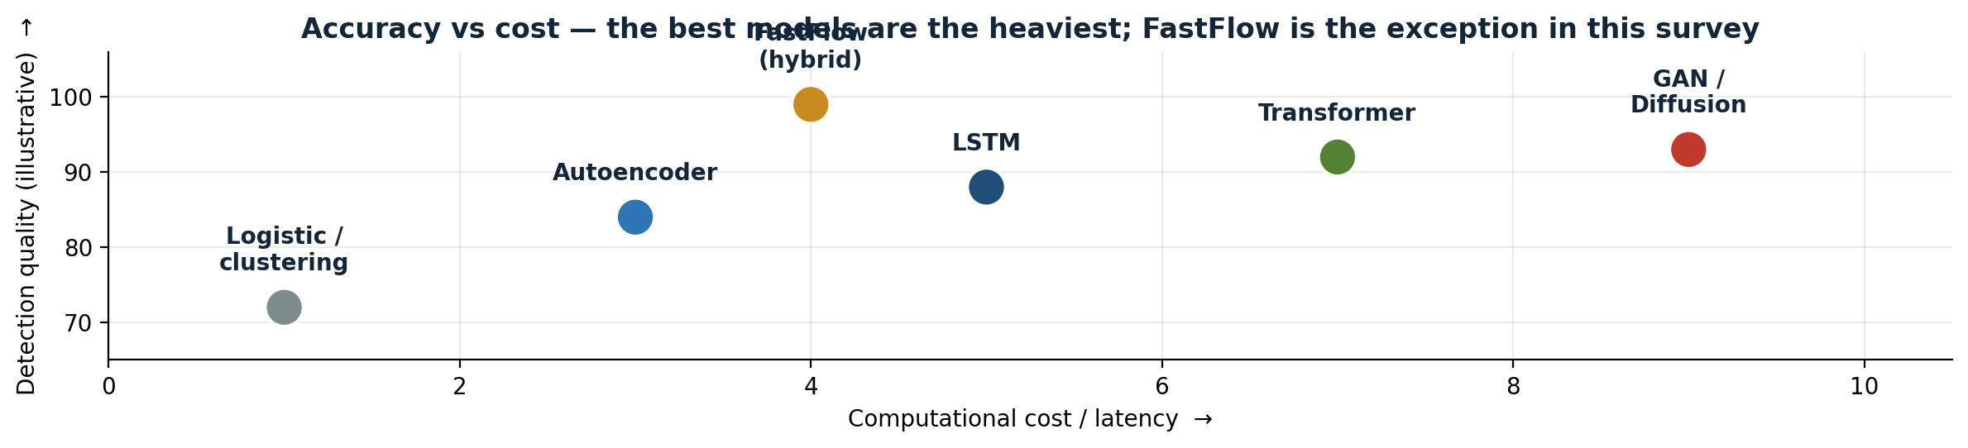
04 EVIDENCE
16 / 18
Ablations & trade-offs — my reading
What the papers collectively say, when you read across them
1
Score > architecture
2
Data > model
3
Accuracy vs cost
Swapping AE → VAE or LSTM → Transformer moves the score a few points. The wrong score / threshold breaks the system.
Clean normal data, imbalance handling, noisy labels matter more than adding another layer.
Best models are the heaviest. A lighter model answering in milliseconds can be right for real-time use.
First ablation to run: fix the model, vary the threshold, plot precision vs recall.
Pranith Varma Pakalapati · SJSU · Huang et al., arXiv:2503.13195v1 (2025)
16 / 18
Notes:
The survey does not run one big ablation study itself — it synthesises ablations from the papers it reviews. Reading across them, four conclusions stand out, and these are my own synthesis, not a single table from the paper.
First, the anomaly score matters more than the architecture. Swapping an autoencoder for a VAE, or an LSTM for a Transformer, typically moves the score by a few points. Choosing the wrong score, or the wrong threshold, can break the system entirely.
Second, the training data matters more than the model. Training only on clean normal data, handling imbalance properly, and removing noisy labels changes results more than adding another layer. This is unglamorous work, and it is where most of the performance lives.
Third, there is a real accuracy-versus-cost trade-off, shown on this slide. The best models are also the heaviest. For real-time use — fraud detection, autonomous driving, industrial monitoring — a lighter model that answers in milliseconds can be the right choice even if its AUC is a point lower.
And fourth, engineered features still help, but only a little. If I had to run one ablation first, it would be the threshold: fix the model, vary the threshold, and plot precision against recall. That one experiment tells you more about deployment than any architecture swap.

Slide 17
05 OUTLOOK
17 / 18
Open issues & future work
The survey's honest ending — and one addition of my own
1
Data collection
2
Compute
Anomalies are rare, labelling is costly and needs experts, and synthetic data does not fully solve it.
AE / GAN / LSTM are heavy. Real-time needs lightweight models, GPU acceleration, edge / cloud offloading.
3
Explainability
4
Diverse anomalies
Black box is not enough in healthcare, finance, safety-critical systems. Answers now: attention, LIME, SHAP.
A model that catches point anomalies may miss sequence or group anomalies entirely.
5
Future directions
6
My addition: benchmarks
Self-supervised learning, more diverse synthetic data, adaptive frameworks, real-time explainability.
Same datasets, same splits, same metrics — until then, headline numbers will keep looking better than they are.
Pranith Varma Pakalapati · SJSU · Huang et al., arXiv:2503.13195v1 (2025)
17 / 18
Notes:
The survey closes with open issues, and they are refreshingly honest. Data collection is still the bottleneck: anomalies are rare, labelling them is expensive and needs experts, and synthetic data does not fully solve it. Computational complexity is second: autoencoders, GANs and LSTMs are expensive, and real-time detection needs lightweight models, GPU acceleration, or edge and cloud offloading.
Explainability is third: deep models are black boxes, and in healthcare, finance and safety-critical systems, a score without a reason is not enough. The survey points to attention mechanisms, and to post-hoc tools like LIME and SHAP, as the current answers.
And fourth, handling diverse anomaly types: a model that catches point anomalies may miss sequence or group anomalies entirely. Future directions are self-supervised learning, more diverse synthetic data, adaptive frameworks, and real-time explainability.
I would add one of my own: benchmarks. Until papers are compared on the same datasets, with the same splits and the same metrics, headline numbers will keep looking better than they are. A 99.4 percent AUC is meaningful because MVTec AD is a shared benchmark. Too many results in this field are not.

Slide 18
05 OUTLOOK
18 / 18
Conclusion
Thank you — questions welcome
1
Reconstruction
2
Prediction
Does it look normal? Learn normal, rebuild the input, flag large reconstruction error.
Does it follow? Learn the sequence, predict the next value, flag large prediction error.
3
Hybrids
4
Real-world success
Deep features + an explainable boundary — the strongest results in this survey, including 99.4% AUC.
Data quality, class imbalance, thresholds and explainability decide whether a model works in practice.
5
My take
6
References
Spend your time on the threshold and the evaluation, not on the architecture. That is where performance lives.
Paper, article, slides and full references are in the GitHub repo linked in the submission.
Pranith Varma Pakalapati · SJSU · Huang et al., arXiv:2503.13195v1 (2025)
18 / 18
Notes:
To conclude. Anomaly detection is the problem of finding the rare observations that matter most, and deep learning changed it by learning representations directly from high-dimensional, temporal, spatial and graph data, instead of relying on hand-crafted features.
Reconstruction methods ask whether an input looks normal. Prediction methods ask whether it follows from the past. Hybrids combine deep features with an explainable boundary, and in this survey, that combination produces some of the strongest results, including 99.4 percent AUC on MVTec AD.
But the survey's real message is not a leaderboard. It is that data quality, class imbalance, thresholds and explainability decide whether a model works in the real world — and those are the parts no architecture, however new, can do for you.
[Pause]
Thank you for listening. The paper, the article, these slides and the full references are all in the GitHub repository linked in the submission. I am happy to take questions.
If running long, cut Slide 4 to one minute and Slide 13 to 45 seconds. Do not rush slides 9, 14 or 15 — those are the slides the rubric rewards most.

