Slide 1
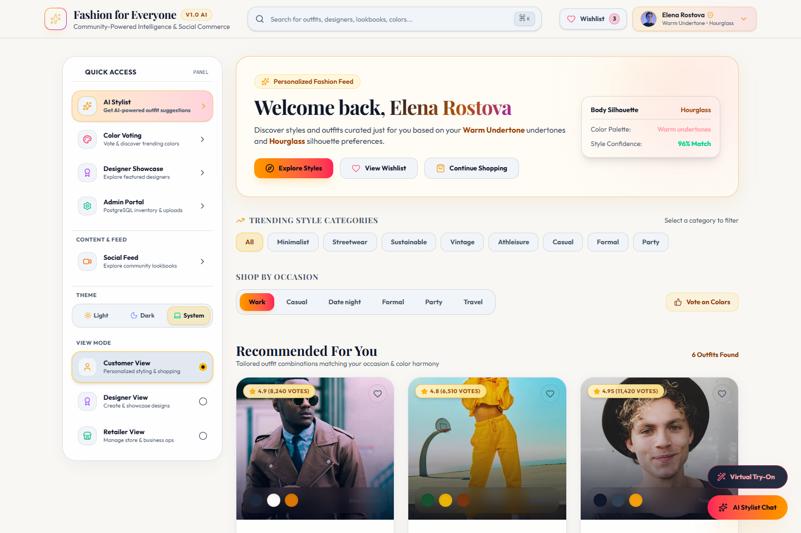
ENTERPRISE FASHION-TECH PLATFORM
LIVE APPLICATION DASHBOARD
Fashion for Everyone
AI-Powered Fashion Discovery & Shopping Platform
A unified multi-tenant ecosystem bridging Customers, Independent Designers, and Retailers with AI-assisted styling, community color voting, live inventory synchronization, and omnichannel order fulfillment.
VERIFIED ARCHITECTURE STACK:
• Full-Stack Web: React 19, TypeScript, Vite 8, Tailwind CSS v4
• Mobile Experience: React Native 0.86, Expo 57, Android APK Configuration
• Backend & Database: Express 5, Prisma ORM 5.22, PostgreSQL, Socket.io Real-Time Engine

Slide 2
PROBLEM STATEMENT
The Modern Fashion Discovery & Fragmentation Dilemma
Real systemic friction experienced by fashion consumers, independent creators, and fashion merchants today.
01
02
03
04
05
Discovery Overwhelm
Styling Indecision
Stylist Exclusivity
Color Coordination Gap
Siloed Ecosystem
Consumers face millions of unsorted items with generic search engines that ignore personal body shape, skin tone, and individual proportions.
Users struggle with daily outfit coordination, color matching, and occasion-specific etiquette without personalized stylist guidance.
Personal styling has traditionally been an expensive luxury service inaccessible to everyday consumers seeking confidence in their appearance.
Lack of community feedback on color harmonies, leading to uncertainty when combining seasonal palettes, undertones, and silhouettes.
Disconnection between Customers (who want curation), Designers (who need exposure), and Retailers (who manage physical store inventory).

Slide 3
THE SOLUTION
One Unified Ecosystem: Customers, Designers & Retailers
A single interconnected digital platform synchronizing discovery, community curation, and transactional commerce.
THE UNIFIED FASHION TRIAD
CUSTOMERS
⟷
DESIGNERS
⟷
RETAILERS
Personalized AI styling, wishlist, omnichannel cart, store pickup & order tracking
Portfolio showcase, design creation, community voting & merit leaderboard rankings
Product catalog CRUD, multi-store stock locator, real-time orders & fulfillment status
END-TO-END PLATFORM VALUE LIFECYCLE
1. Fashion Discovery
2. AI Styling
3. Product Match
4. Wishlist / Cart
5. Fast Checkout
6. Orders & Pickup
Browse catalog, curated trends & social feed
➔
Biometric harmony, body shape & color advice
➔
Real retailer SKU discovery & store locator
➔
Curate favorites & persistent bag storage
➔
Payment intent creation & address confirmation
➔
Lifecycle tracking from Shipped to Delivered

Slide 4
CORE CAPABILITIES
Verified Implemented Features in Current Codebase
Every capability listed below is fully realized with active backend API endpoints, Prisma database models, and responsive UI components.
COMMERCE
DISCOVERY
UX
AI ENGINE
Product Discovery
Product Search
Search Suggestions
AI Stylist Chat
Filterable catalog with silhouettes, price, occasion & live stock badges
Fast full-text search across titles, brands, occasions & garment attributes
Instant keyword autocomplete and occasion suggestions (Ctrl+K keyboard shortcut)
Conversational assistant analyzing skin undertones, body shapes & color harmony
COMMUNITY
DESIGNERS
CUSTOMER
COMMERCE
Color Voting Arena
Designer Showcase
Wishlist System
Shopping Cart
Interactive community palette voting with real-time socket updates and star rating
Independent designer portfolios, design publishing modal, and merit leaderboards
Persistent item bookmarking, saved curated favorites, and stock alerts
Dynamic bag management with size/color selection and tax calculation
FULFILLMENT
OPERATIONS
ACCOUNT
OMNICHANNEL
Checkout Pipeline
Order Management
Profile & Settings
Store Stock Locator
Multi-field shipping form, payment gateway intent creation, and instant verification
Customer order tracking modal and retailer status transitions (Pending to Delivered)
Biometric attributes (skin tone, measurements), occasion vibes, and security update
Nearby brick-and-mortar physical store inventory check with 48h pickup reservation

Slide 5
CUSTOMER USER FLOW
Visual Customer Journey & Discovery Architecture
Chronological customer progression through authentication, personalized discovery branches, cart, and order fulfillment.
PRIMARY PURCHASE FLOW (LINEAR PIPELINE)
Customer
New or Returning
Register / Login
Auth / Token Sync
Home Feed
Personalized Hub
Explore / Search
Instant Auto-suggest
Product Details
Size/Color/Fit Score
Cart or Wishlist
Persistent Storage
Secure Checkout
Address & Payment
Order Tracking
Status Progression
1
➔
2
➔
3
➔
4
➔
5
➔
6
➔
7
➔
8
OPTIONAL DISCOVERY & ENGAGEMENT PATHWAYS (ACCESSIBLE FROM HOME)
AI Stylist Chat
Color Voting Arena
Designer Showcase
Stock Locator
Conversational styling queries, body shape analysis & curated outfits
Upvote/downvote palettes with direct transfer to AI Stylist
Explore creator collections, rate garments & follow designer profiles
Find nearby brick-and-mortar stores with 48-hour pickup reservations

Slide 6
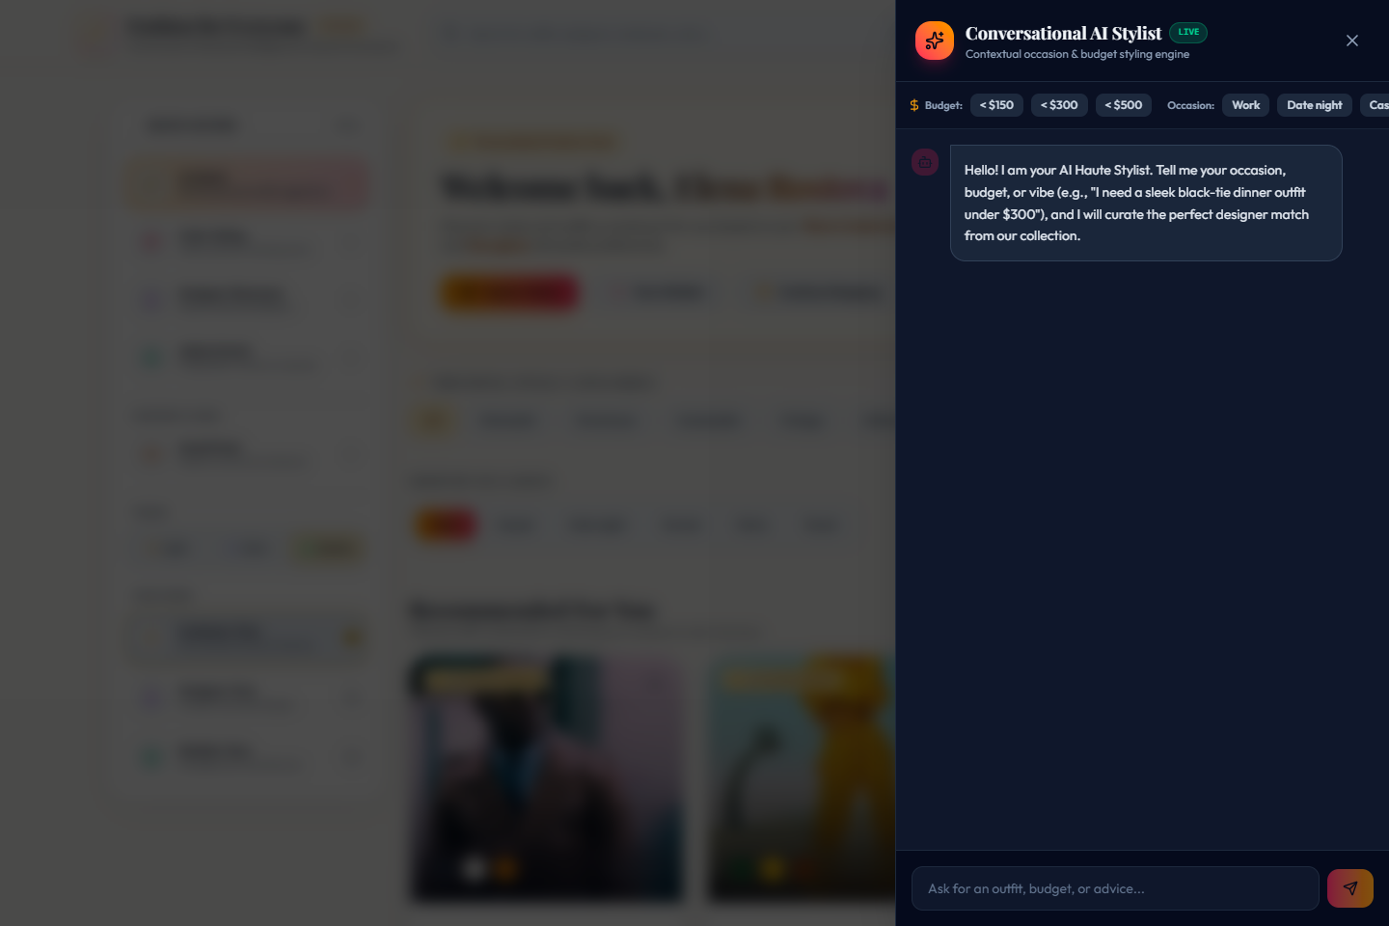
CUSTOMER EXPERIENCE
Customer Features & Interactive Interfaces
Interactive fashion interfaces designed for intuitive exploration, instant feedback, and seamless mobile-responsive shopping.
KEY CUSTOMER CAPABILITIES
VERIFIED APPLICATION SCREENSHOTS
AI Conversational Stylist
Chat assistant calculating color harmony scores & recommending matched retail SKUs.
Interactive Color Voting
5-star community voting arena with real-time socket events and trending filters.
Smart Search & Suggestions
Keyboard-accelerated (Cmd/Ctrl+K) instant search across styles, brands, and categories.
Curated Wishlist & Bag
Persistent customer favorites, size and color selectors, and cart summary calculations.
Order Tracking Modal
Real-time order lifecycle visualizer detailing shipping status, tracking numbers, and delivery dates.
Biometric Profile & Vibe Preferences
Customizable undertone, hair color, body silhouette, and measurements stored in PostgreSQL.

Slide 7
DESIGNER USER FLOW
Designer Workflow & Showcase Pipeline
Dedicated flow for independent fashion creators: from role authentication to design creation, publication, and community rating engagement.
STAGE 1
STAGE 2
STAGE 3
STAGE 4
Authentication & Workspace
Design Creation & Metadata
Catalog Publishing
Community Engagement
Designer Entry
Portal access
Upload Design Modal
Initiate creation
Validate Attributes
Prisma schema validation
Community Showcase
Public feed display
1
1
1
1
↓
↓
↓
↓
➔
➔
➔
Role Switch / Login
Designer identity
Specify Information
Title, occasion, price
Publish Design API
POST /api/designs
Interactive Star Voting
1-5 star user ratings
2
2
2
2
↓
↓
↓
↓
Designer Dashboard
Portfolio workspace
Palette & Image URL
Color hex & CDN photo
Active Showcase
Live in public gallery
Merit Leaderboard
Trending rank updates
3
3
3
3

Slide 8
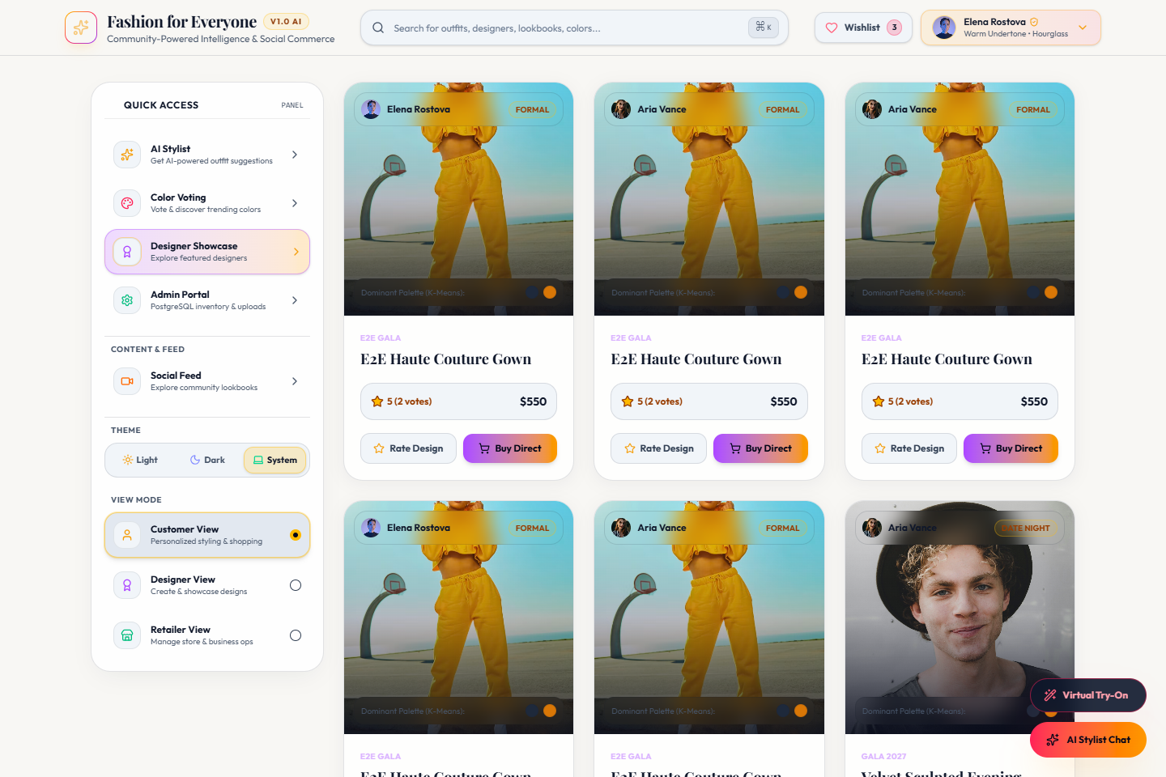
DESIGNER STUDIO
Designer Showcase, Creation & Rating Tools
Empowering independent fashion talent with digital portfolio management, studio publishing modals, and merit-based voting.
LIVE DESIGNER SHOWCASE & LEADERBOARD
DESIGNER TOOLS & SYSTEM INTEGRATIONS
Designer Showcase Portfolio
Showcase grid highlighting creator handle, bio, verification badges, and average rating.
Design Upload Modal
Modal form collecting title, collection season, price, occasion, and garment photo URL.
Custom Palette Definition
Specify curated color hex codes associated with each garment silhouette.
Interactive Star Voting
Community rating algorithm updating live `votesCount` and composite `rating`.
Designer Following System
Audience follow/unfollow capability with dynamic follower counter synchronization.
Merit-Based Leaderboard
Top rated designs automatically boosted on community merit boards.

Slide 9
RETAILER USER FLOW
Retailer Operations & Inventory Lifecycle Flow
Comprehensive operational workflow for store partners: stock management, catalog synchronization, and multi-stage order fulfillment.
RETAILER WORKSPACE EXECUTION PIPELINE
Retailer Entry
Store portal login
Retailer Dashboard
Executive metrics
Product Catalog
Create & edit SKUs
Stock Adjustment
Inventory counter
Order Queue
Inspect line items
Status Update
Progress shipment
Store Settings
Configure alert thresholds
1
➔
2
➔
3
➔
4
➔
5
➔
6
➔
7
ORDER LIFECYCLE STATE MACHINE (VERIFIED IN CODEBASE)
PENDING
PROCESSING
SHIPPED
DELIVERED
Order received & payment confirmed via intent gateway
➔
Warehouse picking, garment packaging & inventory reserve check
➔
Courier dispatch with generated tracking number (TRK-...)
➔
Confirmed delivery to customer address or store pickup point

Slide 10
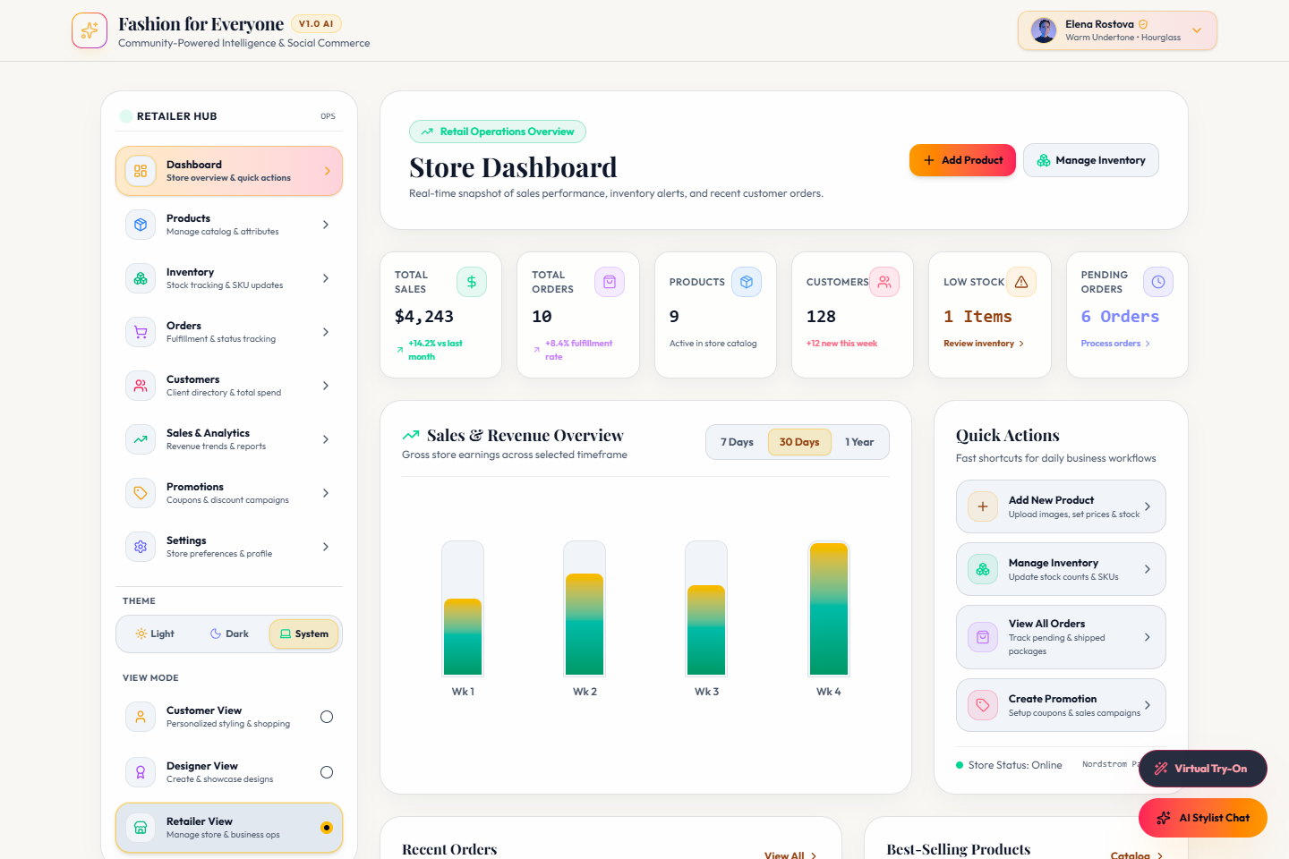
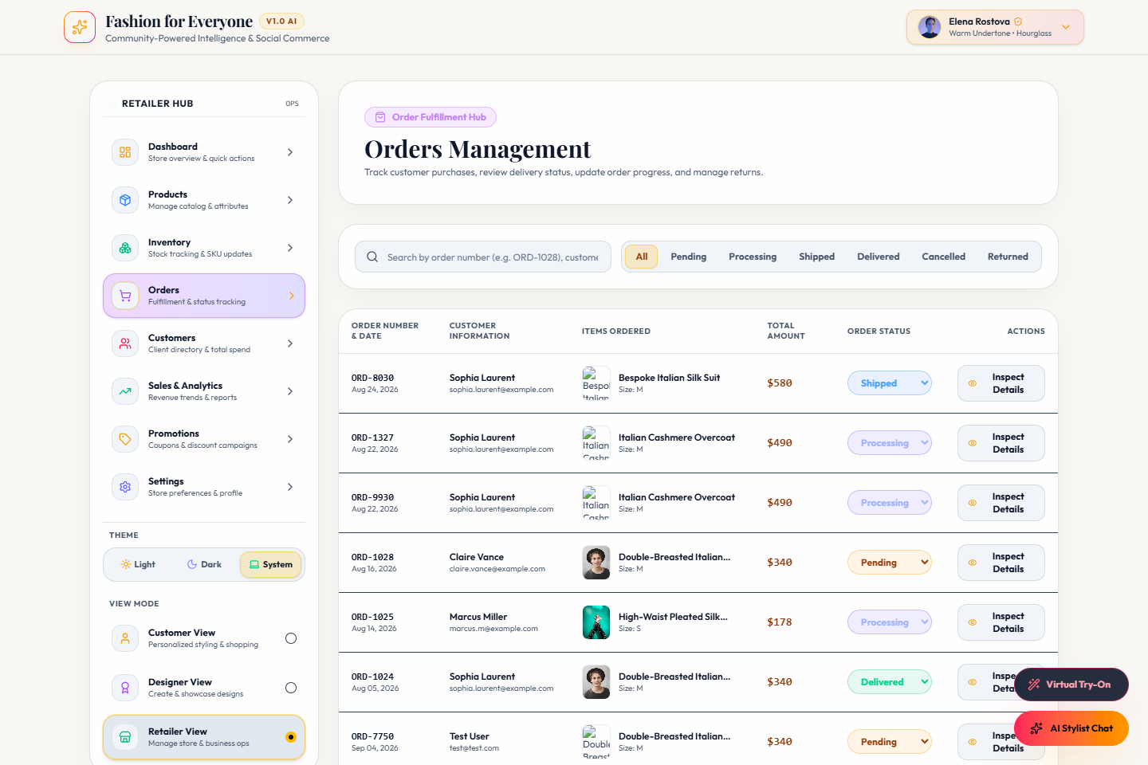
RETAILER WORKSPACE
Retailer Features & Store Operations Console
Real-time retail management tools built into the application: inventory tracking, stock adjustments, and order progression.
LIVE RETAILER DASHBOARD & ORDERS VIEW
IMPLEMENTED RETAILER CAPABILITIES
Operations Dashboard
KPI metrics tracking gross sales, active listings, pending fulfillments, and average order value.
Product Catalog Management
Add new garments with image upload, brand, price, sizes, silhouette, and occasion.
Inventory & Stock Counters
Real-time stock quantity adjustment with automatic "Low Stock" and "Out of Stock" status triggers.
Order Status Lifecycle
Transition customer orders from Pending to Processing, Shipped, or Delivered with tracking.
Retailer Customer CRM
Customer directory recording lifetime orders count, total spend, and recent order history.
Store Settings & Alerts
Manage tax ID, manager contact, low stock thresholds, and email/SMS notification toggles.

Slide 11
ADMIN USER FLOW
Admin Executive Flow & Platform Governance
Verified administrative architecture: JWT staff authentication, executive operations dashboard, and multi-tenant approval workflows.
ADMIN AUTHENTICATION & EXECUTIVE ACCESS PIPELINE
Admin Staff Access
/admin URL or header toggle
Admin Login Page
POST /api/admin/auth/login
JWT Token Issuance
Secure Bearer token generation
AdminGuard Validation
GET /api/admin/auth/me check
Executive Dashboard
Aggregated PostgreSQL KPIs
1
➔
2
➔
3
➔
4
➔
5
ACTIVE PLATFORM MANAGEMENT MODULES (CONFIRMED IN ADMIN ROUTES)
User Management
Designer Governance
Retailer Governance
Orders & Catalog Audit
/api/admin/users
/api/admin/designers
/api/admin/retailers
/api/admin/orders
Inspect customer profiles, toggle account status (Active / Suspended), and review requested role promotions.
Audit submitted designs, verify creator credentials, grant verified badges, or reject violating uploads.
Review merchant onboarding applications, inspect store tax IDs, approve boutique listings, or issue rejections.
Cross-tenant transaction monitoring, global order status inspection, revenue verification, and catalog oversight.

Slide 12
ARCHITECTURE ROLES
One Platform, Four Distinct User Roles
Clean separation of concerns: tailored permissions, specialized dashboards, and custom user journeys for every stakeholder.
B2C SHOPPER
INDEPENDENT CREATOR
MERCHANT & BRAND PARTNER
PLATFORM GOVERNANCE STAFF
CUSTOMER
DESIGNER
RETAILER
ADMIN
AI Conversational Stylist consultation
Creator Showcase & portfolio profile
Executive store performance metrics
JWT-protected executive dashboard
Body shape & color harmony recommendations
Design upload with palette hex definitions
Product catalog creation & SKU updates
Cross-platform aggregated KPIs in PostgreSQL
Community color voting in the arena
Collection management & categorization
Real-time inventory & stock adjustments
Customer account status & role approvals
Multi-product search & stock locator
Community rating feedback & star voting
Multi-stage order lifecycle fulfillment
Designer verification & design approvals
Curated Wishlist & Shopping Cart
Audience follower growth tracking
Retailer customer CRM history tracking
Merchant onboarding & store compliance
Omnichannel checkout & order tracking
Merit leaderboard top ranking visibility
Store alert settings & pickup coordination
Global order audit & system health monitoring

Slide 13
AI STYLIST USER FLOW
Conversational AI Stylist & Recommendation Pipeline
Interactive fashion advisory workflow: natural language fashion requests processed through color harmony rules and silhouette matching.
AI STYLING DECISION PIPELINE
CONVERSATIONAL STYLIST INTERFACE
1
User Opens AI Stylist
Floating button or header nav
↓
2
Enter Fashion Request
"Formal autumn dinner outfit under $400"
↓
3
Occasion & Budget Filters
Work, Casual, Formal, Party constraints
↓
4
AI Engine Processing
Color harmony score + body shape rules
↓
5
Curated Recommendations
Coordinated palette & styling rationale
↓
6
Matched Retail Products
Actual catalog items matching the palette
↓
7
Add to Wishlist / Cart
Direct one-click conversion to purchase

Slide 14
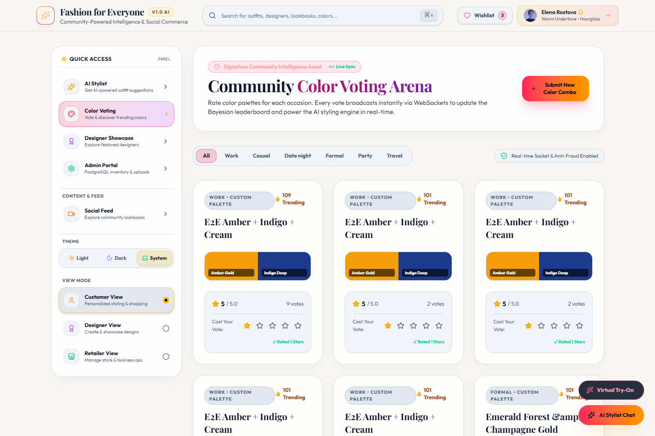
COMMUNITY COLOR VOTING FLOW
Crowdsourced Color Harmony Arena to AI Stylist
Direct integration between community-driven palette validation and the personalized AI Stylist recommendation engine.
COMMUNITY COLOR ARENA ➔ AI STYLIST PIPELINE
LIVE COLOR VOTING ARENA
1
User Opens Color Voting
Access community color combination arena
↓
2
Filter by Occasion
Work, Casual, Gala, Date Night, Resort
↓
3
Inspect Palette Harmonies
View 3-color hex combinations & trending score
↓
4
Cast Interactive Vote
1-to-5 star vote rating or upvote/downvote
↓
5
Real-Time Socket Sync
Socket.io broadcasts updated average to community
↓
6
Select Winning Palette
User clicks favored color combination
↓
7
Direct Transition to AI Stylist
Transfers exact hex palette & occasion to Stylist

Slide 15


COMMERCE PIPELINE
From Search to Purchase: Omnichannel Shopping Flow
The complete transaction journey: real-time suggestions, detailed garment inspection, store reservations, and multi-gateway checkout.
COMPLETE SHOPPING CONVERSION FUNNEL
Search Input
Instant queries
Suggestions
Category tags
Product Card
Price & rating
Product Modal
Silhouette & fit
Size / Color
In-stock check
Cart Review
Bag calculation
Checkout
Address & Pay
Orders Sync
Prisma commit
1
➔
2
➔
3
➔
4
➔
5
➔
6
➔
7
➔
8
GARMENT DETAILS & SIZE SELECTION MODAL
OMNICHANNEL STORE STOCK & PICKUP RESERVATION

Slide 16
TECHNICAL ARCHITECTURE
Verified Implementation Technology Stack
Strictly detailing technologies present and running in the repository — no speculative or uninstalled frameworks.
Frontend Web
Mobile Application
Backend API Engine
Database & Data Layer
React 19.2 (Modern Hooks & State)
React Native 0.86
Node.js & Express 5.2
PostgreSQL (Enterprise Relational DB)
TypeScript 6.0
Expo 57 (Cross-Platform SDK)
TypeScript Runtime (tsx engine)
Prisma ORM 5.22 (Type-safe client)
Vite 8.2 (Fast HMR & Bundler)
React Navigation v7 (Native Tabs/Stack)
Socket.io 4.8 (Real-time events)
Prisma Schema with 14 Data Models
Tailwind CSS v4 (Modern Styling)
Expo SecureStore & LinearGradient
Multer 2.3 (File & Avatar Uploads)
Atomic Transactions ($transaction)
Lucide React & Canvas Confetti
EAS Build Config (Android APK/AAB)
CORS & Cookie-Parser Middleware
JSON File Cache Fallback Engine
Authentication & Security
AI & Fashion Algorithms
Cloud & Deployment
Testing & Verification
JSON Web Tokens (JWT Access/Refresh)
Rule-Based Styling Matcher
Render (Backend Express API & DB)
Custom End-to-End Test Suite
Bcryptjs Password Hashing
Biometric Color Harmony Scorer
Vercel (Frontend SPA Hosting)
PostgreSQL DB Integration Tests
4-Role RBAC (Customer, Designer, Retailer, Admin)
Occasion & Silhouette Filter Engine
Expo EAS (Cloud Android Builds)
Admin Full E2E (`test_admin_*_e2e.ts`)
XSS Sanitization & RegEx Escaping
Semantic Search Query Matcher
Multi-environment (.env.production)
CRUD API Automated Verification
Rate Limiter & Security HTTP Headers
Virtual Try-On Job Queue Model
Vite Reverse Proxy Routing
Oxlint TypeScript Code Quality

Slide 17
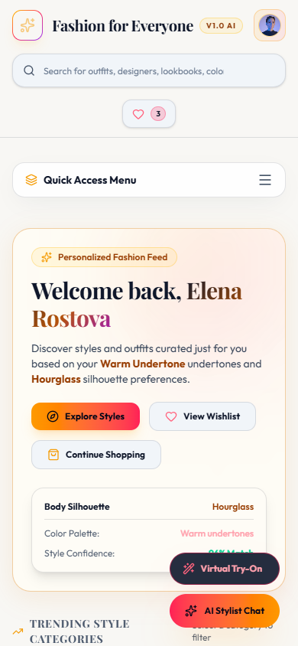
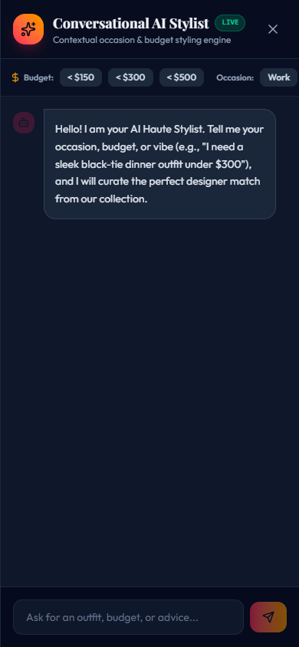
MOBILE EXPERIENCE
Native Android Mobile Application Architecture
Powered by React Native 0.86 & Expo 57: high-performance native touch navigation, biometric styling, and ready-to-deploy APK configurations.
EXPO 57 & REACT NATIVE MOBILE CAPABILITIES
VERIFIED MOBILE APPLICATION INTERFACES
HomeScreen
Featured hero collections, trending garments, and instant occasion category shortcuts.
ExploreScreen
Comprehensive product search with price filtering, brand filtering, and real-time query match.
AiStylistScreen
Native AI consultation with interactive occasion chips, color harmony scores, and outfit cards.
ColorVotingScreen
Community color combination voting with direct navigation parameter passing to AiStylist.
ProductDetailScreen
Full-bleed imagery, size selection chips, color picker, and store reservation buttons.
CartScreen & CheckoutScreen
Persistent item counter, delivery address entry, and payment intent order creation.
ProfileScreen & Settings
Personalized undertone settings, measurements, theme toggle, and secure credential editing.

Slide 18
SECURITY ARCHITECTURE
Implemented Security, Privacy & Reliability Controls
Strict defense-in-depth measures confirmed in the backend codebase (`backend/security.ts` and `backend/middleware/auth.ts`).
Authentication & Session Integrity
4-Tier Role-Based Access Control
Input Sanitization & Anti-XSS
JWT tokens with configurable expiry (15m access / 7d refresh)
Strict middleware guards (`authenticateRole`, `requireRole`, `requireAuth`)
Custom `sanitizeString` recursively stripping `<script>` tags & handler attributes
Bcryptjs salted password hashing preventing plaintext compromise
Independent role permissions for Customer, Designer, Retailer, and Admin
Null-byte removal preventing binary injection
HttpOnly cookie storage and Authorization Bearer header support
Protected administrative endpoints restricted to verified staff tokens
JSON-level sanitization safeguarding against malicious input payloads
Path Traversal & Injection Defense
HTTP Security Headers & Rate Limiting
Database Reliability & ACID Transactions
`validateSafePath` enforcing path boundary containment for uploads
Strict defense headers: X-Content-Type-Options (nosniff), X-Frame-Options (DENY)
Atomic Prisma transactions (`$transaction`) for store stock & orders
`escapeRegex` escaping user search strings against ReDoS attacks
Referrer-Policy: strict-origin-when-cross-origin to protect user data
Graceful in-memory / JSON fallback when database connectivity drops
Prisma parameterized SQL queries preventing SQL Injection
In-memory window rate limiter preventing denial-of-service spam
Automated database seeding and migration scripts for quick disaster recovery

Slide 19
VERIFICATION STATUS
Current Implementation & Automated Verification Status
Real-world test results and functional delivery confirmed by automated TypeScript test suites and active builds.
✓ 100% OPERATIONAL
Web Application
✓ READY FOR BUILD
Mobile Android App
React 19 Vite application running live on localhost:5173 with complete multi-tab layout
Expo 57 React Native app with tab navigation, custom themes & EAS Android build profile
✓ FULLY TESTED
Unified Authentication
✓ ACTIVE & INTERACTIVE
AI Stylist Chat Engine
JWT token issuance, bcrypt passwords, refresh token rotation, and 4-tier RBAC middleware
Conversational assistant with color harmony scoring, body shape heuristics & SKU recommendations
✓ LIVE WITH SOCKETS
Color Voting Arena
✓ FUNCTIONAL & TESTED
Designer Showcase
Occasion filtering, interactive 5-star voting, real-time socket events & AI Stylist navigation
Portfolio showcase, design upload modal with palette hex inputs, and merit rating system
✓ FUNCTIONAL & TESTED
Retailer Dashboard
✓ FUNCTIONAL & TESTED
Admin Governance
Product CRUD, live stock adjustments, low-stock threshold alerts, and order status updates
Admin login, executive KPI overview, user management, and retailer/designer approval views
✓ PASSING AGAINST DB
Automated E2E Tests
✓ POSTGRESQL LIVE
Database Layer
Automated suites (`test_all_e2e.ts`, `test_admin_*_e2e.ts`) verifying DB transactions & guards
Prisma client with 14 models, relational constraints, foreign keys, and JSON fallback mode

Slide 20
FUTURE ROADMAP
Future Scope & Planned Innovations (Strictly Labeled Future)
High-impact engineering extensions planned for upcoming development phases — clearly separated from current code.
VECTOR AI EMBEDDINGS
COMPUTER VISION
DIFFUSION NEURAL MODELS
Advanced Semantic Fashion Search
Visual Similarity & Reverse Image Search
Production Virtual Try-On (VTON)
Integration of vector embeddings (via pgvector or Pinecone) allowing open-ended conceptual queries such as "vintage Parisian café look for rainy weather".
Allowing customers to upload real-world street style photos and find instant visual matches or affordable dupes from active retailer catalogs using CLIP.
Upgrade from current schema queue to distributed GPU-powered diffusion models (e.g. IDM-VTON) for photorealistic draping over user selfie uploads.
FINTECH RAILS
RECOMMENDATION ML
CLOUD MESSAGING
Multi-Gateway Live Payment Onboarding
Deep Machine Learning Personalization
Mobile Push Notifications (FCM / APNs)
Transitioning from current test intent mock to production Stripe Connect and Razorpay automated merchant payouts and split-tender settlements.
Dynamic collaborative filtering models learning from user purchase history, color voting preferences, and fit ratings to personalize the home feed.
Native mobile push notification service alerting shoppers to restocks, price drops, delivery status milestones, and trending color combinations.

Slide 21
EXECUTIVE SUMMARY & CONCLUSION
Fashion for Everyone
Bridging AI Intelligence, Community Creativity, and Omnichannel Commerce
AI STYLING
+
DISCOVERY
+
COMMUNITY
+
SHOPPING
+
DESIGNERS
+
RETAILERS
Democratized Fashion Styling
True Multi-Tenant Synergy
Delivers accessible, personalized garment advice tailored to real body shapes, skin undertones, and individual occasions.
Seamlessly unites consumers, independent designers seeking recognition, and brick-and-mortar retailers needing inventory velocity.
Production-Grade Architecture
Omnichannel Velocity
Built with React 19, Expo 57, Express 5, PostgreSQL, and Prisma ORM, verified through rigorous end-to-end testing suites.
Connects digital discovery directly to physical store stock reservations and reliable home order delivery.
Thank You • Questions & Discussion Welcome

