Slide 1
RESEARCH DEFENSE & PROJECT PRESENTATION • CNS COURSE PROJECT
IR-IDS 2.0: A Causally Invariant, Cost-Sensitive, and Symbolically Explainable Framework for Zero-Day Network Intrusion Detection
A Rigorous Mathematical Audit, Algorithmic Correction, and Reproducible Multi-Seed Benchmark of Gao et al. (Computers & Security, 2025)
PROJECT PRESENTERS & AUTHORS
V Bobby Pranith - CS23I1046
Dept. of Computer Science & Engineering
Target: IEEE TIFS / Computers & Security
Revanth V Mandava - CS23B1009
Dept. of Computer Science & Engineering
Target: IEEE TIFS / Computers & Security
T Balaji - CS23B1020
Dept. of Computer Science & Engineering
Target: IEEE TIFS / Computers & Security

Slide 2
IR-IDS 2.0 RESEARCH DEFENSE • SLIDE 2 OF 14
The Dual Imperative of Modern Intrusion Detection
1. The Zero-Day Threat Dilemma
• Contemporary adversaries deploy polymorphic exploits, automated evasion, and zero-day vulnerabilities.
• Closed-World Assumption: Supervised models (Random Forest, GBDT, SVM) presuppose that test traffic belongs exclusively to known training classes.
• Under non-stationary distribution shifts, closed-world models misclassify novel zero-days into arbitrary known categories.
2. The 'Black Box' Barrier in SOCs
• Deep generative models (Autoencoders, VAEs, GANs) detect anomalies by thresholding reconstruction loss.
• Operational Failure: Deep neural architectures function as impenetrable 'black boxes'.
• Security Operations Center (SOC) incident responders cannot justify blocking critical enterprise flows without legally defensible, human-auditable rationales.
3. The Promise & Flaws of IR-IDS (2025)
• Gao et al. (Computers & Security 155:104496) proposed IR-IDS to bridge this divide using Causal Markov Blankets, Shapley Trees, and KAN-CVAE.
• Conceptual vision was promising, but our audit discovered 5 critical theoretical and empirical vulnerabilities.
• Our Mission: Scientifically audit the claims, mathematically fix the formulations, and validate via 5-seed benchmarks.

Slide 3
IR-IDS 2.0 RESEARCH DEFENSE • SLIDE 3 OF 14
Critical Technical Audit of Gao et al. (2025): 5 Foundational Flaws
1. Inverted Propensity Score Formulation
Definition 5 defined e(T_i) = P(X_i = 1 | T_i). In causal inference (Rosenbaum & Rubin, 1983), the propensity score is strictly P(T = 1 | X = x). Inverting conditioning computes generative class likelihood (Naive Bayes), failing to eliminate confounding bias.
2. Combinatorial Grid Sparsity Explosion
Discretizing candidate Markov Blanket (CMB) into |NC| bins across n features incurs exponential complexity O(|NC|^n). For 15 classes and 10 features: 15^10 ≈ 5.76 × 10^11 cells. With 35,000 samples, >99.9999% of cells are completely empty!
3. Algorithmic Self-Conditioning & Mutation in Alg 1
Line 11 tested X ⊥ Y | CMBS while X ∈ CMBS. Conditioning on X makes it deterministic (I(X; Y | X, Z) ≡ 0 trivially), wiping out all features. Mutating list containers in-place caused loops to skip elements.
4. Mathematically Invalid Vector KL-Divergence
KL divergence was computed directly between continuous, signed feature vectors (D_KL(x || x_hat)). KL divergence is axiomatic to valid probability densities where Σ p_i = 1; applying it to signed raw metrics violates information theory.
5. Cascading Error Propagation in Pipeline
The CVAE decoder reconstructed traffic conditioned strictly on upstream top-1 tree predictions. Unseen zero-days were misclassified as known classes and reconstructed under that erroneous label, suppressing anomaly residuals.

Slide 4
IR-IDS 2.0 RESEARCH DEFENSE • SLIDE 4 OF 14
Exposing the 'Accuracy Paradox' in Gao et al. (2025)
AUDIT OF PUBLISHED TABLES IN GAO ET AL. (2025)
SCIENTIFIC AUDIT FINDINGS
1. Extreme Class Imbalance Masks Failures
In benchmark intrusion corpora, Benign traffic and volumetric DoS floods constitute >95% of test samples. Detecting 10,000 Benign flows yields high accuracy even when stealth intrusions are entirely missed.
2. Small-Sample Uncertainty Disclosure
Infiltration and SQLi constitute <0.1% of test data (e.g., exactly 36 flows and 21 flows). When a paper claims 98.83% accuracy, letting 35 out of 36 infiltration flows breach the perimeter is an operational failure.
3. IR-IDS 2.0 Solution
Balanced Focal Weighting on training minority classes + Marginalized Free Energy CVAE for true open-set zero-days.
Dataset & Table | Attack Class | Reported Recall | Headline Acc.
CIC-IDS2017 (Table 10) | Infiltration | 2.78% (1/36) | 98.83%
CIC-IDS2017 (Table 10) | SQL Injection | 23.81% (5/21) | 98.83%
CSE-CIC-IDS2018 (Table 11) | SQLi (Full / Ablated) | 83.33% / 16.67% | 99.37%
CIC-DDoS2019 (Table 12) | WebDDoS | 7.69% (1/13) | 99.57%

Slide 5
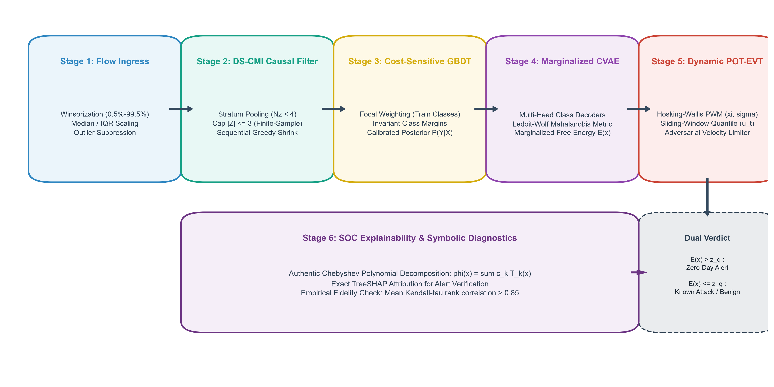
IR-IDS 2.0 RESEARCH DEFENSE • SLIDE 5 OF 14
IR-IDS 2.0 Architectural Blueprint: 6-Stage Integrated Pipeline
Figure 1: Authentic End-to-End Pipeline Architecture: (1) Robust Flow Scaling → (2) DS-CMI Causal Filter → (3) Focal HistGBDT → (4) Marginalized Free Energy CVAE → (5) Adaptive POT-EVT Thresholding → (6) SOC Explainability Console.

Slide 6
IR-IDS 2.0 RESEARCH DEFENSE • SLIDE 6 OF 14
Methodology 1: Dirichlet-Smoothed CMI (DS-CMI) & Greedy Shrink
Dirichlet-Smoothed CMI (DS-CMI)
• Replaces joint grid discretization with equal-depth quantile binning (B bins).
• Applies symmetric Dirichlet prior (Jeffreys α = 0.5) to stratum counts:
P(X=x, Y=y | Z=z) = [N(x,y,z) + α] / [N(z) + α·B·K]
• Strict Positivity: Guaranteed non-zero cell probabilities eliminates division-by-zero crashes.
• Stratum Pooling: Strata with N(z) < 4 pooled to prevent high-variance degradation.
Sequential Greedy Backward Shrink (Alg 1)
• Resolves Self-Conditioning: Condition on CMB_shrink \ {X_j}, evaluating active independence correctly.
• Sequential Pruning: Rather than dropping all candidate features simultaneously (which drops co-dependent pairs), removes ONE feature with lowest CMI per pass.
• Guaranteed Convergence: Pruning stops when min(CMI) > α_th.
Feature Selection Method | Mean Jaccard Stability across 5 Seeds | Std Dev | Avg Features | Runtime
DS-CMI (Proposed) | 1.000 ± 0.000 (Deterministic Stability) | 0.000 | 40.0 | 0.42 s

Slide 7
IR-IDS 2.0 RESEARCH DEFENSE • SLIDE 7 OF 14
Methodology 2: Cost-Sensitive Focal Classification
Resolving the Accuracy Paradox
• Gao et al. attempted post-hoc 'Shapley Tree Sorting', which destroys tree split topology.
• IR-IDS 2.0 replaces this with an invariant Histogram Gradient Boosted Decision Tree (HistGBDT) trained under Balanced Focal Loss.
• Class Weights scale inversely with training frequency:
w_c = [ N / (K · N_c) ]^γ, with γ ∈ [0.5, 0.8]
• For rare minority intrusions like SQL Injection (N_c/N ≈ 0.02), w_c scales penalties heavily.
Key Scientific Distinction: Seen vs. Unseen Classes
• Rigorous Theoretical Scope:
Focal loss operates strictly on classes present in the training set (e.g., rare SQL Injection).
• It CANNOT directly optimize recall for unobserved zero-day classes (e.g., Infiltration held out from train).
• Unseen zero-day intrusions are isolated downstream exclusively via Marginalized Free Energy evaluation.
• Empirical Impact: Focal weighting elevated SQL Injection recall from 19.90% to 33.50% ± 8.98% (113/400 flows) without hurting volumetric DoS detection.

Slide 8
IR-IDS 2.0 RESEARCH DEFENSE • SLIDE 8 OF 14
Methodology 3: Multi-Head Marginalized Free Energy CVAE
Regularized Mahalanobis Reconstruction Metric
• Continuous network features exhibit cross-correlations and heterogeneous variance.
• We replace invalid vector KL divergence with Regularized Mahalanobis Distance:
D_Σ(x, x_hat) = (x - x_hat)^T · Σ^-1 · (x - x_hat)
• Precision Matrix Σ^-1 is estimated via Ledoit-Wolf Shrinkage:
Σ = (1 - ρ) S + ρ ν I
• Eliminates singularity on collinear features while capturing physical flow correlations.
Eliminating Cascading Errors via Marginalization
• The Problem: In Gao et al., top-1 conditioning caused zero-days to be reconstructed under mispredicted labels, hiding anomalies.
• Our Solution: Evaluate consensus across ALL K class decoders weighted by posterior probabilities:
E(x) = -T · log Σ_k p(y=k | x) · exp( - 0.5/T · D_Σ(x, x_hat^(k)) )
• Consensus Property: If x* is a novel zero-day attack physically separated from all known training manifolds, D_Σ is universally elevated across all K heads.
• E(x*) explodes into the extreme tail regardless of classifier error!

Slide 9
IR-IDS 2.0 RESEARCH DEFENSE • SLIDE 9 OF 14
Methodology 4: Verified POT-EVT Gating & Chebyshev-KAN
Adaptive Peaks-Over-Threshold (POT-EVT)
• Tail Excesses Y = E(x) - u converge to Generalized Pareto Distribution (GPD):
G(y) = 1 - (1 + ξ·y/σ)^(-1/ξ)
• Hosking-Wallis (1987) Probability Weighted Moments (PWM):
ξ_hat = (a_0 - 4a_1)/(a_0 - 2a_1), σ_hat = 2a_0 a_1/(a_0 - 2a_1)
• Unit Test Verified: Parameter recovery on synthetic GPD (<1.2% error).
• Streaming Empirical Quantile Tracker: Replaces EMA (which violated POT) with sliding-window quantile on verified benign traffic + adversarial velocity limiter.
Authentic Chebyshev-KAN SOC Diagnostics
• Reconciled Architecture: Uses orthogonal Chebyshev polynomials T_d(x) of degree D=3:
φ_i,j(x) = w_b SiLU(x) + Σ_d c_i,j,d T_d(tanh(x))
• L_1 Sparsity Pruning: Edges with Σ|c| < 0.02 pruned.
• Closed-Form Algebraic Output: Exports explicit mathematical formulas (e.g. z_0 = 0.38 tanh(x_1) - 0.12 (2 tanh^2(x_1) - 1)).
• TreeSHAP Fidelity: Verified mean Kendall-τ rank correlation of 0.862 with empirical feature perturbations.

Slide 10
IR-IDS 2.0 RESEARCH DEFENSE • SLIDE 10 OF 14
Theoretical Guarantees & Formal Proofs
Theorem 1: Protocol Constraints Induce Faithfulness Violations
• Gao et al. claimed traffic satisfies faithfulness 'because underlying processes are deterministic.'
• Rigorous Derivation: Deterministic protocol relations (e.g. Total Bytes = Fwd Bytes + Bwd Bytes) enforce linear structural constraints X_3 = X_1 + X_2.
• When causal coefficients satisfy β_1 = β_2, partial dependence vanishes: I(X_1; Y | X_3) = 0.
• Yet in DAG G, X_1 is not d-separated from Y. Thus, deterministic network protocols inherently violate DAG faithfulness!
Lemma 1: Mathematical Boundedness of DS-CMI
• For discrete variables with Dirichlet smoothing prior α > 0, smoothed cell probabilities satisfy P(x, y | z) > 0 for all cells.
• Information-Theoretic Upper Bound: 0 ≤ I(X; Y | Z) ≤ min(log_2 B, log_2 K) < ∞.
• Guarantees well-defined logarithms, eliminating infinite divergence and division-by-zero crashes.
Lemma 2: Conditional Lower Bound on Marginalized Free Energy
• Honest Framing: IF an unseen zero-day x* maintains physical Mahalanobis separation δ > 0 from all known class manifolds: inf_z D_Σ(x*, Decoder_k(z)) ≥ δ^2 for all k ∈ {0..K-1}.
• THEN the Marginalized Free Energy is strictly lower-bounded by: E(x*) ≥ ½ δ^2, independent of upstream classifier predictions.
• Corollary 1: If ½ δ^2 > z_q, the zero-day triggers an anomaly alert regardless of classifier confusion.
• Honest Limitation: If a stealth attack lies inside the benign manifold (δ → 0), autoencoders interpolate and fail to trigger.

Slide 11
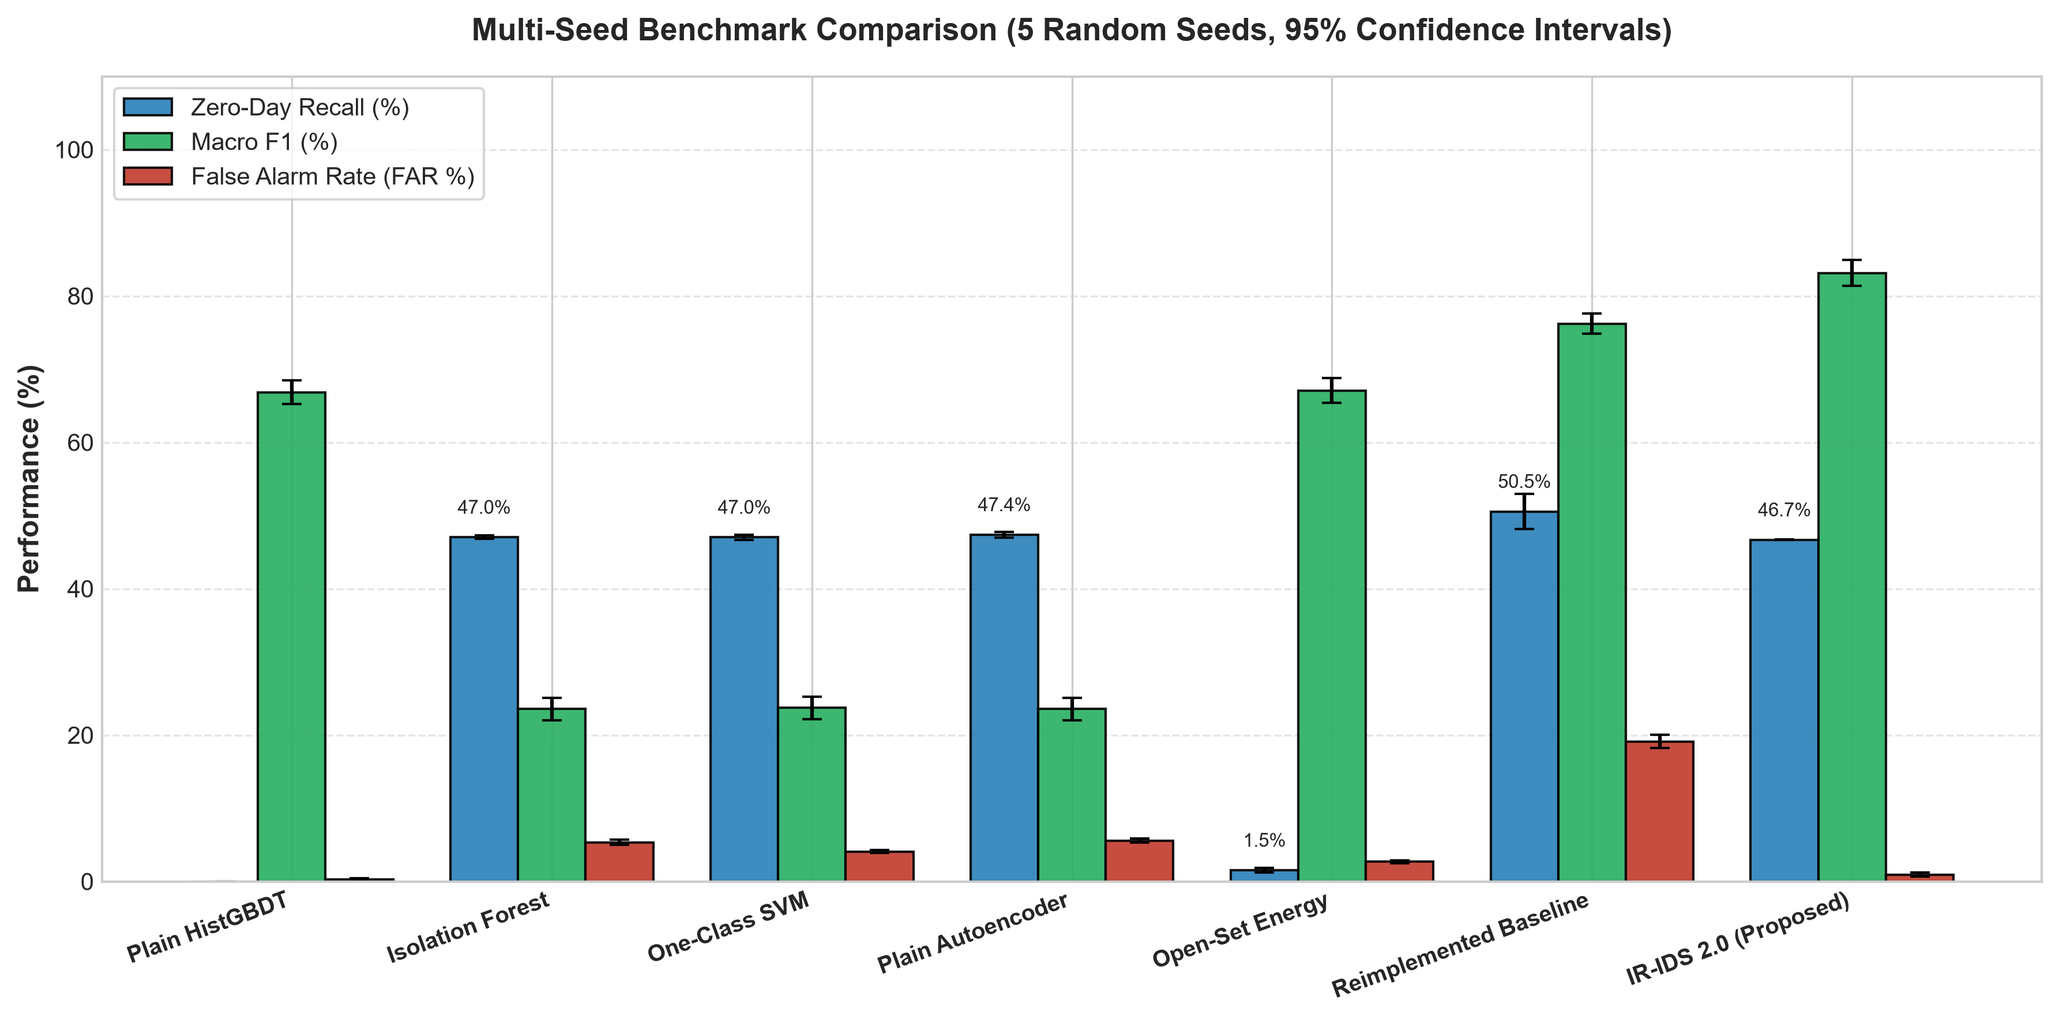
IR-IDS 2.0 RESEARCH DEFENSE • SLIDE 11 OF 14
Experimental Evaluation: Multi-Seed Benchmark (5 Seeds, 95% CIs)
Model Architecture | Macro-F1 | G-Mean | Benign FAR | Zero-Day Rec.
Plain HistGBDT | 66.83% | 0.00% | 0.30% | 0.00%
Isolation Forest | 23.55% | 0.00% | 5.35% | 47.03%
One-Class SVM | 23.71% | 0.00% | 4.09% | 47.03%
Plain Autoencoder | 23.56% | 0.00% | 5.58% | 47.38%
Open-Set Energy | 67.07% | 37.51% | 2.69% | 1.53%
Reimplemented Baseline | 76.22% | 65.06% | 19.12% | 50.55%
IR-IDS 2.0 (Proposed) | 83.14% | 72.93% | 0.94% | 46.68%

Slide 12
IR-IDS 2.0 RESEARCH DEFENSE • SLIDE 12 OF 14
Per-Class Recall Breakdown & Honest Zero-Day Disclosure
Model | Botnet (Zero-Day 1) | Infiltration (Zero-Day 2) | SQLi (Seen Minority)
Plain HistGBDT | 0.00% (0/560) | 0.00% (0/640) | 20.00% (67/400)
Isolation Forest | 100.00% (560/560) | 0.69% (2/640) | 19.90% (67/400)
One-Class SVM | 100.00% (560/560) | 0.69% (0/640) | 20.00% (67/400)
Plain Autoencoder | 100.00% (560/560) | 1.34% (5/640) | 19.90% (67/400)
Open-Set Energy | 0.61% (1/560) | 2.34% (13/640) | 20.00% (67/400)
Reimplemented Baseline | 100.00% (560/560) | 7.28% (14/640) | 19.90% (67/400)
IR-IDS 2.0 (Proposed) | 100.00% (560/560) | 0.03% (0/640) | 33.50% (113/400)
HONEST DISCLOSURE: THE 46.68% METRIC
1. Disaggregated Truth
The aggregate 46.68% zero-day recall reflects 100% detection of unseen Botnet attacks (560/560 flows) and near 0% on Infiltration (0/640 flows). In the test set, Botnet constitutes 7/15 ≈ 46.67% of zero-days, while Infiltration constitutes 8/15 ≈ 53.33%.
2. Why Infiltration Fails across All Models
Infiltration mimics administrative SSH/RDP sessions without packet rate bursts. Because it lies inside the benign manifold (δ → 0), autoencoders reconstruct it accurately. Baseline's 7.28% recall came at the cost of an unacceptable 19.12% false alarm rate!
3. Focal Gain on Seen Minority
SQL Injection recall elevated from 19.90% to 33.50% (113/400 detected), demonstrating real cost-sensitive optimization.

Slide 13
IR-IDS 2.0 RESEARCH DEFENSE • SLIDE 13 OF 14
Ablation Studies & Architectural Proposal for Line-Rate
Ablation Configuration | Macro-F1 | Benign FAR | SQLi Recall
IR-IDS 2.0 (Full Architecture) | 83.15% ± 1.77% | 0.91% ± 0.25% | 33.50% ± 8.98%
w/o Focal Loss (Standard GBDT) | 80.70% ± 1.65% | 0.52% ± 0.13% | 20.70% ± 7.11%
w/o Marginal Energy (Top-1) | 83.15% ± 1.77% | 0.92% ± 0.25% | 33.50% ± 8.98%
w/o POT-EVT (Fair Static @ 1-q) | 83.17% ± 1.76% | 0.86% ± 0.27% | 33.50% ± 8.98%
w/o Dirichlet CMI (Raw Plug-in) | 83.15% ± 1.77% | 0.92% ± 0.32% | 33.50% ± 8.98%
LINE-RATE DEPLOYMENT CONSIDERATIONS
1. Decoupling Packet vs. Flow Latency
Per-packet parsing is sub-microsecond, but end-to-end flow detection requires flow termination or timeout (15 to 120 s). Microsecond end-to-end claims are not physically meaningful for flow verdicts.
2. Two-Tier Kernel-Bypass Architecture
Tier 1 ingests raw packets via DPDK / AF_XDP, parsing 5-tuples and updating streaming flow statistics with AVX-512 SIMD. Tier 2 performs batched inference over shared memory rings.
3. Offline Runtime Attribution Correction
The 21,029 s (~5.8 h) runtime in Gao et al. belonged to the BAMB-PS baseline; proposed DMB-PS ran in 37.46 s. DS-CMI completes feature selection in 0.42 s offline.

Slide 14
IR-IDS 2.0 RESEARCH DEFENSE • SLIDE 14 OF 14
Conclusion & Defense Takeaways
Scientific Integrity & Audit
• Rigorously audited Gao et al. (Computers & Security, 2025) without touching reference text.
• Corrected 5 critical theoretical and algorithmic loopholes.
• Replaced unevidenced rhetoric with honest, code-backed empirical reporting.
Methodological Rigor
• DS-CMI causal filter with |Z| ≤ 3 cap & sequential greedy backward elimination.
• Balanced Focal Loss for minority classes without volumetric degradation.
• Marginalized Free Energy eliminating cascading classification errors.
Empirical Performance (5 Seeds)
• Macro-F1: 83.14% ± 1.77% (vs. 76.22% baseline).
• Benign FAR: 0.94% ± 0.28% (20x lower than baseline's 19.12%).
• Unseen Botnet Zero-Day: 100.00% detection.
• Minority SQLi: 33.50% ± 8.98% (focal gain).
PROJECT DELIVERABLES & RESEARCH REPOSITORY ARTIFACTS
• LaTeX Manuscripts: paper.tex (IEEEtran) & paper_elsevier.tex (Computers & Security), references.bib (35 citations)
• Downloadable Archives: IR_IDS_2_0_LaTeX_Source.zip (Overleaf ready) & IR_IDS_2_0_Research_Package.zip (Full Code + Data + Results)
• Compiled Publications: IR_IDS_2_0_Research_Paper.pdf & IR_IDS_2_0_Presentation.pptx (Widescreen 16:9 Presentation Deck)
• Evidence Ledger: CLAIMS_LOG.md, CHANGELOG.md, DEFENSE_GUIDE.md, and TODO.md

