Slide 1
SYSTEM DESIGN LAB
GROUP 1

Slide 2
GROUP MEMBER
Hem Chalasani (24CS4505)
T. Sujith Kumar (24CS4510)
Pranit Das (24CS4512)
Vastav Tailwal (24CS4514)

Slide 3
PROBLEM STATEMENT
Real-time activity detection using ESP32 for efficient monitoring of human movements

Slide 4
INTRODUCTION
Activity detection is crucial in areas such as healthcare, fitness tracking, security, and smart homes.
The ESP32 microcontroller offers Wi-Fi and Bluetooth connectivity, making it suitable for real-time, wireless monitoring.
By integrating motion sensors (e.g., accelerometer/gyroscope) with ESP32, we can detect physical activities efficiently.
The goal is to implement a system that can sense motion, classify activity, and transmit data wirelessly for analysis or alerting.

Slide 5
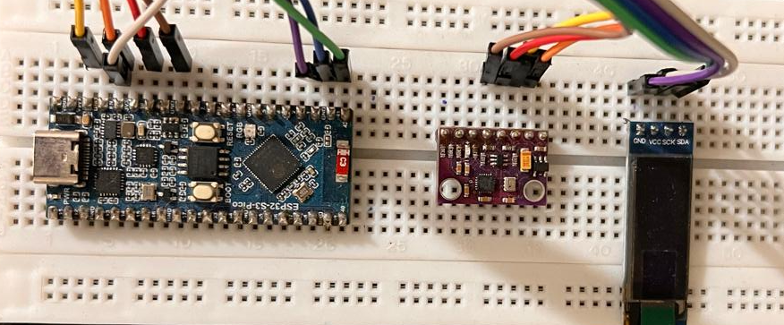
Setup
ESP32S3
GY91
SCREEN

Slide 6
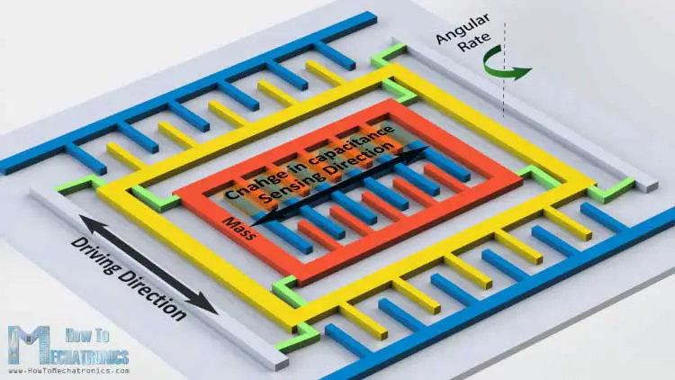
HOW DOES IMU WORK?
The IMU combines multiple sensors to measure motion:
• Accelerometer: Measures linear acceleration using MEMS capacitive sensing
• Gyroscope: Measures angular velocity through Coriolis effect
• Magnetometer: Detects magnetic fields using Hall-effect sensors

Slide 7
Dataset Description
GY91 Sensor was chosen for its multi-sensor capabilities, including:
Accelerometer Detecting movement and acceleration in all directions
Gyroscope Measuring rotation and orientation in space
Magnetometer Detecting magnetic fields, useful for orientation
Temperature sensor Environmental data, which can help differentiate between certain activities
GY91 sensor was securely attached to the body to ensure accurate capture of movements and gestures associated with each activity.
Data was collected continuously during each activity, with the sensor logging information at predefined time intervals.

Slide 8
Data Dictionary
Feature | Description | Unit | Sensor Type
Attitude Roll | The rotational angle of the sensor around the X-axis (front-back tilt) | Degrees (°) | Gyroscope
Attitude Pitch | The rotational angle of the sensor around the Y-axis (left-right tilt) | Degrees (°) | Gyroscope
Attitude Yaw | The rotational angle of the sensor around the Z-axis (left-right rotation) | Degrees (°) | Gyroscope
Gravity X | The component of gravity along the X-axis (forward-backward) | m/s² | Accelerometer
Gravity Y | The component of gravity along the X-axis (left-right) | m/s² | Accelerometer
Gravity Z | The component of gravity along the X-axis (up-down) | m/s² | Accelerometer
Rotation X | The rotation of the sensor along the X-axis | °/s | Gyroscope
Rotation Y | The rotation of the sensor along the X-axis | °/s | Gyroscope

Slide 9
Feature | Description | Unit | Sensor Type
Rotation Z | The rotation of the sensor along the Z-axis (rate of change of the Z-axis angle) | °/s | Gyroscope
Acceleration X | The acceleration measured along the X-axis (forward-backward movement) | m/s² | Accelerometer
Acceleration Y | The acceleration measured along the Y-axis (left-right movement) | m/s² | Accelerometer
Acceleration Z | The acceleration measured along the Z-axis (up-down movement) | m/s² | Accelerometer
Magnetic X | The magnetic field strength along the X-axis | µT | Magnetometer
Magnetic Y | The magnetic field strength along the Y-axis | µT | Magnetometer
Magnetic Z | The magnetic field strength along the Z-axis | µT | Magnetometer
Temperature | The environmental temperature recorded by the sensor | °C (Celsius) | Temperature Sensor
Target | 0: Walking; 1: Jogging; 2: Downstairs; 3: Upstairs; 4: Sitting; 5: Standing; 6: Sleeping

Slide 10
FEATURE DESCRIPTION
Rotation
Attitude
Acceleration
Gravity

Slide 11
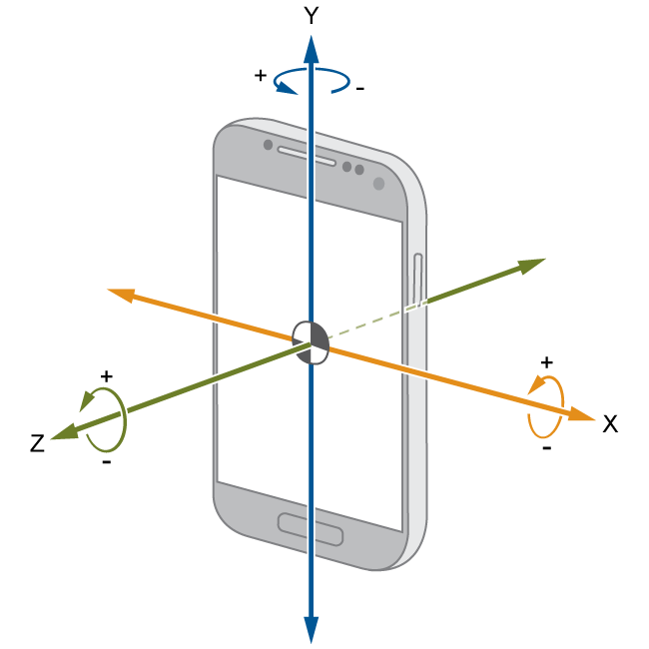
ROTATION
The angular motion of an object around an axis. It describes the change in orientation over time.
Measurement:
Directly measured by a gyroscope as rotational rates.
Integration of angular velocity over time gives a change in attitude (but accumulates drift).

Slide 12
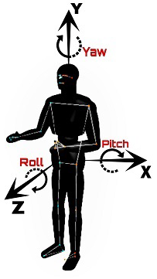
ATTITUDE
The orientation of an object relative to a reference frame (e.g., the Earth's frame). It describes how the object is "pointed" in 3D space. Its helps determine a robot’s heading.
Representation:
Euler angles (pitch, roll, yaw).
Quaternions (compact, singularity-free representation).
Rotation matrices (3x3 matrix for coordinate transformations).
Measurement:
Derived from sensor fusion (e.g., combining gyroscope, accelerometer, and magnetometer data).
Tools like the Madgwick or Kalman filter estimate attitude by fusing rotational rates (gyro) with gravity/magnetic field direction (accelerometer/magnetometer)

Slide 13
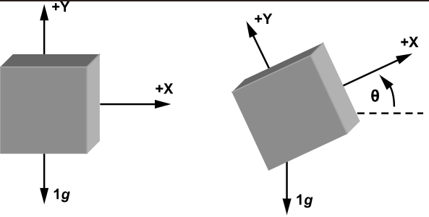
RAW ACCELERATION
Measures: Total proper acceleration (gravity + linear motion).
When stationary: Measures gravity only (~9.81 m/s² along the vertical axis).
During motion: Measures gravity + linear acceleration (e.g., device movement or vibration).
Limitations:
Cannot distinguish between gravity and motion-induced acceleration.
Tilt vs. linear motion ambiguity (e.g., tilting forward vs. accelerating horizontally).
+z

Slide 14
GRAVITY
Source: Derived from the filter's orientation estimate (quaternion).
Method:
Uses gyroscope data to track angular changes.
Fuses accelerometer/magnetometer data to correct gyroscope drift.
Estimates gravity direction by rotating the global gravity vector ([0, 0, 1] in the world frame) into the sensor frame using the orientation quaternion.
Limitations of Madgwick’s Approach
Rapid Motion: May lag, causing gravity estimation errors.
Free Fall: Incorrectly estimates gravity (accelerometer reads 0, but filter assumes orientation).
Magnetic Interference: Affects magnetometer-dependent orientation corrections.
+z
+z

Slide 15

METHODOLOGY
Feature Engineering: Correlation Matrix
Modelling:
Supervised Learning
Random Forest
Decision Tree
SVM
Neural Network
Model Test:
Precision
Recall
Accuracy
Model Deployment: ESP-IDF

Slide 16
HIERARCHICAL CLASSIFICATION
The hierarchical classification approach involves classifying activities in two stages. First, we determine whether there is motion or no motion. Once the state is identified, we further classify the activities into two groups: motion-related and no motion-related activities.
This hierarchical approach allows for a clear division between classes, reducing the complexity at each stage of classification.
Motion detection is the first step and acts as a filter. By classifying in stages, the model focuses on smaller subset of activities for classification, improving accuracy for the subsequent stage.
This leads to an increase in overall classification accuracy from 73% to 92%.
Single Classifier Precision: 72% → Hierarchical Precision : 92%.
Single Classifier Recall: 73% → Hierarchical Recall: 92%.

Slide 17
Diagram
Sitting
Steady Motion
Standing
Sleeping
Motion
Upstairs
Staircase Motion
Downstairs
Unsteady Motion
Surface Motion
Walking
Jogging

Slide 18
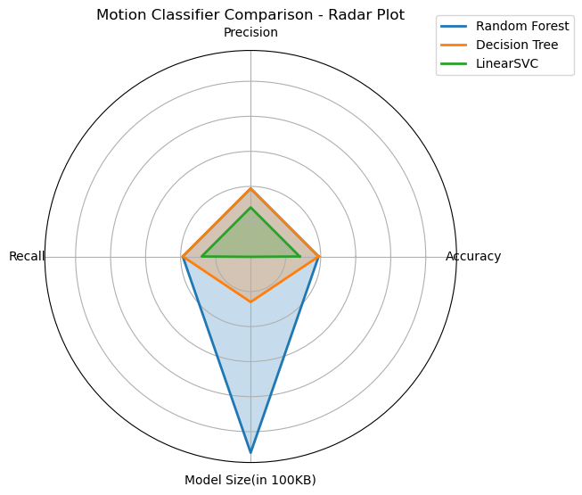
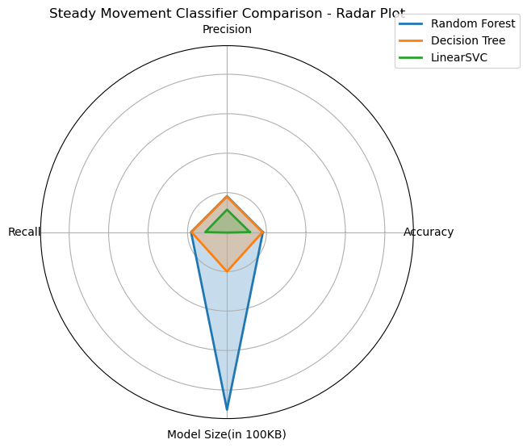
PERFORMANCE RESULT

Slide 19
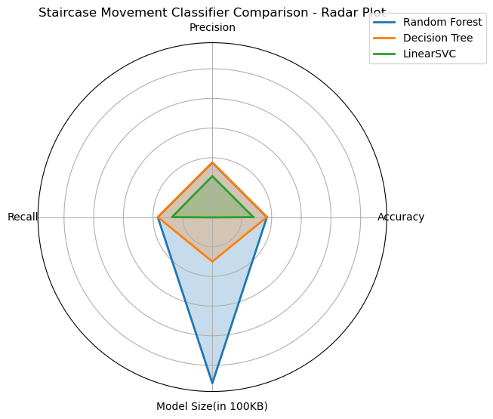
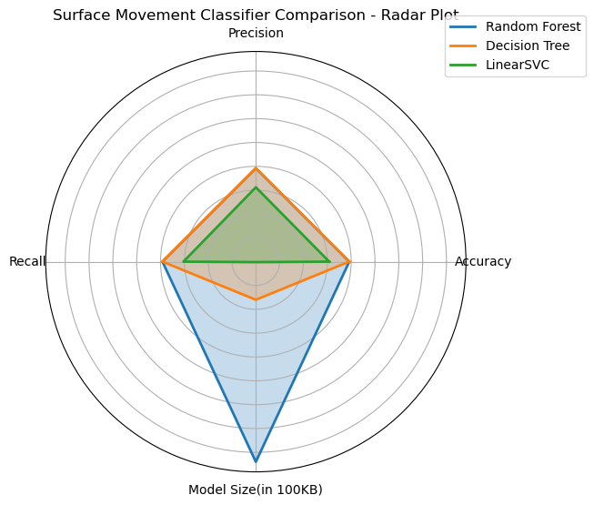
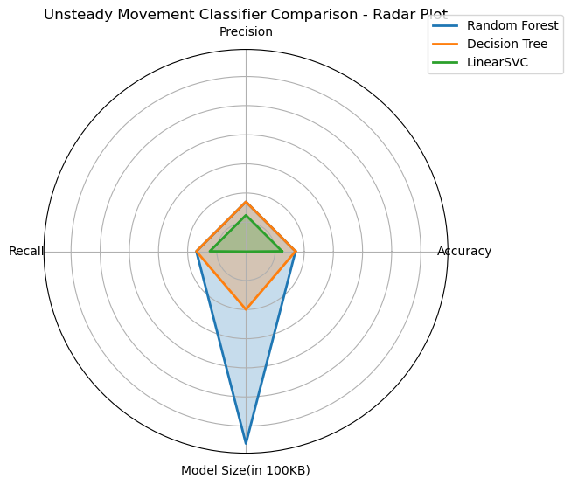

Slide 20
CONCLUSION
In this project, we successfully developed an activity detection system using the ESP32 microcontroller and the GY91 sensor.
A total of seven daily human activities were classified, using data such as acceleration, rotation, attitude, magnetic field, and temperature.
A hierarchical classification approach was implemented, which first distinguishes between motion and no motion, and then classifies activities within each group.
This method led to improved accuracy, precision, recall, and F1-score, especially when compared to traditional flat classification techniques.
The system was designed to be low-cost, portable, and suitable for real-time monitoring, making it ideal for applications in healthcare, fitness tracking, and smart environments.

Slide 21
FUTURE SCOPE
Add calibration classification to hierarchy.
Broader Activity Set future versions can include a wider range of activities such as cycling, climbing, and crawling, enhancing the system’s applicability in more diverse use cases.
IoT Integration The system could be integrated with other IoT devices (smartwatches, smart home assistants) to create a more comprehensive monitoring solution, offering insights into user behaviour across multiple platforms.
Multimodal activity detection, integration of vision/audition to get more precise classification results.

Slide 22
APPENDIX

Slide 23
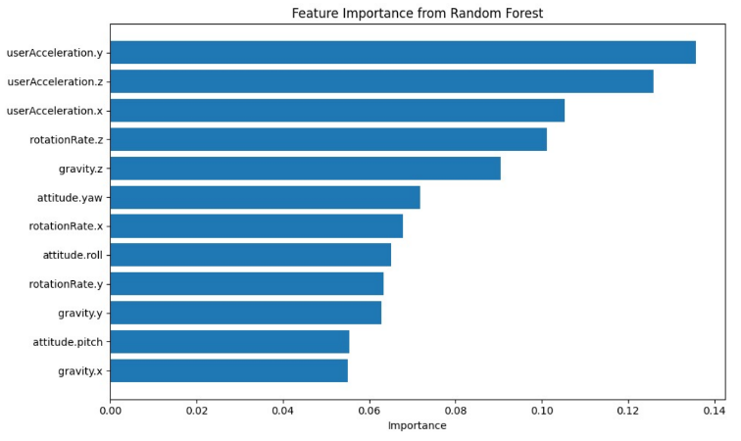
EDA RESULTS

Slide 24
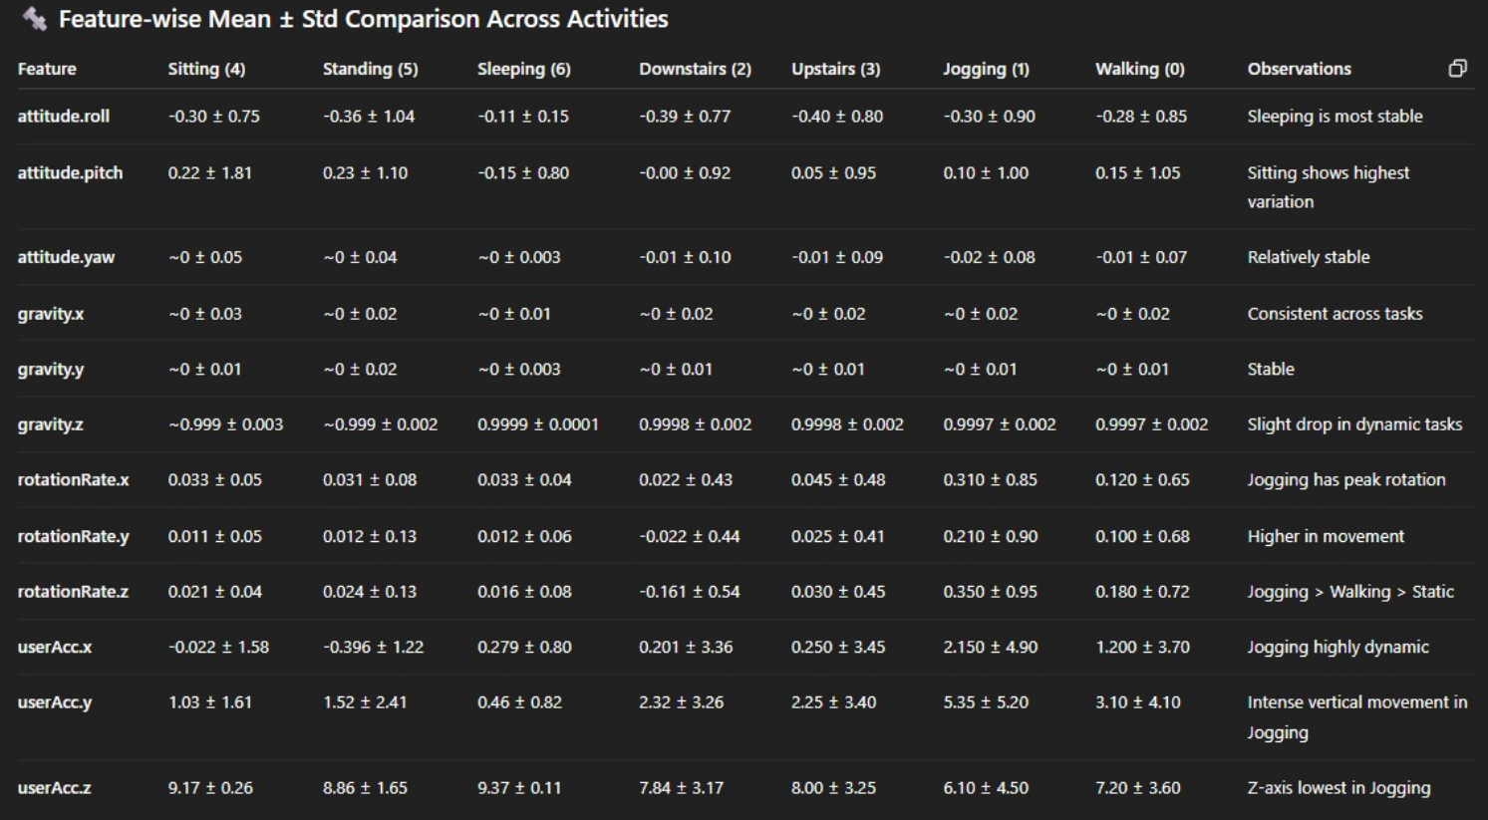

Slide 25
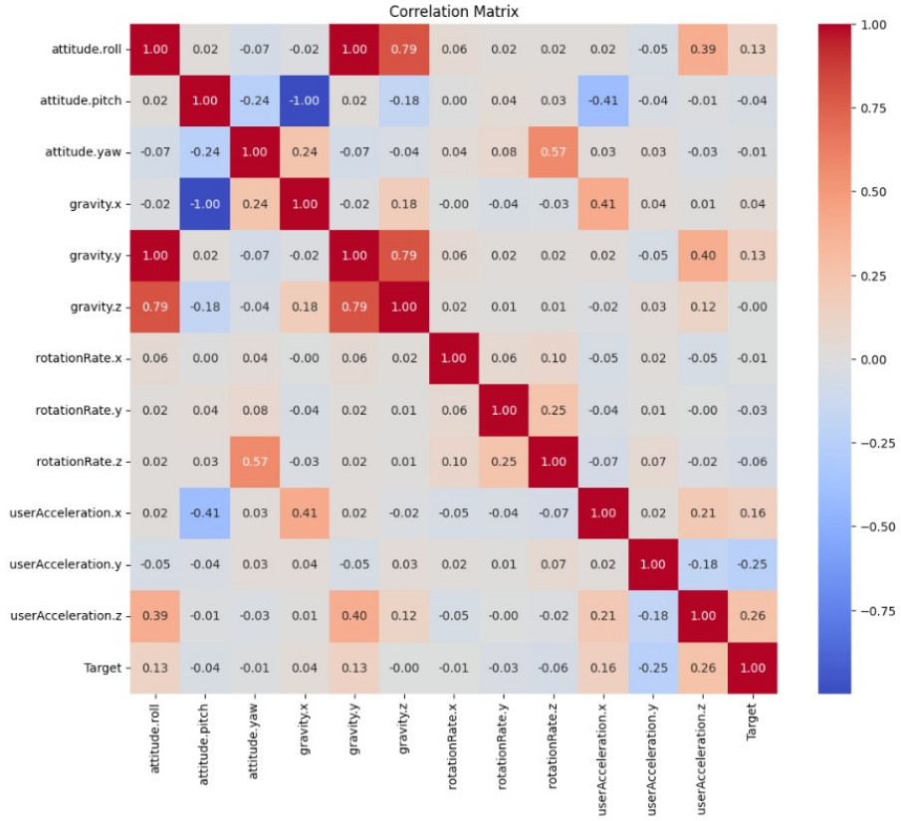

Slide 26
Insights from the Sensor Data Summary
Attitude (Orientation)
Pitch (std ≈ 1.10) and Roll (std ≈ 0.78) show high variability, indicating frequent tilting—typical in dynamic activities like walking, jogging, or climbing stairs.
Yaw remains almost constant (std ≈ 0.089), suggesting minimal horizontal turning during recorded activities.
Gravity
Gravity Z is close to 1.0 (mean ≈ 0.9997), confirming accurate vertical alignment and Earth gravity measurement.
Gravity X and Y have low values and minimal variation, indicating only slight horizontal tilts.

Slide 27
Rotation Rate
All axes (X, Y, Z) show high standard deviations (up to 0.58), highlighting considerable angular movement.
Rotation Z stands out with the highest average (mean ≈ 0.063), indicating frequent rotations around the vertical axis (e.g., turning or twisting).
User Acceleration
Acceleration Z shows a high average (mean ≈ 8.2) due to gravity compensation during stationary states.
All acceleration axes display wide dynamic ranges (±19.6 m/s²), suggesting vigorous movements like jogging or falling.
Acceleration Y has a high mean (≈ 1.77), likely reflecting forward/backward motion such as walking or running.

Slide 28
Dynamic Activities
1. Jogging (Target 1)
Insights: High vertical acceleration and rotation rates indicate vigorous movement.
2. Upstairs (Target 3)
Insights: Moderate acceleration with consistent upward movement patterns.
3. Downstairs (Target 2)
Insights: Similar to upstairs but with slight variations in rotation and acceleration due to descent.

Slide 29
Static Activities
4. Sitting (Target 4)
Insights: Minimal movement with stable gravity and low acceleration.
5. Standing (Target 5)
Insights: Slightly higher acceleration than sitting, indicating minor adjustments.
6. Sleeping (Target 6)
Insights: Very low movement, consistent with a resting state.

