Slide 1
SUPPLY CHAIN SALES & INVENTORY ANALYTICS
Interactive Power BI Business Intelligence Project
Sales • Customers • Products • Suppliers • Purchase Orders • Inventory • Returns • Shipments
Portfolio Project | Pranit Pawar

Slide 2
Project Overview
2
Purpose and business scope
Built an interactive Power BI solution to monitor the end-to-end supply-chain and commercial performance.
Combines sales orders, customers, products, suppliers, purchase orders, inventory, warehouses, shipments and returns.
Provides management visibility into revenue, profit, procurement cost, stock, warehouse capacity, customer performance and logistics.
Designed around four analytical areas: Main, Sales, Warehouse & PO, and Return & Shipment.

Slide 3
Business Problem
3
Why a centralized dashboard is needed
Sales, procurement, inventory, shipment and return data are often analyzed separately, making cross-functional decisions difficult.
Management needs a single view of revenue, profit, orders, purchasing cost, inventory and logistics performance.
Key questions include: Which customers and products drive sales? Which suppliers have the highest purchase cost? Where is inventory concentrated? What is the shipment status? Why are orders returned?
Goal: convert operational data into clear KPIs, trends and actionable business insights.

Slide 4
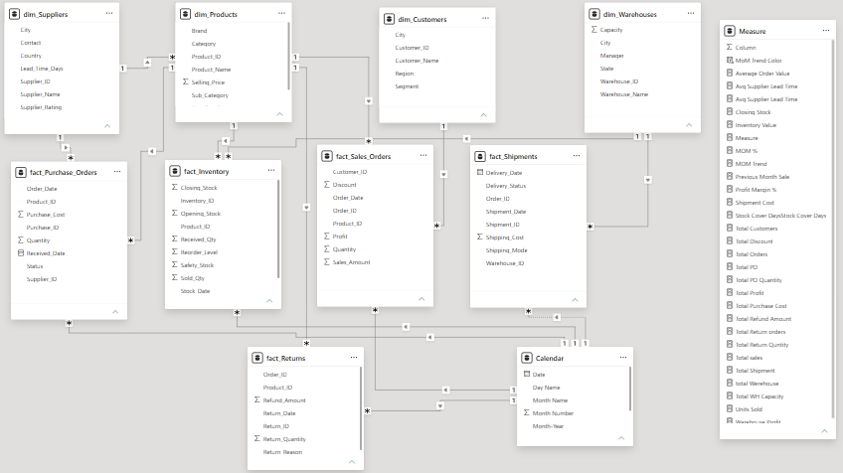
Data Model
4
Dimensional model supporting the dashboard
Model observation: Dimension tables feed the main business fact tables through one-to-many relationships; Calendar supports time-based analysis.
Supply Chain Sales & Inventory Analytics | Power BI

Slide 5
Data Model — Tables & Relationships
5
Structure visible in the Power BI model
Dimensions: dim_Suppliers, dim_Products, dim_Customers, dim_Warehouses and Calendar.
Fact tables: fact_Sales_Orders, fact_Purchase_Orders, fact_Inventory, fact_Shipments and fact_Returns.
Sales Orders connects customer and product information with order date, quantity, sales amount, discount and profit.
Purchase Orders connects supplier and product information with purchase cost, quantity and order status.
Inventory stores opening stock, received quantity, sold quantity, closing stock, reorder level and safety stock.
Shipments stores delivery/shipment dates, status, shipping cost, shipping mode and warehouse.
Returns stores refund amount, return date, return quantity and return reason.

Slide 6
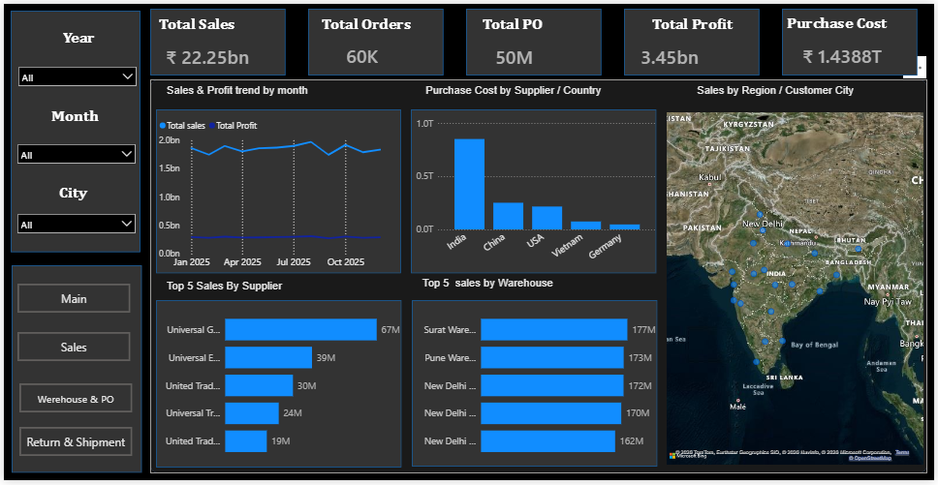
01 | Main Dashboard
6
Executive view of sales, profit, orders and procurement
Purpose: Monitor overall business performance and compare sales/profit with purchasing and geographic performance.
Supply Chain Sales & Inventory Analytics | Power BI

Slide 7
Main Dashboard — KPI & Visual Explanation
7
What each visual answers
KPIs: Total Sales, Total Orders, Total PO, Total Profit and Purchase Cost.
Sales & Profit Trend by Month: tracks monthly revenue and profit movement.
Purchase Cost by Supplier / Country: identifies where procurement spend is concentrated.
Sales by Region / Customer City: geographic view of sales distribution.
Top 5 Sales by Supplier: highlights suppliers associated with the highest sales contribution.
Top 5 Sales by Warehouse: compares sales performance across warehouses.
Year, Month and City slicers enable interactive filtering.

Slide 8
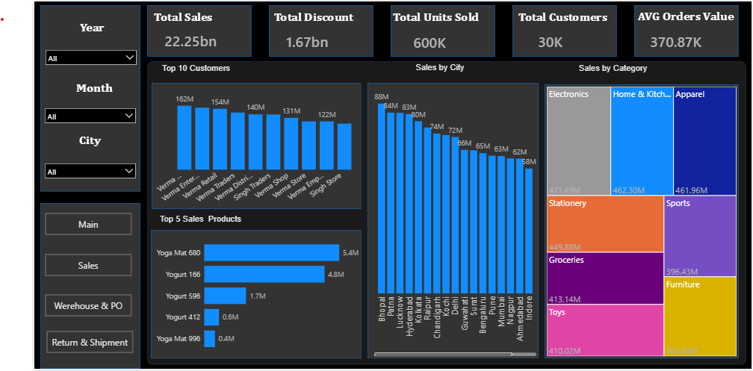
02 | Sales & Product Analysis
8
Customer, product, city and category performance
Purpose: Understand who buys, what sells, where sales occur and how categories contribute to revenue.
Supply Chain Sales & Inventory Analytics | Power BI

Slide 9
Sales & Product — Business Explanation
9
Customer and product performance
KPIs: Total Sales, Total Discount, Total Units Sold, Total Customers and Average Order Value.
Top 10 Customers: identifies the highest-value customer accounts.
Sales by City: compares geographic revenue performance.
Sales by Category: shows category contribution using a treemap.
Top 5 Sales Products: identifies products generating the highest sales.
These visuals support customer prioritization, product strategy and regional sales planning.

Slide 10
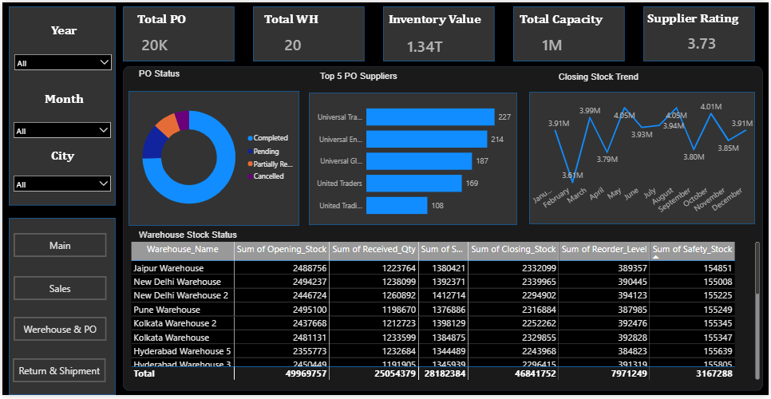
03 | Warehouse & Purchase Orders
10
Procurement, stock and warehouse performance
Purpose: Track procurement volume, warehouse capacity, supplier rating and inventory position.
Supply Chain Sales & Inventory Analytics | Power BI

Slide 11
Warehouse & PO — Business Explanation
11
Procurement and inventory visibility
KPIs: Total PO, Total WH, Inventory Value, Total Capacity and Supplier Rating.
PO Status: monitors completed, pending, partially received and cancelled purchase orders.
Top 5 PO Suppliers: identifies suppliers with the highest purchase-order volume.
Closing Stock Trend: monitors month-wise stock movement.
Warehouse Stock Status: compares opening stock, received quantity, sold quantity, closing stock, reorder level and safety stock.
Business value: supports purchasing decisions, stock planning, supplier evaluation and warehouse capacity management.

Slide 12
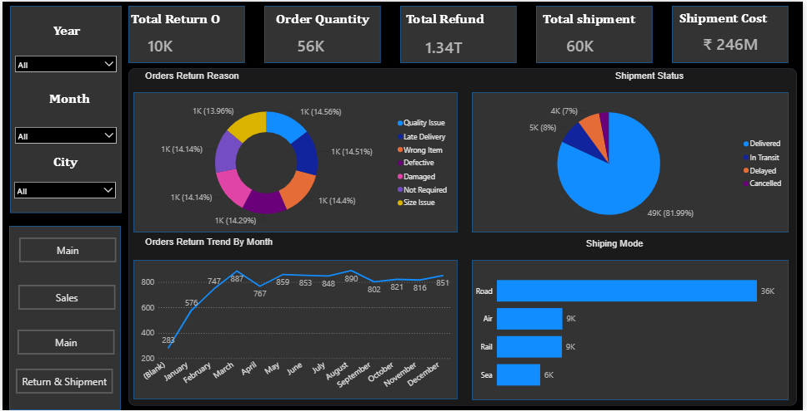
04 | Returns & Shipments
7
Logistics, delivery and return performance
Purpose: Understand shipment status, return reasons, monthly return trend and shipping mode usage.
Supply Chain Sales & Inventory Analytics | Power BI

Slide 13
Returns & Shipments — Business Explanation
13
Logistics performance and customer issues
KPIs: Total Return, Order Quantity, Total Refund, Total Shipment and Shipment Cost.
Orders Return Reason: identifies why orders are returned, including quality, delivery, wrong item, defective, damaged, not required and size issues.
Shipment Status: compares Delivered, In Transit, Delayed and Cancelled shipments.
Orders Return Trend by Month: tracks return volume over time.
Shipping Mode: compares Road, Air, Rail and Sea shipment usage.
Business value: helps improve delivery reliability, reduce avoidable returns and control logistics cost.

Slide 14
Key Business Insights
14
Insights supported by the dashboard
Sales performance can be monitored against profit and purchasing cost to understand commercial efficiency.
Customer and product rankings identify the accounts and products that contribute most to revenue.
Supplier and country procurement analysis highlights where purchasing spend is concentrated.
Warehouse analysis shows stock position and helps identify inventory levels relative to reorder and safety stock.
Shipment status provides visibility into delivered, in-transit, delayed and cancelled orders.
Return-reason analysis can reveal recurring quality, delivery or product issues.
Shipping-mode analysis supports logistics planning and cost optimization.

Slide 15
Business Recommendations
15
Actions management can take
Prioritize high-value customers and products while developing underperforming segments.
Review supplier performance, purchase cost and supplier ratings before increasing procurement volume.
Use reorder level and safety stock to reduce stock-out risk while avoiding excess inventory.
Investigate delayed and cancelled shipments and improve logistics planning.
Analyze repeated return reasons and address quality, packaging, product-information or delivery issues.
Compare shipment modes by cost and service performance to improve logistics efficiency.
Review sales and profit together rather than revenue alone when evaluating performance.

Slide 16
Technical Implementation
16
Skills demonstrated
Power BI — interactive dashboard development, navigation and business reporting.
Power Query — data cleaning, transformation and preparation.
DAX — KPI calculations, time analysis, sales/profit, inventory, shipment and return metrics.
Data Modeling — dimensional model with business dimensions and fact tables.
Visualization — KPI cards, line charts, bar charts, donut/pie charts, treemap, tables and maps.
Business Analysis — sales, procurement, inventory, logistics, customer and product performance.

Slide 17
Resume-Ready Project Description
17
Professional portfolio wording
• Developed an interactive Power BI dashboard to analyze sales, customers, products, suppliers, purchase orders, inventory, returns and shipments.
• Built a dimensional data model and DAX-driven KPIs for revenue, profit, orders, purchase cost, inventory value, shipment cost, refunds and customer performance.
• Created interactive analysis for sales trends, top customers/products, supplier procurement, warehouse stock, shipment status and return reasons.
• Delivered business insights to support inventory planning, supplier evaluation, customer prioritization, logistics optimization and return reduction.

Slide 18
Recommended GitHub Repository
18
Professional portfolio structure
Repository name: Supply-Chain-Sales-Inventory-Analytics-PowerBI
README.md — project overview, business problem, dashboard, insights and recommendations.
PowerBI/ — .pbix report file.
Dataset/ — source dataset, only if it is safe and permitted to publish.
Dashboard_Screenshots/ — Main, Sales & Product, Warehouse & PO, Return & Shipment and Data Model images.
Documentation/ — Project Overview, Data Model, Data Cleaning, DAX Measures and Business Insights.
Presentation/ — project presentation PPT.
Important: remove confidential or company-sensitive data before making the repository public.

Slide 19
Project Conclusion
19
From operational data to business decisions
This project provides a connected view of the supply-chain lifecycle: Sales → Procurement → Inventory → Shipment → Returns.
It helps management monitor revenue, profitability, purchasing cost, stock, warehouse operations, customer performance and logistics.
The dashboard demonstrates practical Power BI, DAX, Power Query, data modeling and business-analysis skills.
Overall outcome: a centralized BI solution that turns operational data into measurable business insights.
THANK YOU | QUESTIONS & DISCUSSION

