Slide 1
Disaster tweet Classification

Slide 2
Summary
The project aims to build a model which can correctly identify if the tweet is related to the topic of disaster of any kind.
It’s not always that when someone tweets ‘Ablaze’ it’s related to disaster. It can be metaphorical. For example, “On the plus, side look at the sky last night it was ablaze”.
There are different was of performing a classification however, I have used following methods:
Count Vector and Random forest
Embedding layer with Bidirectional LSTM
Tfidf Vector and topic extraction (Extra)
Sentiment score with afinn(Extra)

Slide 3
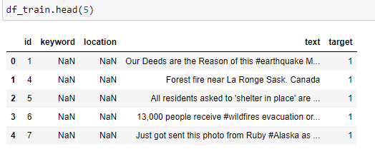
Dataset
The dataset is from the site Kaggle, it’s from a current on-going competition.
Link: https://www.kaggle.com/competitions/nlp-getting-started/data

Slide 4
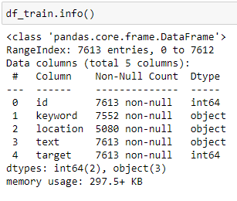
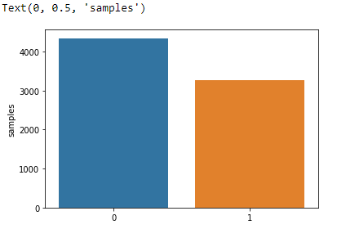
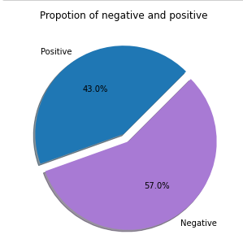
Dataset

Slide 5
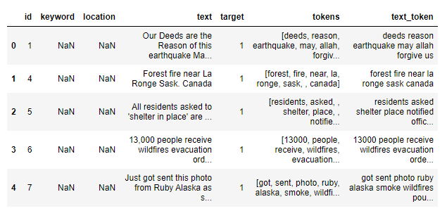
Preprocessing the Dataset
For processing the data, it needs cleaning.
1. Removed hashtags for the tweets.
2. Removed links from the tweets.
3. Tokenized the text and made text to lower case.
4. Removed stopwords.
5. Made a different column of tokens.
6. Made a different column for clean text.

Slide 6
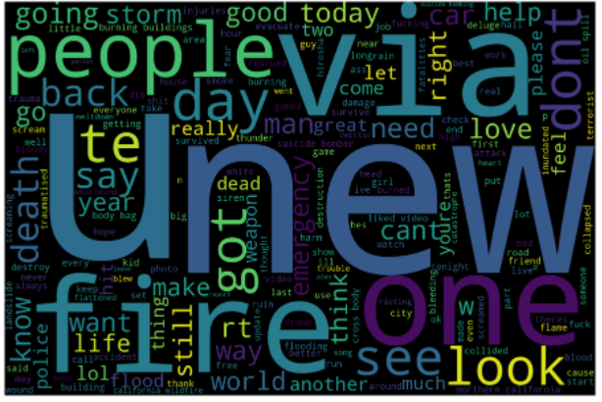
Word Cloud
The world cloud shows what words are used multiple times in the clean text.
Words to take note of:
Fire
Storm
Emergency
Death
Help

Slide 7
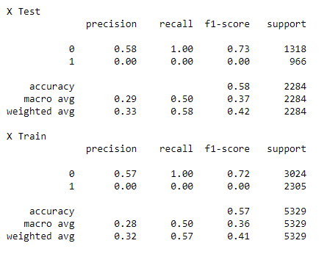
Count Vector and Random forest
The first step in this model was to convert the tokenized text to a vector. I used Count vector to do so.
Secondly, for finding the best parameter for random forest, I used grid search. Got max_depth: 12, Max_features: 7, n_estimators: 15.
Ran random forest on these parameters and got a f1 score of 58% on test set.

Slide 8
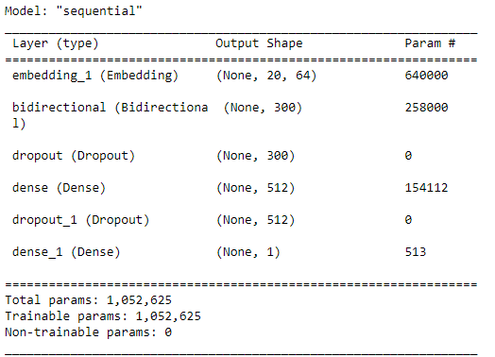
LSTM model
Firstly, I split the data to train and test. This time I used Keras Tokenizer to tokenizer the text with max words 10_000.
Secondly, applied text to sequence and pad sequence on the tokenized text. In addition, did the same on the test set.
Defined a model with callbacks of learning rate scheduler.

Slide 9
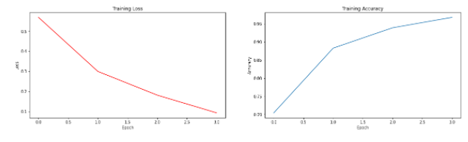
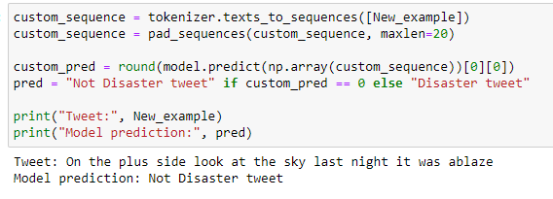
Accuracy
Running on the test set I got the accuracy of 75%
Custom input:

Slide 10
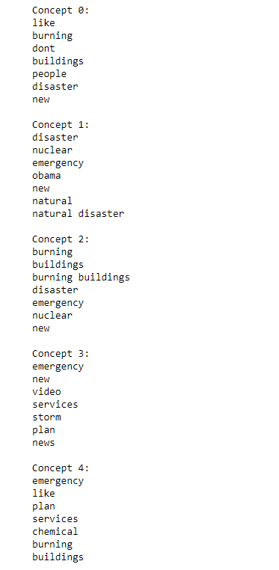
Tf-idf vector and randomized SVD
Firstly, I got a matrix from the TfidfVectorizer with max of 500 features.
Extracted the terms from the vector.
Used sklearn’s randomized SVD for topic extraction.

Slide 11
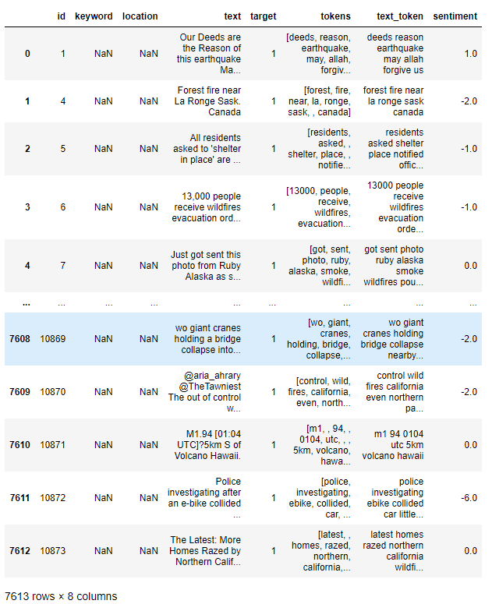
Afinn sentiment score

Slide 12
Conclusion
The model of LSTM, essentially a deep neural network, is comparatively more capable of identifying tweets related to disaster then Random forest classifier.
LSTM identifies tweets with 75% accuracy while random forest identifies tweets with 58% accuracy.

