Slide 1
Road Warrior
Event-Driven Trip Management Dashboard
Team - 4
Notes:
Good morning. Today I will present our solution for Road Warrior, a trip management dashboard that gives travelers a consolidated view of their existing airline, hotel, and car reservations across web and mobile.
The core architectural choice was to design the system as event-driven microservices with a Backend-for-Frontend pattern. We made that choice to optimize for scalability, responsiveness, and near real-time reservation updates while keeping integration with the agency systems loosely coupled.

Slide 2
Problem, Scope, and Constraints
Notes:
Business Problem, Users, and Growth Context, Scope Boundaries, Assumptions, and External Dependencies

Slide 3
What Problem Are We Solving?
Unified dashboard
View and manage all existing travel reservations in one place across web and mobile
Reservation ingestion
Auto load reservations from agency airline, hotel, and car rental systems, with manual fallback entry
Trip management
Group reservations into logical trips with search/filter support and archive completed trips
Real-time experience
Provide live dashboard updates, notifications, and social trip sharing
Business visibility
Highlight preferred partner vendors while keeping new booking out of scope
Notes:
The business problem is straightforward: travelers currently do not have a single place where they can view and manage all of their existing trip reservations in a unified way.
This system must integrate with the agency's existing interface systems for airline, hotel, and car rental data. It also needs to allow manual reservation entry as a fallback, group reservations into trips automatically, and archive completed trips into a past trips view.
One important scope boundary is that booking new travel is explicitly out of scope. It is a trip management and visibility platform. That distinction matters because it lets us optimize the architecture for retrieval, organization, and updates rather than transactional booking workflows.

Slide 4
Quality Drivers
Scalability Support growth from 10k to 100k active users
Responsiveness Rich UI across web and mobile with fast interactions
Elasticity Absorb seasonal traffic spikes efficiently
Availability Travelers must access current trip details globally
Data freshness Updates such as delays or cancellations should appear quickly
Notes:
The design was driven primarily by quality attributes rather than only functional features.
The first driver is scalability. The problem statement starts at more than ten thousand users and expects growth toward one hundred thousand active users, with seasonal peaks reaching several thousand concurrent users.
The second driver is responsiveness. The phrase richest user interface possible implies fast and fluid user interactions on both web and mobile.
The third driver is elasticity. Travel demand is seasonal, so the system must scale up during peaks and scale down efficiently during off-peak periods.
The fourth driver is availability. Travelers rely on the platform while in transit, so the system must remain accessible and dependable across time zones.
Finally, data freshness is critical. Updates such as delays or cancellations need to appear quickly enough that users trust the dashboard as the current source of truth.

Slide 5
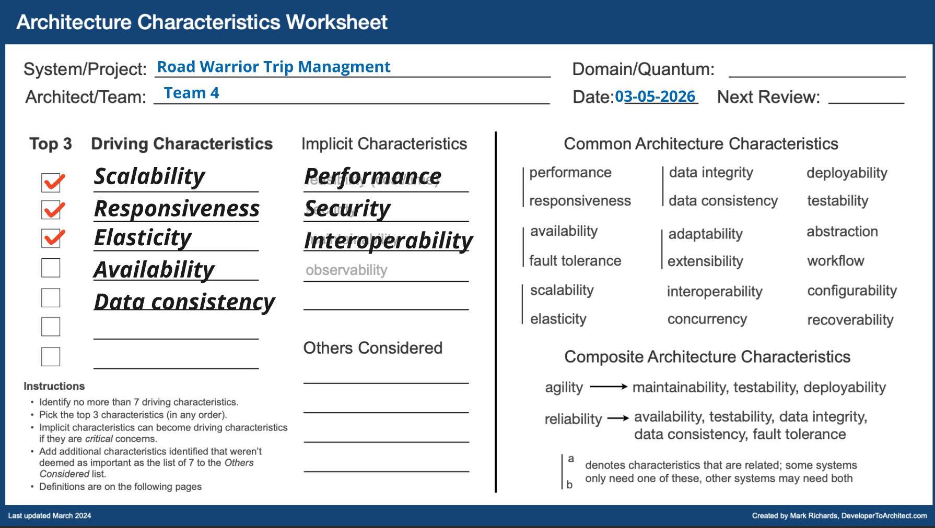

Slide 6
Assumptions
Agency systems can publish events or expose efficient delta APIs
Authentication is handled by the agency identity provider
Trip grouping uses dates, locations, and travel sequence heuristics
Initial release focuses on English and UTC-based handling
Favored vendor status is provided by the agency interface layer

Slide 7
Solution Strategy
Notes:
Functional and Non-Functional Requirements Driving Design, Chosen Architecture Style and Rationale

Slide 8
Functional and Non-Functional Requirements Driving Design
Core Functional Requirements
Defines essential system tasks including reservation ingestion, manual fallback, trip grouping, and lifecycle handling.
User Engagement Features
Includes search, filtering, social sharing, and notifications to enhance usability and provide real-time updates.
Non-Functional Requirements
Specifies system quality aspects like availability, performance, scalability, data freshness, security, and observability.
Notes:
The functional requirements of Road Warrior define what the system must do from a user’s perspective, while the non-functional requirements describe how well it must do it. Core functional requirements include automatic ingestion of reservations from agency systems, manual reservation management as a fallback, automatic grouping of reservations into trips, and lifecycle handling that moves completed trips into a ‘Past Trips’ archive. Additional capabilities such as search, filtering, and social sharing improve usability and engagement, while optional notifications for delays or cancellations add tangible user value. Equally important are the non-functional requirements, which strongly shape the architecture. Availability is targeted at 99.9% monthly, implying the use of multi–availability zone managed services and resilient communication patterns. Performance goals specify P95 read latencies under 200 milliseconds and write latencies under 500 milliseconds, reflecting the read-heavy nature of dashboard interactions. Scalability requirements call for handling thousands of concurrent users during peak seasons without degradation. Data freshness requirements emphasize near real-time updates, though bounded staleness is acceptable. Security and privacy requirements mandate modern authentication, encryption in transit and at rest, auditability, and minimization of personally identifiable information. Finally, observability requirements demand end-to-end tracing, metrics, and alerting to ensure the system can be operated confidently at scale. Together, these requirements form the foundation for all subsequent architectural decisions.

Slide 9
Chosen Architecture Style and Rationale
Event-Driven Microservices
Allows independent scaling and asynchronous processing for reservations, notifications, and trip computations.
Modular Backend-For-Frontend
Simplifies client integration by providing a cohesive API surface, centralizing authentication and caching.
Scalability and Simplicity Balance
Combines microservices scalability with operational simplicity through streamlined client interactions.
Considered Alternatives
Synchronous monolith and serverless approaches were rejected due to scalability and predictability issues.
Notes:
To meet the defined requirements, the chosen architecture style for Road Warrior is an event-driven microservices approach, complemented by a modular API or backend-for-frontend (BFF) layer. Event-driven microservices are particularly well suited to the problem because they allow reservation ingestion, trip computation, notifications, and sharing to scale independently and process updates asynchronously. This is critical for handling seasonal spikes and bursts of updates from agency systems without overwhelming the user-facing APIs. Events also enable near real-time propagation of changes, such as delays or cancellations, while providing natural buffering and backpressure through messaging infrastructure. At the same time, exposing a modular BFF to clients simplifies the web and mobile integration by providing a single, cohesive API surface. This avoids chatty client interactions with multiple services and centralizes concerns such as authentication, caching, and aggregation. The combination balances scalability with operational simplicity: microservices handle domain-specific workloads, while the BFF streamlines client interactions. Alternatives such as a purely synchronous monolith or a fully serverless approach were considered but rejected due to limitations in scalability, real-time behavior, or operational predictability. The chosen style provides a clear evolution path, allowing individual services to be optimized or extracted further as usage grows.

Slide 10
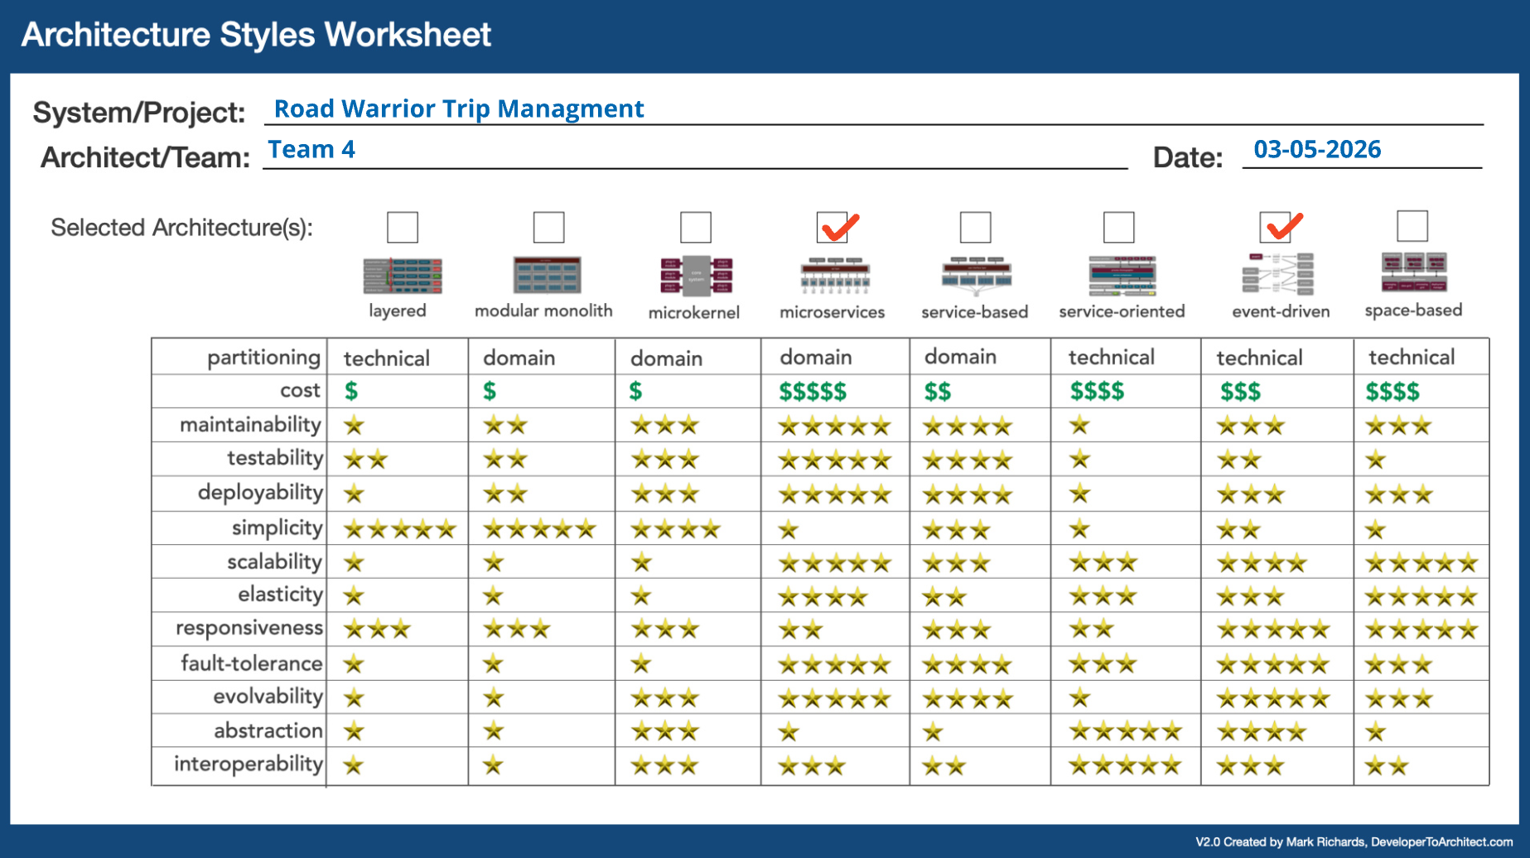

Slide 11
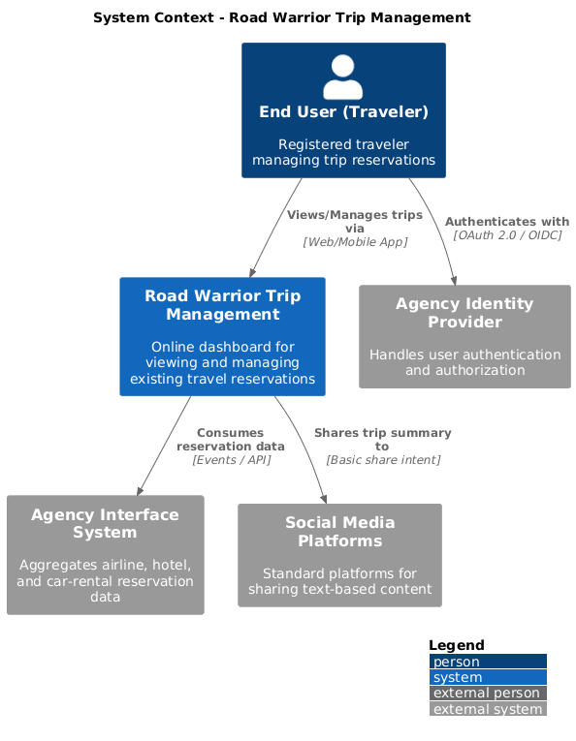

Slide 12
Logical and Physical Architecture
Notes:
Logical Architecture and Service Responsibilities, Physical Deployment Architecture on Azure

Slide 13
Logical Architecture
Web and mobile clients consume APIs through API Management and BFF
Reservation Ingestion Service processes agency-system updates
Trip Management Service groups reservations into trips
Notification Service pushes critical updates to clients
Azure SQL stores core data, Redis improves read performance, Service Bus carries events
Notes:
At the edge, web and mobile clients connect through API Management and the BFF layer. That gives us a clean boundary for client-specific APIs, security enforcement, and traffic management.
Behind that, the Reservation Ingestion Service handles updates coming from agency systems. Its job is to validate and normalize incoming events and persist reservation changes into the system.
The Trip Management Service applies grouping logic to organize reservations into meaningful trips based on timing, geography, and travel sequence.
The Notification Service is responsible for pushing important changes, such as delays or cancellations, back to connected clients.
For persistence, Azure SQL is the primary operational store because the data model is naturally relational and benefits from strong consistency and robust joins. Redis is used for high-speed reads and caching, and Service Bus carries events between services.

Slide 14
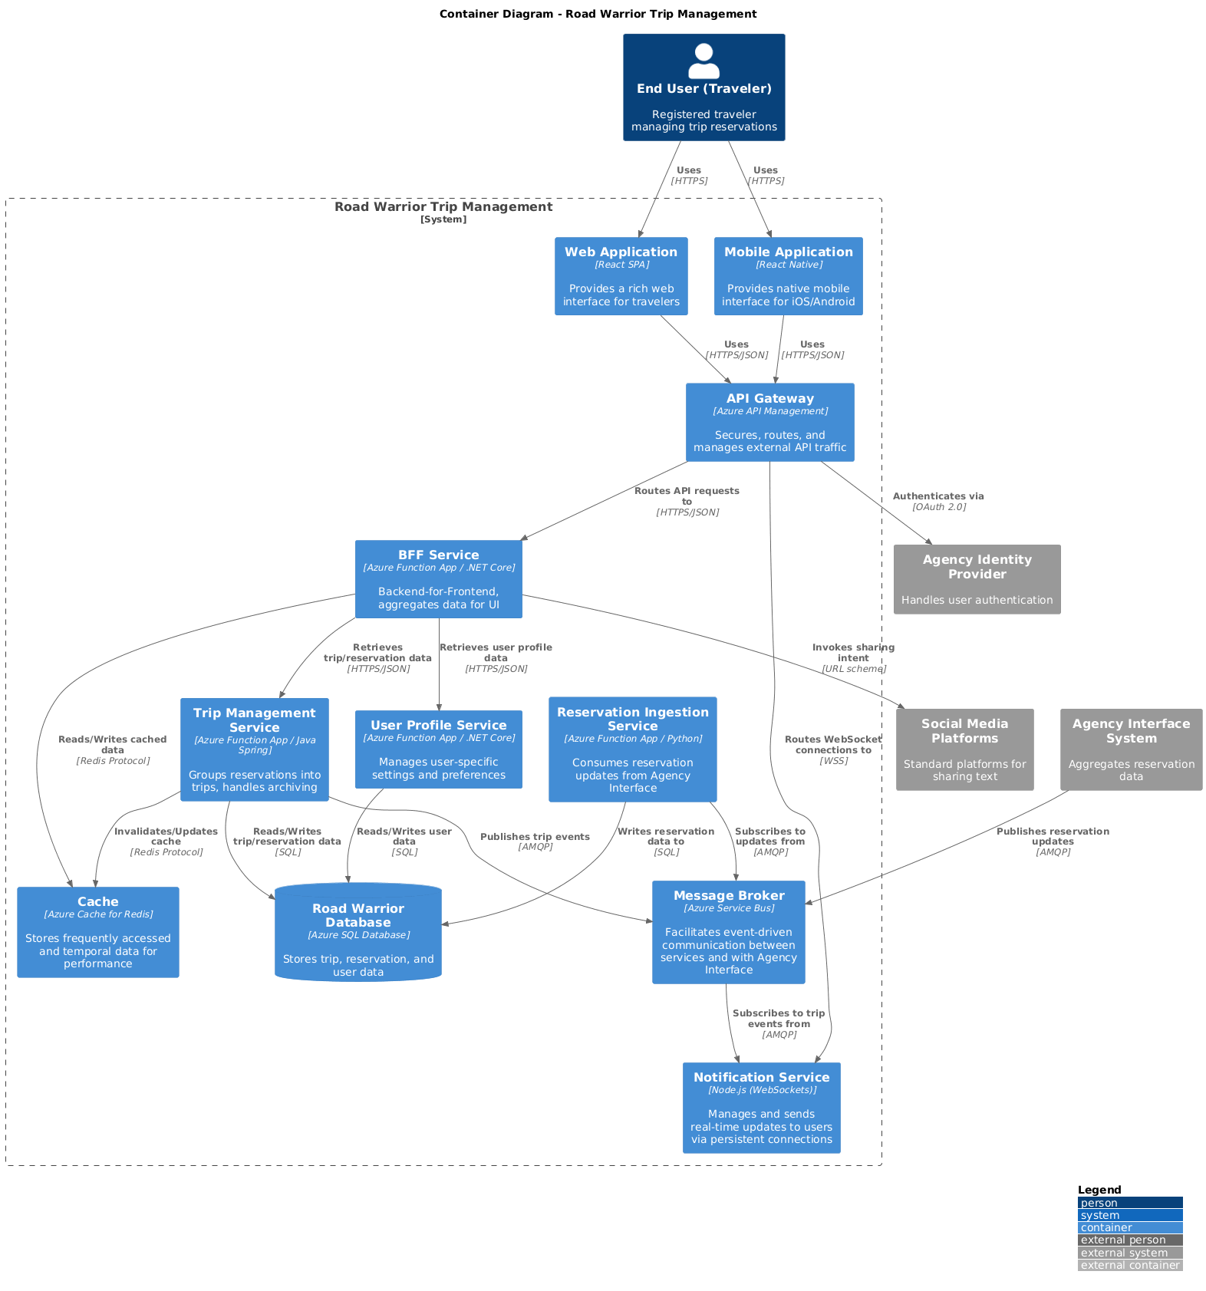

Slide 15
Runtime Flow
Agency system publishes a reservation update event
Reservation Ingestion Service validates and persists the change
Trip Management updates trip grouping if needed
Notification Service pushes delay or cancellation changes to active clients
Dashboard reflects the latest state without user polling
Notes:
This slide shows the most important runtime scenario: how an update reaches the traveler.
First, an agency system publishes a reservation update event, for example a gate change, delay, or cancellation.
Second, the Reservation Ingestion Service consumes that event, validates it, and updates the reservation state in the database.
Third, if the reservation change affects the trip structure, the Trip Management Service recomputes the grouping. For example, if a flight moves across a date boundary, the trip organization may change.
Fourth, the Notification Service pushes the relevant update to active clients using WebSockets or Server-Sent Events.
The important architectural point here is that the system is near real-time but event-driven and eventually consistent. We are not forcing every downstream change into one synchronous request path. That improves resilience and decoupling, while still keeping the dashboard fresh enough for traveler needs.

Slide 16
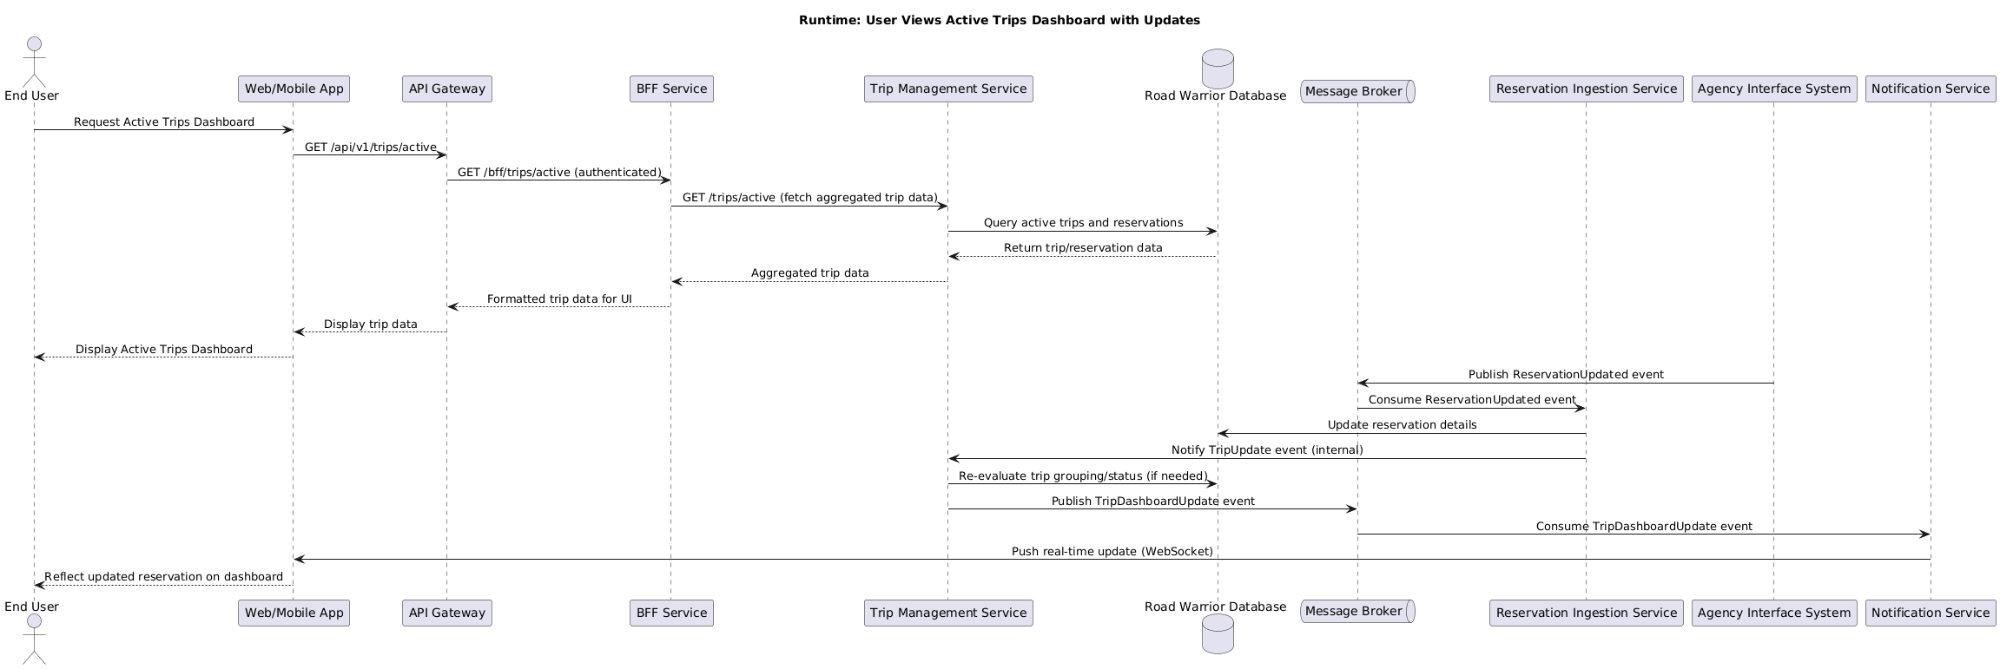

Slide 17
Deployment Posture
Cloud-native deployment on Azure managed services
AKS hosts stateless backend services with horizontal auto-scaling
Azure SQL, Redis, and Service Bus provide managed data and messaging capabilities
Front Door and CDN improve global performance and edge protection
Observability supports distributed tracing, metrics, and alerting
Notes:
From a deployment perspective, the system is cloud-native and built around managed Azure services.
Stateless backend services run on AKS so they can scale horizontally under changing demand. Azure SQL, Redis, and Service Bus provide managed database, cache, and messaging capabilities without requiring us to run those platforms ourselves.
At the edge, Front Door and CDN improve latency, distribution, and protection for globally distributed users.
This deployment posture supports elasticity, availability, and reduced operational burden. The tradeoff is vendor dependence, but in this case we accepted that because managed services materially reduce platform overhead for a system with meaningful scale and uptime requirements.

Slide 18
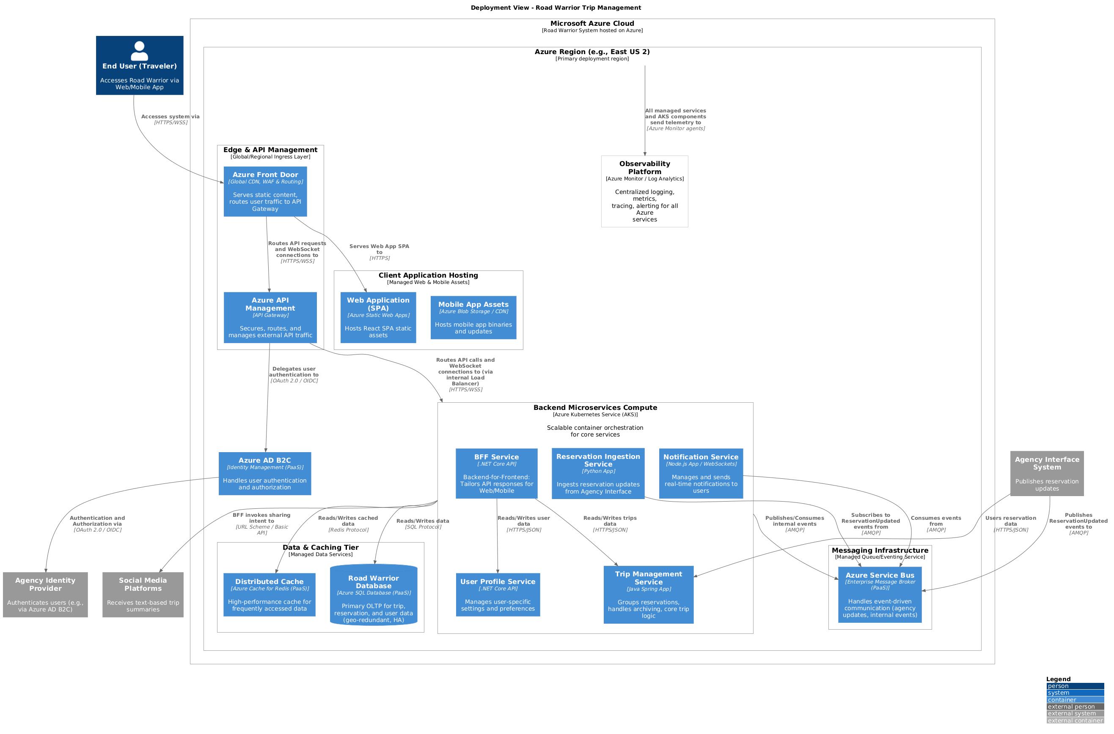

Slide 19
Logical Architecture
API Management Layer
The API management layer routes requests and enforces rate limiting and authentication for client applications.
Core Domain Microservices
Microservices like User, Trips, Reservation, Sharing, and Notification own their business logic and data independently.
Event-Driven Messaging Backbone
Services communicate asynchronously through a central messaging backbone enabling event publication and consumption.
Caching and Real-Time Updates
Caching accelerates dashboard queries while real-time messaging pushes updates to connected clients.
Notes:
At the edge, web and mobile clients connect through API Management and the BFF layer. That gives us a clean boundary for client-specific APIs, security enforcement, and traffic management.
Behind that, the Reservation Ingestion Service handles updates coming from agency systems. Its job is to validate and normalize incoming events and persist reservation changes into the system.
The Trip Management Service applies grouping logic to organize reservations into meaningful trips based on timing, geography, and travel sequence.
The Notification Service is responsible for pushing important changes, such as delays or cancellations, back to connected clients.
For persistence, Azure SQL is the primary operational store because the data model is naturally relational and benefits from strong consistency

Slide 20
Physical Deployment Architecture on Azure
Secure Traffic Entry
Azure Front Door and web application firewall provide global entry points with caching and attack protection.
Core Application Hosting
Core app components run in virtual networks using Azure App Service, Container Apps, and AKS for microservices.
Messaging and Background Processing
Azure Service Bus and Event Hubs enable event-driven communication, with Azure Functions for background tasks.
Data Storage and Caching
Data stored in Cosmos DB and SQL Database ensures high availability, supported by Redis cache and Blob Storage.
Notes:
The physical deployment architecture maps the logical components of Road Warrior onto concrete Azure infrastructure in a way that satisfies availability, performance, and security requirements. Client traffic enters through Azure Front Door and a web application firewall, providing global entry points, caching, and protection against common attacks. Azure API Management acts as the primary gateway into the system, enforcing policies and routing requests to the backend. The core application components run within a virtual network using a combination of Azure App Service or Container Apps for the BFF and AKS or Container Apps for the microservices. This private data plane isolates sensitive services and data from direct internet exposure. Azure Service Bus or Event Hubs provide the messaging backbone for event-driven communication, while Azure Functions or containerized workers process ingestion and background tasks. Data is stored in managed services: Azure Cosmos DB for user-related data and Azure SQL Database for trips and reservations, both configured for high availability. Azure Cache for Redis accelerates read paths, and Azure Blob Storage supports archival and export needs. Azure SignalR Service resides in the public subnet to manage persistent client connections for real-time updates. Cross-cutting concerns such as secrets management and observability are handled by Azure Key Vault and Azure Monitor with Application Insights. This deployment leverages managed services to reduce operational burden while delivering the required resilience and scalability.

Slide 21
Decisions, Risks, and Evolution
Notes:
Key Architecture Decision Records and Data Strategy, Risk Mitigation, NFR Coverage, and Future Evolution

Slide 22
Key Architecture Decision Records and Data Strategy
Event-Driven Data Ingestion
Data ingestion uses event-driven approach for near real-time updates, fallback polling,retries, and failure handling via queues.
Primary Data Store Choices (ADR-5)
User Service employs flexible NoSQL database for evolving profiles; Trips Service uses relational SQL for robust search and indexing.
Automated Trip Grouping Logic (ADR-6)
Reservations are grouped automatically by deterministic date and location rules while allowing manual user overrides for flexibility.
ADR-1: Microservices Architecture
For independent scaling, fault isolation, and maintainability; tradeoff is distributed-system and operational complexity.
ADR-2 and ADR-3: Event-Driven Ingestion and Push Updates
To support near real-time reservation changes and responsive clients; tradeoff is eventual consistency, retries, and connection-management complexity.
ADR-4: Managed Cloud Deployment
To improve elasticity, availability, and operational efficiency; tradeoff is cloud cost control and vendor dependence.
ADR-5: Data Strategy Azure SQL is the primary operational store because trips, reservations, and user data are strongly relational; Redis improves read performance and Service Bus carries events.
ADR-6: Automatic Trip Grouping Chosen to reduce user effort, with manual override to handle heuristic mistakes and edge cases.
Notes:
Several key architecture decisions are captured as Architecture Decision Records to document rationale and trade-offs. The first major decision concerns primary data stores. The User Service uses a NoSQL database such as Azure Cosmos DB with a MongoDB-compatible API, chosen for its flexible schema, low-latency access, and suitability for user profile data that may evolve over time. In contrast, the Trips Service relies on Azure SQL Database, as relational storage with strong indexing and query capabilities is well suited for grouping, filtering, and searching trips and reservations. The second decision addresses trip grouping logic. Rather than relying on manual user-defined trips, the system automatically groups reservations using deterministic rules based on date proximity and location continuity, while still allowing user overrides. This balances automation with user control. The third decision focuses on data ingestion from agency systems. An event-driven approach is preferred, enabling near real-time updates and decoupled processing. Where events are unavailable, scheduled polling acts as a fallback. Ingestion workers perform idempotent upserts, handle retries, and route failures to dead-letter queues. Together, these ADRs ensure that data management and processing are aligned with scalability, usability, and resilience goals.

Slide 23
Why This Design Is Defensible
Microservices chosen for scale and maintainability; cost is distributed-system complexity
Event-driven updates chosen for decoupling and freshness; cost is eventual consistency
Azure SQL chosen for relational integrity and query fit; cost is structured schema evolution
Automatic trip grouping chosen for UX; cost is occasional incorrect grouping, mitigated with user override
Managed cloud services chosen for elasticity and availability; cost is vendor dependence
Notes:
The strongest defense of this architecture is that each major decision is tied to a concrete problem driver and each one has an acknowledged cost.
We chose microservices for scalability and maintainability, but that adds complexity in monitoring and inter-service coordination.
We chose event-driven updates for loose coupling and better data freshness, but that introduces eventual consistency and the need for retries, dead-letter handling, and reconciliation.
We chose Azure SQL because reservations, trips, and user profiles are strongly relational and require consistent querying, but that means schema evolution needs more discipline than a schemaless model.
We chose automatic trip grouping to reduce user effort, but the algorithm can make mistakes, so we explicitly included user override as a mitigation.
Finally, we chose managed cloud services for elasticity and resilience, while accepting some vendor lock-in as the cost.

Slide 24
Risk Mitigation, NFR Coverage, and Future Evolution
Risk Mitigation Strategies
Key risks are addressed through asynchronous messaging, retries, and fallback mechanisms to maintain system functionality.
Non-Functional Requirements Coverage
Availability uses multi-zone managed services; performance is enhanced via caching and indexed queries.
Data Consistency and Privacy
Data duplication is reduced by idempotent processing; privacy ensured with encryption and audit logging.
Future Evolution Path
Architecture supports scaling with read replicas, multi-region deployments, and advanced machine learning features.
Notes:
The Road Warrior architecture explicitly addresses key risks and maps them to mitigation strategies. Dependency on the agency integration hub is mitigated through asynchronous messaging, retries, and a polling fallback, ensuring the dashboard remains functional even during upstream issues. Seasonal traffic spikes are handled through horizontal scaling of stateless services and background workers, with queue depth monitoring and autoscaling policies to absorb bursts. Data duplication and inconsistency risks are reduced through idempotent processing and deduplication based on vendor and confirmation identifiers. International privacy and compliance risks are mitigated through encryption, audit logging, and careful handling of personally identifiable information. From a non-functional perspective, availability is supported by multi–availability zone managed services, while performance benefits from caching and indexed queries. Observability is built in through distributed tracing and metrics, enabling proactive issue detection. Looking ahead, the architecture provides a clear evolution path. High-traffic services such as reservation ingestion can be further optimized or isolated if needed. Read replicas or multi-region deployments can be introduced to reduce latency and improve disaster recovery. More advanced trip grouping techniques, such as machine learning, can be layered on once the rule-based system is proven. This forward-looking design ensures Road Warrior can grow and adapt as user needs and scale increase.

Slide 25
Thank You

Slide 26
Scope Boundaries, Assumptions, and External Dependencies
System Integration Boundaries
The system integrates only with existing travel agency interfaces, avoiding direct integration with numerous vendors to reduce complexity.
Data Freshness Assumptions
Data is kept updated via event-driven feeds or periodic polling without strict real-time requirements, balancing freshness with reliability.
User Interaction and Trip Grouping
Trip grouping is system-driven with heuristic rules and allows user overrides; manual reservation entry supports resilience and usability.
Security and External Dependencies
The system operates within a trusted agency infrastructure, simplifying security and avoiding complex social media integration flows.
Notes:
Defining clear scope boundaries and assumptions is critical to avoiding unnecessary complexity in the Road Warrior architecture. The most important boundary is that the system integrates only with the travel agency’s existing airline, hotel, and car rental interface systems, which act as facades over many external vendors. Direct integration with hundreds of individual airlines or hotels is explicitly out of scope, and this assumption significantly reduces integration risk and operational overhead. Another key assumption concerns data freshness: reservations are expected to be automatically loaded and kept up to date, but strict real-time guarantees are not required. The architecture therefore assumes an event-driven feed from the agency systems where available, with a well-documented fallback to periodic polling when events are not provided. Manual reservation entry is supported as a resilience and usability feature, allowing users to input the same data model that would otherwise be received automatically. Trip grouping is assumed to be primarily system-driven, based on reasonable heuristics such as date proximity and location continuity, with optional user overrides for edge cases. Social media sharing is intentionally scoped to high-level, textual summaries or links, avoiding deeper integrations that would require complex authorization flows. Finally, the system is assumed to operate within a trusted agency infrastructure boundary, simplifying network security and identity integration. These assumptions allow the architecture to focus on scalability, reliability, and clarity, while still leaving room for future enhancements if business priorities evolve.

Slide 27
Requirements and Architecture Strategy
Notes:
Functional and Non-Functional Requirements Driving Design, Chosen Architecture Style and Rationale

Slide 28
Chosen Architecture
Event-driven microservices for independent scaling and loose coupling
Backend-for-Frontend to tailor APIs for web and mobile experiences
Reservation updates handled asynchronously through a message broker
Stateless services plus managed cloud services for elasticity and resilience
Notes:
To satisfy those drivers, we chose an event-driven microservices architecture combined with a Backend-for-Frontend pattern.
We considered a modular monolith, and that would have reduced operational complexity. However, it was a weaker fit for this problem because different capabilities, especially ingestion, trip management, and notifications, have different scaling and change patterns.
Microservices let us scale components independently, isolate faults more effectively, and evolve integrations without coupling the entire system to one deployment unit.
We also adopted a Backend-for-Frontend so that web and mobile clients can receive tailored payloads and interaction models without forcing one generic API shape onto both channels.
The tradeoff is clear: we accepted more distributed-system complexity in exchange for better scalability, responsiveness, and long-term maintainability.

