Slide 1

Asynchronous Programming In Dart
Futures, Streams, Isolates, async and await

Slide 2
Isolates and Event Loops
Isolates: Dart code runs in an "isolate," which is like a separate space on your computer with its own memory and a single thread. You can have multiple isolates for different tasks.
Event Loops: Each isolate has an event loop that processes events like user inputs or data from the disk. The event loop keeps running and picking events from a queue to handle them one by one.

Slide 3


Slide 4
Futures
A Future is like a "gift box" that will contain a value at some point in the future.
When you perform an asynchronous operation, Dart gives you this "gift box" immediately, but it's empty (uncompleted).
Eventually, the box will either have a value (completed) or an error.
Three States of a Future:
Uncompleted: Initially, when an asynchronous function is called, it returns an uncompleted Future.
Completed with a Value: When the asynchronous operation is successful, the Future is completed with a value.
Completed with an Error: If the operation fails, the Future is completed with an error.

Slide 5


Slide 6
Streams
Dart Streams: Essential for reactive programming, delivering multiple values and errors over time.
Event Loop: Manages data chunks from streams.
File Reading Example: Demonstrates how Dart reads and sends data in chunks.
Subscription Types:
Single Subscription: One listener via listen method.
Broadcast Streams: Multiple listeners.
Error Handling: Utilizes onError method.
Stream Completion: Uses onDone method for post-stream actions

Slide 7
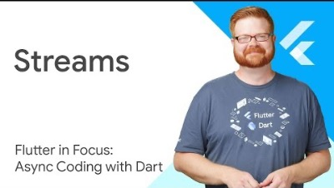

Slide 8
Async/Await
The async and await modifiers are often used to work with asynchronous operations
async
The async modifier is used to define an asynchronous function.
An async function returns a Future.
Inside an async function, you can use the await modifier to pause the execution until a Future is complete.
await
The await expression makes the program wait until the Future returns a result.
await can only be used inside an async function.

Slide 9
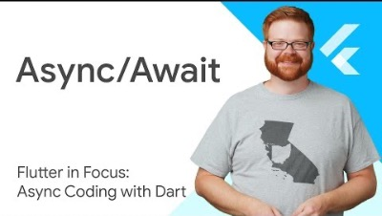

Slide 10
import 'dart:async'; // An async function that simulates fetching data from the internet Future<String> fetchData() async { await Future.delayed(Duration(seconds: 2)); // Simulate a network request return 'Hello, World!'; } // Main function void main() async { print('Fetching data...'); // Await the fetchData function and store the result String result = await fetchData(); print('Data received: $result'); }

