Slide 1
TIME SERIES ANALYSIS · LAB AAT · SMART CITY
Hourly Urban Water Demand Forecasting with SARIMA and Multi-Seasonal Decomposition
Day-ahead MAE: 271 → 199 m³/h (26.4% lower) on 6,912 unseen hours
[Member 1 · USN] [Member 2 · USN] [Member 3 · USN] [Member 4 · USN]
Instructor: [Name] · 30 October 2026
Notes:
Introduce the team and the one-line result: on the same unseen 9½ months of data, modelling the weekly cycle as well as the daily cycle cut day-ahead forecast error by about a quarter.

Slide 2
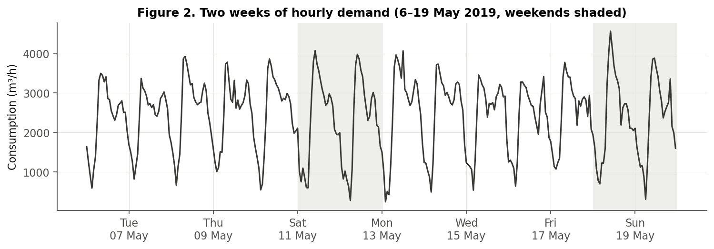
Problem: forecast tomorrow's hourly water demand
Smart City domain · day-ahead (1–24 h) forecasting from past consumption
• Why: pump schedules and tank levels are planned a day ahead
• Task: at 00:00 forecast all 24 hours of the day
• Challenge: a daily cycle and a weekly cycle that changes the shape of the day
• RQ: does modelling both cycles beat a standard SARIMA on the same unseen data?
Weekend mornings (shaded) start later and peak higher.
Hourly Urban Water Demand Forecasting · Time Series Analysis (24AM7PCTSA)
2
Notes:
Why the problem matters: utilities schedule pumps and tank levels a day ahead. Pumping costs energy and tanks have limited capacity, so they need tomorrow's hourly demand. Our task: at midnight, forecast each of the next 24 hours from past consumption only. Point at the figure: the daily cycle is obvious, and the weekend mornings (shaded) look different. That observation drives the whole project.

Slide 3
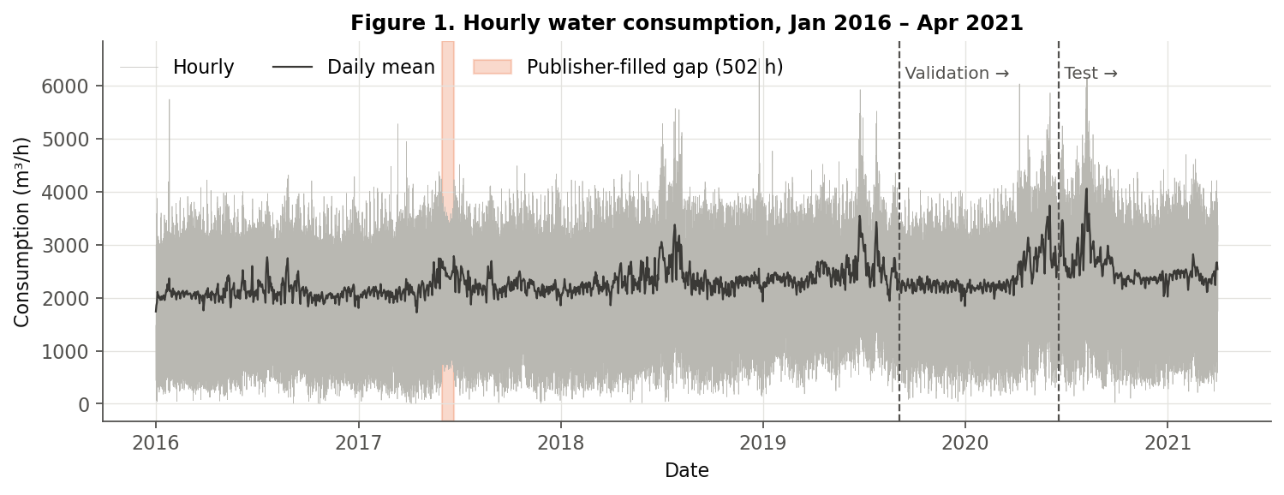
Dataset: 5¼ years of hourly pumping data
Weyrauch et al. (2024), Zenodo doi:10.5281/zenodo.11045013 · residential + commercial + industrial users
46,032
1.18%
0
2,314
hourly observations
2016-01-01 → 2021-04-01
hours filled or altered by publisher (flagged)
rows removed · 0 duplicates · 0 negative values
mean m³/h (range 1 – 6,514)
Hourly Urban Water Demand Forecasting · Time Series Analysis (24AM7PCTSA)
3
Notes:
Data from Zenodo, CC-BY licence, provided by Siemens for a KIT study. We downloaded all three versions and verified the checksums. We chose the version with exactly 24 hours per day, because seasonal periods of 24 and 168 need a regular grid. By comparing with the raw file, we flagged every value the publisher created or changed: 544 hours, mostly a 3-week gap in June 2017 filled with averages from earlier years. Nothing was deleted.

Slide 4
Literature review → research gap
Seven verified sources (full matrix in report, Table 1)
Arandia et al. 2016
Taylor 2003
Gap we address
SARIMA + Kalman updating for water; weekly-seasonal removes more autocorrelation
Double-seasonal (day + week) Holt-Winters beats single-seasonal for utility demand
For this dataset, no classical SARIMA baseline and no multi-seasonal statistical model is reported, and MAE/RMSE are not reported.
We test MSTL (24 h + 168 h) + ARIMA against a tuned SARIMA(s = 24) under a leakage-free day-ahead protocol, and isolate the weekly part with an ablation.
Bandara et al. 2021
Pacchin et al. 2019
MSTL: decomposition with several seasonal periods, low compute cost
24-h hourly water forecasts; moving-window pattern models most robust
Herrera et al. 2010
Weyrauch et al. 2024
ML models for hourly urban demand; demand profiles carry key information
Same dataset, deep learning: simple profile ≈ best model (MAPE 13.9 vs 13.8%)
Hourly Urban Water Demand Forecasting · Time Series Analysis (24AM7PCTSA)
4
Notes:
Seven sources were verified on publisher or arXiv pages. Arandia et al.: SARIMA with Kalman updating for water, and weekly-seasonal models remove autocorrelation better than daily ones. Taylor: two seasonal cycles beat one for electricity demand. Bandara et al.: MSTL, the decomposition we use. Pacchin et al.: simple moving-window pattern models are robust. Weyrauch et al. used this exact dataset with deep learning; a simple historical profile was almost as good, and no SARIMA baseline was reported. That is our gap. We do NOT claim nobody has ever done multi-seasonal water forecasting.

Slide 5
Preprocessing and experimental protocol
No shuffling · no test data in any fitting or tuning step
TRAIN
VALIDATION
TEST
2016-01-01 → 2019-09-03
32,208 h
2019-09-04 → 2020-06-17
6,912 h
2020-06-18 → 2021-04-01
6,912 h
• Rolling day-ahead: origin 00:00, uses data ≤ 23:00 previous day, outputs 24 h
• 288 origins in validation and in test → 6,912 forecasts each
• Same rule for both models: lowest validation MAE; test touched once
• Regular hourly grid: DST days fixed, timestamps unique and gap-free
• Publisher fills flagged, metrics re-checked without them
• Peaks kept: night lows and summer peaks are real behaviour
• Weather excluded: not known at forecast time (leakage)
Hourly Urban Water Demand Forecasting · Time Series Analysis (24AM7PCTSA)
5
Notes:
Chronological split in whole days, about 70/15/15. Training is used only for exploratory statistics. Validation selects the model configuration for both models with the same rule: lowest validation MAE. Test is used exactly once. Every model follows the same rolling protocol: each day at midnight it sees data up to 23:00 yesterday and forecasts the next 24 hours, 288 times. Weather is excluded because tomorrow's weather isn't known at midnight without a weather forecast.

Slide 6
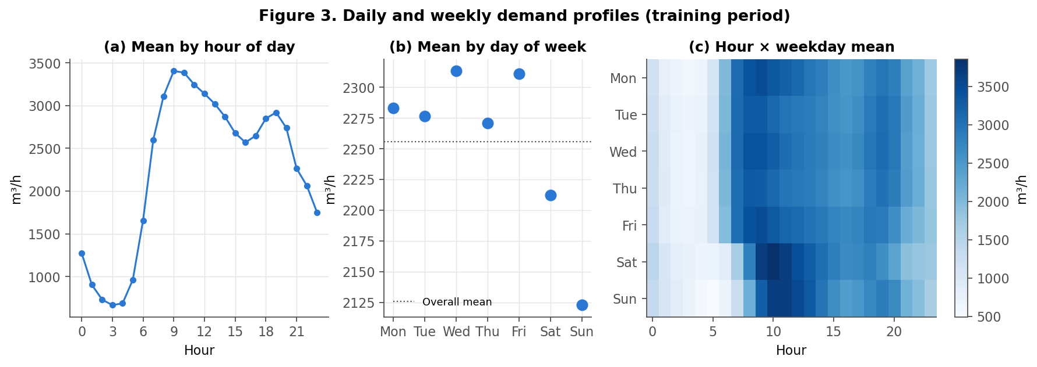
EDA: daily cycle + weekly change in day shape
0.96
MSTL seasonal strength, 24 h
0.67
MSTL seasonal strength, 168 h
Trend: annual mean rose from 2097 (2016) to 2534 m³/h (2020); summers bring higher, weather-driven evening peaks.
Weekly effect = shape, not level: weekend mean is only 5.4% lower, but the morning ramp moves by ~2 hours.
Hourly Urban Water Demand Forecasting · Time Series Analysis (24AM7PCTSA)
6
Notes:
Demand drops to about 666 m³/h at 3 am and peaks around 3405 at 9 am. The weekday averages differ only slightly, but the heat map shows the real weekly effect: Saturday and Sunday mornings start later and peak higher. MSTL seasonal strength confirms both cycles: 0.96 daily and 0.67 weekly, on a 0-to-1 scale. We verified the weekly cycle from the data rather than assuming it.

Slide 7
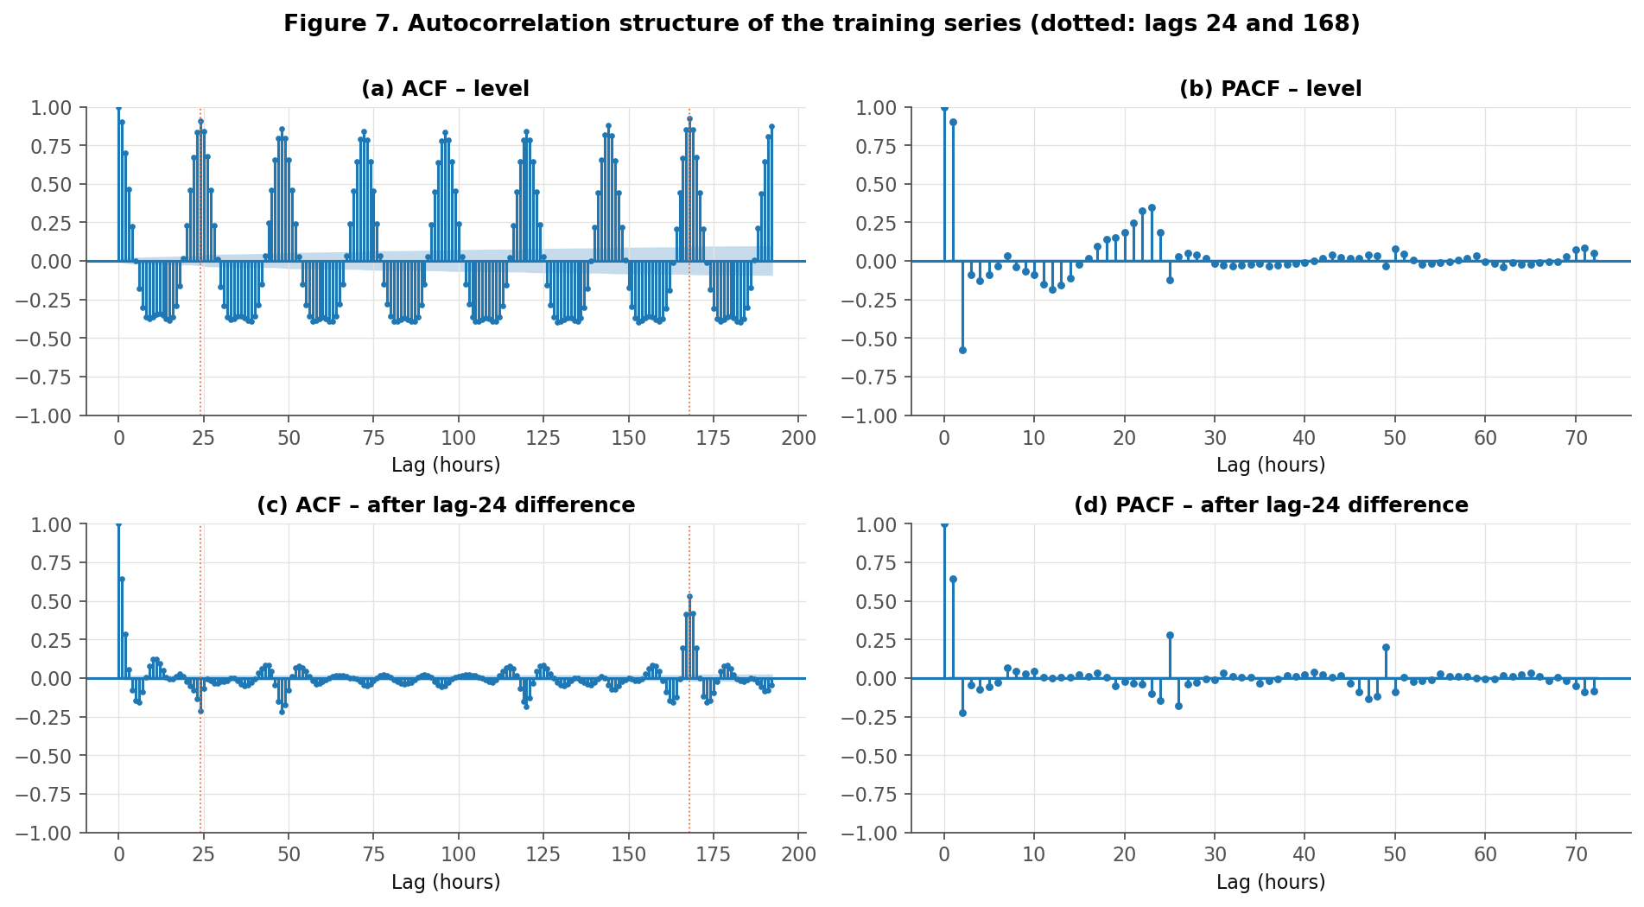
Stationarity and ACF/PACF reveal the gap
ADF / KPSS (training)
Level: ADF -9.201, KPSS 9.097 → conflict
After lag-24 diff: ADF -31.694, KPSS 0.003 → stationary
⇒ d = 0, D = 1, s = 24
Left after lag-24 differencing
ACF at lag 168 = 0.53
Weekly memory that a single seasonal period of 24 cannot capture.
Hourly Urban Water Demand Forecasting · Time Series Analysis (24AM7PCTSA)
7
Notes:
ADF tests the null of a unit root; KPSS tests the null of stationarity. On the raw level they disagree: ADF rejects a unit root, KPSS rejects stationarity, because the mean moves with the daily cycle. After one seasonal difference at lag 24, both agree the series is stationary, so d = 0 and D = 1. Then look at panel (c): the PACF cuts off after about two lags, so a low AR order; a negative spike at 24 suggests a seasonal MA term; and a big spike at 168, 0.53, is left over. SARIMA with s = 24 cannot model that. This is the motivation for the enhancement.

Slide 8
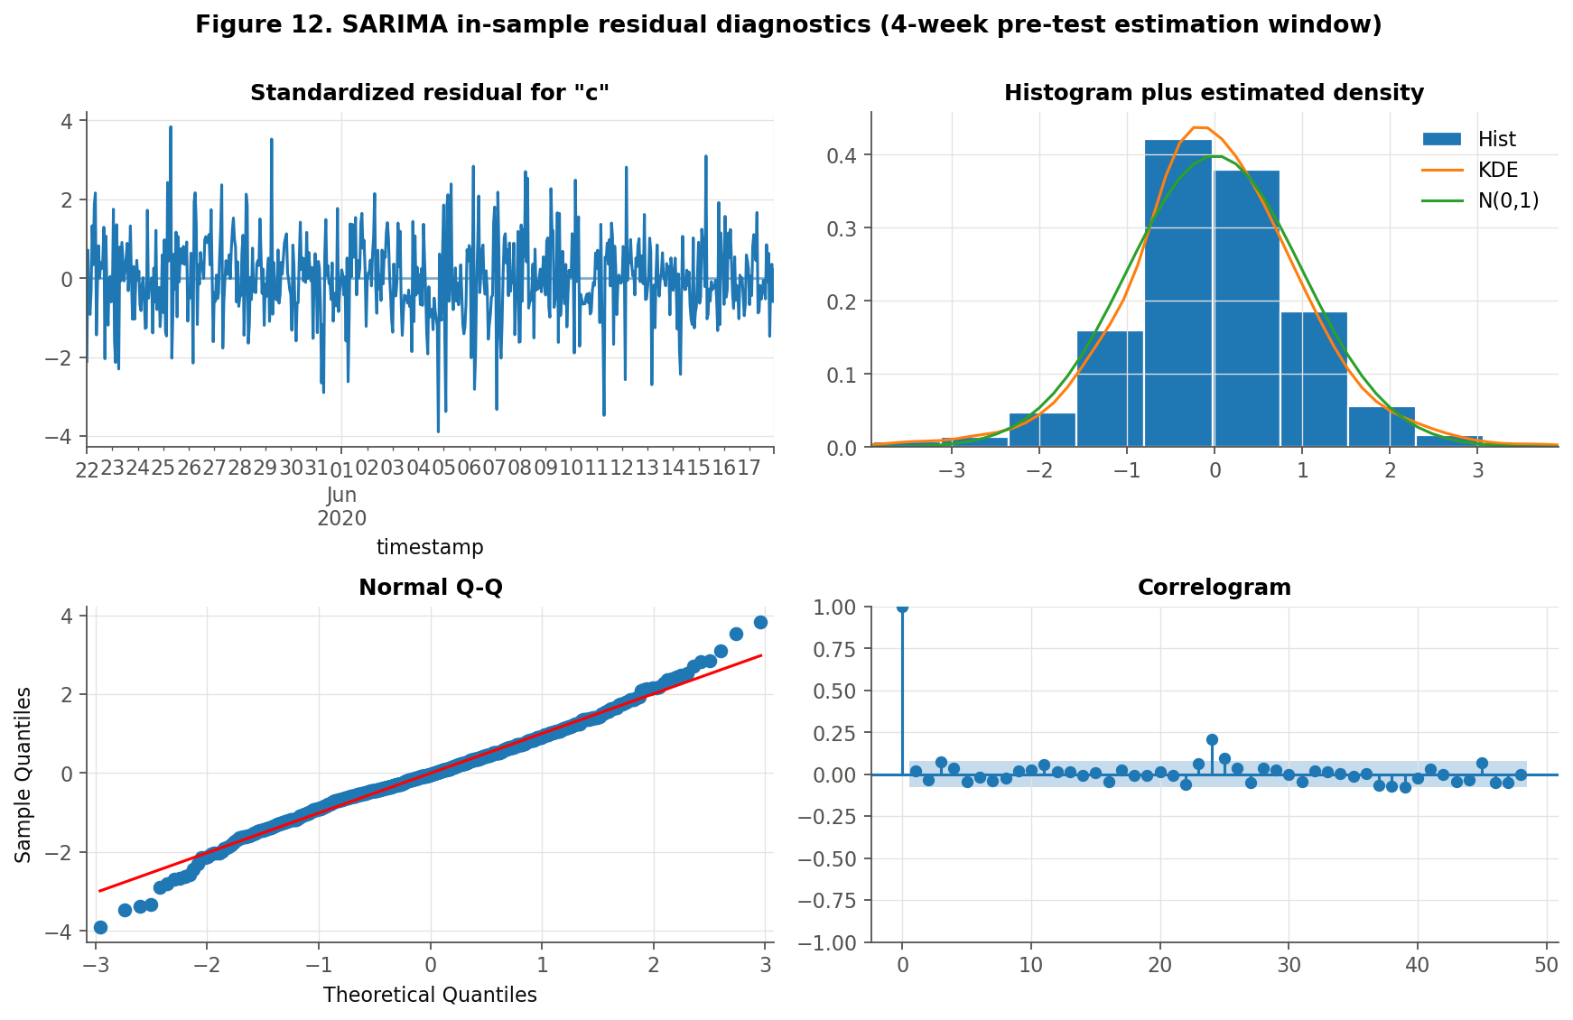
Baseline: SARIMA(3,0,1)(0,1,1)24
18 configurations (6 orders × 3 estimation windows) compared on validation
• Order from ACF/PACF: d = 0, D = 1, seasonal MA(1), AR(3) + MA(1)
• Estimated on last 4 weeks before the forecast period; then fixed
• Kalman filter update with each new day (no refit, no leakage)
• Coefficients: seasonal MA -0.85; AR sum 0.997; all p < 0.001
• Validation MAE: 280.9 m³/h
• Limitation: one seasonal period, so the weekly pattern is invisible
Hourly Urban Water Demand Forecasting · Time Series Analysis (24AM7PCTSA)
8
Notes:
Baseline: SARIMA(3,0,1)(0,1,1)24. Six candidate orders came from the ACF and PACF, times three estimation windows, giving 18 configurations. Fitting on all 32,000 training hours with s = 24 is impractical on a laptop, so parameters are estimated on the most recent weeks. After that the parameters are fixed and the Kalman filter absorbs each new day, as Arandia et al. did. The best on validation was the 4-week window. All coefficients are significant. The AR terms sum to nearly 1, so it behaves almost like an integrated model. Residuals look roughly normal, but a lag-24 spike remains.

Slide 9
Enhancement: MSTL (24 h + 168 h) + ARIMA
Re-run every day on a trailing 12-week window · 9 configurations tuned on validation
1
2
3
4
5
Trailing window
MSTL
Extend seasonality
ARIMA(1,1,1)
Recombine
last 12 weeks before 00:00
trend + daily + weekly + remainder
repeat last day / last week
forecast trend + remainder
ARIMA + daily + weekly
ŷ(t+h) = ARIMA forecast(t+h) + S24(t+h−24) + S168(t+h−168), h = 0…23
• No leakage: decomposition and fitting use only the window before each origin
• Ablation: same pipeline with only the 24 h period (MSTL-24 only)
• Selected: 12-week window, ARIMA(1,1,1); validation MAE 205.7
• Cost: ~1 s per daily forecast on a laptop
Hourly Urban Water Demand Forecasting · Time Series Analysis (24AM7PCTSA)
9
Notes:
Enhanced model, step by step, at every midnight. One: take the last 12 weeks. Two: MSTL splits them into trend, a daily component, a weekly component and a remainder. Three: extend each seasonal component by repeating its latest cycle, yesterday's for the daily part and last week's for the weekly part. Four: take out the seasonal parts and forecast what is left, trend plus remainder, with ARIMA(1,1,1). Five: add everything back. MSTL itself does not forecast; the forecast comes from steps 3 to 5. Window length mattered most: 12 weeks beat 4, because four weeks give only four weekly cycles to learn from.

Slide 10
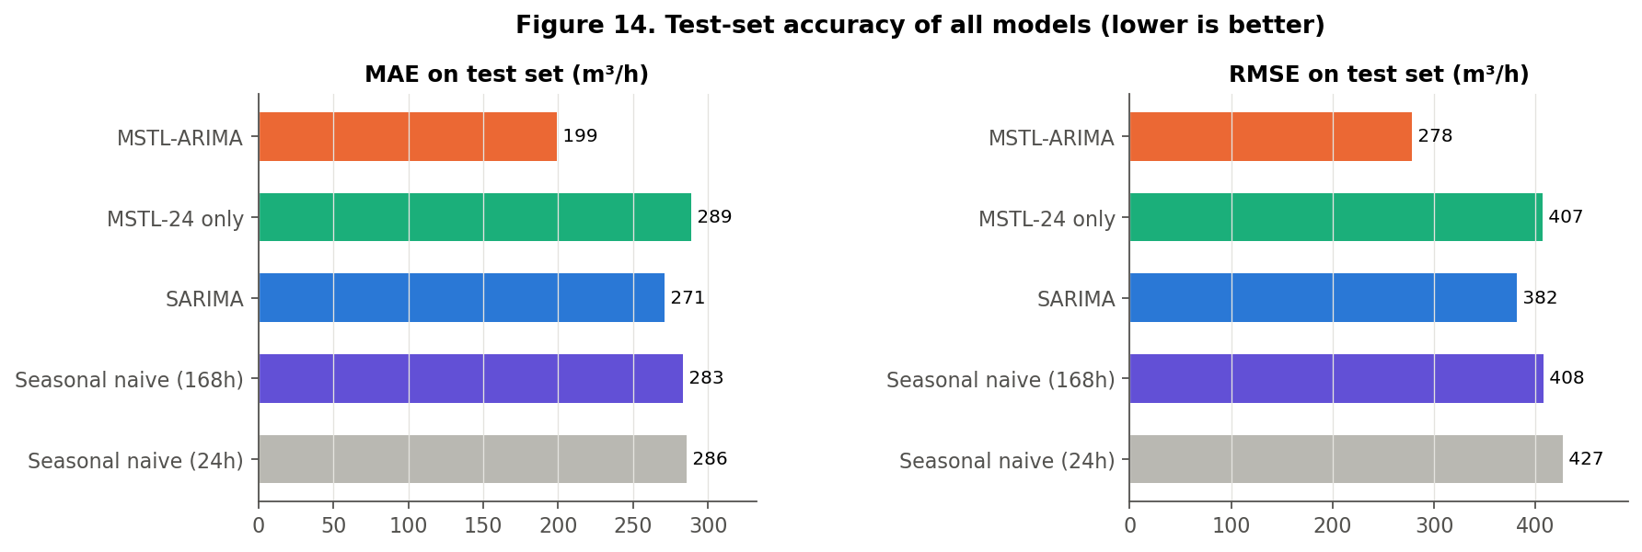
Results: ~26% less error on unseen data
Test period 18 Jun 2020 – 1 Apr 2021 · 6,912 day-ahead forecasts · identical timestamps for every model
−26.4%
−27.3%
11.2%
237/288
MAE 271 → 199 m³/h
RMSE 382 → 278 m³/h
MAPE (SARIMA 15.9%)
test days with lower MAE
Is it significant?
Diebold–Mariano: DM = 10.9, p < 0.001
Bootstrap 95% CI, MAE reduction: 21.8–31.9%
SARIMA vs weekly naive: p = 0.43 (not significant)
Hourly Urban Water Demand Forecasting · Time Series Analysis (24AM7PCTSA)
10
Notes:
Headline results on the test period, 6,912 forecasts. MAE falls from 270.7 to 199.1 m³/h, 26.4% lower. RMSE falls 27.3%. MAPE falls from 15.9 to 11.2%, though MAPE is inflated by small night values, so MAE and RMSE are our main metrics. Is it just luck? The Diebold–Mariano test on daily losses gives a statistic of 10.9, p far below 0.001, and the bootstrap 95% interval for the MAE reduction is 22 to 32%. Honest note: SARIMA is not significantly better than simply copying last week (p = 0.43).

Slide 11
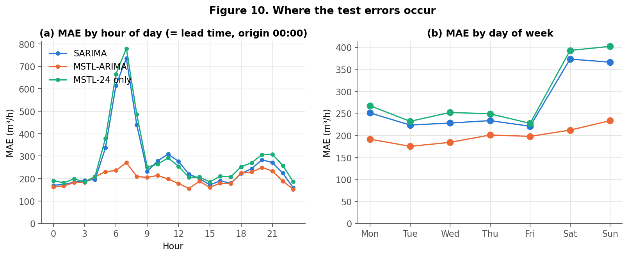
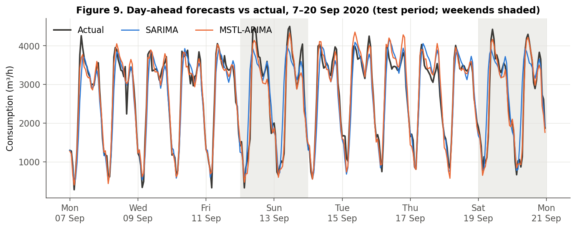
Why it works: mornings and weekends
289
MAE without weekly component (worse than SARIMA)
0.56 → 0.03
error autocorrelation at lag 168
Weekend MAE: SARIMA 370 vs MSTL 223
07:00 MAE: SARIMA 736 vs MSTL 271
MSTL wins in all 11 test months
Hourly Urban Water Demand Forecasting · Time Series Analysis (24AM7PCTSA)
11
Notes:
Where does the gain come from? Left: SARIMA's error explodes at 7 am, 736 m³/h, because on Saturdays and Mondays 'yesterday' has the wrong morning ramp. MSTL-ARIMA stays at 271. Right: SARIMA's weekend error is 370 vs 231 on weekdays. MSTL-ARIMA is much flatter. The ablation is the key evidence: the same pipeline without the weekly component is worse than SARIMA, MAE 289. So the improvement comes from the weekly cycle, not from decomposition in general. The lag-168 error autocorrelation drops from 0.56 to 0.03.

Slide 12
Discussion, implications and limitations
What we found
Possible use
Limitations
• H1 supported: lower MAE and RMSE, significant
• Gain comes from the weekly cycle (ablation)
• Agrees with Taylor (2003) and Arandia et al. (2016)
• Day-ahead pump and tank planning
• Cheap: past consumption only, ~1 s per day
• SDG 6 link: better-informed supply planning (savings not measured)
• One district; test overlaps 2020–21
• Weather-driven summer peaks missed
• No holidays, no prediction intervals
• Not compared with TBATS / double-seasonal HW
Hourly Urban Water Demand Forecasting · Time Series Analysis (24AM7PCTSA)
12
Notes:
Hypothesis supported: multi-seasonal modelling clearly helps here. But be honest about the limits. One district, and a test period overlapping 2020–21, which may be unusual. The biggest remaining errors are summer evenings driven by weather, which neither model sees. We compared with SARIMA, not with TBATS or double-seasonal Holt-Winters. We produced point forecasts without intervals. And we measured accuracy, not energy savings, so any savings are a potential application, not a result.

Slide 13
Conclusion
• Water demand here has a daily cycle and a weekly change in daily shape
• SARIMA(3,0,1)(0,1,1)24 misses the weekly part and is no better than copying last week
• MSTL (24 h + 168 h) + ARIMA: MAE −26.4%, RMSE −27.3%, significant
• Future: holidays, weather forecasts, prediction intervals, more districts
Key references
Arandia et al. (2016) JWRPM 142(3)
Bandara et al. (2021) arXiv:2107.13462
Donkor et al. (2014) JWRPM 140(2)
Herrera et al. (2010) J. Hydrology 387
Pacchin et al. (2019) WRM 33(4)
Taylor (2003) JORS 54(8)
Weyrauch et al. (2024) arXiv:2405.03429; dataset doi:10.5281/zenodo.11045013
Thank you — questions?
Notes:
Wrap up in three sentences: weekly seasonality matters in this water network; a simple, leakage-free MSTL plus ARIMA pipeline captures it and cuts error by about a quarter; next steps are holidays, weather forecasts and prediction intervals. Then invite questions.

