Slide 1

Smart Water Utility: Consumption Monitoring & Real-Time Anomaly Detection
Presented by: Pranjal Srivastava
An end-to-end data pipeline solution leveraging Akka, Kafka, Spark Streaming & Batch, MySQL, Avro, JSON, S3, and Play Framework to transform water utility operations through real-time monitoring and intelligent anomaly detection.

Slide 2

Business Problem Statement
Core Challenges
City water utilities struggle with operational inefficiencies that impact both revenue and customer satisfaction:
No real-time visibility into household water usage patterns
Undetected leaks or abnormal consumption spikes
Manual or delayed billing processes causing errors
Poor long-term usage insights limiting infrastructure planning
Business Impact
The consequences are significant: Revenue loss from unbilled consumption, massive water wastage from undetected leaks, and eroded customer trust due to billing inaccuracies and poor service responsiveness.

Slide 3





Project Objectives
Real-Time Monitoring
Anomaly Detection
Accurate Billing
Continuously track water consumption from smart meters with second-level granularity for immediate visibility.
Automatically identify sudden spikes and drops in consumption patterns to flag potential leaks or meter issues.
Generate precise monthly billing statements based on actual consumption data, eliminating estimation errors.
Long-Term Analytics
API Integration
Store comprehensive historical usage data to support infrastructure planning and trend analysis.
Expose insights through lightweight REST APIs for seamless integration with existing utility systems.

Slide 4




Why a Data Pipeline Approach?
High-Volume Data
Analytical Requirements
Smart meters generate readings every 10 seconds per household, creating massive data streams that require efficient ingestion and processing.
Monthly billing, daily reports, and trend analysis require both real-time streaming and scheduled batch processing capabilities.
Solution Requirements
Streaming Pipelines
For real-time ingestion and processing
Batch Analytics
For aggregation and reporting
Multiple Storage
For hot and cold data access
Scalable Architecture
To handle growth and peak loads

Slide 5
High-Level Solution Overview
Our end-to-end pipeline orchestrates real-time and batch processing to deliver comprehensive water utility management.
01
02
Meter Data Generation
Event Ingestion
Smart meters continuously generate consumption readings with metadata including pressure, status, and timestamps.
Kafka acts as the central event bus, ingesting high-velocity meter readings with guaranteed delivery and fault tolerance.
03
04
Streaming Anomaly Detection
Multi-Tier Storage
Spark Streaming analyzes consumption patterns in real-time, triggering alerts for abnormal spikes or drops.
Recent data stored as JSON for fast API access; historical data archived in compressed Avro format on S3.
05
06
Batch Billing & Reporting
API Data Exposure
Spark Batch jobs aggregate consumption data to generate monthly bills and comprehensive usage reports.
Play Framework provides reactive REST APIs for seamless integration with customer portals and utility systems.

Slide 6
System Architecture
Device Simulation Layer
Streaming Processing Layer
Batch Analytics Layer
Akka actors simulate thousands of smart meters generating realistic consumption patterns and anomaly scenarios for testing.
Kafka topics partition meter events, while Spark Streaming applies windowing and stateful operations for anomaly detection.
Scheduled Spark jobs perform aggregations, join with customer data in MySQL, and generate billing statements.
Storage Layer (Hot & Cold)
API Layer
JSON files provide millisecond access to recent data; Avro on S3 offers cost-effective, compressed long-term storage.
Non-blocking Play Framework endpoints serve consumption data, alerts, and billing information to client applications.

Slide 7
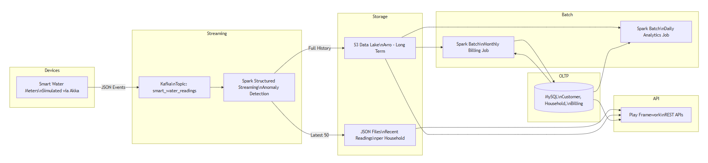
System Architecture

Slide 8
Technology Used & Why?
Each technology was strategically selected to address specific architectural requirements and performance characteristics.
Akka
Kafka
Spark
Avro
Provides massive concurrency through lightweight actors, enabling simulation of thousands of meters with minimal resource overhead and built-in fault tolerance.
Delivers high-throughput, fault-tolerant ingestion with horizontal scalability, partition-based parallelism, and guaranteed message ordering for reliable event streaming.
Unified engine handles both streaming and batch workloads, eliminating technology sprawl while providing powerful windowing, aggregation, and machine learning capabilities.
Columnar, compressed format with schema evolution support reduces storage costs while maintaining query performance for historical analytics.
JSON
MySQL
Play Framework
Lightweight, human-readable format enables sub-millisecond API response times for recent data without database query overhead.
Provides ACID guarantees and strong relational consistency for customer data, billing plans, and transactional operations requiring data integrity.
Non-blocking, reactive architecture maximizes throughput for API requests, handling thousands of concurrent connections with minimal server resources.

Slide 9
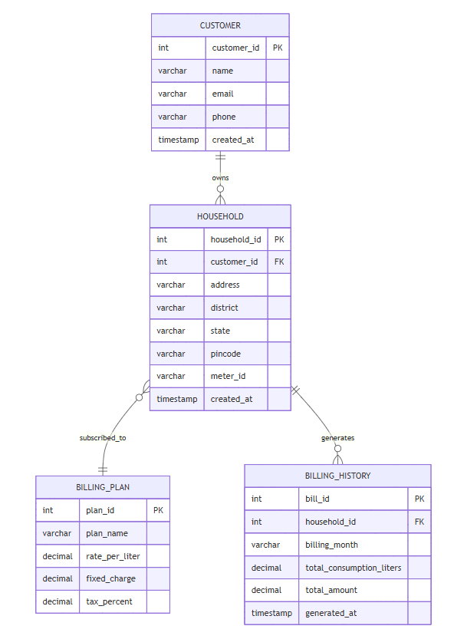
Data Model (MySQL)
Core Entities
Customer
Stores account holder information, contact details, and account status for billing and communication.
Household
Represents physical locations with meter IDs, linking customers to their consumption devices.
Billing Plan
Defines tiered pricing structures, base rates, and usage thresholds for accurate cost calculation.
Billing History
Archives monthly statements with consumption totals, charges, and payment status for audit trails.

Slide 10
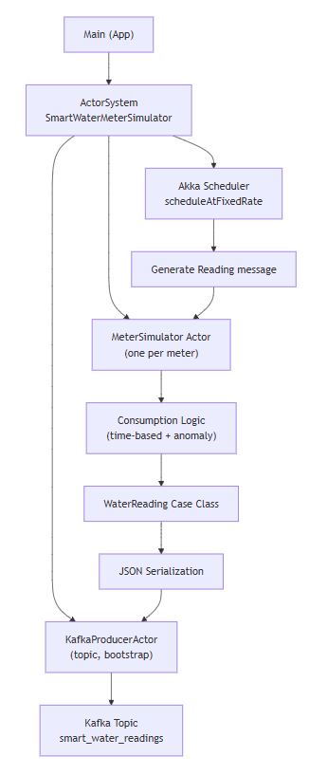
Pipeline A: Smart Meter Simulation
Actor-Based Architecture
Realistic Data Generation
Each meter runs as an independent Akka actor, enabling thousands of concurrent simulations with minimal overhead and natural scalability.
Time-based consumption patterns mirror real household usage, with random pressure variations reflecting actual distribution network conditions.
Anomaly Injection
2% anomaly rate introduces realistic edge cases including spikes, drops, and irregular patterns for robust testing.
The actor-per-meter model provides inherent fault isolation and backpressure handling, making it ideal for high-volume simulation workloads.

Slide 11
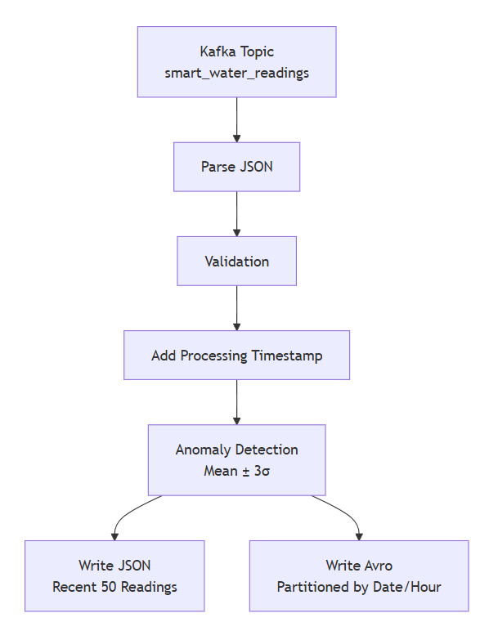
Pipeline B: Real-Time Stream Processing
Processing Flow
Consume events from Kafka topic
Parse and validate JSON schema
Enrich with processing timestamps
Apply statistical anomaly detection
Dual-write to storage layers
1
Recent Data Store
JSON format in hot storage for low-latency API access to the most recent 50 readings per household.
2
Historical Archive
Avro format in cold storage provides efficient compression and schema evolution for long-term analytics.

Slide 12
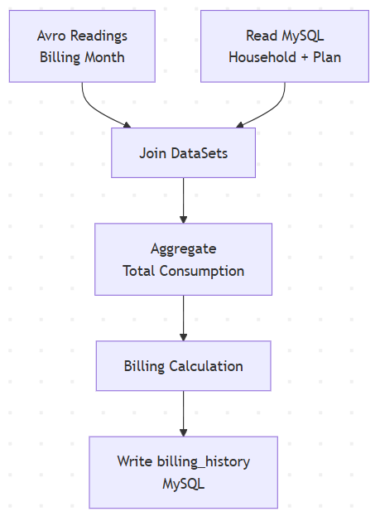
Pipeline C: Monthly Billing Batch Job
01
Extract Consumption Data
Read month's Avro files from cold storage, leveraging partitioning for efficient data retrieval.
02
Enrich with Master Data
Join with MySQL customer and rate tables to apply correct billing rates and account details.
03
Aggregate & Calculate
Sum consumption by household, apply tiered rates, and compute total charges including taxes.
04
Persist Billing Records
Write results to billing_history table with full audit trail for compliance and dispute resolution.
Runs as a scheduled Spark batch job, processing millions of readings efficiently with fault tolerance and retry logic.

Slide 13



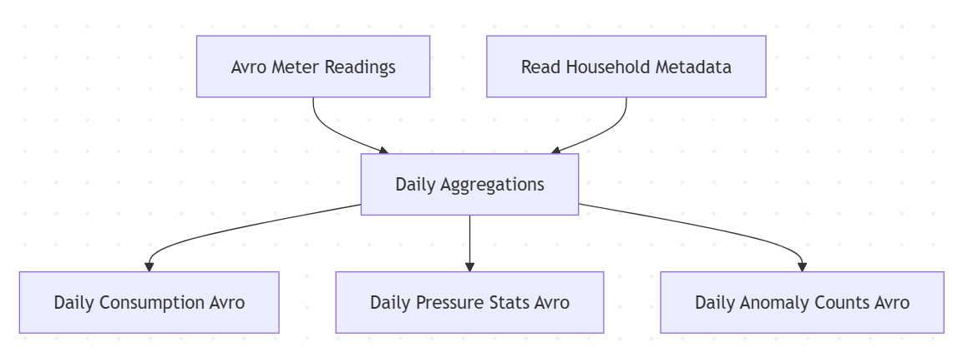
Pipeline D: Daily Analytics Aggregation
Generated Metrics
Daily Consumption
Pressure Statistics
Anomaly Counts
Per-household usage patterns aggregated from raw meter readings, identifying trends and seasonal variations.
Min, max, and average pressure readings across the distribution network, flagging infrastructure issues.
Daily summary of detected spikes and drops by zone, enabling proactive maintenance scheduling.

Slide 14
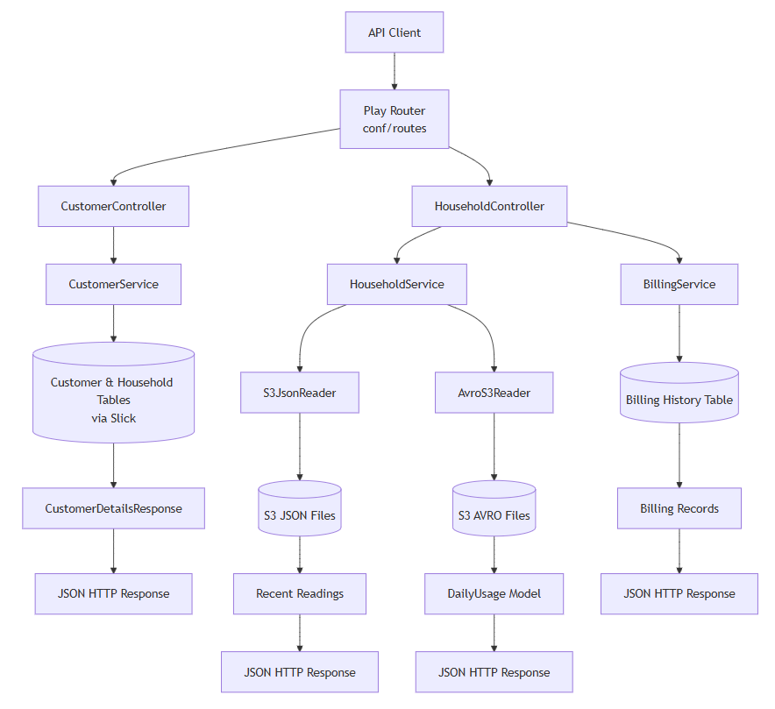
Play Framework API Layer
RESTful Endpoints
/customer/{id} – Customer profile and account details
/household/{id}/recentReadings – Latest 50 meter readings (JSON)
/household/{id}/dailyUsage – Aggregated consumption trends
/household/{id}/billing – Current and historical billing records
No Heavy Computation
APIs serve pre-computed data, keeping response times consistently low.
Clean Separation
Processing pipelines and API layer evolve independently without coupling.
Horizontal Scaling
Stateless design enables simple load balancing and auto-scaling.

Slide 15
Limitations & Assumptions
Current Limitations
System Assumptions
Basic Anomaly Detection
Data Reliability
Relies on statistical thresholds rather than sophisticated machine learning models for identifying unusual consumption patterns.
Assumes meter devices consistently transmit accurate readings without significant gaps or transmission errors.
Synthetic Data
Fixed Schedules
Simulation generates test data that may not capture the full complexity and variability of real-world meter readings.
Batch processing windows operate on predetermined intervals without dynamic adjustment based on data arrival patterns.
No Predictive Analytics
Current implementation focuses on processing and storage without forecasting future consumption trends.

Slide 16
Future Enhancements
The roadmap focuses on advancing analytics capabilities, operational resilience, and user experience while maintaining the platform's core architectural principles.
01
02
03
ML-Based Anomaly Detection
Real-Time Alerting
Interactive Dashboard
Deploy advanced machine learning models to identify complex consumption patterns and predict equipment failures before they occur.
Implement event-driven notifications for critical anomalies, enabling immediate response to unusual meter behavior or system issues.
Build visualization layer providing stakeholders with self-service analytics and customizable reporting capabilities.
04
05
Kubernetes Auto-Scaling
Schema Registry Integration
Enable dynamic resource allocation based on workload demands, optimizing infrastructure costs while maintaining performance.
Centralize schema management for robust versioning, compatibility checking, and seamless evolution of data contracts.

Slide 17
Key Learnings
End-to-End Pipeline Design
Streaming + Batch Integration
Storage Format Trade-offs
Mastered the integration of streaming and batch processing paradigms within a unified architecture, balancing real-time responsiveness with analytical depth.
Developed expertise in lambda architecture patterns, coordinating stateful stream processing with periodic batch aggregations for comprehensive data coverage.
Evaluated JSON, Avro, and Parquet characteristics, selecting optimal formats based on query patterns, compression needs, and schema evolution requirements.
Spark Performance Tuning
API-Driven Data Access
Applied partitioning strategies, memory configuration, and shuffle optimization techniques to achieve production-grade throughput and latency targets.
Designed RESTful interfaces that abstract pipeline complexity while providing flexible, performant access to both streaming and historical datasets.

Slide 18



Conclusion
This project demonstrates a well-architected data engineering solution that combines modern streaming technologies with established batch processing patterns. The focus is on clarity of design, correctness of data flow, and scalability principles rather than full production hardening.
Near Real-Time Processing
Scalable-by-design Architecture
Supports near real-time streaming of high-velocity smart meter data using Kafka and Spark Structured Streaming.
Designed with horizontal scalability principles, allowing the system to scale with increased data volumes through distributed processing.
Clean Data Modeling
Structured Data Pipelines
Well-structured schemas across MySQL, JSON, and Avro formats, enabling efficient querying and clear separation of operational and analytical data.
Clearly defined streaming and batch pipelines with basic error handling and logging, suitable for learning and controlled environments.

Slide 19
THANK YOU

