Slide 1

Hotel Reception App
Event-Driven Microservices Architecture
Built with Play Framework, Scala, Akka & Kafka
Prepared by: Pranjal Srivastava

Slide 2
Problem Statement
System Requirements
A hotel (10 floors, identical layout) requires a Reception Desk application to manage guest check-ins and check-outs, allocate rooms across three categories (Deluxe, Luxury, Luxury Suite) with per-category pricing, and securely store guest data and ID proofs.
After successful check-in, the system must asynchronously notify Room Service (welcome email), Wi-Fi Service (Wi-Fi credentials), and Restaurant Service (send daily menu every morning while the guest is active).
The Play Framework app is the booking system and produces Kafka events; an Akka-based microservice consumes those events, uses the Actor Model to orchestrate the three services, schedules daily restaurant menus while a guest is checked in, and cancels them at check-out.

Slide 3
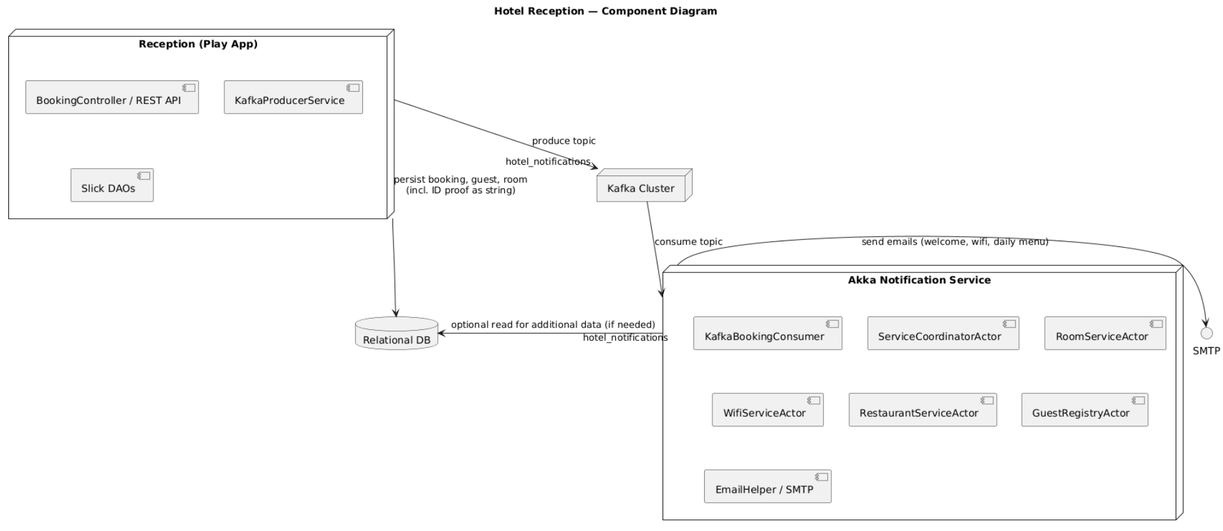
Overall design (summary)

Slide 4
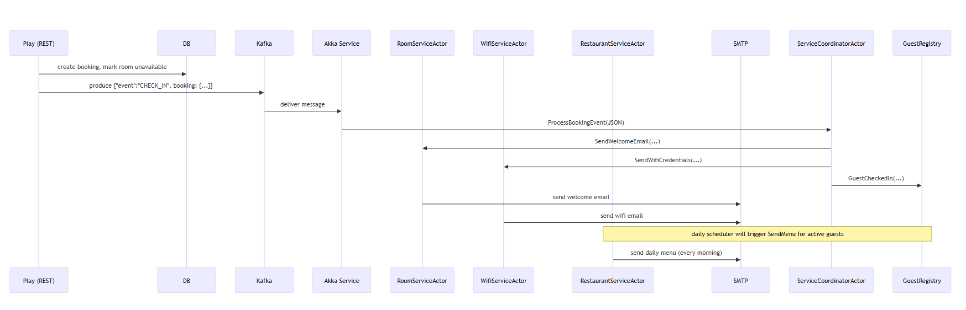
Sequence Diagram – Check-in Flow

Slide 5
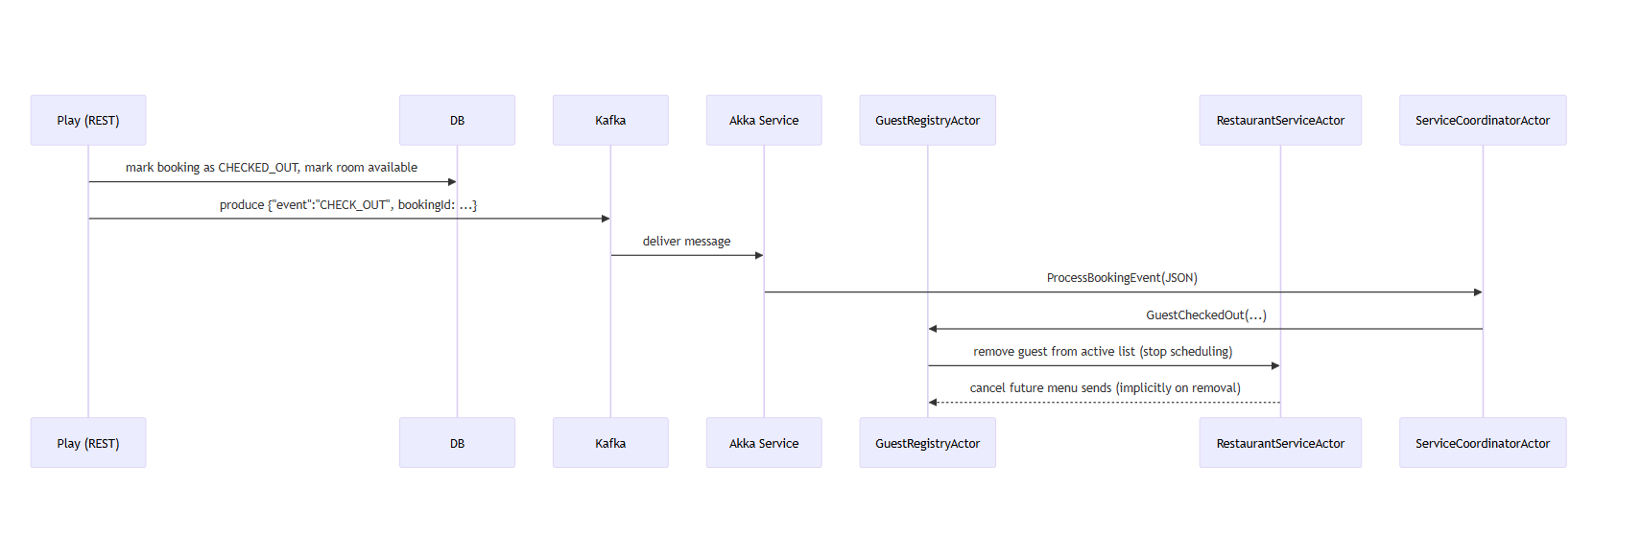
Sequence Diagram – Check-out Flow

Slide 6
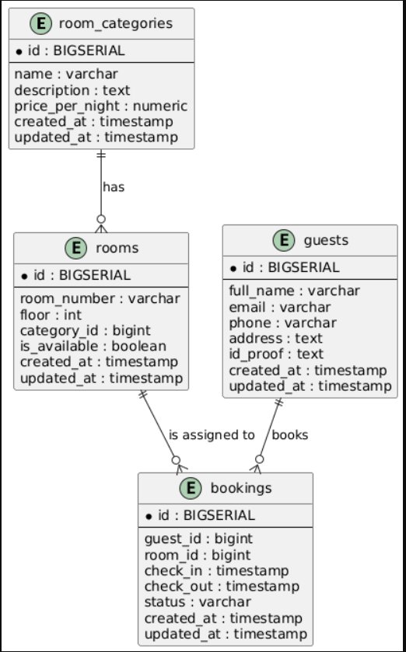
ER Diagram
The database contains four main entities: room_categories, rooms, guests, and bookings.
room_categories: Stores the different room types (Deluxe, Luxury, Luxury Suite), each with its own price; one category can have many rooms.
rooms: Represents individual hotel rooms with room number, floor, and category; each room belongs to one category and can have many bookings over time.
guests: Contains guest details like name, email, contact, address, and ID proof; one guest can have multiple bookings.
bookings: Links a guest to a room with check-in/check-out details and booking status; each booking belongs to one guest and one room.

Slide 7
Play App (Booking Service)
REST APIs
Data Persistence
Event Publishing
Exposes REST APIs for bookings, guest/room management.
Uses Slick DAOs and a relational DB to persist Guests, Rooms, Room Categories, Bookings (files under app/models/).
Publishes booking lifecycle events (CHECK_IN, CHECK_OUT) as JSON messages to Kafka topic hotel_notifications via KafkaProducerService.scala.

Slide 8



Notification Microservice (Akka)
Kafka Consumer (KafkaBookingConsumer.scala) subscribes to hotel_notifications.
On message receive, forwards parsed JSON to ServiceCoordinatorActor.
ServiceCoordinatorActor coordinates child actors:
RoomServiceActor
WifiServiceActor
RestaurantServiceActor
One-time welcome email.
Sends credentials email.
Single email on check-in and scheduled daily menu sends while guest is active.
GuestRegistryActor keeps an in-memory map of active guests; scheduled job in RootBehavior triggers SendDailyMenus which iterates active guests and calls RestaurantServiceActor.SendMenu.
EmailHelper is used to send emails via SMTP.

Slide 9
Key Nonfunctional Considerations
Implemented / Recommended
Asynchronous decoupling
Scaling
Kafka decouples booking and notification flow; Play pushes events and immediately returns (low latency for reception desk).
Kafka plus Akka cluster for horizontal scaling of notifications. Database isolation and proper locking for room allocation.
Scheduling
Persistence
Akka scheduler in RootBehavior triggers daily menu dispatches.
DB (Slick DAOs) stores guests, rooms, bookings and ID proof references (files or URIs).
Security
Protect APIs with authentication (JWT/OAuth2).

Slide 10
Akka Actor Hierarchy & Message Flows
Mapping to your code
Actors in repo
ServiceCoordinatorActor (file actors/ServiceCoordinatorActor.scala): Entry point for JSON events. Parses "CHECK_IN" and "CHECK_OUT" and dispatches to service actors.
RoomServiceActor (actors/RoomServiceActor.scala): SendWelcomeEmail(name, email, roomNo, category).
WifiServiceActor (actors/WifiServiceActor.scala): SendWifiCredentials(email, wifiUser, wifiPass).
RestaurantServiceActor (actors/RestaurantServiceActor.scala): SendMenu(name, email, roomNo).
GuestRegistryActor (actors/GuestRegistryActor.scala): In-memory map of active guests, receives GuestCheckedIn, GuestCheckedOut, SendDailyMenus.
Flow / responsibilities
KafkaBookingConsumer receives raw JSON and coordinator ! ServiceCoordinatorActor.ProcessBookingEvent(parsedJson)
ServiceCoordinatorActor pattern-matches event type and:
On CHECK_IN:
Extract guest name, email, room info.
Send RoomServiceActor.SendWelcomeEmail
Send WifiServiceActor.SendWifiCredentials
Send GuestRegistryActor.GuestCheckedIn (so scheduler will include guest)
On CHECK_OUT:
Send GuestRegistryActor.GuestCheckedOut (remove guest)
Optionally inform actors to cancel pending tasks.
Scheduler
RootBehavior schedules guestRegistry ! GuestRegistryActor.SendDailyMenus at a configured time (calculated to next occurrence of target hour; code does this).

Slide 11
Suggested Improvements & TODOs
Actionable and prioritized
1
Idempotency
Include correlationId in Kafka messages to make reprocessing safe.
2
Email reliability
Wrap EmailHelper.sendEmail with retries, and persist notification status in DB for auditing.
3
Persistence of scheduled jobs
GuestRegistryActor is in-memory — restart loses active guests. Persist active guest list or use persistent actors / a small DB table to keep scheduled state.
4
Monitoring
Add metrics for Kafka consumer lag, actor mailbox sizes, email failures.

Slide 12

Any Questions ?

Slide 13
Thank you

