Slide 1

Visitor Management System
Event-Driven Microservices Architecture
Built with Play Framework, Scala, Akka & Kafka
Prepared by: Pranjal Srivastava

Slide 2





The Challenge
Business Requirements
A modern corporate office needs an intelligent system to automate visitor lifecycle management from entry to exit.
The system must seamlessly coordinate between reception staff, host employees, IT support, and security teams—ensuring real-time communication and complete audit trails.
Check-In/Out
Automated visitor registration and departure tracking
Data Capture
Visitor details, host info, ID proof, and visit purpose
Modern Stack
Play, Akka, Kafka, Docker for scalability
Smart Alerts
Real-time notifications to host, IT, and security teams

Slide 3





Event-Driven Solution Architecture
Play Framework Backend
Akka Microservice
RESTful API for check-in/check-out operations
Kafka message consumer with actor-based processing
Persistent storage of visitor and visit-log data
ServiceCoordinatorActor orchestrates message routing
Secure ID proof upload and reference management
Specialized actors: HostEmployee, ITSupport, Security
Event publishing to Kafka topic visitor_notifications
Email delivery and activity logging
Kafka Event Bus
Data Layer
Decouples services for independent scaling
Slick DAOs manage relational entities
Ensures reliable, asynchronous messaging
Tables: Visitors, Employees, Departments, VisitLogs
Guarantees event delivery and ordering
Type-safe database queries and transactions

Slide 4
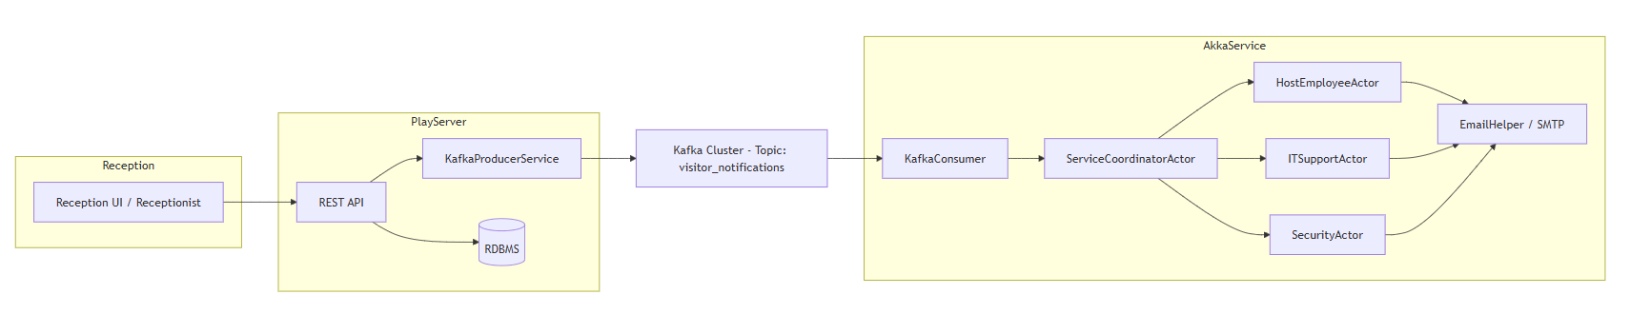
Architecture Diagram

Slide 5



Implementation Flow
Check-In Flow
Reception triggers /checkIn endpoint → VisitorController persists Visitor and VisitLog entities → ID proof uploaded and URL stored → KafkaProducerService builds JSON event → Message published to visitor_notifications topic
Message Processing
KafkaVisitorConsumer listens for incoming events → Parsed JSON sent to ServiceCoordinatorActor → Coordinator intelligently routes to specialized actors → EmailHelper sends notifications to stakeholders
Check-Out Flow
/checkout endpoint updates VisitLog status → CHECK_OUT event published to Kafka → Akka actors process exit notifications → Activity logged and notification workflows stopped

Slide 6
Check-In Sequence Flow
Reception Initiates
1
Staff submits visitor details via web interface
2
Play App Processes
Controller validates data, persists to database, uploads ID proof
Event Published
3
CHECK_IN message sent to Kafka topic with visitor context
4
Akka Consumer Receives
KafkaVisitorConsumer picks up message and deserializes JSON
Coordinator Routes
5
ServiceCoordinatorActor distributes to HostEmployee, IT, and Security actors
6
Notifications Sent
EmailHelper delivers customized alerts to all stakeholders

Slide 7
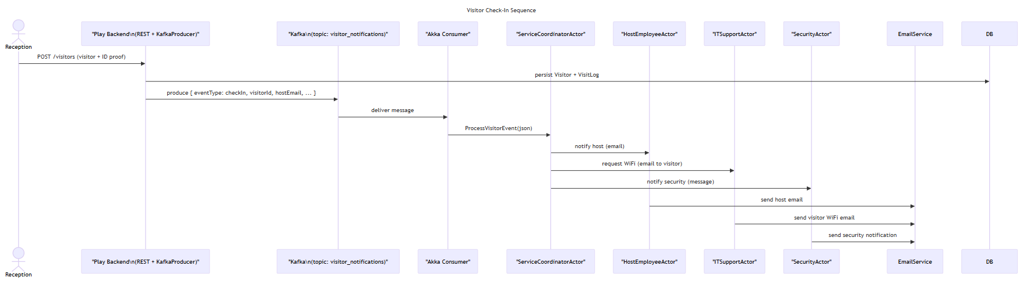
Sequence Diagram for Check-in Flow

Slide 8


Check-Out Sequence Flow
Exit Registration
Key Benefit: The system automatically stops all active notifications when a visitor checks out, preventing unnecessary alerts and ensuring clean state management.
Reception staff triggers /checkout endpoint with visitor ID
Status Update
Play service updates VisitLog with check-out timestamp and status
Event Broadcast
CHECK_OUT event published to Kafka with exit details
Actor Processing
Akka actors receive message and trigger exit notifications
Workflow Completion
Exit alerts sent to relevant parties, notification flows terminated

Slide 9
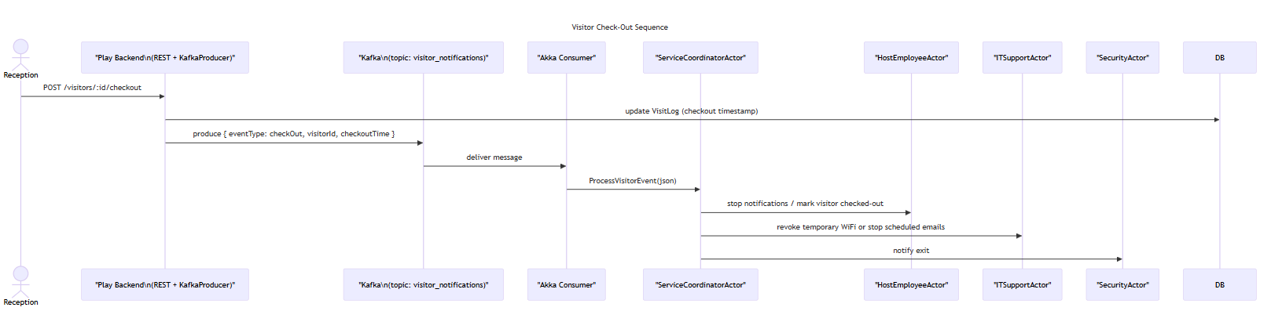
Sequence Diagram for Check-out Flow

Slide 10
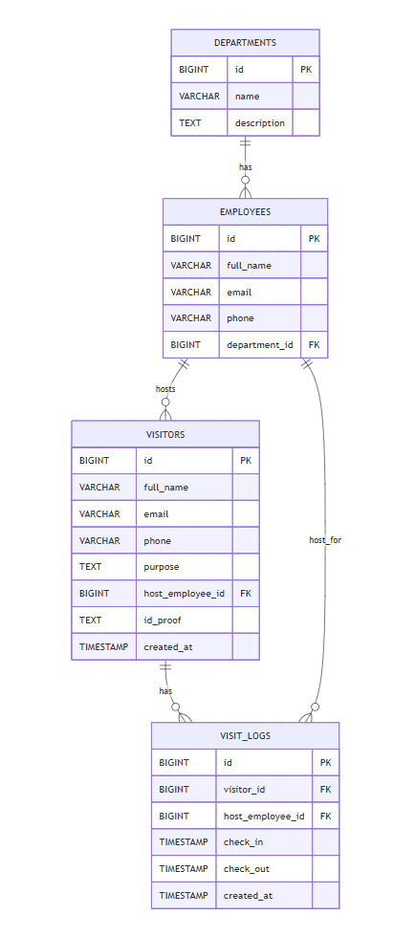
Entity Relationship Model
Core Entities
Relationships
Visitors: Personal information, contact details, ID proof reference
Visitor ↔ VisitLog (one-to-many)
Employee ↔ VisitLog (host assignment)
Employees: Host employee data, department association, contact info
Employee ↔ Department (membership)
Departments: Organizational units and hierarchies
Referential integrity enforced via foreign keys
VisitLogs: Check-in/out timestamps, purpose, status tracking

Slide 11
Suggested Improvements & TODOs
While the current implementation is functional, these enhancements would elevate the system to production-grade reliability and operational excellence.
Idempotency
Outbox Pattern
Email Templates
Add UUID-based eventId to prevent duplicate message processing and ensure exactly-once semantics.
Implement transactional outbox to guarantee event publishing even during Kafka failures.
Extract HTML email templates into separate files for easier maintenance and designer collaboration.
Security Hardening
Observability
Enable TLS encryption for Kafka connections and implement SASL authentication for producer/consumer authorization.
Integrate Prometheus metrics for monitoring actor mailbox sizes, message processing rates, and system health indicators.
Error Handling
Testing & Deployment
Configure dead letter queue (DLQ) for failed messages and implement retry logic with exponential backoff.
Expand unit test coverage for DAOs and actors, optimize Dockerfiles, and establish CI/CD pipeline with automated deployments.

Slide 12

Any Questions ?

Slide 13
Thank you

