Slide 1
Predictive maintenance of Aircraft engine using Long Short Term Memory Neural Networks
Vigneshwar-40016940
Rohit Kumar-40016951
Vikram Patel-40016950

Slide 2
Individual Contribution
Rohit Kumar: Implementation of code, helped in the preparation of report and Presentation
Vigneshwar: Prepared Report, implementation of data pre-processing and preparation of Presentation
Vikram Patel: Prepared Presentation, Helped in the implementation of code and preparation of report

Slide 3
Problem Statement
Engines of aircraft usually degrade over time, which can cause severe damages to the components which in turn may catastrophic accidents. It takes a lot of time and resources to repair the degraded components. To prevent the engine from degradation, maintenance activities must be carried out constantly, which proves to be a hectic task and its expensive.
Solution – Predictive Maintenance

Slide 4
OBJECTIVE
To create an analytical framework to implement predictive maintenance of aircraft engines
By analaysing whether the engine will within a certain window fail or not ?
By calculating the Remaining useful life(RUL) of the engine

Slide 5
DATASET
Turbofan Engine Degradation Simulation Data Set
The dataset is collected from Prognostics CoE at NASA Ames
Data sets consist of multiple multivariate time series. There are three operational settings that have a substantial effect on engine performance.
The dataset consists of 26 columns of numbers, separated by spaces. Each row is a snapshot of data taken during a single operational cycle, each column is a different variable.

Slide 6
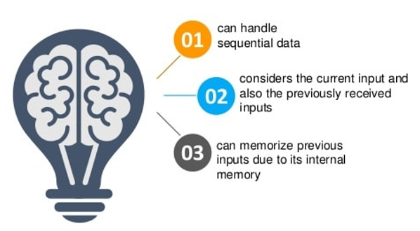
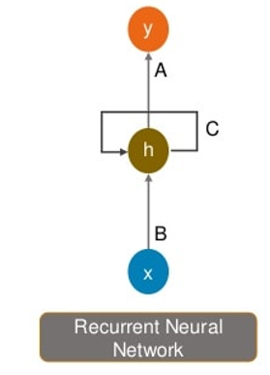
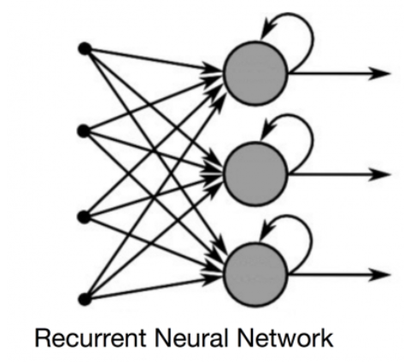
Recurrent Neural Networks
Recurrent neural networks (RNN) are the state of the art algorithm for sequential data
It is the first algorithm that remembers its input, due to an internal memory, which makes it perfectly suited for machine learning problems that involve sequential data.

Slide 7
Issues of Standard RNN’s
EXPLODING GRADIENTS:
Exploding gradients are when the algorithm, without much reason, assigns a stupidly high importance to the weights. This problem can be easily solved by truncating or squashing the gradients.
VANISHING GRADIENTS:
Vanishing gradients occur when the values of a gradient are too small and the model stops learning or takes way too long as a result. This problem can be solved by LSTM
When dealing with a time series, it tends to forget old information. When there is a distant relationship of unknown length, we wish to have a “memory” to it.

Slide 8
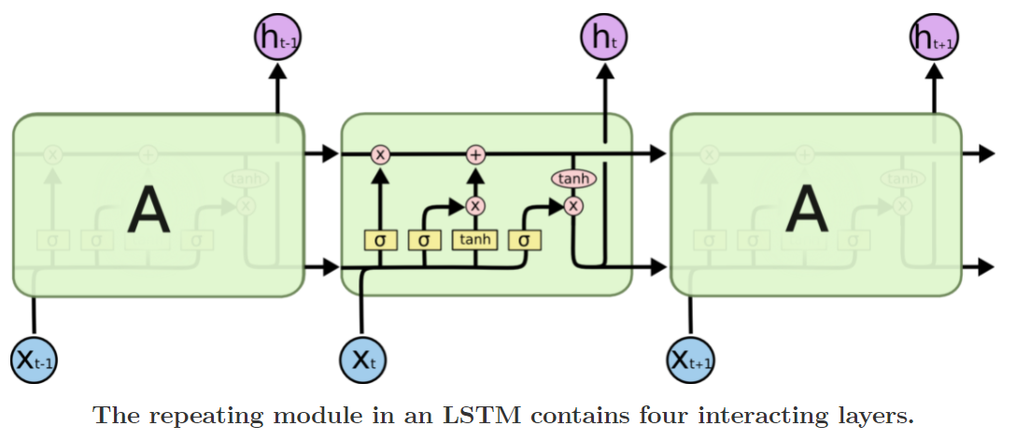
Long Short Term Memory(LSTM)
Long short-term memory networks (LSTMs) are an extension for recurrent neural networks, which basically extends the memory.
LSTMs are explicitly designed to avoid the long-term dependency problem. Remembering information for long periods of time is practically their default behavior, not something they struggle to learn
An LSTM has three gates, to protect and control the cell state.

Slide 9
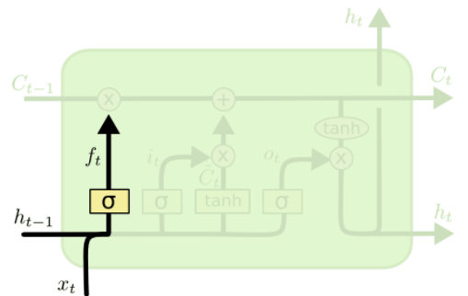
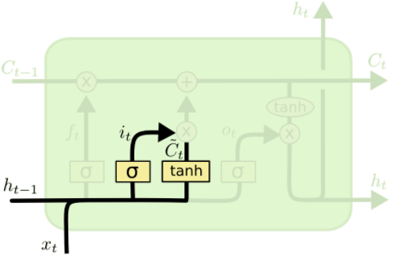
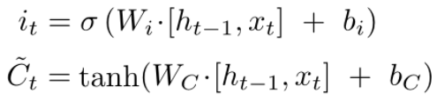

Step-by-Step LSTM Walk Through
FORGET GATE LAYER
It decide what information we’re going to throw away from the cell state
INPUT GATE LAYER
It decide what new information we’re going to store in the cell state
for eac

Slide 10
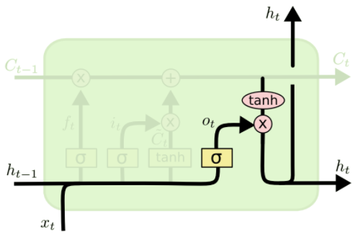
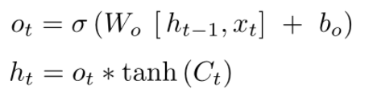
Output Gate Layer
It decide what we’re going to output

Slide 11
Gated Recurrent Unit(GRU)
A slightly more dramatic variation on the LSTM is the GRU Gated Recurrent Unit
It combines the forget and input gates into a single “update gate.”
It also merges the cell state and hidden state, and makes some other changes
The resulting model is simpler than standard LSTM models, and has been growing increasingly popular.

Slide 12
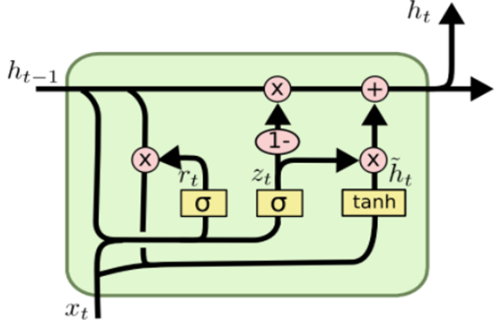
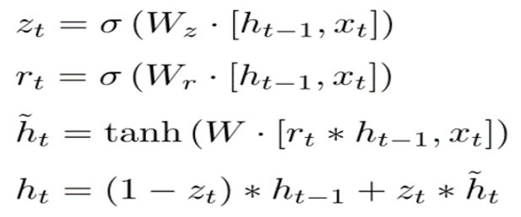
Update gate:
The update gate helps the model to determine how much of the past information (from previous time steps) needs to be passed along to the future.
Reset Gate:
This gate is used from the model to decide how much of the past information to forget. The formula is the same as the one for the update gate. The difference comes in the weights and the gate’s usage.

Slide 13
Data pre-processing and Exploratory Data Analysis
The dataset contains failure data of 100 engines denoted by their ID numbers, with 3 operational settings and sensor measurements from 21 sensors for several time cycles before eventual failure.
Feature engineering - Remaining Useful Life(RUL), label1
Label1 = 0 -> engine will not fail window w1
Label1 = 1 -> will fail within window w1
Normalization of data

Slide 14
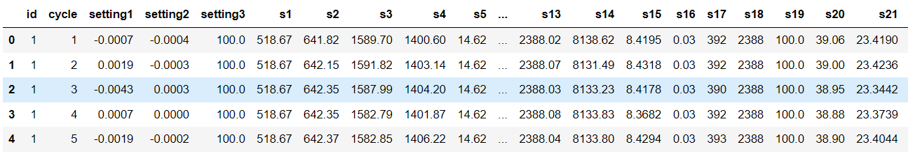
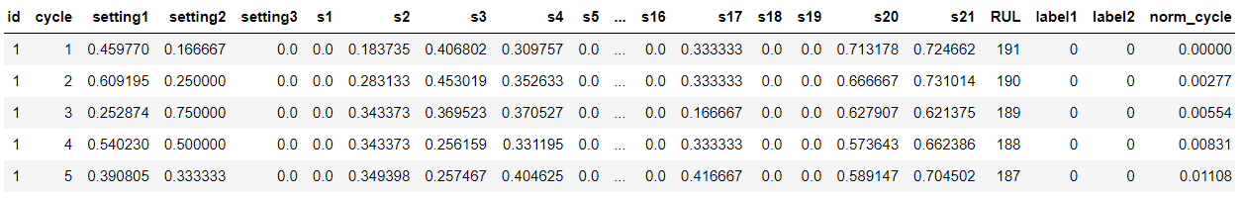
BEFORE:
AFTER:

Slide 15
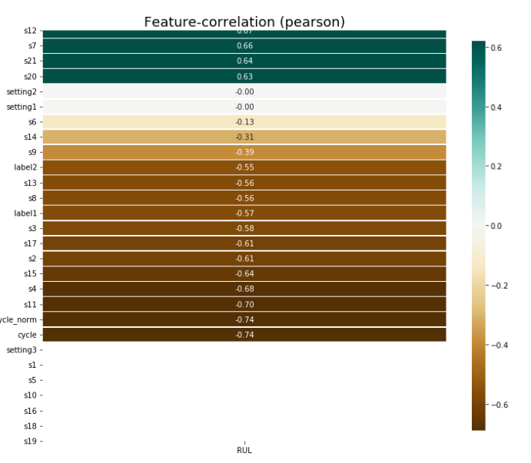

Data Visualization
Correlation with RUL:
This figure correlates RUL value with all other features. RUL gives the insight about our engines remaining lifespan and is our prediction variable for our regression problem.

Slide 16
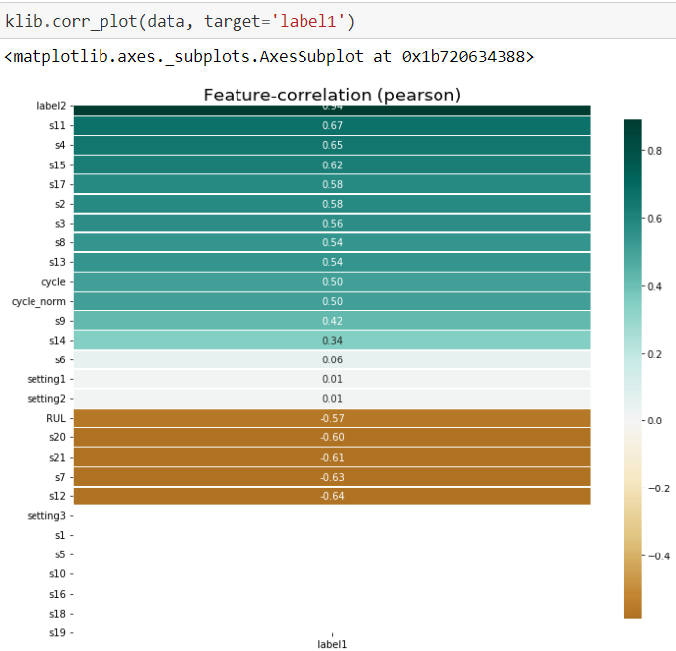
Correlation of label1:
The above figure correlates label1 with all the other features. “label1” is the prediction variable for the binary classification problem.

Slide 17
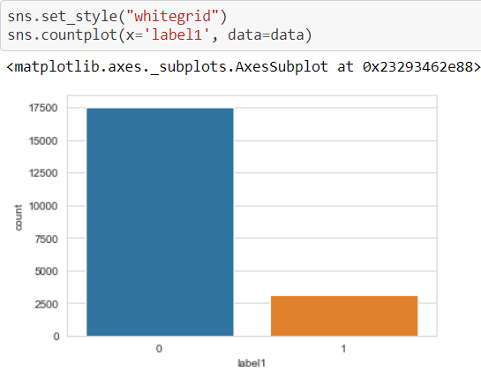
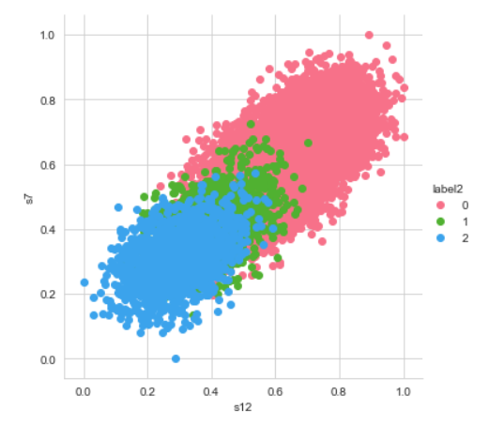
Distribution of values in label1
Distribution of labels based on sensors
Sensor-7 vs sensor-12:

Slide 18
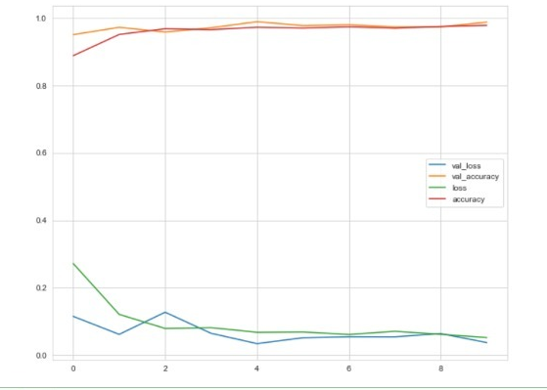
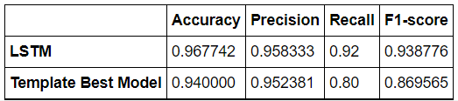
Binary Classification
In this problem, our aim is to predict whether our engine will fail within a given window or not. So, we will use label1 values as the prediction variable for this problem.
LSTM Model

Slide 19
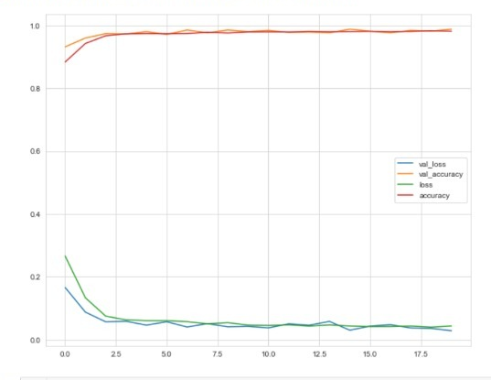
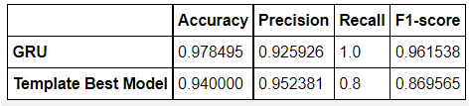
GRU Model

Slide 20
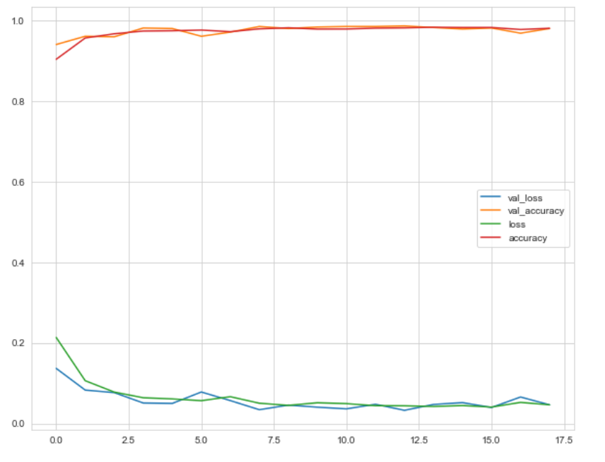
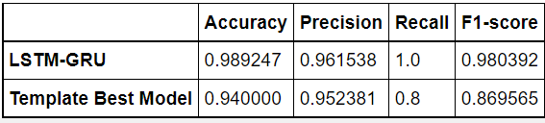
Combined Model of LSTM and GRU

Slide 21
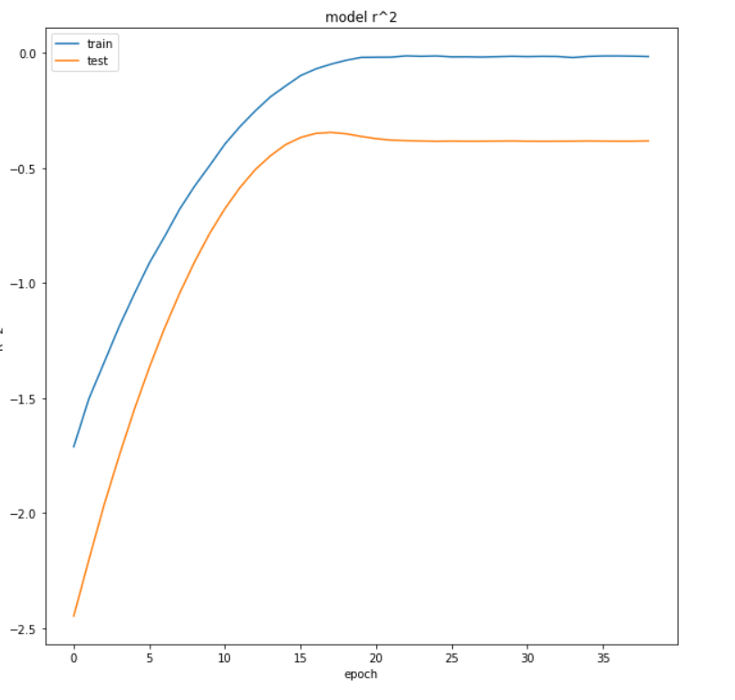
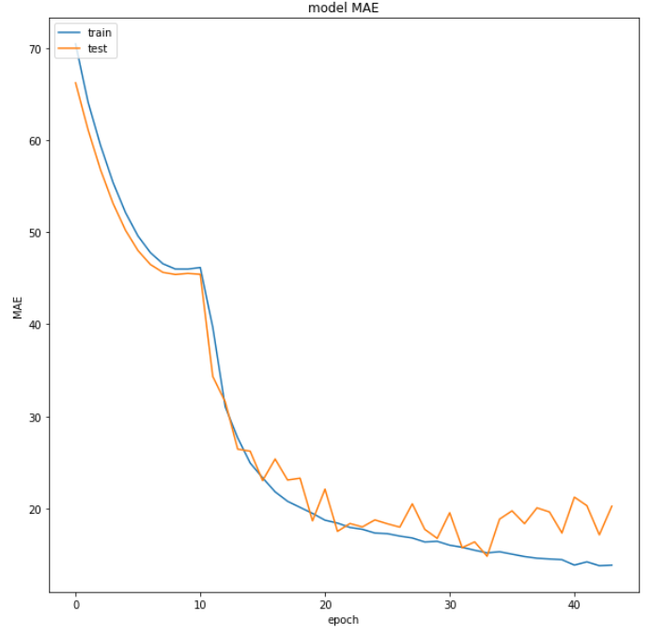
Regression Model Results

Slide 22
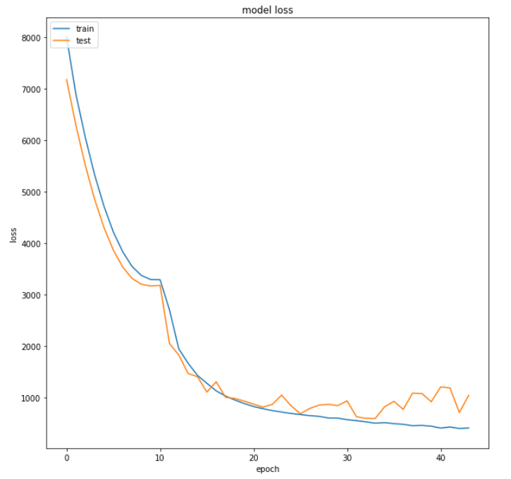
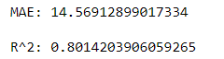



Model 1
For Training
For Testing
Model 2
For Training
For Testing

Slide 23
Results and Conclusion
RNN is quite useful for predicting time series data, but it does not have long term memory, so by using LSTM we can remove this problem .
For binary classification, both LSTM and GRU perform equally well. But the custom model we built performed much better giving higher accuracy of 99%.
Using Regression model we predicted the Remaining useful Lifecycle of engine with an accuracy of 76%.

Slide 24
Future Scope
Predictive maintenance can be utilized everywhere from small houses to large industries.
It can be incorporated with IoT devices, which gather and send live sensor data.
Adding prognostic capabilities to electronic devices can cut down the maintenance cost drastically.
Can mine critical-asset data and identify anomalies or deviations from standard performance.
Can be used in predicting environmental risks and mitigate the damages caused due to it.

Slide 25
References
https://gallery.azure.ai/Collection/Predictive-Maintenance-Template-3
https://ti.arc.nasa.gov/tech/dash/groups/pcoe/prognostic-data-repository/#turbofan
https://www.kaggle.com/nafisur/dataset-for-predictive-maintenance
https://builtin.com/data-science/recurrent-neural-networks-and-lstm
https://www.youtube.com/watch?v=LfnrRPFhkuY

Slide 26
THANK YOU

