Slide 1





ASSIGNMENT 3
PROJECT 1: RSA-BASED PUBLIC KEY DISTRIBUTION
Pranjal Bharti 2021080
Daksh Bhasin 2021035

Slide 2
INTRODUCTION
OBJECTIVE:
  DEMONSTRATE A SECURE COMMUNICATION PROTOCOL COMBINING PUBLIC-KEY (RSA) AND SESSION KEY CRYPTOGRAPHY.
OVERVIEW:
  IMPLEMENTATION OF A PUBLIC KEY DISTRIBUTION AUTHORITY (PKDA) THAT HANDLES KEY DISTRIBUTION AND MESSAGE ENCRYPTION.
  USE OF NONCES AND TIMESTAMPS TO PREVENT REPLAY ATTACKS AND ENSURE MESSAGE FRESHNESS.

Slide 3
CRYPTOGRAPHIC COMPONENTS
RSA PUBLIC-KEY CRYPTOGRAPHY:
  KEY GENERATION: USES FUNCTIONS LIKE GCD, MOD_INV, AND GENERATE_KEYPAIR TO CREATE RSA KEY PAIRS.
  ENCRYPTION/DECRYPTION: FOR PUBLIC-KEY OPERATIONS, USES POW() WITH MODULUS ARITHMETIC.
SESSION KEY ENCRYPTION:
  A LIGHTWEIGHT SYMMETRIC ENCRYPTION USING XOR (ENCRYPT_WITH_SESSION_KEY AND DECRYPT_WITH_SESSION_KEY).
  SESSION KEYS ARE GENERATED USING RANDOM NUMBERS AND NONCE FUNCTIONS.

Slide 4
COMMUNICATION FLOW
STEP 1: SESSION KEY REQUEST BY INITIATOR A
  INITIATOR A SENDS A REQUEST INCLUDING ITS PUBLIC KEY, NONCE, AND TIMESTAMP.
  PKDA PROCESSES AND RETURNS AN ENCRYPTED SESSION KEY.
STEP 2: COMMUNICATION BETWEEN INITIATOR A AND RESPONDER B
  INITIATOR A SENDS ITS IDENTITY AND NONCE TO RESPONDER B.
  RESPONDER B SIMILARLY REQUESTS A SESSION KEY FROM PKDA.
  A CHALLENGE-RESPONSE MECHANISM USING NONCES VERIFIES THE IDENTITY.
STEP 3: SECURE MESSAGE EXCHANGE
  ONCE THE SESSION KEY IS ESTABLISHED, BOTH PARTIES ENCRYPT AND DECRYPT MESSAGES USING XOR ENCRYPTION.

Slide 5
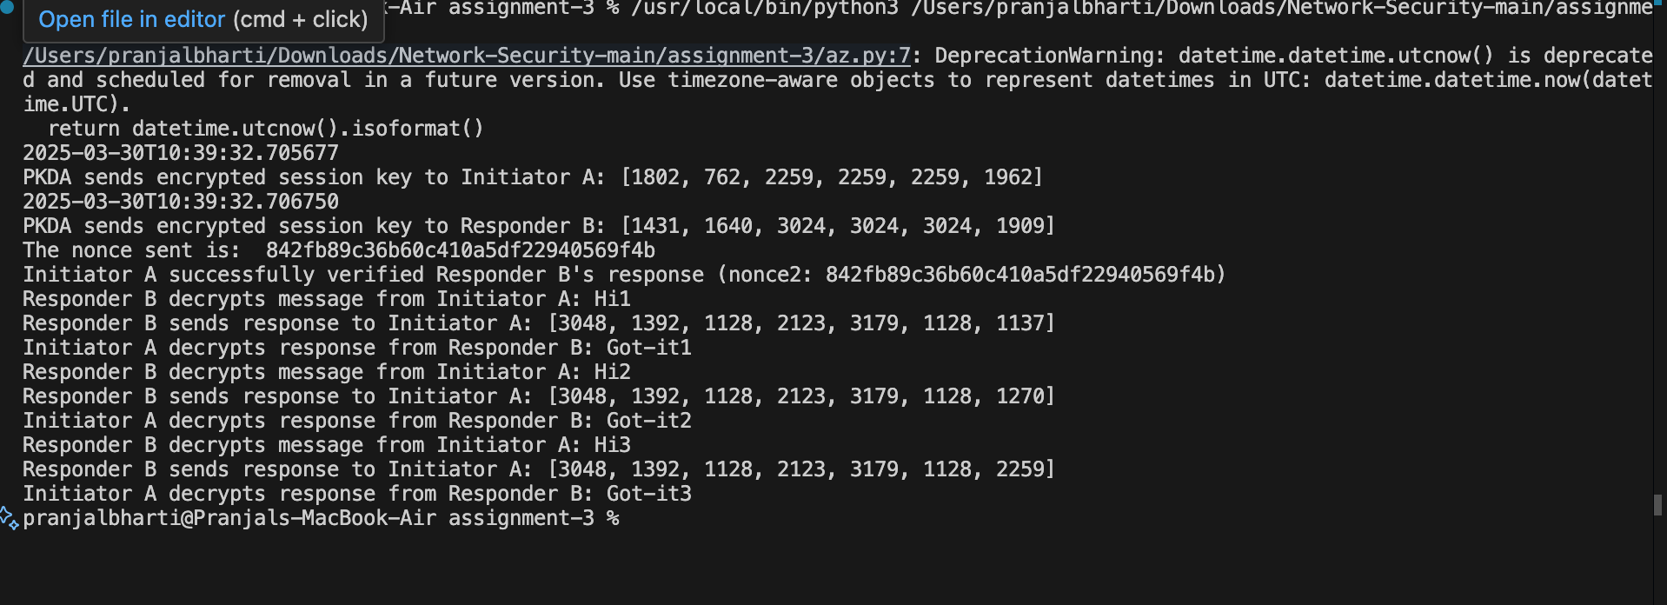
CODE OUTPUT

Slide 6
THANKYOU

