Slide 1
MySQL

Slide 2
What is MySQL
MySQL is a fast, easy to use relational database. It is currently the most popular open-source database. It is very commonly used in conjunction with PHP,JSP scripts to create powerful and dynamic server-side applications.
MySQL is used for many small and big businesses. It is developed, marketed and supported by MySQL AB, a Swedish company. It is written in C and C++

Slide 3
Reasons of popularity
MySQL is an open-source database so you don't have to pay a single penny to use it.
MySQL is customizable because it is an open source database and the open-source GPL license facilitates programmers to modify the SQL software according to their own specific environment.
MySQL is quicker than other databases so it can work well even with the large data set.

Slide 4
MySQL supports many operating systems with many languages like PHP, PERL, C, C++, JAVA, etc.
MySQL uses a standard form of the well-known SQL data language.
MySQL is very friendly with PHP,JSP,SERVLET the most popular language for web development.
MySQL supports large databases, up to 50 million rows or more in a table. The default file size limit for a table is 4GB, but you can increase this (if your operating system can handle it) to a theoretical limit of 8 million terabytes (TB).

Slide 5
MySQL Features
Relational Database Management System (RDBMS): MySQL is a relational database management system.
Easy to use: MySQL is easy to use. You have to get only the basic knowledge of SQL. You can build and interact with MySQL with only a few simple SQL statements.
It is secure: MySQL consist of a solid data security layer that protects sensitive data from intruders. Passwords are encrypted in MySQL.

Slide 6
Client/ Server Architecture: MySQL follows a client /server architecture. There is a database server (MySQL) and arbitrarily many clients (application programs), which communicate with the server; that is, they query data, save changes, etc.
Free to download: MySQL is free to use and you can download it from MySQL official website.
It is scalable: MySQL can handle almost any amount of data, up to as much as 50 million rows or more. The default file size limit is about 4 GB. However, you can increase this number to a theoretical limit of 8 TB of data.

Slide 7
Compatibale on many operating systems: MySQL is compatible to run on many operating systems, like Novell NetWare, Windows* Linux*, many varieties of UNIX* (such as Sun* Solaris*, AIX, and DEC* UNIX), OS/2, FreeBSD*, and others. MySQL also provides a facility that the clients can run on the same computer as the server or on another computer (communication via a local network or the Internet).
Allows roll-back: MySQL allows transactions to be rolled back, commit and crash recovery.

Slide 8
High Performance: MySQL is faster, more reliable and cheaper because of its unique storage engine architecture.
High Flexibility: MySQL supports a large number of embedded applications which makes MySQL very flexible.
High Productivity: MySQL uses Triggers, Stored procedures and views which allows the developer to give a higher productivity.

Slide 9
MySQL Data Types
MySQL supports a lot number of SQL standard data types in various categories. It uses many different data types broken into mainly three categories: numeric, date and time, and string types.

Slide 10
Numeric Data Type
Numeric Data Type
INT
BIGINT
FLOAT(m,d)
DOUBLE(m,d)
DECIMAL(m,d)

Slide 11
Date and Time Data Type:
Date and Time Data Type
DATE
DATETIME
TIMESTAMP

Slide 12
String Data Types:
String Data Types:
CHAR(size)
VARCHAR(size)
TEXT(size)
LONGTEXT(size)
BINARY(size)

Slide 13
Large Object Data Types (LOB) Data Types:
Large Object Data Types (LOB) Data Types:
BLOB(size)
LONGTEXT
MEDIUMBLOB

Slide 14
Download MySQL
Follow these steps:
Go to MySQL official website
http://www.mysql.com/downloads/
Choose the version number for MySQL community server which you want.

Slide 15
MySQL Create Database
CREATE DATABASE database_name;
CREATE DATABASE employees;

Slide 16
SHOW DATABASES;

Slide 17
MySQL SELECT Database
SELECT Database is used in MySQL to select a particular database to work with. This query is used when multiple databases are available with MySQL Server.
You can use SQL command USE to select a particular database.
USE database_name;

Slide 18
MySQL Drop Database
You can drop/delete/remove a MySQL database easily with the MySQL command. You should be careful while deleting any database because you will lose your all the data available in your database.
DROP DATABASE database_name;
Now you can check that either your database is removed by executing the following query
SHOW DATABASES;

Slide 19
MySQL CREATE TABLE
The MySQL CREATE TABLE command is used to create a new table into the database. A table creation command requires three things:
Name of the table
Names of fields
Definitions for each field

Slide 20
Following is a generic syntax for creating a MySQL table in the database.
CREATE TABLE table_name
(column_name column_type...);

Slide 21
Here, we will create a table named "cus_tbl" in the database "customers".
CREATE TABLE cus_tbl ( cus_id INT , cus_firstname VARCHAR(100) , cus_surname VARCHAR(100) , );

Slide 22
MySQL ALTER Table
MySQL ALTER statement is used when you want to change the name of your table or any table field. It is also used to add or delete an existing column in a table.
The ALTER statement is always used with "ADD", "DROP" and "MODIFY" commands according to the situation.

Slide 23
1) ADD a column in the table
ALTER TABLE table_name
ADD new_column_name column_definition
[ FIRST | AFTER column_name ];
table_name: It specifies the name of the table that you want to modify.
new_column_name: It specifies the name of the new column that you want to add to the table.
column_definition: It specifies the data type and definition of the column (NULL or NOT NULL, etc).
FIRST | AFTER column_name: It is optional. It tells MySQL where in the table to create the column. If this parameter is not specified, the new column will be added to the end of the table.

Slide 24
In this example, we add a new column "cus_age" in the existing table "cus_tbl".
Use the following query to do this:
ALTER TABLE cus_tbl
ADD cus_age varchar(40) NOT NULL;
See the recently added column:
SELECT* FROM cus_tbl;

Slide 25
2) Add multiple columns in the table
Syntax:
ALTER TABLE table_name
ADD new_column_name column_definition
[ FIRST | AFTER column_name ],
ADD new_column_name column_definition
[ FIRST | AFTER column_name ],
...
;

Slide 26
In this example, we add two new columns "cus_address", and cus_salary in the existing table "cus_tbl". cus_address is added after cus_surname column and cus_salary is added after cus_age column.
ALTER TABLE cus_tbl
ADD cus_address varchar(100) NOT NULL
AFTER cus_surname,
ADD cus_salary int(100) NOT NULL
AFTER cus_age ;
See the recently added columns:
SELECT* FROM cus_tbl;

Slide 27
3) MODIFY column in the table
The MODIFY command is used to change the column definition of the table.
Syntax:
ALTER TABLE table_name
MODIFY column_name column_definition
[ FIRST | AFTER column_name ];

Slide 28
In this example, we modify the column cus_surname to be a data type of varchar(50) and force the column to allow NULL values.
Use the following query to do this:
ALTER TABLE cus_tbl
MODIFY cus_surname varchar(50) NULL;

Slide 29
4) DROP column in table
Syntax:
ALTER TABLE table_name
DROP COLUMN column_name;
Let's take an example to drop the column name "cus_address" from the table "cus_tbl".
ALTER TABLE cus_tbl
DROP COLUMN cus_address;

Slide 30
5) RENAME column in table
Syntax:
ALTER TABLE table_name
CHANGE COLUMN old_name
new_name column_definition
[ FIRST | AFTER column_name ]

Slide 31
In this example, we will change the column name "cus_surname" to "cus_title".
Use the following query to do this:
ALTER TABLE cus_tbl CHANGE
COLUMN cus_surname
cus_title varchar(20) NOT NULL;

Slide 32
6) RENAME table
Syntax:
ALTER TABLE table_name
RENAME TO new_table_name;
In this example, the table name cus_tbl is renamed as cus_table.
ALTER TABLE cus_tbl
RENAME TO cus_table;

Slide 33
MySQL TRUNCATE Table
MYSQL TRUNCATE statement removes the complete data without removing its structure.
The TRUNCATE TABLE statement is used when you want to delete the complete data from a table without removing the table structure.

Slide 34
Syntax:
TRUNCATE TABLE table_name;
This example specifies how to truncate a table. In this example, we truncate the table "cus_tbl".
TRUNCATE TABLE cus_tbl;

Slide 35
MySQL DROP Table
MYSQL DROP table statement removes the complete data with structure.
Syntax:
DROP TABLE table_name;
This example specifies how to drop a table. In this example, we are dropping the table "cus_tbl".
DROP TABLE cus_tbl;

Slide 36
MySQL INSERT Statement
MySQL INSERT statement is used to insert data in MySQL table within the database. We can insert single or multiple records using a single query in MySQL.
Syntax:
INSERT INTO table_name ( field1, field2,...fieldN )
VALUES
( value1, value2,...valueN );

Slide 37
INSERT INTO emp VALUES
(7, ‘GGCT', 40000);
INSERT INTO emp(id,name,salary) VALUES (7, ‘GGCT', 40000);

Slide 38
Here, we are going to insert record in the "cus_tbl" table of "customers" database.
INSERT INTO cus_tbl
(cus_id, cus_firstname, cus_surname)
VALUES
(5, 'Ajeet', 'Maurya'),
(6, 'Deepika', 'Chopra'),
(7, 'Vimal', 'Jaiswal');

Slide 39
MySQL UPDATE Query
MySQL UPDATE statement is used to update data of the MySQL table within the database. It is used when you need to modify the table.
Syntax:
UPDATE table_name SET
field1=new-value1,
field2=new-value2
[WHERE Clause]

Slide 40
update cus_surname field for a record having cus_id as 5.
UPDATE cus_tbl
SET cus_surname = ‘Williams '
WHERE cus_id = 5;

Slide 41
MySQL DELETE Statement
MySQL DELETE statement is used to delete data from the MySQL table within the database. By using delete statement, we can delete records on the basis of conditions.
Syntax:
DELETE FROM table_name
WHERE
(Condition specified);

Slide 42
DELETE FROM cus_tbl
WHERE cus_id = 6;

Slide 43
MySQL SELECT Statement
The MySQL SELECT statement is used to fetch data from the one or more tables in MySQL. We can retrieve records of all fields or specified fields.
Syntax for specified fields:
SELECT expressions
FROM tables
[WHERE conditions];
Syntax for all fields:
SELECT * FROM tables [
WHERE conditions];

Slide 44
SELECT
officer_name, address
FROM
officers

Slide 45
MySQL WHERE Clause
MySQL WHERE Clause is used with SELECT, INSERT, UPDATE and DELETE clause to filter the results. It specifies a specific position where you have to do the operation.
Syntax:
WHERE conditions;
Parameter:
conditions: It specifies the conditions that must be fulfilled for records to be selected.

Slide 46
SELECT * FROM officers
WHERE
address = 'Mumbai';

Slide 47
MySQL AND Condition
The MySQL AND condition is used with SELECT, INSERT, UPDATE or DELETE statements to test two or more conditions in an individual query.
Syntax:
WHERE condition1
AND condition2
...
AND condition_n;
condition1, condition2, ... condition_n: Specifies all conditions that must be fulfilled for the records to be selected.

Slide 48
SELECT * FROM cus_tbl
WHERE cus_firstname = 'Ajeet'
AND cus_id > 3;

Slide 49
MySQL OR Condition
The MySQL OR condition specifies that if you take two or more conditions then one of the conditions must be fulfilled to get the records as result.
Syntax:
WHERE condition1
OR condition2
...
OR condition_n;
Parameter explanation
condition1, condition2, ... condition_n: Specifies all conditions that must be fulfilled for the records to be selected.

Slide 50
SELECT *
FROM cus_tbl
WHERE cus_firstname = 'Ajeet'
OR cus_id > 100;

Slide 51
MySQL JOINS
MySQL JOINS are used with SELECT statement. It is used to retrieve data from multiple tables. It is performed whenever you need to fetch records from two or more tables.

Slide 52
There are three types of MySQL joins:
MySQL INNER JOIN
(or sometimes called simple join)
MySQL LEFT OUTER JOIN
(or sometimes called LEFT JOIN)
MySQL RIGHT OUTER JOIN
(or sometimes called RIGHT JOIN)

Slide 53
MySQL Inner JOIN (Simple Join)
The MySQL INNER JOIN is used to return all rows from multiple tables where the join condition is satisfied. It is the most common type of join.
Syntax:
SELECT columns
FROM table1
INNER JOIN table2
ON table1.column = table2.column;

Slide 54
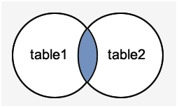
Image representation:

Slide 55
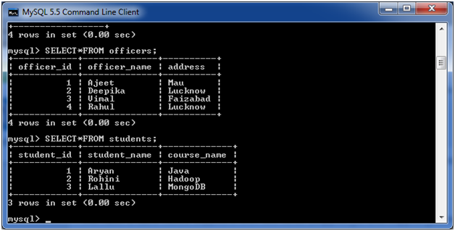

Slide 56
SELECT officers.officer_name, officers.address, students.course_name
FROM officers
INNER JOIN students
ON officers.officer_id = students.student_id;

Slide 57
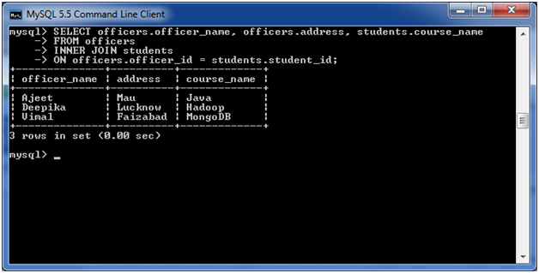

Slide 58
MySQL Left Outer Join
The LEFT OUTER JOIN returns all rows from the left hand table specified in the ON condition and only those rows from the other table where the join condition is fulfilled.
Syntax:
SELECT columns
FROM table1
LEFT [OUTER] JOIN table2
ON table1.column = table2.column;

Slide 59
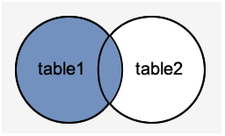
Image representation:

Slide 60
SELECT officers.officer_name, officers.address, students.course_name
FROM officers
LEFT JOIN students
ON
officers.officer_id = students.student_id;

Slide 61
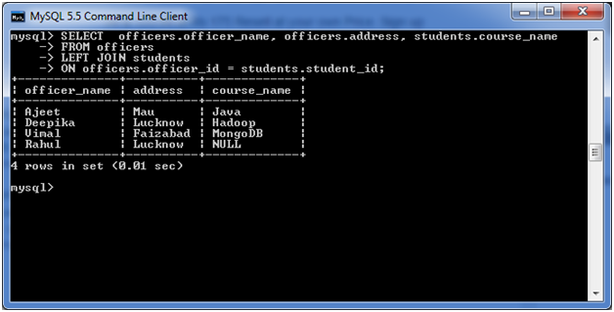

Slide 62
MySQL Right Outer Join
The MySQL Right Outer Join returns all rows from the RIGHT-hand table specified in the ON condition and only those rows from the other table where he join condition is fulfilled.
Syntax:
SELECT columns
FROM table1
RIGHT [OUTER] JOIN table2
ON table1.column = table2.column;

Slide 63
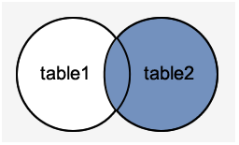
Image representation:

Slide 64
SELECT
officers.officer_name,
officers.address,
students.course_name,
students.student_name
FROM officers
RIGHT JOIN students ON
officers.officer_id = students.student_id;

Slide 65
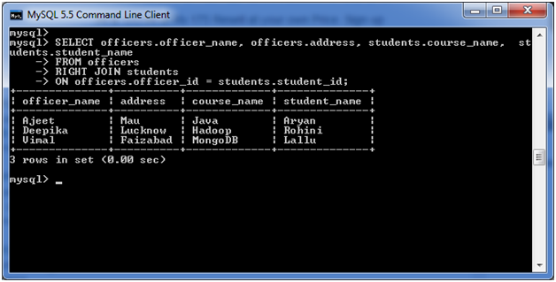

Slide 66
Aggregate Functions

Slide 67
MySQL count() Function
The MySQL count() function is used to return the count of an expression. It is used when you need to count some records of your table.
Syntax:
SELECT COUNT (aggregate_expression)
FROM table_name
[WHERE conditions];

Slide 68
Parameter explanation
aggregate_expression: It specifies the column or expression whose NON-NULL values will be counted.
table_name: It specifies the tables, from where you want to retrieve records. There must be at least one table listed in the FROM clause.
WHERE conditions: It is optional. It specifies the conditions that must be fulfilled for the records to be selected.

Slide 69
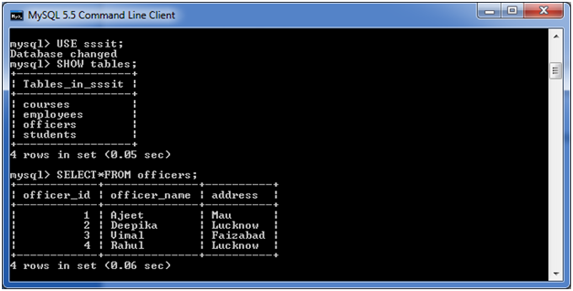
Consider a table named "officers", having the following data.

Slide 70
SELECT COUNT(officer_name)
FROM officers;

Slide 71
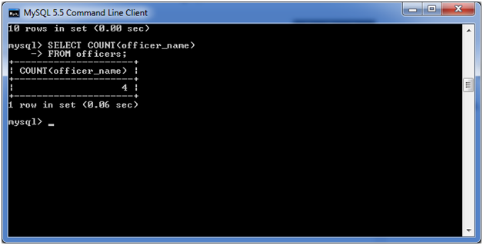

Slide 72
MySQL sum() function
The MySQL sum() function is used to return the total summed value of an expression.
Syntax:
SELECT SUM(aggregate_expression)
FROM tables
[WHERE conditions];

Slide 73
Parameter explanation
aggregate_expression: It specifies the column or expression that will be summed.
table_name: It specifies the tables, from where you want to retrieve records. There must be at least one table listed in the FROM clause.
WHERE conditions: It is optional. It specifies the conditions that must be fulfilled for the records to be selected.

Slide 74
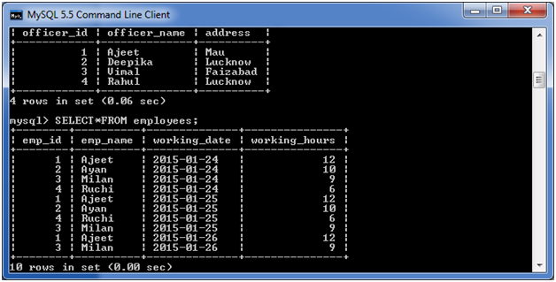

Slide 75
SELECT SUM (working_hours) AS "Total working hours"
FROM employees
WHERE working_hours > 5;

Slide 76
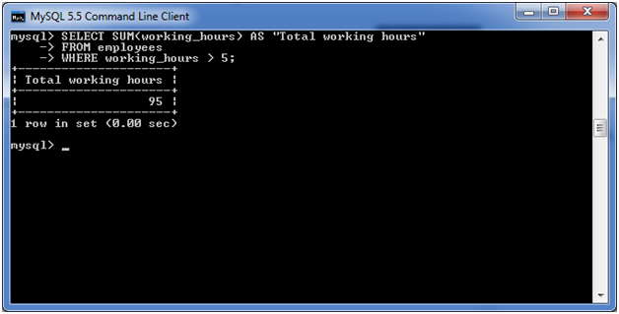

Slide 77
MySQL avg() function
The MySQL avg() function is used to return the average value of an expression.
Syntax:
SELECT AVG(aggregate_expression)
FROM tables
[WHERE conditions];

Slide 78
Parameter explanation
aggregate_expression: It specifies the column or expression that will be averaged.
table_name: It specifies the tables, from where you want to retrieve records. There must be at least one table listed in the FROM clause.
WHERE conditions: It is optional. It specifies the conditions that must be fulfilled for the records to be selected.

Slide 80
SELECT AVG(working_hours) AS "Avg working hours"
FROM employees
WHERE working_hours > 5;

Slide 81
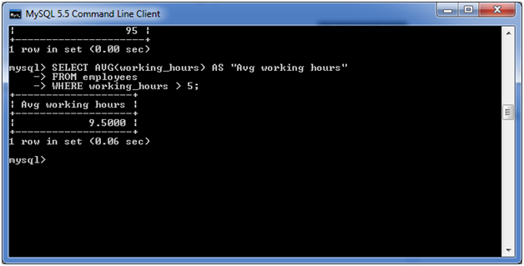

Slide 82
MySQL min() function
The MySQL min() function is used to return the minimum value from the table.
Syntax:
SELECT MIN (aggregate_expression)
FROM tables
[WHERE conditions];

Slide 83
Parameter explanation
aggregate_expression: It specifies the column or expression, from which the minimum value will be returned.
table_name: It specifies the tables, from where you want to retrieve records. There must be at least one table listed in the FROM clause.
WHERE conditions: It is optional. It specifies the conditions that must be fulfilled for the records to be selected.

Slide 84
SELECT MIN (working_hours) AS "Minimum working hours"
FROM employees;

Slide 85
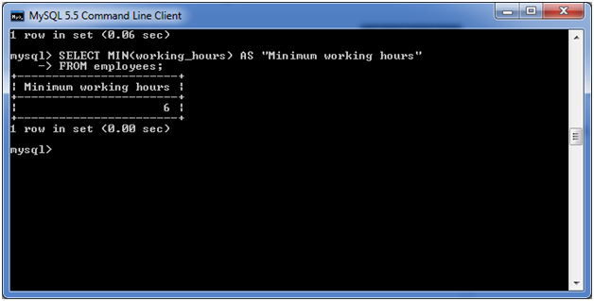

Slide 86
MySQL max() function
The MySQL max() function is used to return the maximum value of an expression. It is used when you need to get the maximum value from your table.
Syntax:
SELECT MAX(aggregate_expression)
FROM tables
[WHERE conditions];

Slide 87
Parameter explanation
aggregate_expression: It specifies the column or expression, from which the maximum value will be returned.
table_name: It specifies the tables, from where you want to retrieve records. There must be at least one table listed in the FROM clause.
WHERE conditions: It is optional. It specifies the conditions that must be fulfilled for the records to be selected.

Slide 88
SELECT MAX (working_hours)
AS "Maximum working hours"
FROM employees;

Slide 89
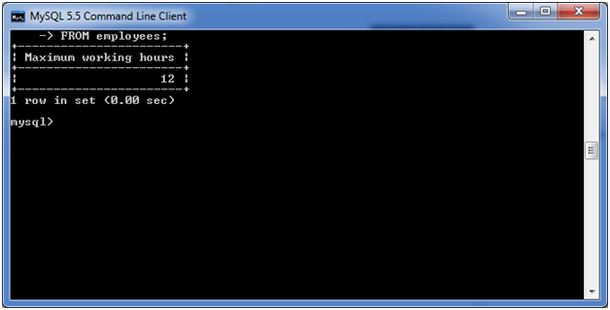

Slide 90
MySQL first function
The MySQL first function is used to return the first value of the selected column. Here, we use limit clause to select first record or more.
Syntax:
SELECT column_name
FROM table_name
LIMIT 1;

Slide 92
SELECT officer_name
FROM officers
LIMIT 1;

Slide 93
SELECT officer_name
FROM officers
LIMIT 2;

