Slide 1
CASE STUDY ON HOSPITAL MANAGEMENT SYSTEM
MADEBY :- PRANJAL PATEL

Slide 2
1.
TECH STACK

Slide 3

MONGODB - 4.4.0
EXPRESSJS – 4.17.2
ANGULAR – 13.2.1
NODEJS – 16.13.2(LTS)

Slide 4
2.
FEATURES

Slide 5
ADMIN DASHBOARD:-
VIEW PATIENTS LIST
REQUEST A SERVICE
APPROVE A DOCTORS LEAVE
ABOUT US
ADD A PATIENT
DELETE A PATIENT

Slide 6
3 ARCHITECTURE DIAGRAM

Slide 7
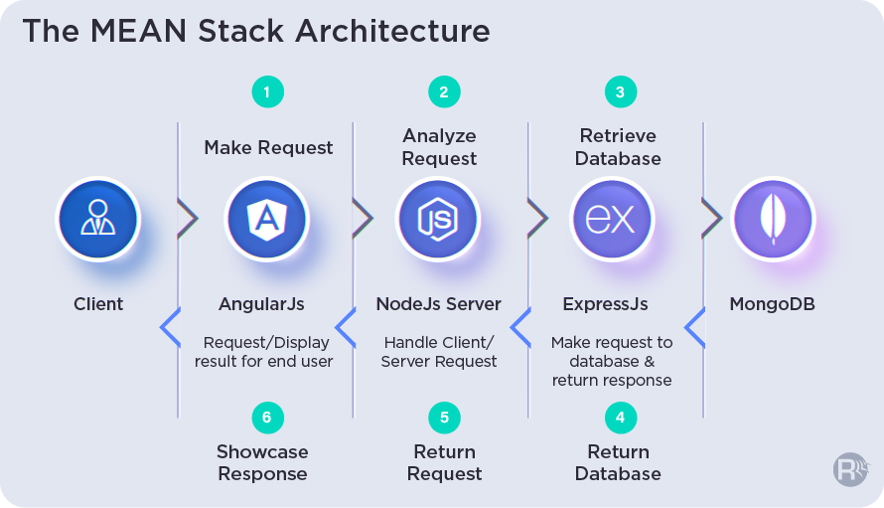

Slide 8
PROJECT DIAGRAM

Slide 9
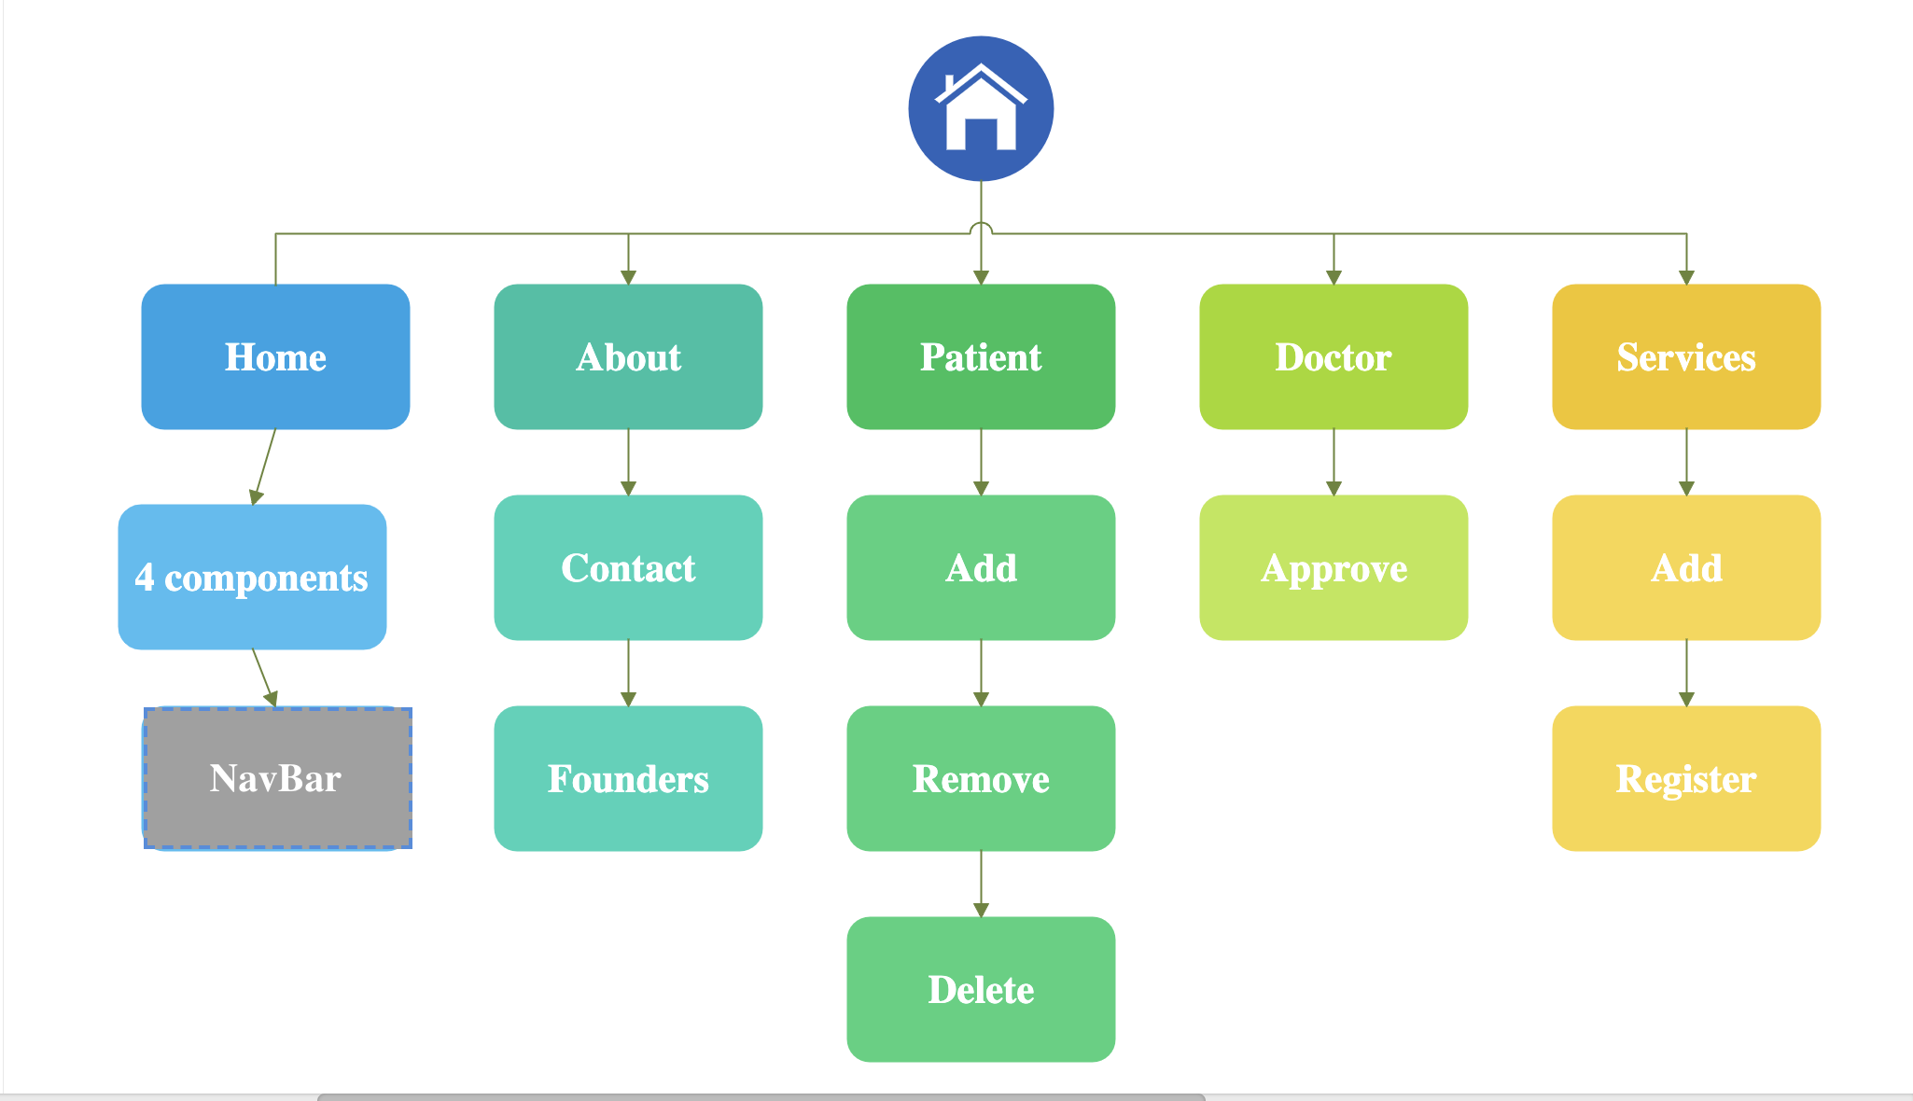

Slide 10
PROJECT OVERVIEW
This project highlights the usage of hospital management system in a very effective way.
As I am new to these technologies, I tried to incorporate basic things which can work effectively and can be useful for this system

