Slide 1
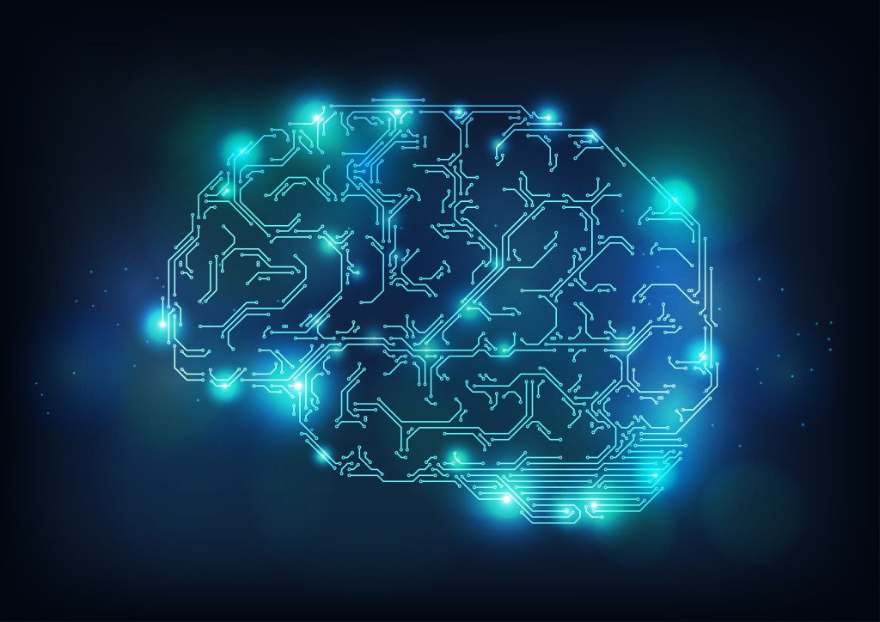
Medical Image Analysis Using Deep Learning
Pranjal Agarwal Btech CSE
5th Semester Section : ML
University Roll No. : 2015301 Class Roll No. : 85

Slide 2
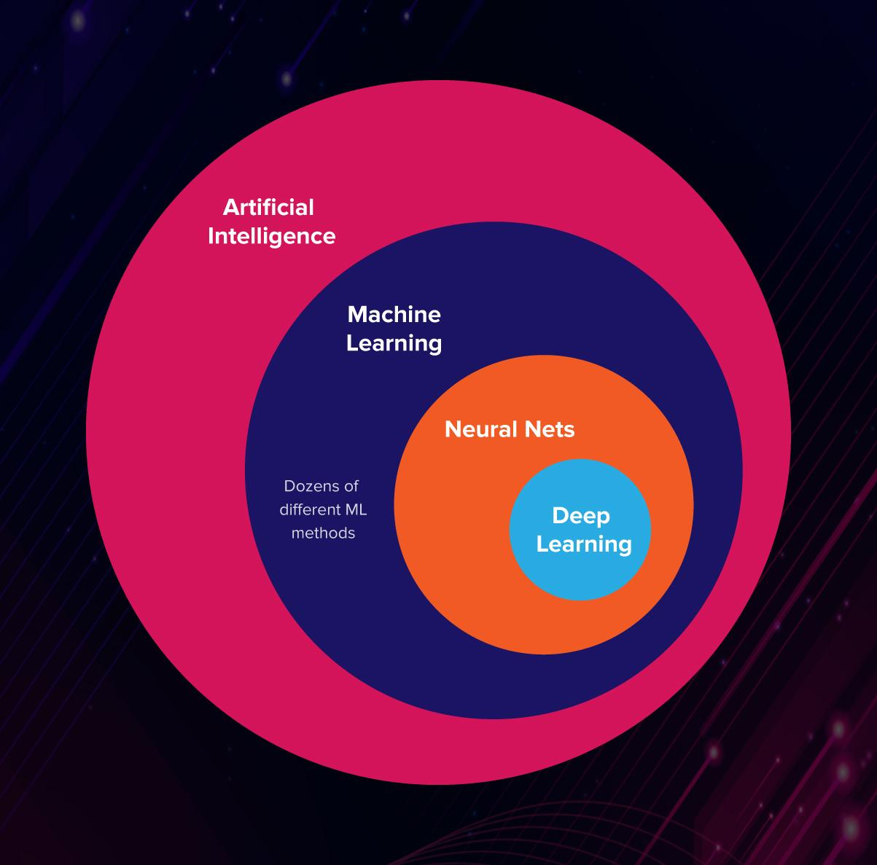
What is a Deep Learning?
Deep learning is a subset of machine learning, which is essentially a neural network with three or more layers. These neural networks attempt to simulate the behavior of the human brain—albeit far from matching its ability—allowing it to “learn” from large amounts of data. While a neural network with a single layer can still make approximate predictions, additional hidden layers can help to optimize and refine for accuracy.

Slide 3

Block Diagram
Loading the Dataset
Initializing the data
Preparing the data
Applying CNN
Fitting the model
Evaluating the model
Training the model

Slide 4
Algorithm Used
A Convolutional Neural Network is a Deep Learning algorithm which can take in an input image, assign importance (learnable weights and biases) to various aspects/objects in the image and be able to differentiate one from the other. The pre-processing required in a ConvNet is much lower as compared to other classification algorithms.
Convolutional neural networks are distinguished from other neural networks by their superior performance with image, speech, or audio signal inputs.

Slide 5
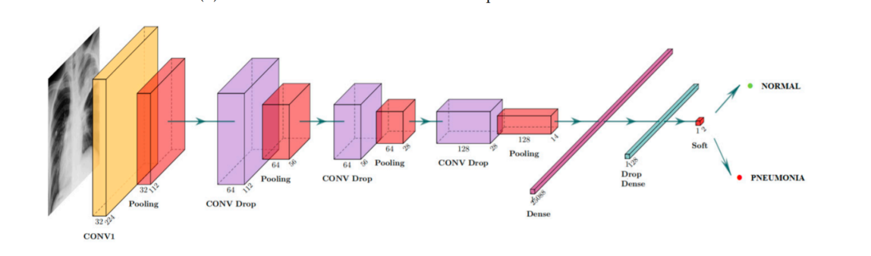
Layers in CNN
ALGORITHM
Convolutional Layer-Apply filters to extract features.Filters are composed of small kernels learned.
Pooling layer-Reduce dimensionality.
Fully-connected (FC) layer-Aggregate information from final feature mapsGenerate final
classification.

Slide 6
Libraries Used
Pandas
Matplotlib
Tensorflow
Pandas is a library which is used fo data analysis such as Data cleansing
Data fill
Data normalization
Data visualization
Statistical analysis
Data inspection
Loading and saving data
Matplotlib is a cross-platform, data visualization and graphical plotting library for Python and its numerical extension NumPy
TensorFlow is a free and open-source software library for machine learning and artificial intelligence. It can be used across a range of tasks but has a particular focus on training and inference of deep neural networks.
NumPy
Seaborn
NumPy is a library for the Python programming language, adding support for large, multi-dimensional arrays and matrices, along with a large collection of high-level mathematical
functions to operate on these arrays.
Seaborn is a data visualization library built on top of matplotlib and closely integrated with pandas data structures in Python. Visualization is the central part of Seaborn which helps in exploration and understanding of data.

Slide 7
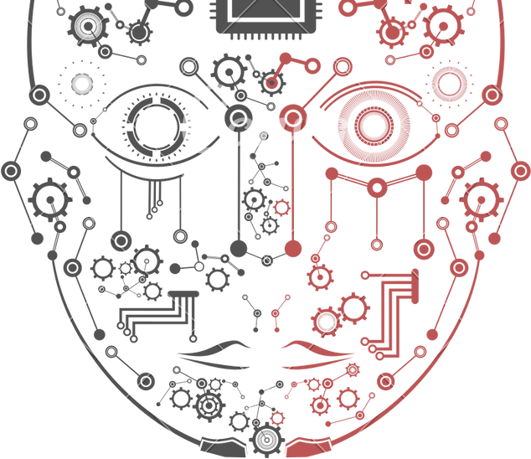
Preparing the data
We will increase the size of the image training dataset artificially by performing some Image Augmentation technique.
Image Augmentation expands the size of the dataset by creating a modified version of the existing training set images that helps to increase dataset variation and ultimately improve the ability of the model to predict new images.
We can use various hyperparameter to generate dataset such as
rescale—To rescale the image pixel values to be between [0,1] which makes the images contribute more equally to the overall loss.
horizontal_flip —Some images are flipped horizontally at random.
vertical_flip — Some images are flipped vertically at random.
brightness_range — brightness of 0.0 corresponds to absolutely no brightness, and 1.0 corresponds to maximum brightness.

Slide 8
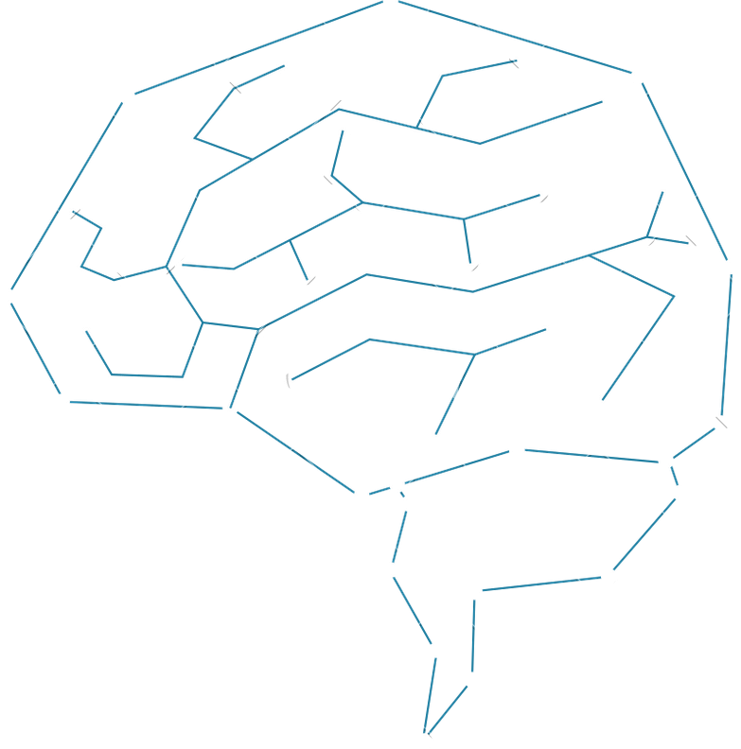
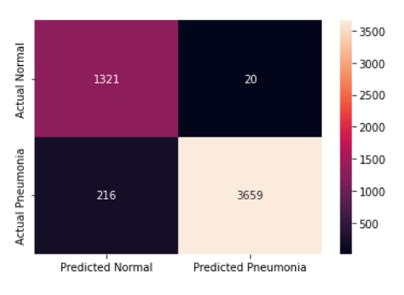
Confusion matrix
A confusion matrix is a table that is often used to describe the performance of a classification model on a set of test data for which the true values are known.
True Positive predictions are- 1321
True Negative predictions are-20
False Positive predictions are-216
False Negative predictions are-3659
Total correct predictions are-4980
Total incorrect predictions are-236
Fatal errors -216

Slide 9

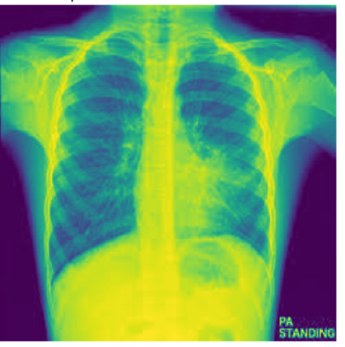
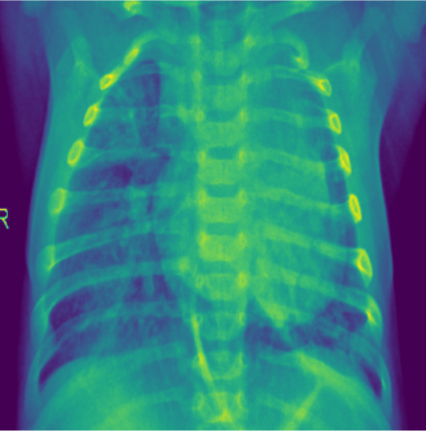
Final Results
Here we define the path of an image and we get to know about whether the x-ray image is anormal or pneumonia case
98.34% precent confirmed that this is a Normal case
95.40% precent confirmed that this is a Pneumonia case

Slide 10
Conclusion
Convolutional Neural Networks (CNN) technology is a very useful technology and has vast application in the real world.It can be used in Analyzing Documents, Decoding Facial Recognition, Advertising , Driverless cars, robots that can mimic human behavior, predicting earthquakes and natural disasters, even self-diagnoses of medical problems and many more.

Slide 11


Reference
www.google.com www.stakoverflow.com www.youtube.com www.medium.com
https://kaggle.com

Slide 12
Thank you

