Slide 1
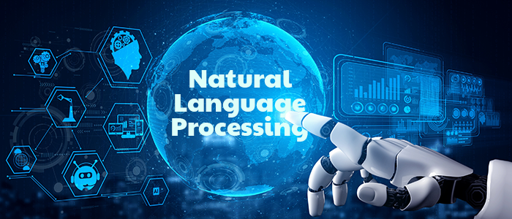
Natural Language Processing Based Chatbot
Pranjal Agarwal Btech CSE
6th Semester Section : ML
University Roll No. : 2015301

Slide 2
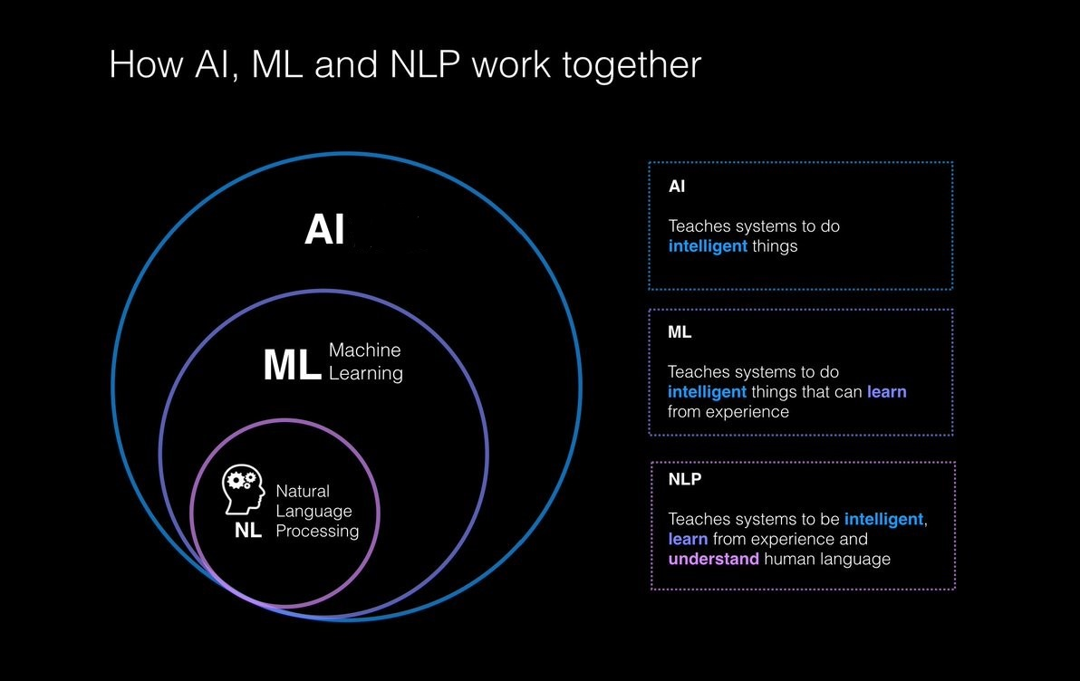
What is a NLP?
NLP is a subset of AI. NLP analyses vast volumes of human language data. It is a two-way process between the system and humans. It includes the entire system, from understanding information to making judgments while interacting. Such as reading information, breaking it down, comprehending it, and deciding how to respond.

Slide 3
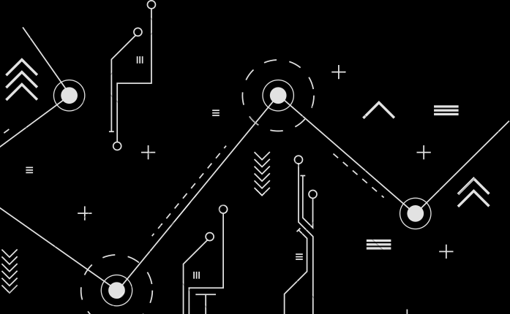
Applications Of NLP
Chatbots
Email filters
Virtual assistants, voice assistants
Predictive text and autocorrect
Monitor brand sentiment on social media
Sorting customer feedback
Automating processes in customer support
Automatic summarization
Machine translation
Natural language generation

Slide 4
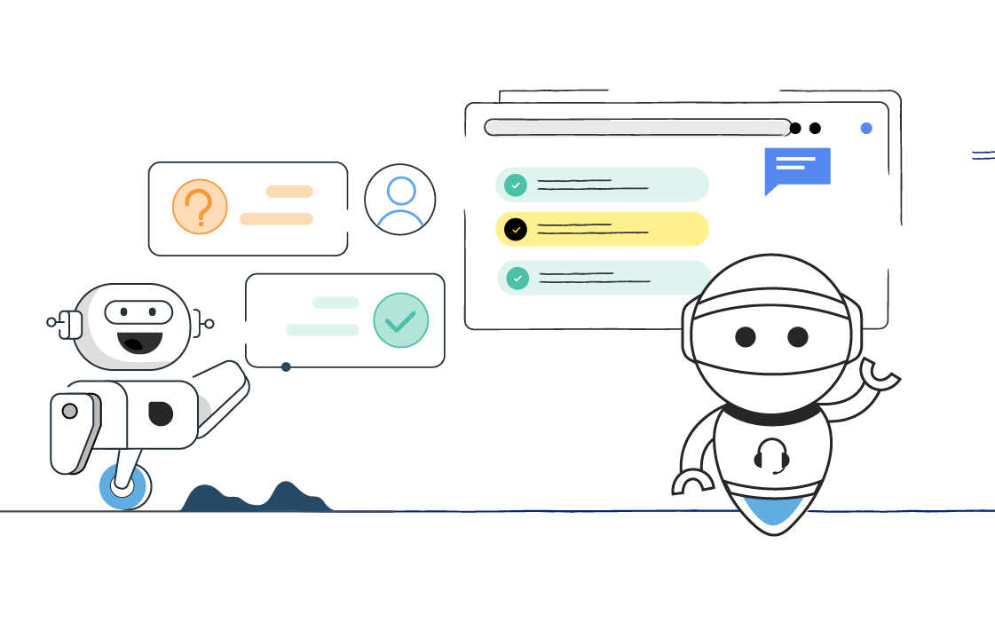
Chatbot
A chatbot is a computer program that simulates and processes human conversation (either written or spoken), allowing humans to interact with digital devices as if they were communicating with a real person. Chatbots can be as simple as that answer a simple query with a single-line response, or as sophisticated as digital assistants that learn and evolve to deliver increasing levels of personalization as they gather and process information.
Types of AI Chatbots
Scripted chatbots
Artificially Intelligent Chatbots

Slide 5

Block Diagram
Importing the libraries
Initializing the JSON file
Preparing the JSON file
Training the Chatbot
Getting Response
Deploying the Chatbot
Frontend

Slide 6
Libraries Used
Wordnet Lemmatizer
Flask
Wordnet is an large, freely and publicly available lexical database for the English language aiming to establish structured semantic relationships between words.
It offers lemmatization capabilities as well and is one of the earliest and most commonly used lemmatizers.
Flask is a web framework, it’s a Python module that lets you develop web applications easily. It’s has a small and easy-to-extend core: it’s a microframework.
It does have many cool features like url routing, template engine. It is a web app framework.
Keras
NumPy
JSON
Keras is a powerful and easy-to-use free open source Python library for developing and evaluating deep learning models.
It is part of the TensorFlow library and allows you to define and train neural network models in just a few lines of code.
NumPy is a library for the Python programming language, adding support for large, multi-dimensional arrays and matrices, along with a large collection of high-level mathematical
functions to operate on these arrays.
The json library can parse JSON from strings or files. The library parses JSON into a Python dictionary or list. It can also convert Python dictionaries or lists into JSON strings.

Slide 7
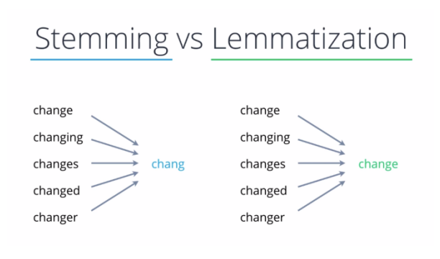
Algorithm Used
Lemmatization is the process of grouping together the different inflected forms of a word so they can be analyzed as a single item. Lemmatization is similar to stemming but it brings context to the words. So it links words with similar meanings to one word.

Slide 8
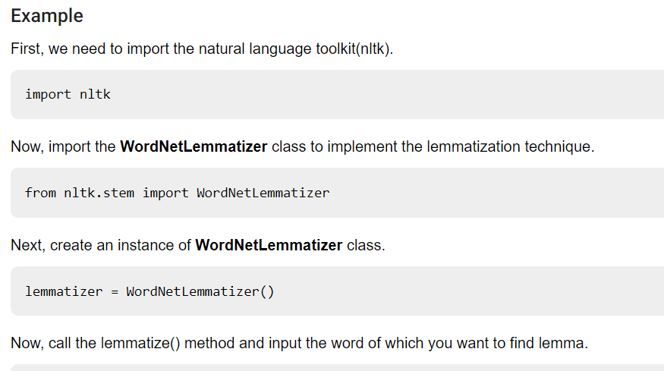
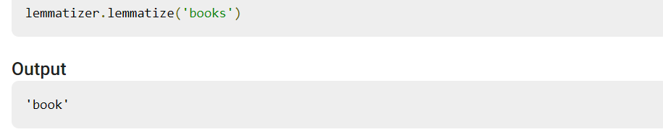

Slide 9
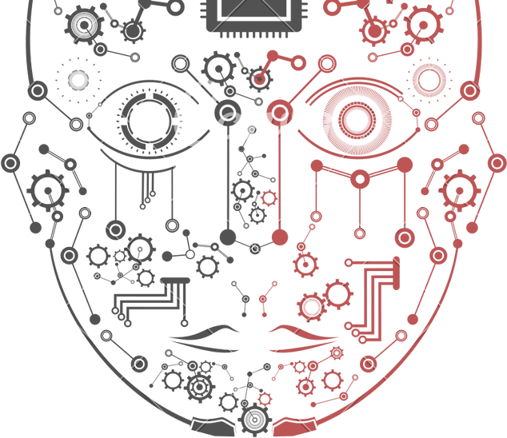
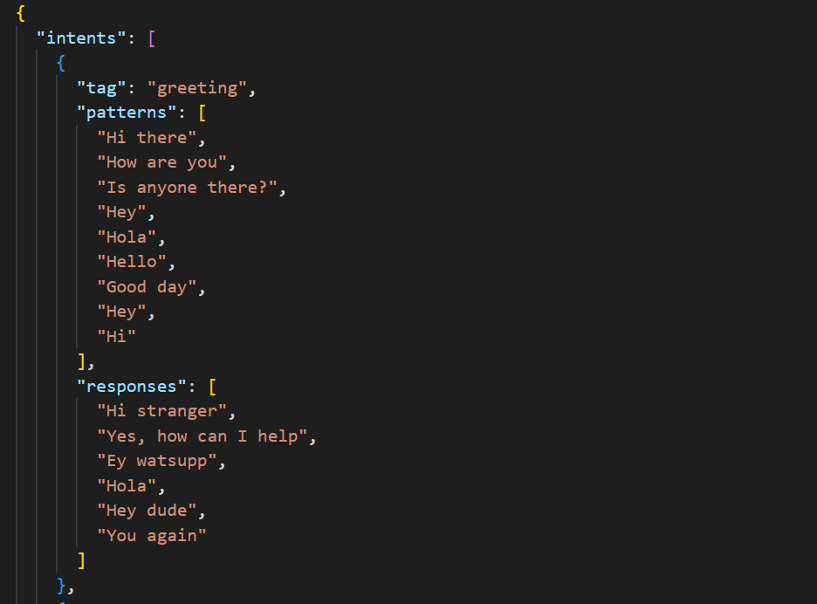
Preparing the JSON

Slide 10
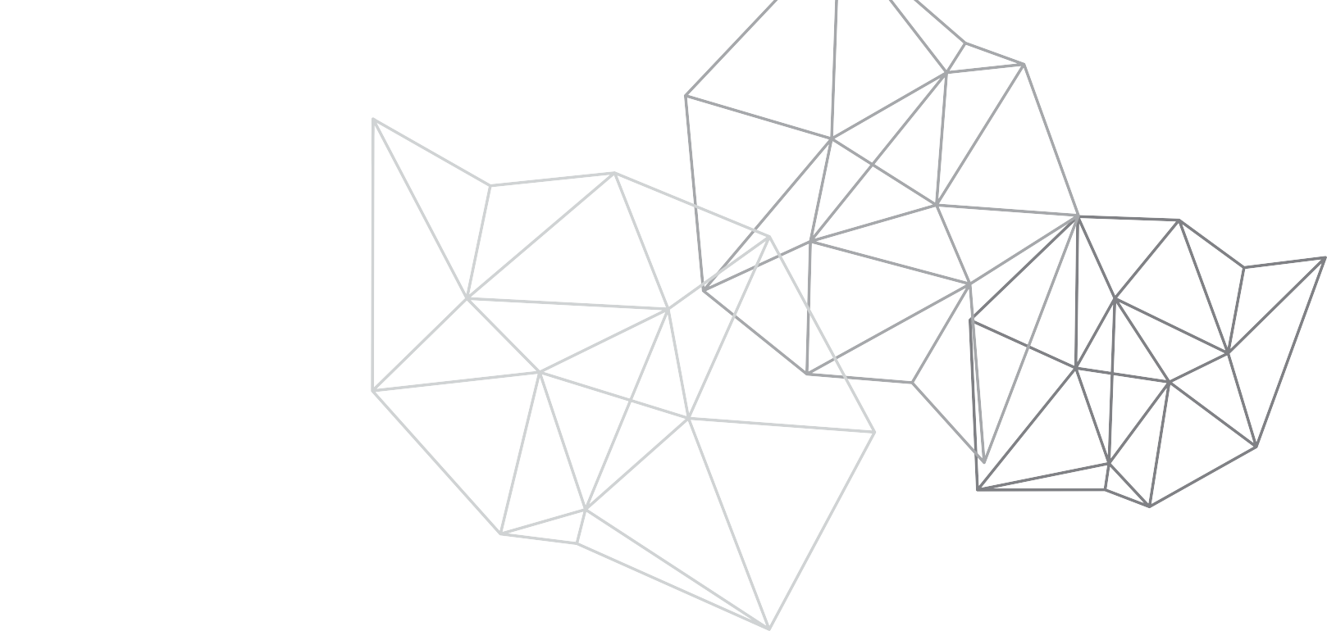
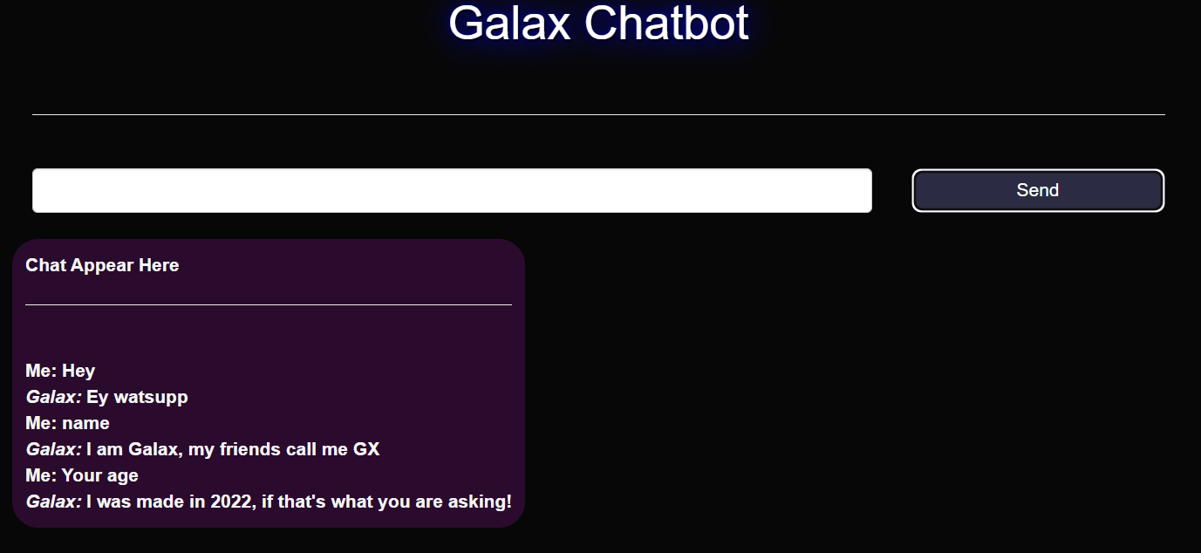
Final Results
When we enter the question how chatbot responses.
GALAX is a chatbot name and Me is user.

Slide 11
Conclusion
Natural language processing is transforming the way we analyze and interact with language-based data by training machines to make sense of text and speech, and perform automated tasks like translation, summarization, classification, and extraction.
We understood about chatbots and implemented a deep learning version of a chatbot in Python which is accurate. Chatbots are used everywhere and all businesses are looking forward to implementing bot in their workflow.

Slide 12
Reference
www.google.com
www.stakoverflow.com
https://docs.python.org/3/
https://www.nltk.org/
https://numpy.org/
https://flask.palletsprojects.com/en/2.1.x

Slide 13
Thank you

