Slide 1
Style Transformer: Unpaired Text Style Transfer without Disentangled Latent Representation Ning Dai, Jianze Liang, Xipeng Qiu, Xuanjing Huang Shanghai Key Laboratory of Intelligent Information Processing, Fudan University School of Computer Science, Fudan University
Utsav Das, CS 886 - Winter 2020

Slide 2
Agenda
What is Style Transfer and Disentangled Representation Learning?
Problems with past approaches
Motivation of the paper
Model Overview
Learning algorithm
Experimental Results
Ablation study
Future Work

Slide 3
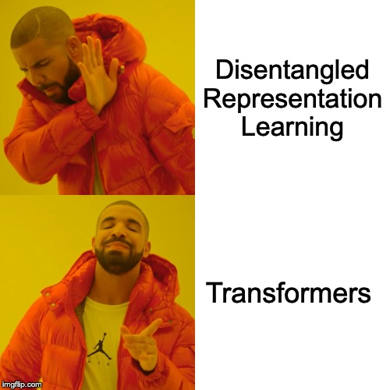

Slide 4
Style Transfer
Text Style Transfer is the task of changing the style (for e.g., sentiment) of the text, while preserving its content.
There is a lack of parallel data.
Example:
Negative sentiment sentence: ‘the food ’s ok , the service is among the worst i have encountered’
Sentence transferred to positive sentiment (human reference): ‘the food is good , and the service is one of the best i ’ve ever encountered’

Slide 5

Formalizing the Problem
We have a collection of datasets ${\{D_{i}\}}_{i=1}^{K}$where each dataset $D_{i}$ consists of sentences of a style $s^{(i)}$.
The goal of the style transfer task is:
Given a sentence $x$ and a desired style $\hat{s }∈ {{\{s}^{(i)}\}}_{i=1}^{K}$, rewrite $x$ to $\hat{x}$ with style $\hat{s }$ while preserving as much of the content of $x$ as possible.

Slide 6
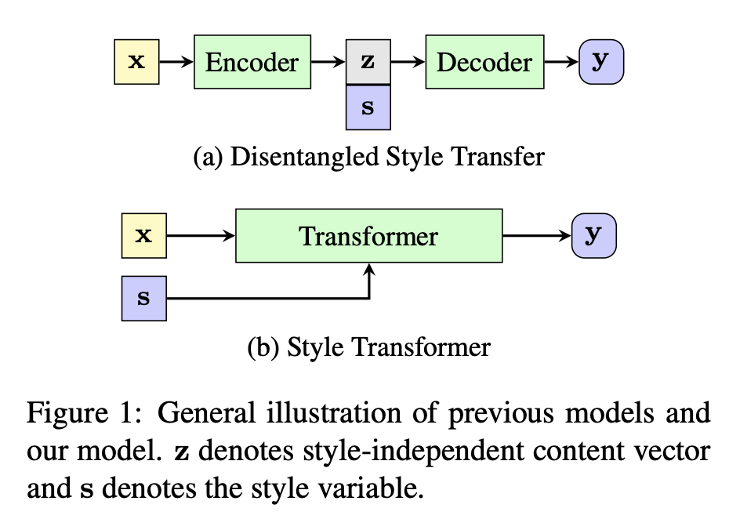
Related Work
Previous approaches, starting with Hu et al. (2017), have attempted to learn a disentangled latent representation to solve this task.
We can consider s to be completely disentangled from z if it is impossible to recover s from z.
Previous approaches use RNNs to solve this task. An encoder creates a latent representation that is supposed to only contain information about the content, i.e., the representation is supposed to be completely ‘disentangled’ from the style. The decoder takes in this disentangled representation and a style embedding to generate the new text with the same content but different style.

Slide 7
Concerns with the previous approach
Contributions of the paper
Style information can still be recovered from the disentangled representation (Lample et al., 2019).
Disentanglement is unnecessary. Style transfer can also be achieved through back-translation (Prabhumoye et al., 2018, Lample et al., 2019).
Both work using disentangled latent representations and without have been done in style transfer. However, none have substantially utilized the attention mechanism the way transformers do.
The first paper to use the Transformer architecture for style transfer.
The paper proposes a new training algorithm to transfer style that does not use disentangled representations.
Better results.

Slide 8
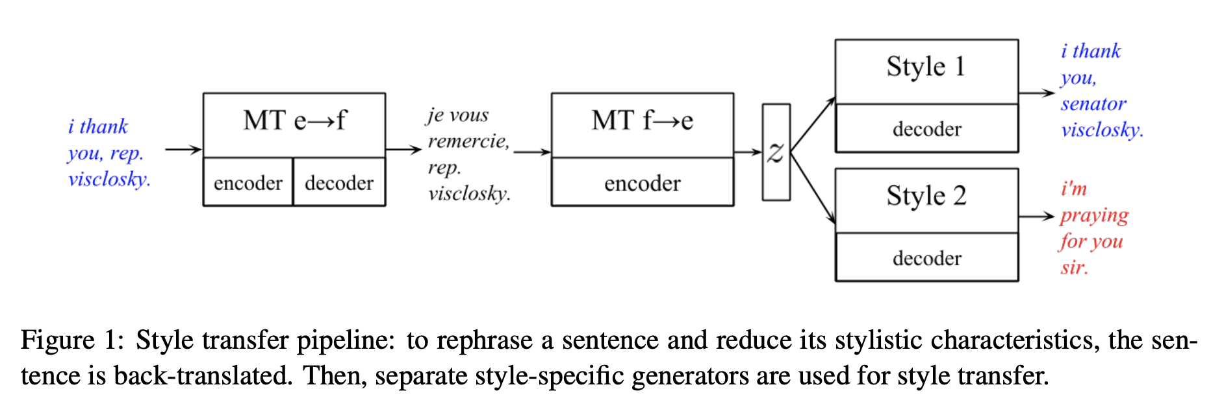
Style Transfer Through Back-Translation (Prabhumoye et al., 2018)

Slide 9
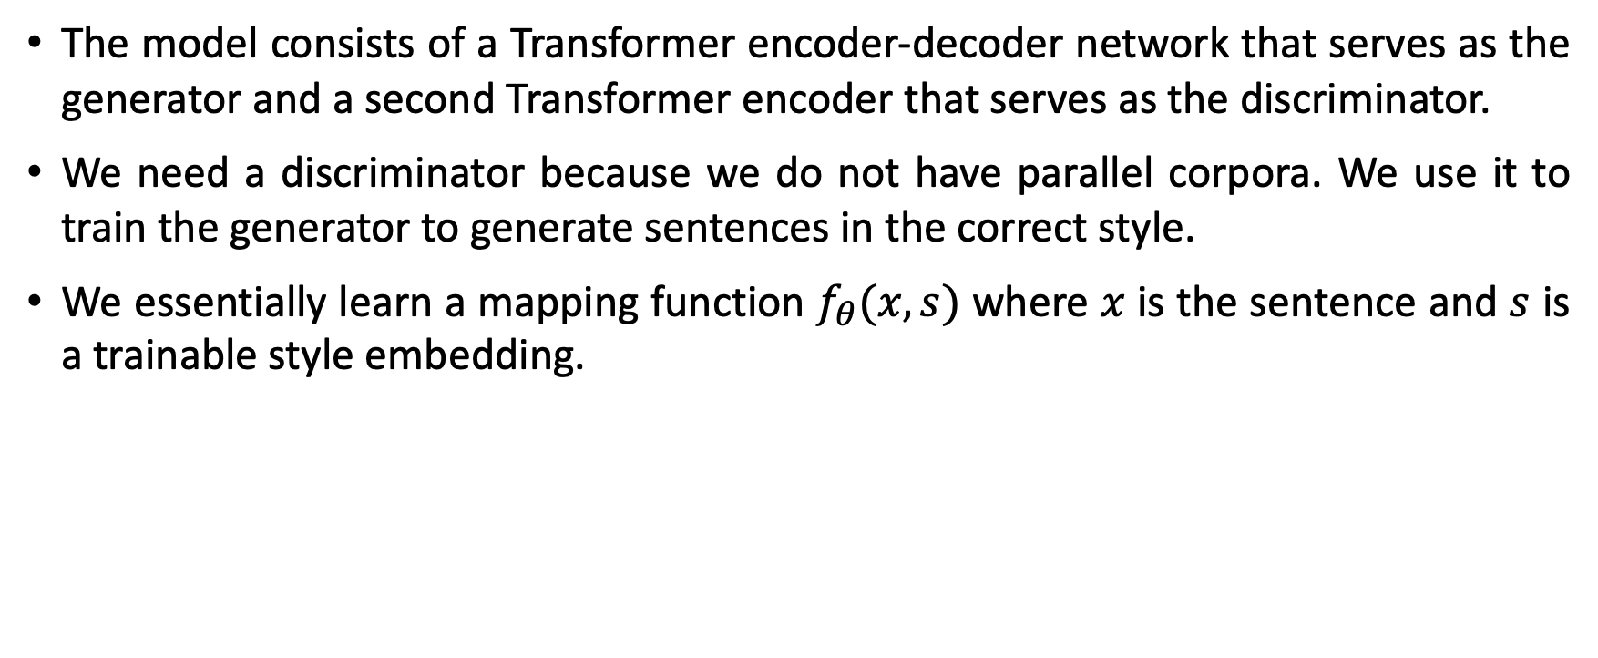
Model Overview
The model consists of a Transformer encoder-decoder network that serves as the generator and a second Transformer encoder that serves as the discriminator.
We need a discriminator because we do not have parallel corpora. We use it to train the generator to generate sentences in the correct style.
We essentially learn a mapping function $f_{θ}(x, s)$ where $x$ is the sentence and $s$ is a trainable style embedding.

Slide 10
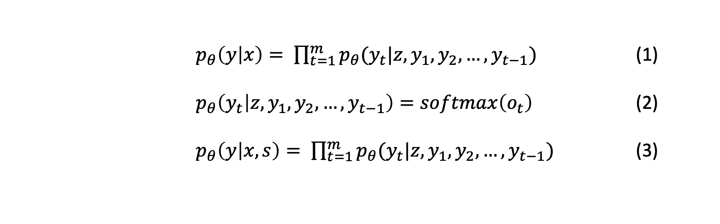
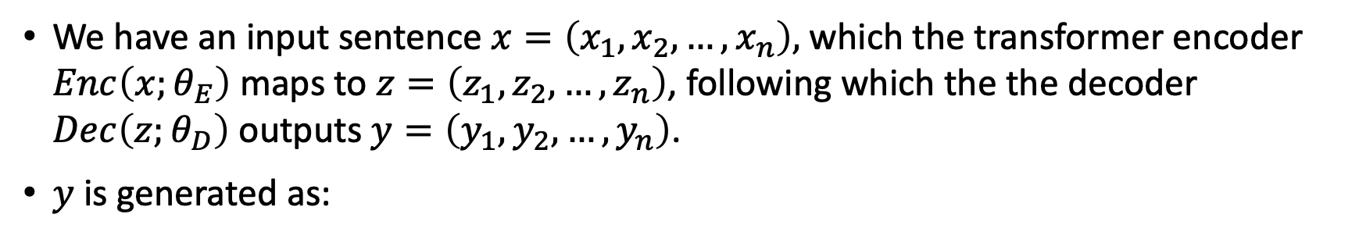
Style Transformer Network
We have an input sentence $x=\left(x_{1},x_{2},…,x_{n}\right),$ which the transformer encoder $Enc\left(x;θ_{E}\right)$ maps to$z=\left(z_{1},z_{2},…,z_{n}\right)$, following which the the decoder $Dec\left(z;θ_{D}\right)$ outputs $y=\left(y_{1},y_{2},…,y_{n}\right)$.
$y$ is generated as:
$p_{θ}\left(y | x\right)= \prod_{t=1}^{m}{p_{θ}(y_{t}|z,y_{1},y_{2},…,y_{t−1})}$ (1)
$p_{θ}\left(y_{t} | z,y_{1},y_{2},…,y_{t−1}\right)=softmax\left(o_{t}\right)$ (2)
$p_{θ}\left(y | x,s\right)= \prod_{t=1}^{m}{p_{θ}(y_{t}|z,y_{1},y_{2},…,y_{t−1})}$ (3)

Slide 11
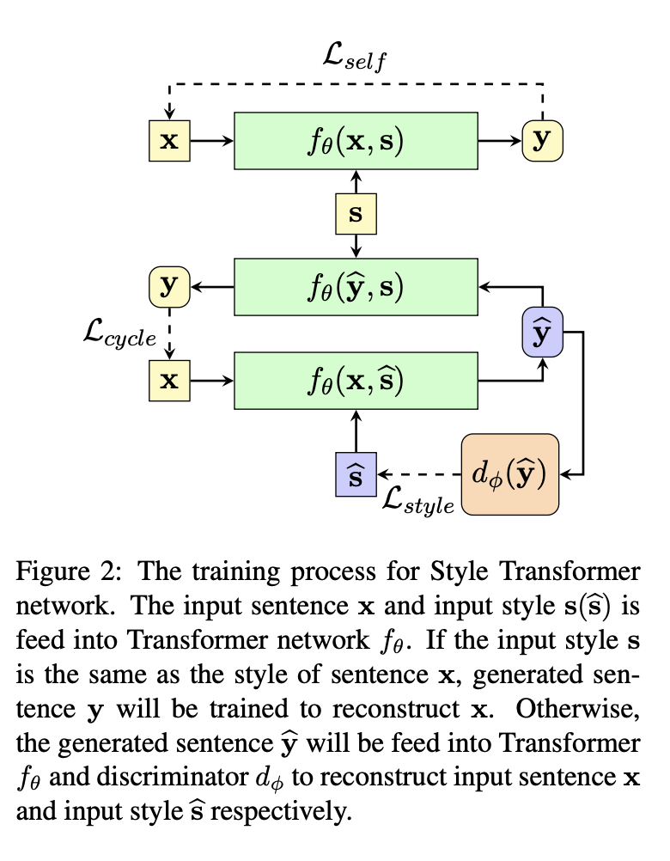

Slide 12
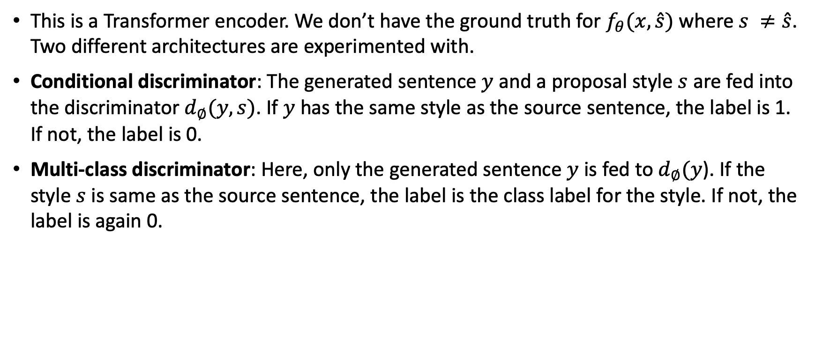
Discriminator Network
This is a Transformer encoder. We don’t have the ground truth for $f_{θ}(x,\hat{s})$ where $s ≠\hat{s}$. Two different architectures are experimented with.
Conditional discriminator: The generated sentence $y$ and a proposal style $s$ are fed into the discriminator $d_{∅}(y,s)$. If $y$ has the same style as the source sentence, the label is 1. If not, the label is 0.
Multi-class discriminator: Here, only the generated sentence $y$ is fed to $d_{∅}(y$). If the style $s$ is same as the source sentence, the label is the class label for the style. If not, the label is again 0.

Slide 13
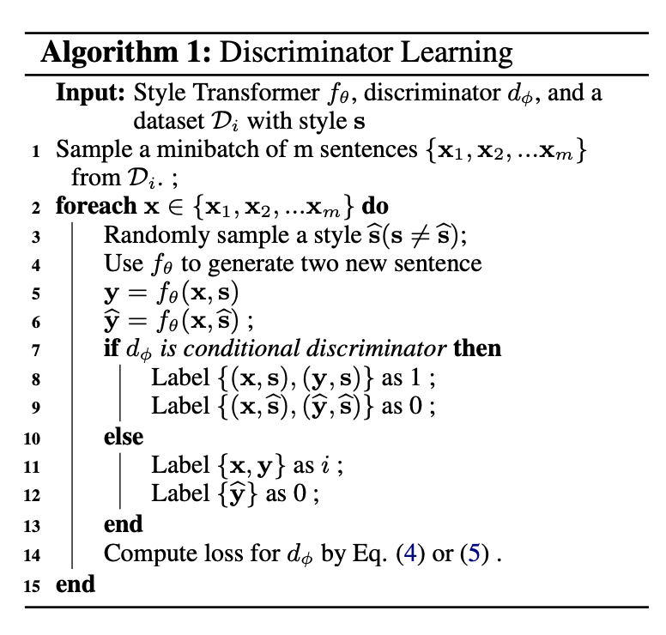

Discriminator Learning
Conditional discriminator loss:
$ℒ_{discriminator }(∅)= −p_{∅}\left(c | y,s\right)$. (4)
Multi-class discriminator loss:
$ℒ_{discriminator}\left(∅\right)=−p_{∅}\left(c | y\right).$ (5)

Slide 14
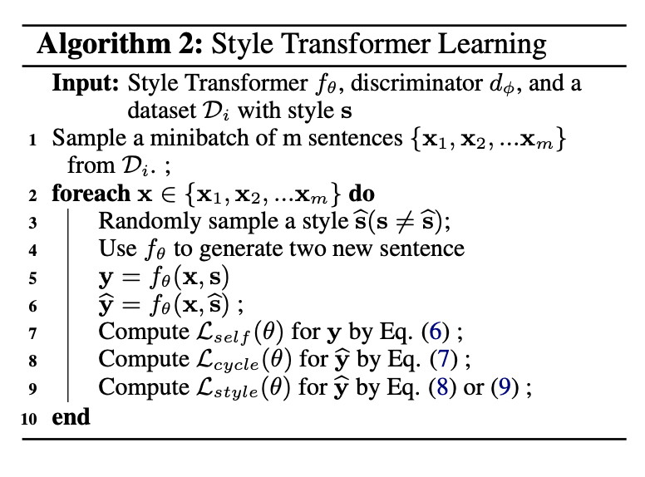

Style Transformer Learning
Self Reconstruction loss:
$ℒ_{self }(θ)= −p_{θ}\left(y=x | x,s\right)$ (6)
Cycle Reconstruction loss:
$ℒ_{cycle }\left(θ\right)= −p_{θ}\left(y=x | f_{θ}\left(x,\hat{s}\right),s\right)$ (7)
Style controlling for conditional discriminator:
$ℒ_{style }\left(θ\right)= −p_{∅}\left(c=1 | f_{θ}\left(x,\hat{s}\right),\hat{s}\right)$ (8)
Style controlling for multi-class discriminator:
$ℒ_{style }\left(θ\right)= −p_{∅}\left(c=\hat{s} | f_{θ}\left(x,\hat{s}\right) \right)$ (9)

Slide 15
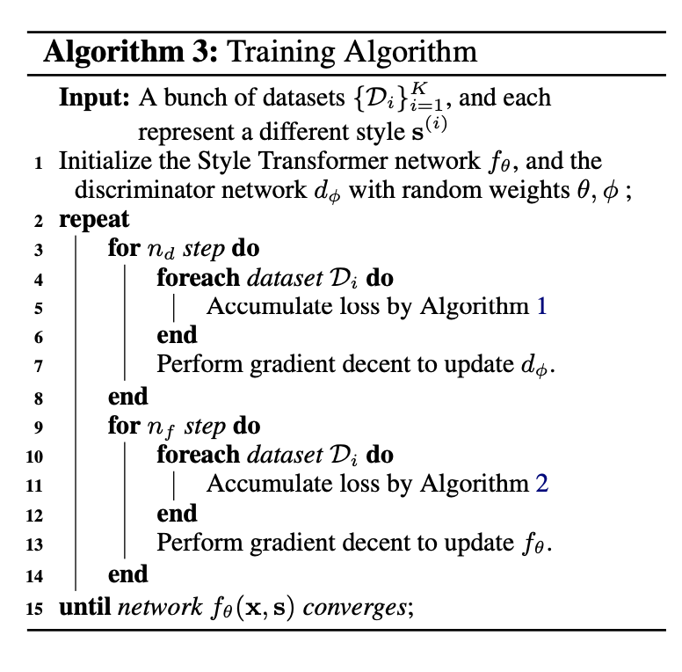

Slide 16
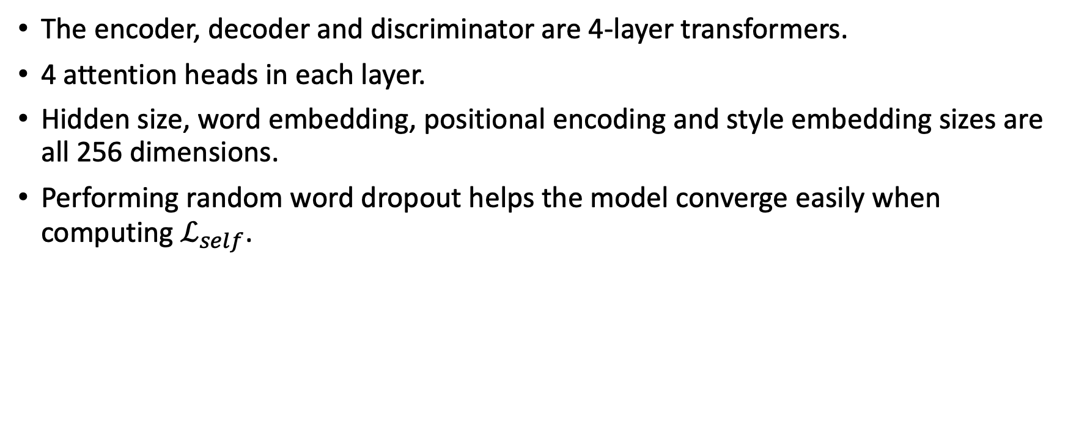
Training Details
The encoder, decoder and discriminator are 4-layer transformers.
4 attention heads in each layer.
Hidden size, word embedding, positional encoding and style embedding sizes are all 256 dimensions.
Performing random word dropout helps the model converge easily when computing $ℒ_{self}$.

Slide 17
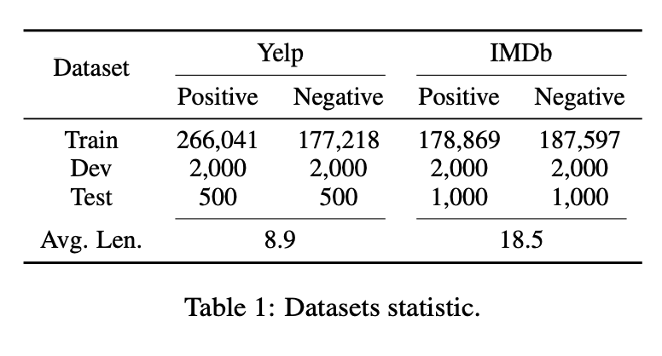
Datasets
To get sentences with positive and negative sentiment from the IMDb dataset, they (1) Fine tune a BERT classifier that achieves 95% accuracy on the test set. (2) Split each review into sentences. (3) Discard sentences below 0.9 confidence by the classifier.
Automatic Style control evaluation is done for each dataset by training a fastText classifier on them.
BLEU scores from the source sentence and human reference (when available) is used for automatic content preservation evaluation.
Fluency is measured by perplexity.

Slide 18
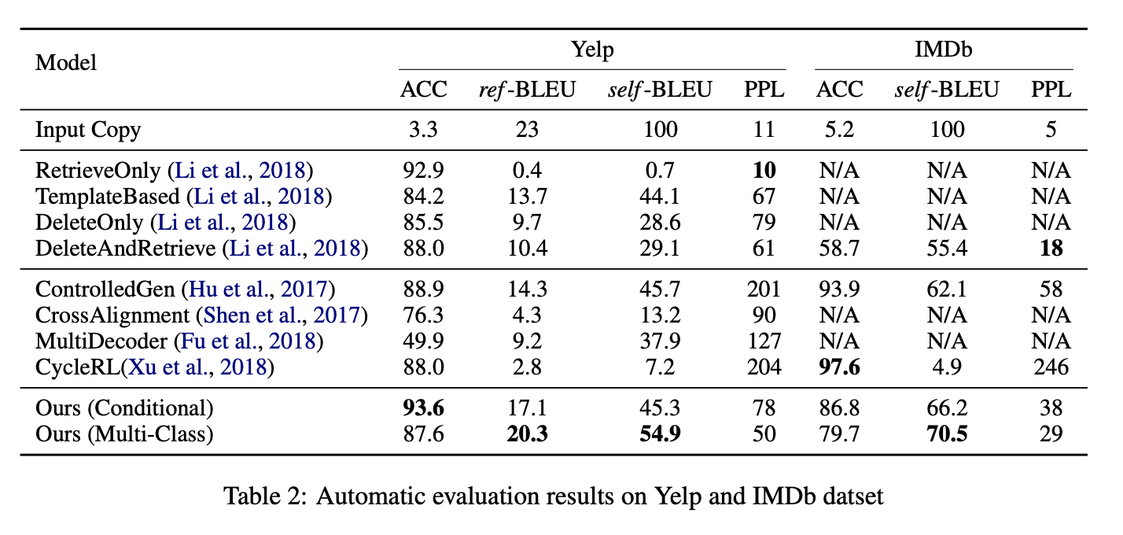
Results

Slide 19
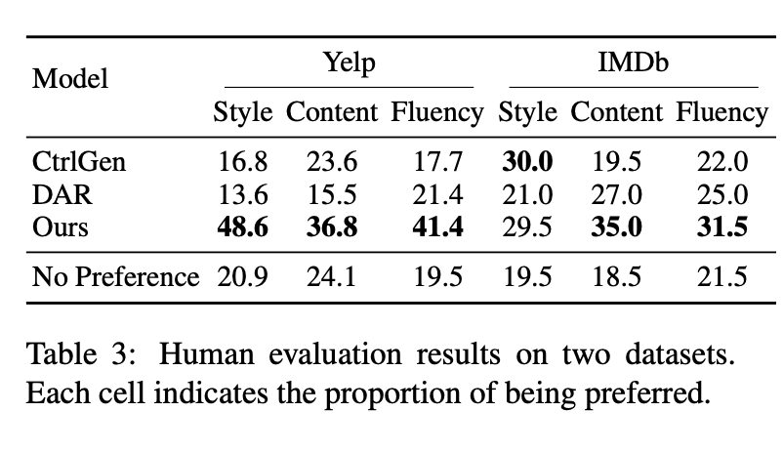
Automatic evaluation is not sufficient as there is no parallel data.
Comparison with Controlled Generation (Hu et al., 2017) and Delete and Retrieve (Li et al., 2018) as they have the best reported human evaluation results.
Perform 400+ evaluations.

Slide 20
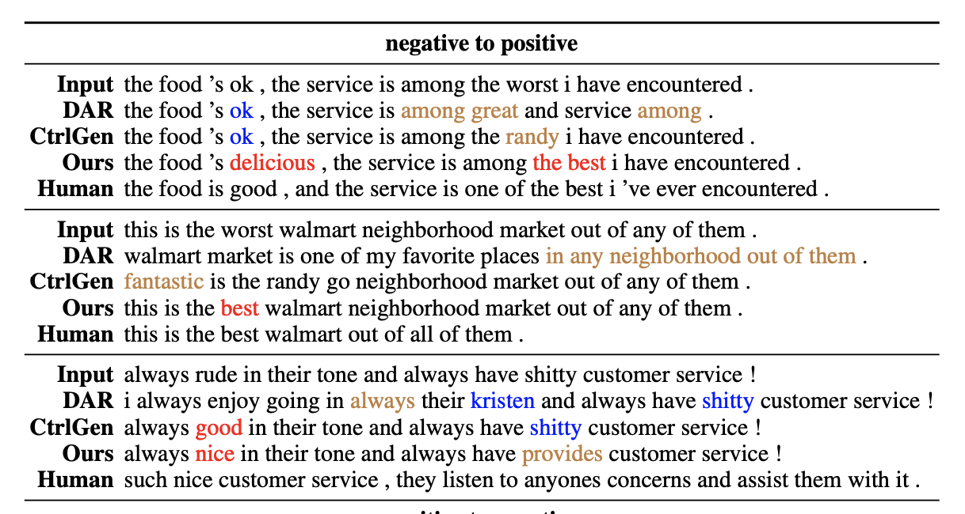
Style Transfer examples

Slide 21
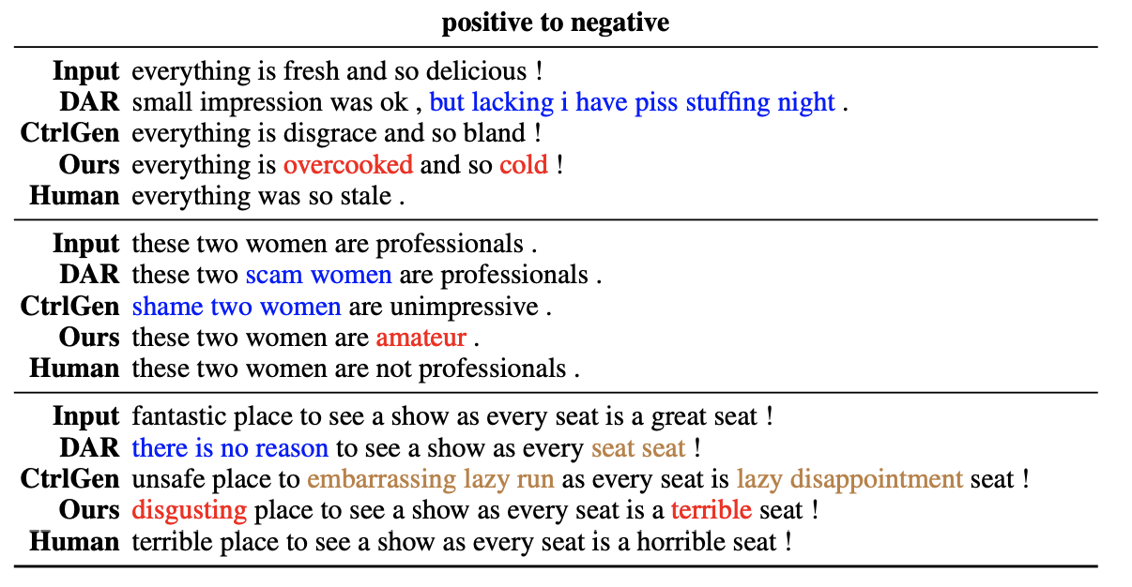

Slide 22
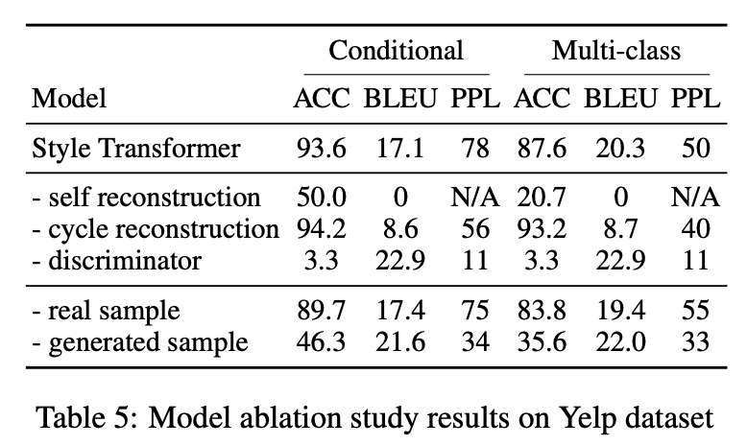
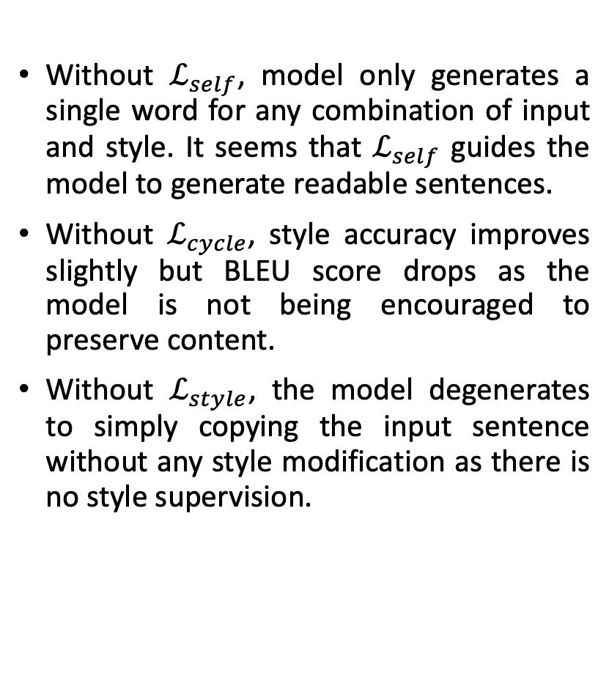
Ablation Study
Without $ℒ_{self}$, model only generates a single word for any combination of input and style. It seems that $ℒ_{self}$ guides the model to generate readable sentences.
Without $ℒ_{cycle}$, style accuracy improves slightly but BLEU score drops as the model is not being encouraged to preserve content.
Without $ℒ_{style}$, the model degenerates to simply copying the input sentence without any style modification as there is no style supervision.

Slide 23
Conclusions and Future Work
The lack of assumption of a disentangled representation and utilizing the attention mechanism of transformers leads to better content preservation on both the datasets tested for.
In the future, combine the back-translation (Prabhumoye et al., 2018, Lample et al., 2019) technique with the method proposed here.
Extend work to multi-attribute setting (Lample et al., 2019): transfer style across attributes like sentiment, category, gender, etc. simultaneously in a sentence. It is easier to change sentiment than other attributes.
Example (Lample et al., 2019):
Positive Movie: ‘exciting new show. john malkovich is superb as always. great supporting cast. hope it survives beyond season 1’
Positive Books: ‘exciting new book. john grisham is one of the best. great read. hope he continues to write more.’
Negative Music: ‘horrible. the songs are not as good as the original. not worth the price.’

Slide 24
Thank You!

Slide 25
References
Style Transformer: Unpaired Text Style Transfer without Disentangled Latent Representation - https://www.aclweb.org/anthology/P19-1601.pdf
Multiple-attribute Text Style Transfer - https://arxiv.org/pdf/1811.00552.pdf
Style Transfer Through Back-Translation - https://arxiv.org/pdf/1804.09000.pdf
Toward Controlled Generation of Text - https://arxiv.org/pdf/1703.00955.pdf
Delete, Retrieve, Generate: A Simple Approach to Sentiment and Style Transfer - https://arxiv.org/pdf/1804.06437.pdf

Slide 26
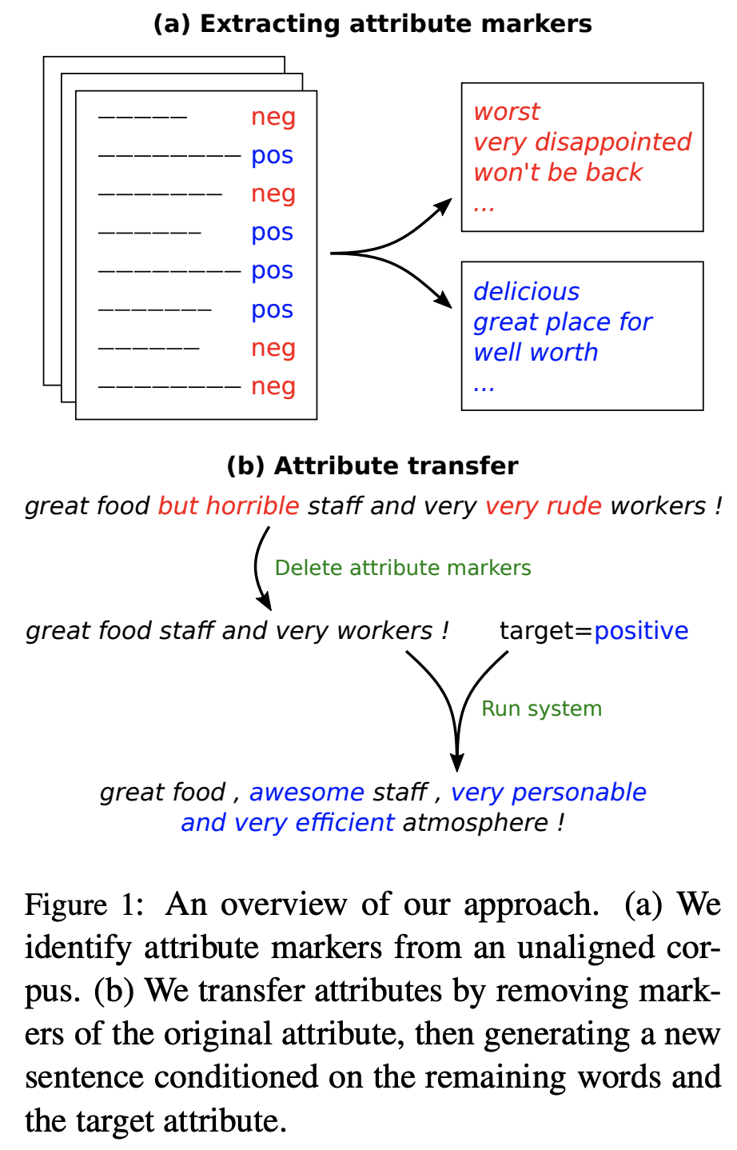
Appendix
Delete and Retrieve – Li et al., 2018.
They propose a three-stage method. Their model first extracts content words by deleting phrases a strong attribute value, then retrieves new phrases associated with the target attribute, and finally uses a neural model to combine these into a final output.

