Slide 1
INTERVIEW TRAINER agent
IBM AICTE PROJECT
Presented By:
Student name : Pranjali Kargaonkar
College Name & Department : Ajeenkya D Y Patil School Of Engineering

Slide 2
OUTLINE
Problem Statement
Technology used
Wow factor
End users
Result
Conclusion
Future scope
IBM Certifications

Slide 3
Problem Statement
Job interview preparation is often generic and not specifically tailored to the unique needs of each candidate, such as their role, experience level, and industry trends. Candidates frequently struggle to find realistic, role-specific questions and personalized feedback that address both technical expertise and soft skills, which are crucial for overall interview success. Existing tools largely overlook the importance of behavioral and communication skills assessment, creating a gap in truly comprehensive interview preparation

Slide 4
Technology used
IBM cloud lite services
Natural Language Processing (NLP)
Retrieval Augmented Generation (RAG)
IBM Granite model

Slide 5
IBM cloud services used
IBM Cloud Watsonx AI Studio
IBM Cloud Watsonx AI runtime
IBM Cloud Agent Lab
IBM Granite foundation model

Slide 6
Wow factors
The Interview Trainer Agent addresses these challenges by using Retrieval-Augmented Generation (RAG) technology combined with IBM Granite and Cloud Lite services. This enables the agent to provide context-aware, up-to-date, and role-specific interview questions, model answers, and improvement tips. It adapts dynamically to each user’s profile, supports both technical and soft skill preparation, and even offers simulated interview environments, making preparation smarter, personalized, and effective.

Slide 7
End users
Academic Researchers
Research Institutions and Universities
Industry R&D Teams
Educators

Slide 8
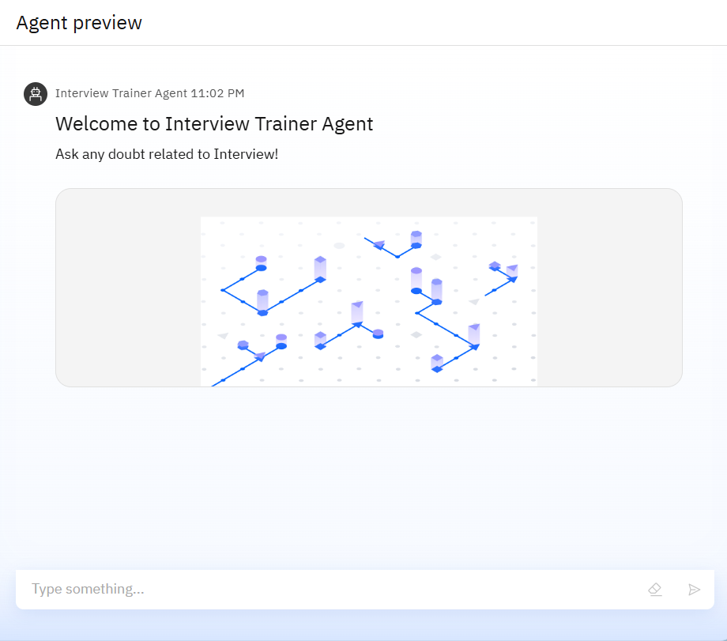
Results

Slide 9
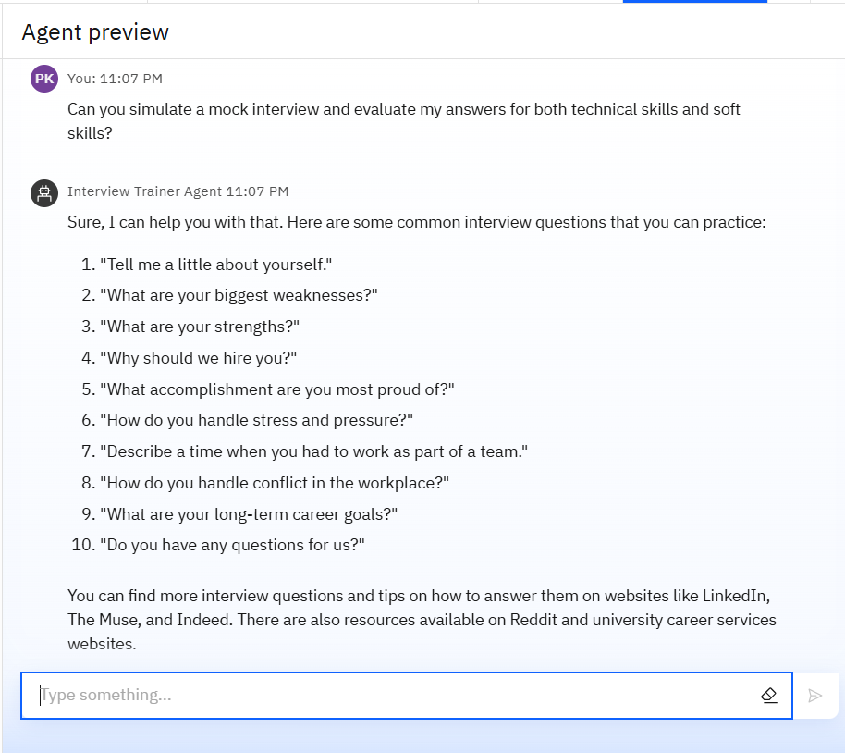
Results

Slide 10
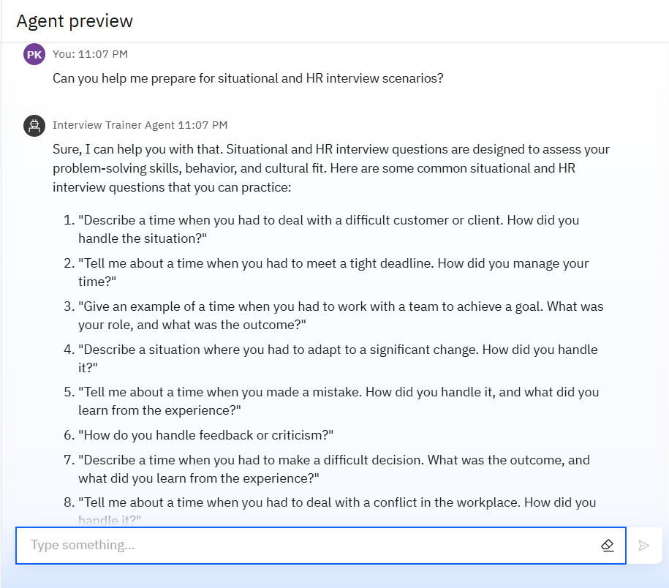
Results

Slide 11
git-hub link - pranjalikr/interview_agent

Slide 12
Conclusion
The Interview Trainer Agent transforms interview preparation into a personalized, intelligent, and comprehensive experience.
It equips candidates with relevant, up-to-date content that enhances both their technical knowledge and soft skills.
The solution boosts user confidence and improves their chances of success in competitive hiring processes.
IBM Granite and Cloud Lite technology provide a scalable, enterprise-grade AI infrastructure ensuring accessibility and reliability.

Slide 13
Future scope
Integrate with company-specific interview databases for highly customized preparation.
Expand to support multiple regional and international languages.
Connect with learning platforms to generate personalized study plans based on identified weak areas.
Provide performance analytics and benchmarking tools for candidates and recruiters.

Slide 14
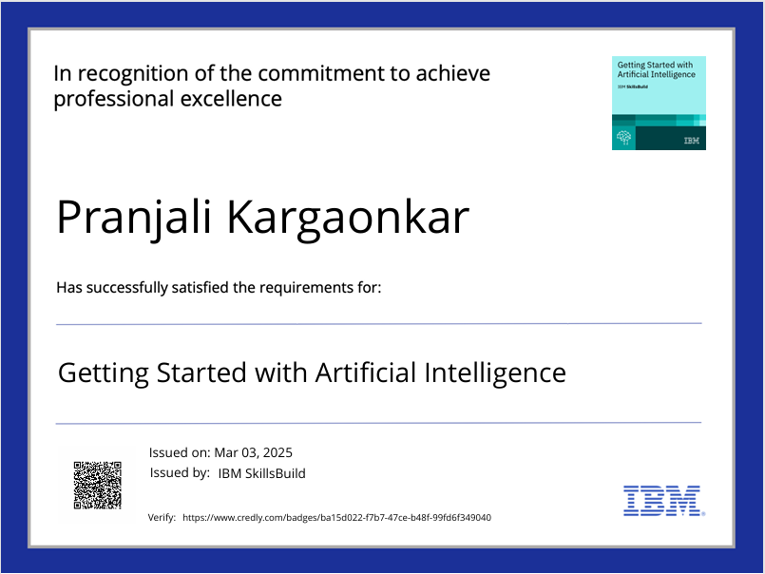
IBM Certifications

Slide 15
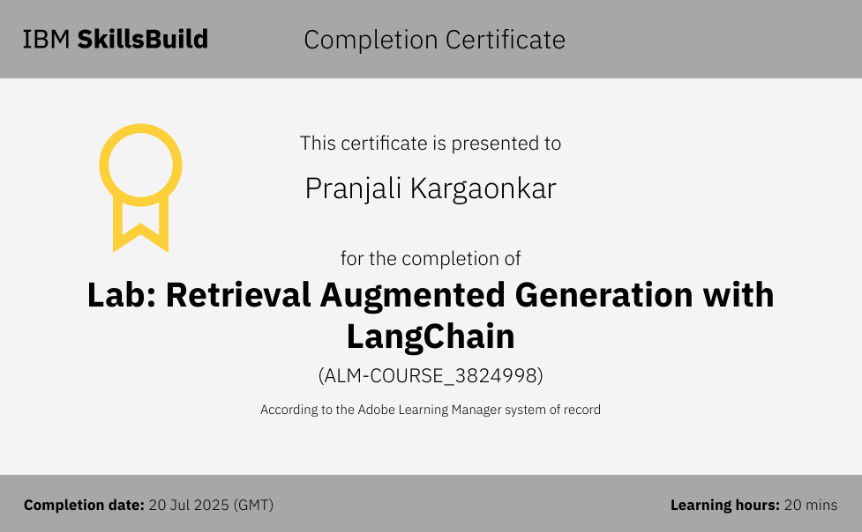

Slide 16
THANK YOU

