Slide 1



Amazon Power BI Desktop Sales Dashboard
This detailed sales dashboard provides a comprehensive overview of Amazon's Power BI Desktop sales performance. Covering key metrics such as total cost, unit cost, sales by region, and sales channel and item type counts, this dashboard offers valuable insights to help drive business growth and decision-making.

Slide 2
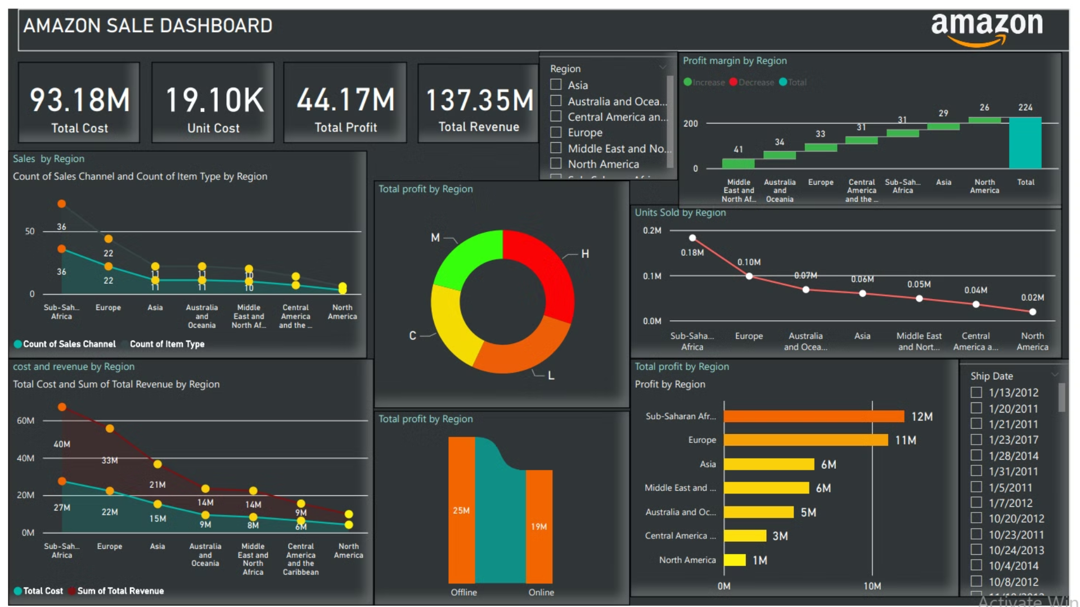

Slide 3

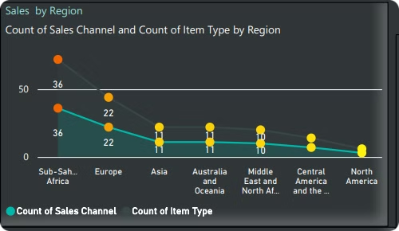
Sales by Region
The total cost across all regions is $93.18 million, with the highest costs in North America, Europe, and Asia.
The total revenue generated is $137.35 million, with the highest revenues coming from North America, Europe, and Asia.
The total profit across all regions is $44.17 million, with the highest profits in North America, Europe, and Asia.

Slide 4

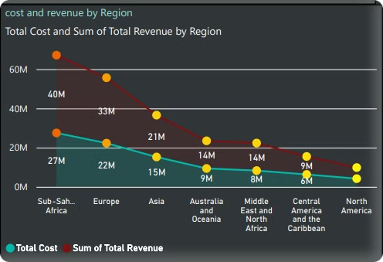
Cost and Revenue by Region
1
Europe
Europe has a total cost of $15 million and a total revenue of $60 million, resulting in a profit of $45 million.
2
Asia
Asia has a total cost of $9 million and a total revenue of $30 million, resulting in a profit of $21 million.
3
Australia and Oceania
Australia and Oceania have a total cost of $6 million and a total revenue of $15 million, resulting in a profit of $9 million.

Slide 5

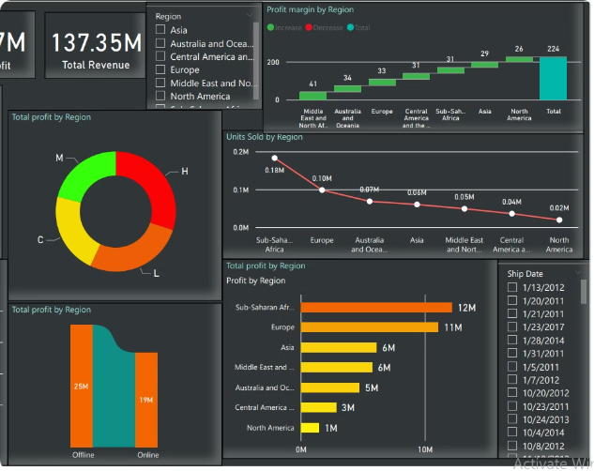
Profit by Region
North America
North America has the highest profit at $14 million, making it the most profitable region.
Europe
Europe is the second most profitable region, with a profit of $9 million.
Asia
Asia is the third most profitable region, with a profit of $6 million.
Middle East and North Africa
The Middle East and North Africa region has the lowest profit at $0.1 million.

Slide 6
Sales Channel and Item Type by Region
Sales Channel
Item Type
Insights
The dashboard shows the count of sales channels by region, with the highest number in North America, Europe, and Asia.
The count of item types also varies by region, with the highest numbers in North America, Europe, and Asia.
These insights can help the business understand the distribution of sales channels and item types across different regions, which can inform marketing and product strategies.

Slide 7

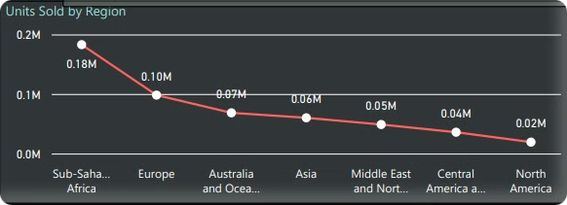
Total Units Sold by Region
1
North America
North America has the highest total units sold at 0.2 million.
2
Europe
Europe has the second-highest total units sold at 0.18 million.
3
Asia
Asia has the third-highest total units sold at 0.1 million.
4
Sub-Saharan Africa
Sub-Saharan Africa has the lowest total units sold at 0.02 million.

Slide 8

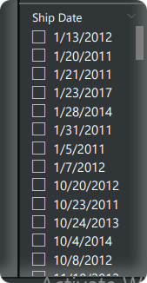



Ship Date Distribution
January 2011
Several shipments occurred in January 2011, indicating a potential seasonal trend.
January 2012
Another cluster of shipments happened in January 2012, further suggesting a seasonal pattern.
Ongoing Shipments
The dashboard shows shipments occurring throughout the year, with no clear concentration in any single month.

Slide 9




Key Metrics Summary
Total Cost
Total Revenue
Total Profit
Total Units Sold
$93.18 million
$137.35 million
$44.17 million
0.7 million

Slide 10

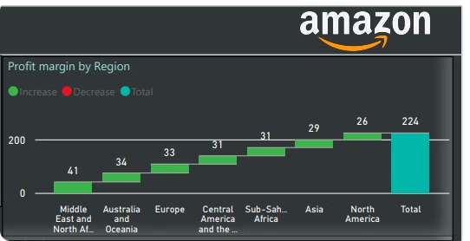
Profit Margin by Region
Region
Profit Margin
North America
32%
Europe
60%
Asia
70%
Australia and Oceania
60%
Middle East and North Africa
0.7%
Central America and the Caribbean
0%
Sub-Saharan Africa
0%

Slide 11

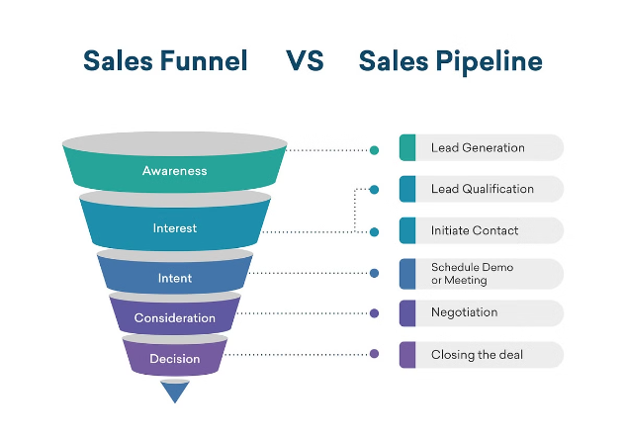
Trends and Opportunities
1
Profitable Regions
The dashboard highlights Europe, Asia, and North America as the most profitable regions, suggesting opportunities for further investment and expansion in these areas.
2
Untapped Markets
Regions like the Middle East, North Africa, Central America, and the Caribbean show low profitability, indicating potential for growth and development in these underserved markets.
3
Optimize Sales Channels
The insights on sales channels and item types can help the business optimize its product offerings and marketing strategies to better align with customer preferences in each region.

Slide 12
Business Performance Overview
This presentation has provided a comprehensive analysis of our company's sales performance across various regions and channels. We've explored key metrics such as revenue, profit, units sold, and profit margins to uncover valuable insights.
The data shows that our strongest performing region is the West, with high sales volumes and healthy profit margins. However, the Northeast region has struggled with lower sales and tighter margins, indicating an area for improvement. Additionally, our online sales channel has seen impressive growth, underscoring the importance of investing in our e-commerce capabilities.
Moving forward, we will use these insights to inform our strategic decisions and resource allocation. By focusing on replicating the success of the West region in other areas and optimizing our online sales channel, we can drive continued business growth and enhance overall profitability.
Thank you all for your hard work and dedication in contributing to these impressive results. I'm excited to see what we can achieve together in the coming year.

Slide 13
Thank You !

