Slide 1


K. RAMAKRISHNAN COLLEGE OF ENGINEERING
(AUTONOMOUS), SAMAYAPURAM – TRICHY
DEPARTMENT OF ARTIFICIAL INTELLIGENCE AND DATA SCIENCE
CGB1221 DATABASE MANAGEMENT SYSTEMS
JOB PORTAL SYSTEM
PRESENTED BY SUPERVISOR
SIVADHARSHINI S Mrs.V.Sankari, M.E.,
8115U24AD106 Assistant Professor/AI &DS

Slide 2
PRESENTATION OVERVIEW
Objective
Project Introduction
Problem Statement
Existing and Proposed Comparision
Modules Used
E-R Diagram
Database schema
Output Database and Frontend
Conclusion and Future scope

Slide 3
OBJECTIVE
To develop a user-friendly web-based platform for job seekers and administrators
To provide job recommendations and search functionality based on skills and location
To enable users to apply for jobs and track application status in real time
To allow admin to manage job postings and update application statuses efficiently

Slide 4
PROJECT INTRODUCTION
Smart Job Portal System is a web-based application built using Python Streamlit and MySQL
It connects job seekers and admin through a simple and interactive platform
Users can search jobs, apply, and track application status easily
Admin can post jobs and manage applications efficiently

Slide 5
PROBLEM STATEMENT
Job seekers face difficulty in finding relevant jobs based on their skills and location
Existing platforms are complex and not user-friendly for beginners
Lack of a simple system to track job application status
No centralized platform for easy job posting and management by admin

Slide 6
EXISTING SYSTEM
Existing job portals are difficult for beginners to use
Jobs are not properly matched with user skills
Application tracking is not clear or easy
Users need to use multiple platforms to find jobs
Interface is complex and not user-friendly

Slide 7
PROPOSED SYSTEM
simple and user-friendly Smart Job Portal developed using Streamlit and MySQL
Provides job recommendations based on user skills and search by location
Allows users to apply for jobs easily and get an Application ID
Enables real-time application tracking using ID or user name
Includes admin panel to post jobs and update application status

Slide 8
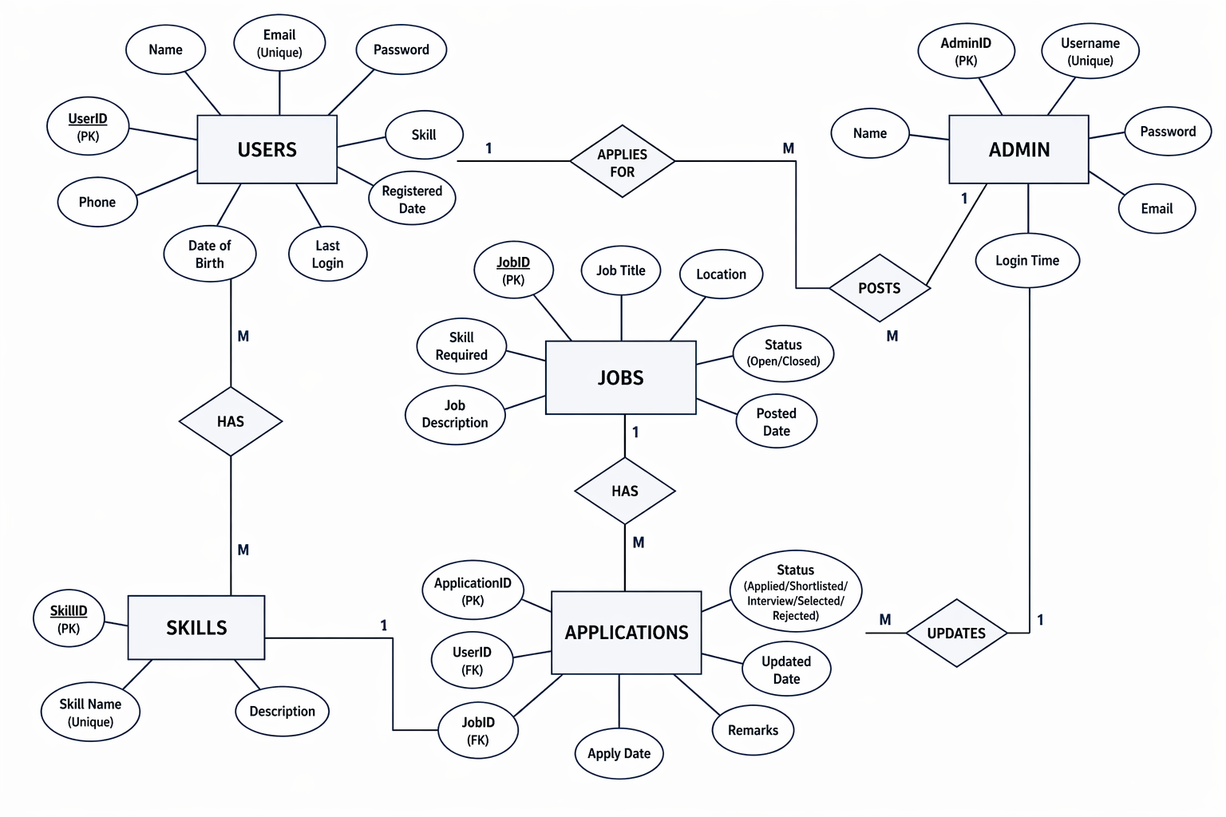
ER DIAGRAM

Slide 9
MODULES USED
1.User Registration Module
Allows users to create an account by entering basic details like name, email, and skill.
Stores user information securely in the database for future use.
2.Job Recommendation Module
Provides job listings based on the user’s skill input.
Helps users find relevant jobs quickly and easily.
3. Job Search Module
Enables users to search jobs based on location.
Filters and displays matching job opportunities from the database.

Slide 10
MODULES USED
4.Application Module
Allows users to apply for jobs by submitting their details.
Stores application data and generates an Application ID.
5.Tracking Module
Helps users track the status of their job applications.
Displays real-time updates like Applied, Shortlisted, or Selected.
6.Admin Module
Allows admin to post new job listings into the system.
Enables updating of application status and managing job data.

Slide 11
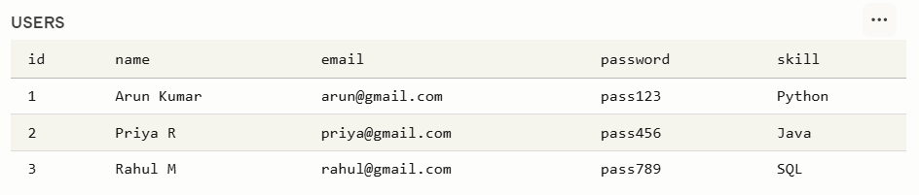
BACKEND DATABASE
USERS

Slide 12
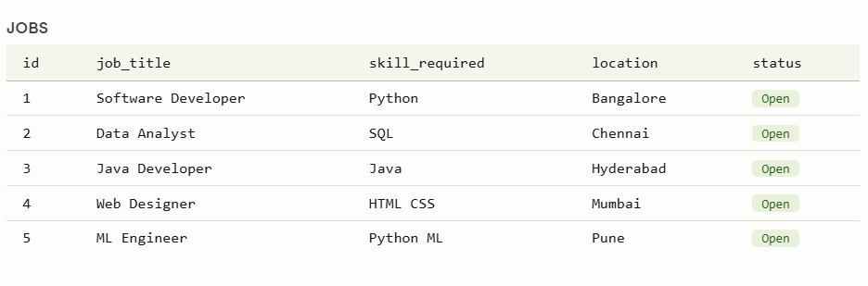
BACKEND DATABASE
JOBS

Slide 13
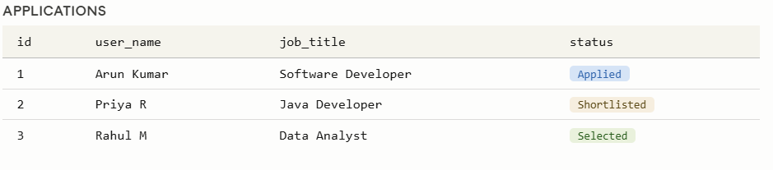
BACKEND DATABASE
APPLICATIONS

Slide 14
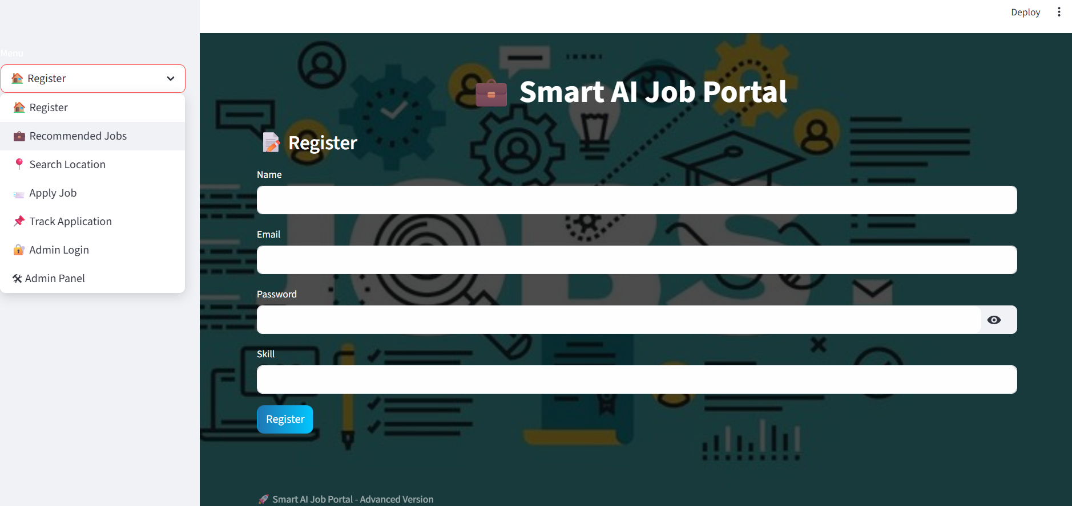
FRONTEND DATABASE

Slide 15
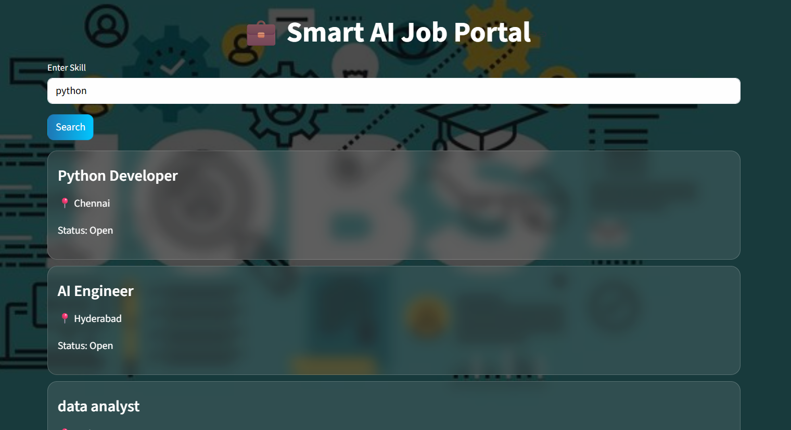
FRONTEND DATABASE

Slide 16
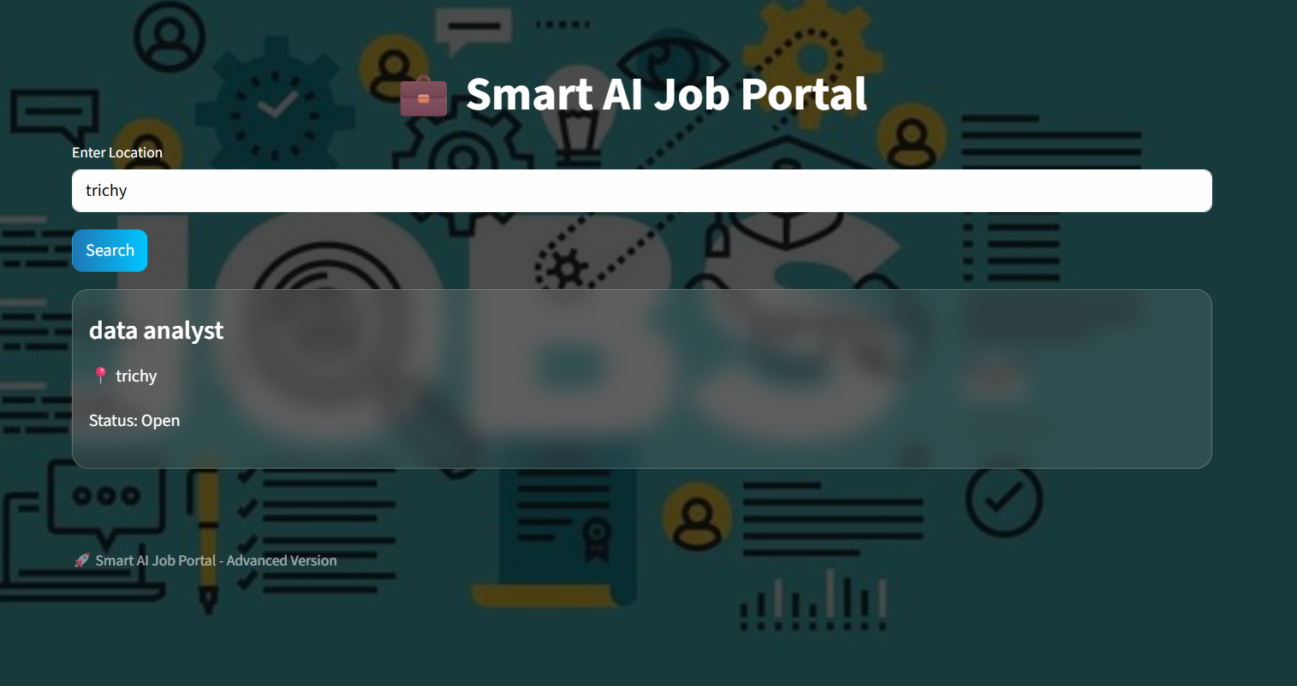
FRONTEND DATABASE

Slide 17
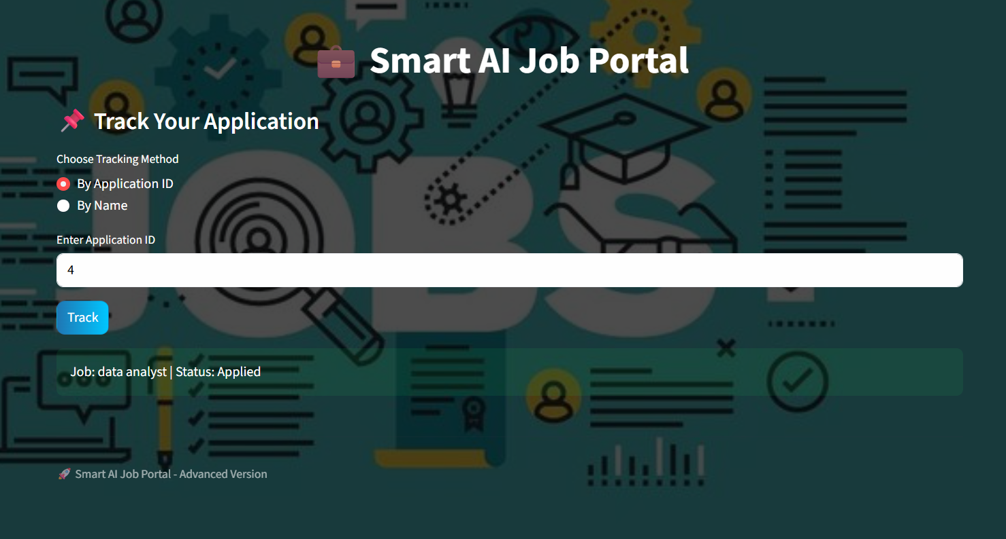
FRONTEND DATABASE

Slide 18
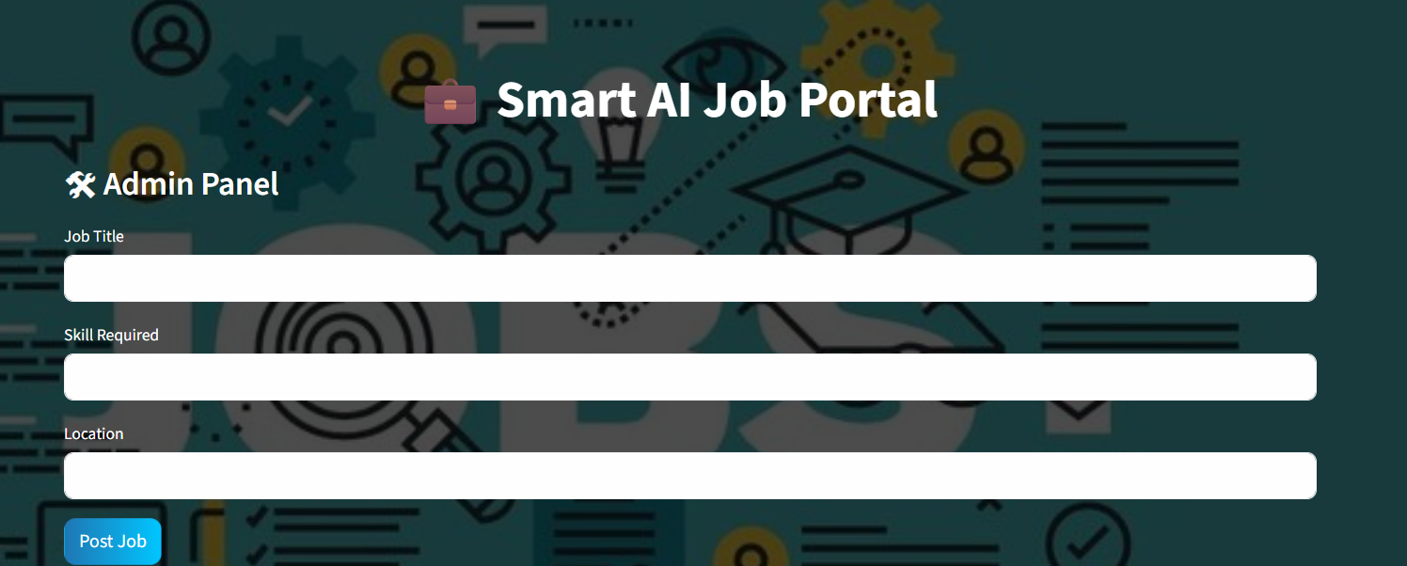
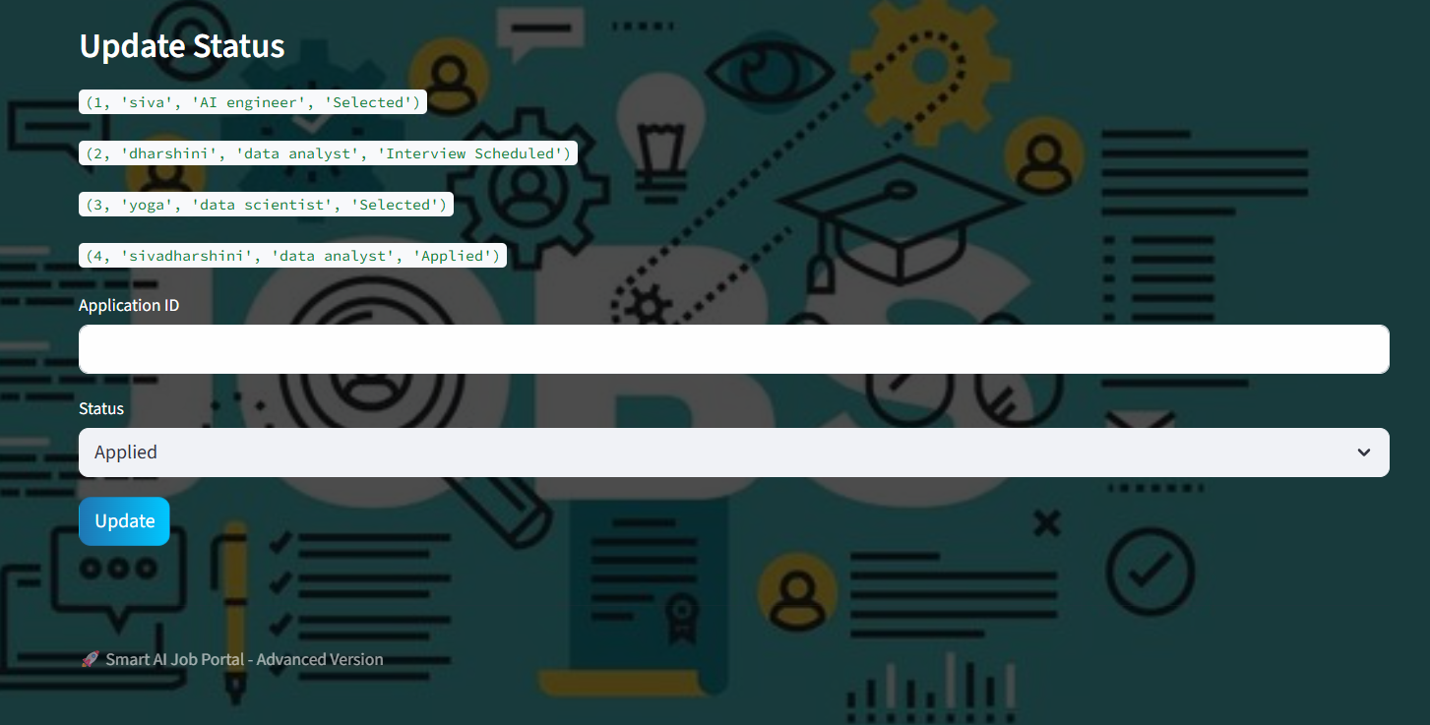
FRONTEND DATABASE

Slide 19
FUTURE SCOPE
Implement AI-based job recommendation for better matching of user skills
Add resume upload and automatic profile creation feature
Integrate email/SMS notifications for job updates and application status
Develop a mobile application for easier access
Enhance security features such as password encryption and user authentication

Slide 20
CONCLUSION
The Smart Job Portal System provides a simple and efficient platform for job seekers to search, apply, and track job applications. It also enables the admin to manage job postings and update application statuses easily. By using Streamlit and MySQL, the system ensures smooth performance and organized data handling. Overall, the project makes the job search process faster, user-friendly, and reliable.

Slide 21


