Slide 1





Sales Analysis on
DMART
Presented by
Pranjal jain

Slide 2
DMART
INTRODUCTION
D-Mart is an Indian supermarket chain, owned and operated by Avenue Supermarts Ltd. (ASL), founded by Radhakishan Damani in 2002. The stores offer a wide range of products, including food, personal care items, clothing, and home essentials, at competitive prices, focusing on an Everyday Low Price (EDLP) model. D-Mart's success is attributed to its strategy of owning store properties to avoid rent costs, maintaining low operational expenses, and building customer loyalty through value pricing. It has a significant presence across various Indian states, operating hundreds of stores and employing private-label brands to enhance its offerings.
Ownership Radhakishan Damani in 2002.
EDLP Model
Profitable retail chain
First store Powai 2002
Brands- D Mart
D Mart Minimax
D Mart Premia
D Homes
Dutch Harbour

Slide 3

OBJECTIVES
Identifying sales trends : Analyzing sales data to spot peak and dips in sales, and potential growth opportunities.
Understanding Product performance: Determining which product categories and indivisual items are driving the most sales and which are underperforming.
Gaining Customer Insight: Analyzing customer behavior, such as average order value , purchase frequency and demographics to understand customer preferences and tailor offerings.
Analyzing Geographical Sales patterns :Examining sales patterns across different regions,city to identify areas with high growth potential .
Improving Overall Business Performance :By leveraging the insights gained from sales analysis , Dmart can make data driven decisions to improve sales efficiency, customer satisfaction and overall business performance .

Slide 4
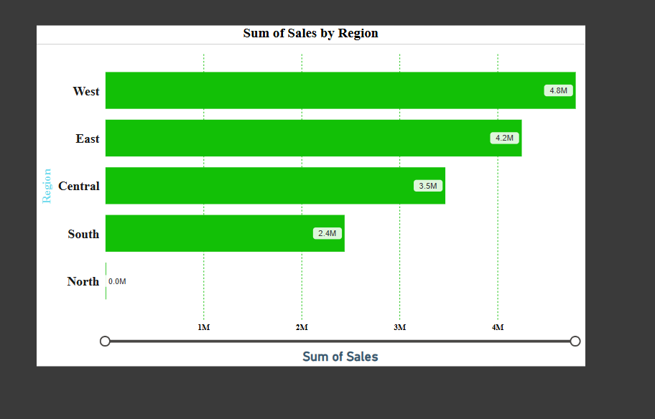
SALE BY REGION
This clustered bar chart shows the sum of sales analysis by region .
Highest sale –
Western region – 4.8 M
Eastern region – 4.2 M
Lowest sale –
North region – 0.1-1M

Slide 5
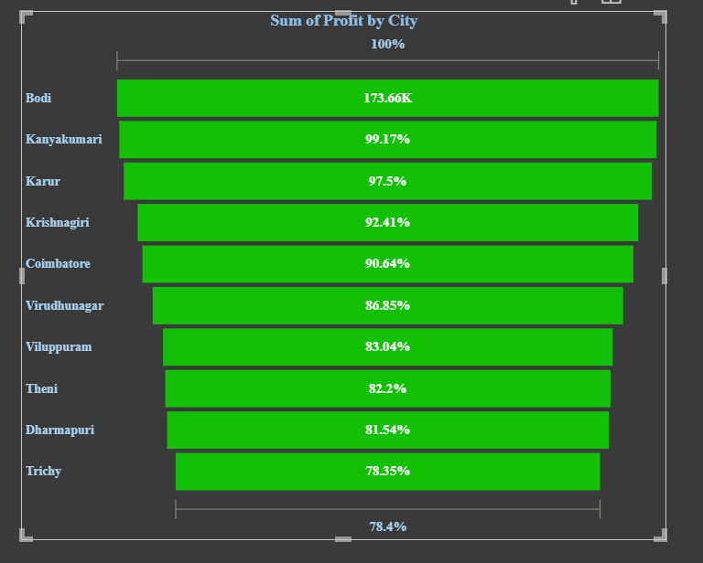
SUM OF PROFIT BY CITY
This funnel chart shows the sum of profit by city.
Highest profit –
Bodi – 176.66K
Kanyakumari – 99.1%
Lowest profit –
Trichy – 78.35 %

Slide 6
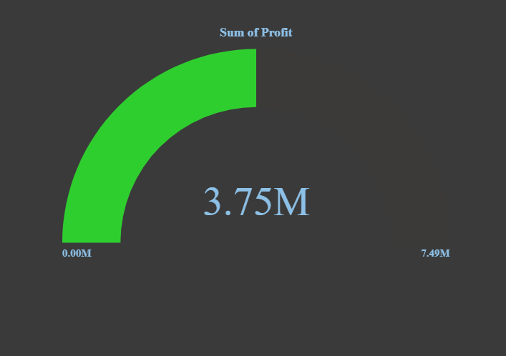
TARGETED PROFIT
Representation ---
Metric : Sum of Profit
Current Value: 3.75M → This is the total profit earned by Dmart.
Minimum Value: 0.00M
Maximum/Target Value: 7.49M
Interpretation --
The green arc shows how much of the target profit has been achieved.
With 3.75M out of 7.49M, DMart has achieved ~50% of the target profit.
The larger the filled green portion, the closer DMart is to meeting or exceeding its profit goal.

Slide 7
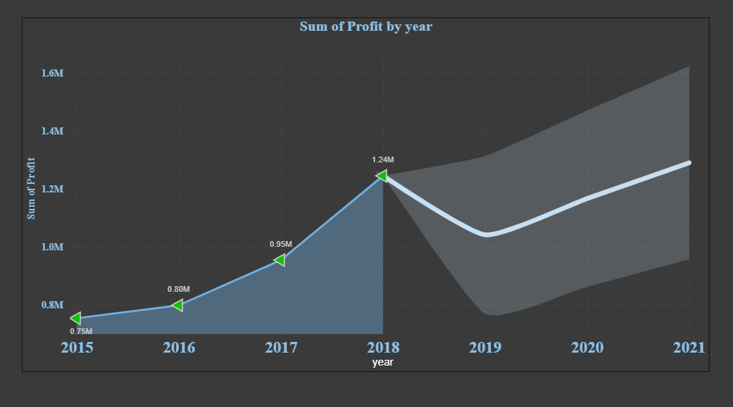
YEAR WISE PROFIT
It displays how DMart’s total profit has changed year-by-year from 2015 to 2021.
Year-wise interpretation
2015: ~0.75M → Lower starting profit
2016: ~0.80M → Slight growth
2017: ~0.95M → Steady increase
2018: ~1.24M → Highest growth / peak profit
2019: ~1.05M → Profit decline
2020: ~1.18M → Recovery begins
2021: ~1.30M → Strong growth again
Key insights for DMart
Overall upward trend in profits over the years
Best performing year: 2018
Temporary dip in 2019, indicating possible operational or market challenges
Post-2019 recovery, showing improved sales strategy or demand

Slide 8
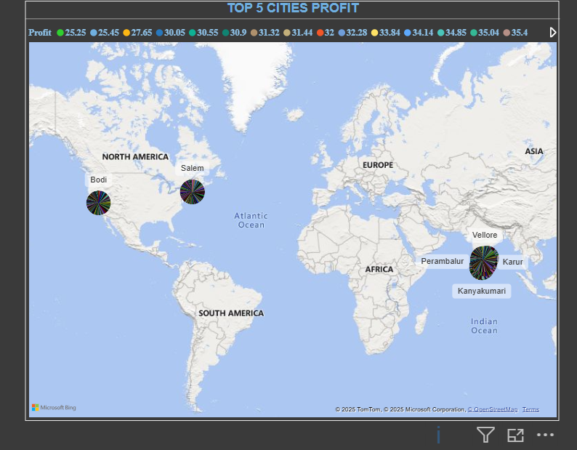
TOP 5 CITIES PROFIT
Key business insights for Dmart--
Southern cities dominate profit contribution
Vellore & Karur appear among the Highest profit-generating cities
DMart can:
Replicate successful strategies from these cities
Invest more in logistics & inventory for high-profit regions
Identify underperforming cities for improvement
This map visual shows the top 5 cities contributing the highest profit to DMart. The bubble size and color indicate profit levels, helping identify high-performing regions geographically

Slide 9
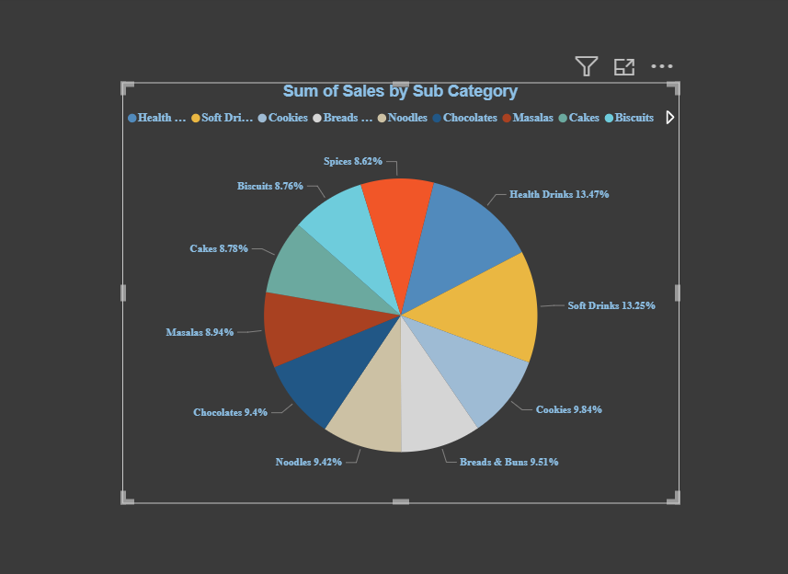
SUB CATEGORY WISE
This pie charts shows the sum of sales by sub category
Highest sales—
Soft drinks – 13.75%
Lowest sales—
Biscuits –8.62%

Slide 10

SWOT ANALYSIS OF D-MART
STRENGHTS
Low-Cost Leadership
Debt-Light Financial Model
Efficient Inventory & Supply Chain
Loyal and Repeat Customers
Expanding National Presence

Slide 11

SWOT ANAYSIS
WEAKNESS
Overdependence on Physical Stores
No International Expansion
No International Expansion
Low Profit Margins
No-Frills Shopping Experience
Limited Online Presence

Slide 12

SWOT ANALYSIS
OPPORTUNITIES
Expansion into Tier II & III Cities
Growth in Online Grocery Market.
Private Label Product Lines
Sustainability Initiatives
Partnerships with Fintechs & Local Brands
New Store Openings

Slide 13

SWOT ANALYSIS
THREATS
E-Commerce Giants Scaling Fast
Economic Volatility & Inflation
Supply Chain Disruptions
Regulatory & Policy Risks
Unorganized Retail Competition
Evolving Consumer Expectations

Slide 14
RECOMMENDATIONS
Strengthen High-Profit Cities
Focus on Closing the Profit Gap
Analyze & Prevent Profit Declines
Replicate Success of Peak Year (2018)
Accelerate Growth Momentum Post-2020Profits recovered strongly in 2020–2021.
Optimize Regional Expansion Strategy
Improve Decision-Making with Advanced KPIs
Enhance Dashboard for Leadership .

Slide 15
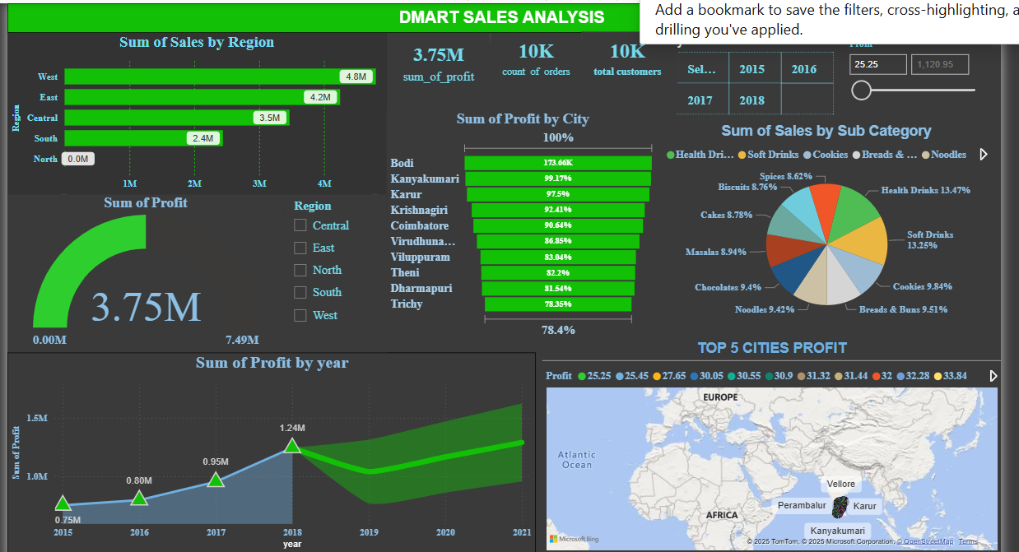
DASHBOARD

