Slide 1

Price Setter & Follower Detection Algorithm

Slide 2

THE TEAM
Pranjal Paira
Avval Kaur
209309016
209309001

Slide 3
Problem Statement
RedBus is an online platform where bus operators offer their services and sell seats. These bus operators vary from single service operators to ones which have scores of services. Pricing is a complex decision for Bus Operators, who continuously adjust the prices seeing the demand and supply signals. But not all operators have the same level of visibility on these signals or the capability to price effectively. Operators who have better ability/confidence may price independently while some others may choose to follow the prices of such price setters.
What we need is a data based method to reveal these market dynamics.

Slide 4
Introduction
TASK- Construction of a data-based method or algorithm that can reveal the market dynamics, which usually occurs in the price-setting game for a bus. This method should broadly classify which bus operator changes price based on supply and demand independently and who is a follower of other price setters. We must also produce a confidence score in favor of what we predict.
DATASET –Our dataset consists of 5 columns out which ‘Seat Fare Type 1’ and ‘Seat Fare Type 2’ column contains 4 comma separated price values for different categories like front/back/upper/lower. Some of the entries in these columns only have one price, some have two, three, and four. Depending upon available seat categories. Few entries of the ‘Seat Fare Type 2’ column are zero which is an anomaly. The column ‘recorded contains the time at which the prices are recorded, we also have the ‘service date’ column which specifies the date on which bus will run, and ‘Bus’ column which contains different bus ids.

Slide 5
Algorithm
In time series analysis, dynamic time warping (DTW) is an algorithm for measuring similarity between two temporal sequences, which may vary in speed. For instance, similarities in walking could be detected using DTW, even if one person was walking faster than the other, or if there were accelerations and decelerations during the course of an observation. DTW has been applied to temporal sequences of video, audio, and graphics data — indeed, any data that can be turned into a linear sequence can be analyzed with DTW.

Slide 6
Understanding with an example
- Two repetitions of a walking sequence recorded using a motion-capture system. While there are differences in walking speed between repetitions, the spatial paths of limbs remain highly similar.

Slide 7
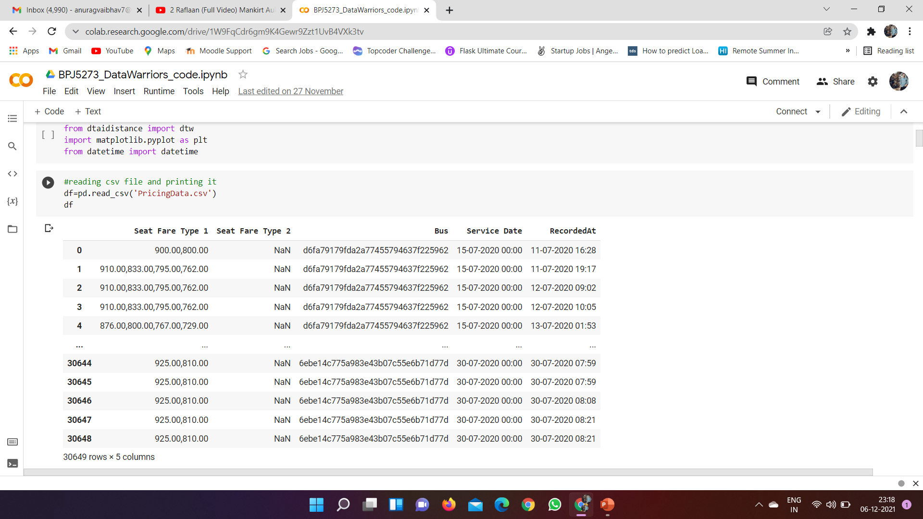
Dataset

Slide 8
Approach
Step1 : First, we used pandas for reading the csv dataset file then we performed a data cleaning operation to remove rows having ‘Seat Fare Type 2’ value zero.
Step2 : In the next step, we made the ‘Seat Fare Type1’ and ‘Seat Fare Type 2’ split into 4 categories each depending on subcategories(front/back/upper/lower) in this process we created 8 new columns like Category11 for Seat Fare Type 1 front seat, Category12 and so on
Step3 :This step is a bit complicated to understand but to summarise it. We first used a unique method to find several unique buses in the dataset. Later we iterated over the dataset and we started storing all the prices and time of Category11 for a bus in a list . Then we created a new data frame in which we stored unique buses and corresponding to it we stored a list of prices along with the time in the list.

Slide 9
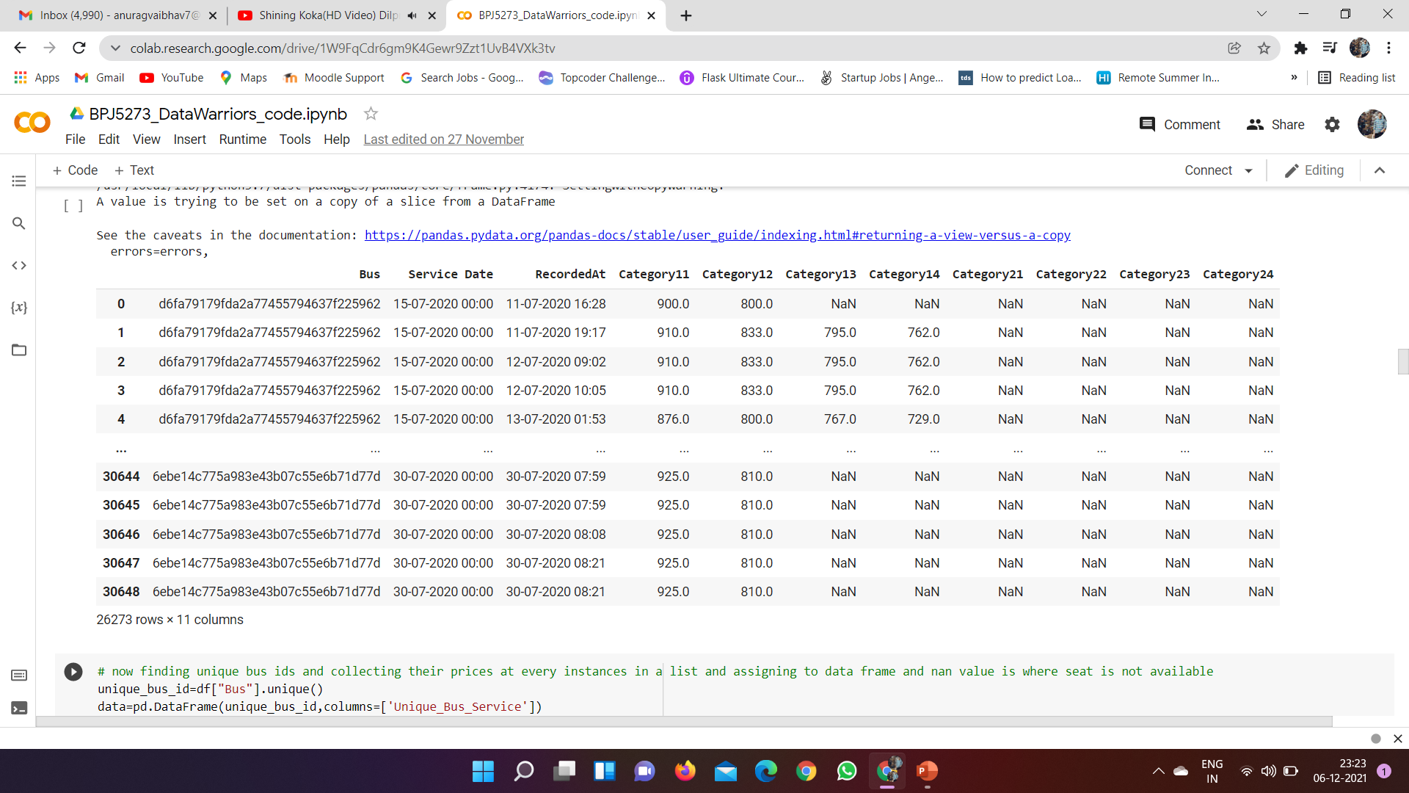
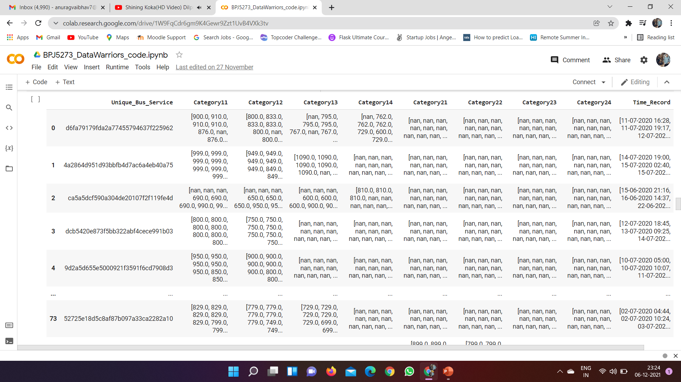
Data set after the above Three Steps

Slide 10
Step4 : : In this step, we have sorted the time list for each bus and accordingly we sorted the price list and converted the date in Date Time format then we started plotting time-series graphs for each category column.
Step5: We found that the time series graph of Category21, Category22 ,Category23 have only 1 or 2 bus data so we decide to drop it off.
Step6 : In this step, we used a dynamic time wrapping algorithm to compare time series. We calculated the dtw distance between buses for each category and stored it in a list and if unfortunately, we got dtw distance as infinity then we stored -1 in place of it and then later replaced it with the max of that list +1000 to prevent our analysis to produce poor results.
Step7 : Now we added dtw distance of each category together and obtained a compared distance list for each bus. Then we used minimum distance in the list which corresponds to the closest comparison. Using this we're able to find who follows whom then we normalized the distance using (M-S(x,y))/M and then passed it to the sigmoid function to get a confidence score.

Slide 11
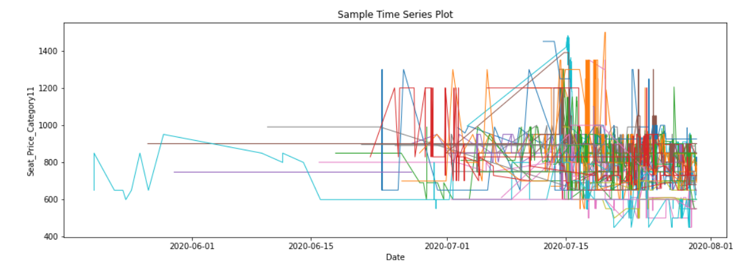
TimeSeries

Slide 12
Generalization
Our model is generalized that even if a bus doesn’t follow another bus completely then also our algorithm will find some generalization because we are first comparing category wise then we are merging results. So our model is generalized to handle this case and also we have generalized infinite dtw distance with a maximum of the list so that if we combine results then it should not distort results for other categories because it can happen a bus doesn’t follow in one category so got infinity distance but it follows in other categories.

Slide 13
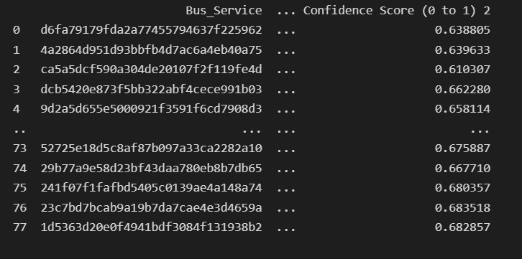
Result Analysis

Slide 14
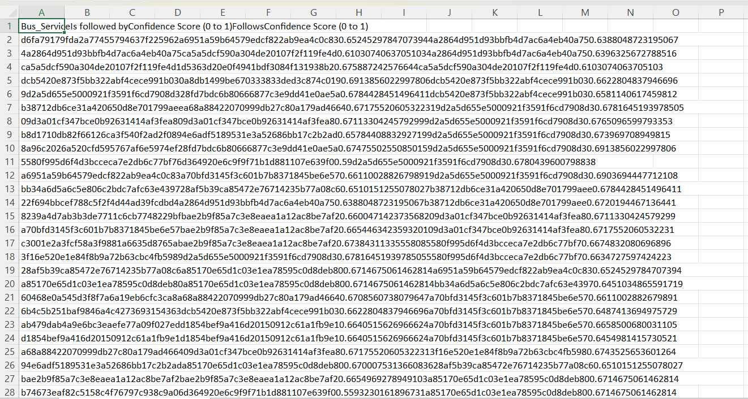

Slide 15

THANKS!
Any Question for us?

