Slide 1


Real-Time Fire & Smoke Detection
Presented by : IOT KANPUR
Lavkush Mani Tripathi Atul Kumar
Pranjal Kumar Srivastava Mayank Devnani
Vivek Kumar Gautam

Slide 2
AGENDA
Proposal
Conclusion
Workflow
2
Classification
11
Problem Statement
4
6
Challenges
1
9
Data Sourcing
10
5
Task Contribution
3
7
Localization
Traditional Methods

Slide 3
PROBLEM STATEMENT
1

Slide 4
PROBLEM STATEMENT
Fire is a Universal hazard
Preventing damages from fire requires fast and immediate detection
Minimize hardware cost and maximize efficiency

Slide 5
TRADITIONAL METHODS
2

Slide 6
TRADITIONAL METHODS
Use of Physical Sensors :
E.g. Smoke Detectors, Flame Detectors
Requires close proximity to fire sources
Takes some time to detect fire
Cannot provide information about fire location
Requires large network of physical sensors
Cannot deploy sensors everywhere (E.g. forest area)

Slide 7
TRADITIONAL METHODS
Manual monitoring :
Human error
Incapable of monitoring every camera
Limited screens

Slide 8
PROPOSAL
3

Slide 9
PROPOSAL
Real time fire and smoke detection, monitoring and localization
Identifying fire as hazardous / non-hazardous
Using Computer Vision and Image processing based techniques
Sending an email if fire / smoke is detected

Slide 10
WORK-FLOW
4

Slide 11
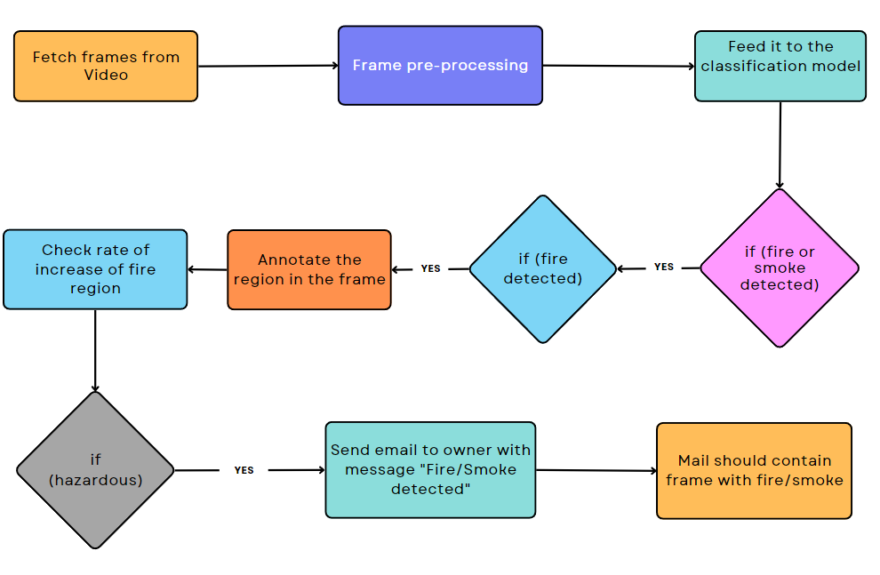
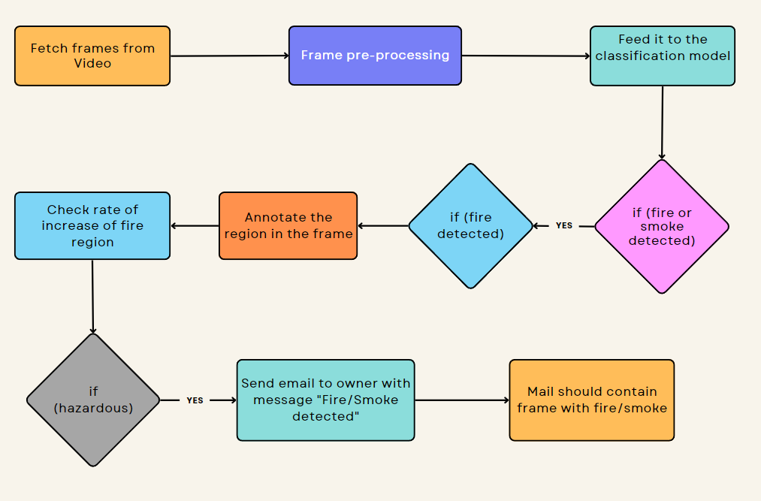
WORK-FLOW

Slide 12
DATA SOURCING
5

Slide 13
DATA COLLECTION
Mostly from open-source internet sources
Some images are generated / added by us
Indoor + Outdoor images
Split | Only Fire | Only Smoke | Fire + Smoke | Normal | Total
Train | 1098 | 1050 | 1155 | 1050 | 4353
Validation | 225 | 225 | 225 | 225 | 900
Test | 225 | 225 | 225 | 225 | 900
Total | 1548 | 1500 | 1605 | 1500 | 6153

Slide 14
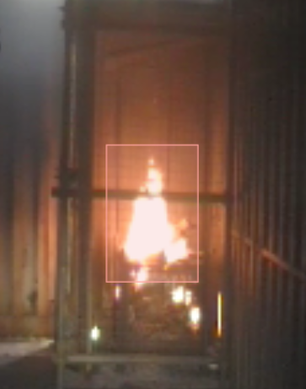
DATA ANNOTATION
Labelling of classification of image
Annotating region of interest (fire) in
the image
Open-source tool ‘label-studio’ used
for annotation

Slide 15
CLASSIFICATION
6

Slide 16
TRANSFER LEARNING
Focuses on storing knowledge gained while solving one problem and applying it to a different but related problem
Widely used across different domains in ML including text classification, digit recognition, medical imaging etc.
As per Andrew Ng, Transfer learning will be the next driver of ML commercial success after supervised learning

Slide 17
TRAINED MODELS
Pre-Trained Model | Optimizer | Training Accuracy (%) | Validation Accuracy (%) | Test Accuracy (%) | Model Size
Res-Net 50 | SGD | 99.02 | 96.22 | 96.00 | 94.2 MB
MobileNetV1 | SGD | 98.41 | 94.33 | 94.11 | 14.3 MB
MobileNetV2 | SGD | 98.44 | 98.44 | 94.55 | 12.4 MB
EfficientNetB0 | Adam | 98.78 | 95.77 | 94.88 | 20.9 MB
InceptionV1 | Adam | 95.15 | 92.11 | 90.55 | 89.8 MB

Slide 18
RESNET-50
ResNet stands for Residual Network
Introduced in the 2015 paper “Deep Residual Learning for Image Recognition”
50-layer CNN (48 convolutional layers, 1 MaxPool layer, 1 Average Pool layer)
Modification
Added an output layer with 2 nodes, each with sigmoid activation function

Slide 19
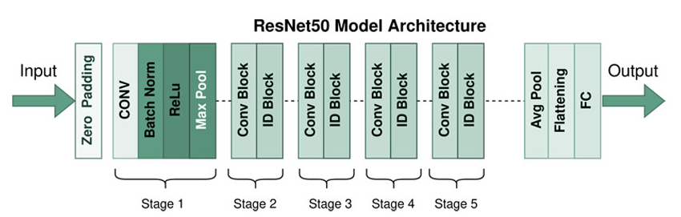
RESNET-50 ARCHITECTURE
Figure: ResNet-50 Architecture

Slide 20
PERFORMANCE
FIRE |  | Actual Values
 |  | Positive | Negative
Predicted Values | Positive | 441 | 9
 | Negative | 9 | 441
 | Precision | Recall | F1-Score
Fire | 0.98 | 0.98 | 0.98
Smoke | 0.98 | 0.97 | 0.98
Table 1: Fire Confusion Matrix
SMOKE |  | Actual Values
 |  | Positive | Negative
Predicted Values | Positive | 442 | 8
 | Negative | 14 | 436
Table 3: Precision, Recall & F1-Score
Table 2: Smoke Confusion Matrix

Slide 21
LOCALIZATION
7

Slide 22
LOCALIZATION
Input
Frame classified as fire
Processing
Convert to grayscale
Perform binary thresholding
Extract the biggest contour by area
Hazardous / Non-Hazardous
If average rate exceed 13 %, then classified as Hazardous

Slide 23
CHALLENGES
8

Slide 24
CHALLENGES
Images with only smoke and no fire were difficult to find
Image annotation was a tedious task
Model performance on real-world data didn’t reflect performance on test data
Localization of fire is difficult in presence of bright areas in frame (eg. tubelights)

Slide 25
RESULTS
9

Slide 26
RESULTS
Real-time Prediction
15 Frames per second
Reduced False Positives and False Negatives
 | False Positive Rate | False Negative Rate
Fire | 1 % | 1 %
Smoke | 0.88 % | 1.55 %

Slide 27
TASK CONTRIBUTION
10

Slide 28
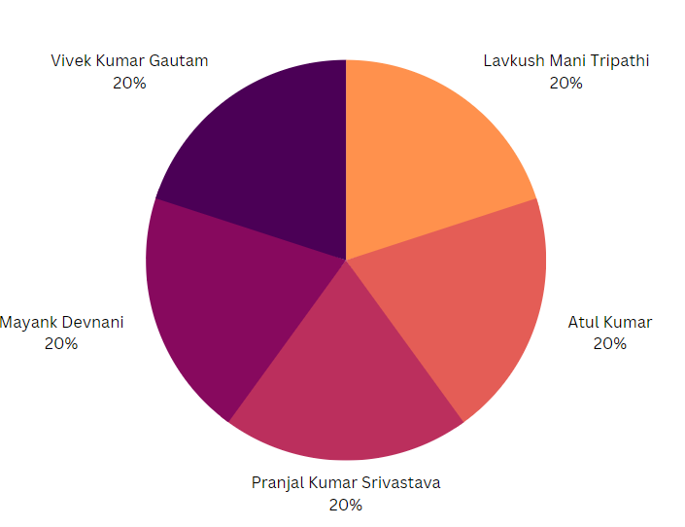
CONTRIBUTION

Slide 29
CONTRIBUTION
Lavkush Mani Tripathi
Data Annotation
Email Automation
Atul Kumar
Data Annotation
Fire Localization
Pranjal Kumar Srivastava
Data Annotation
Classification model development
Mayank Devnani
Data Annotation
Classification model development
Vivek Kumar Gautam
Detect hazardous fire
Code Integration

Slide 30

THANK YOU !
Any questions?

