Slide 1
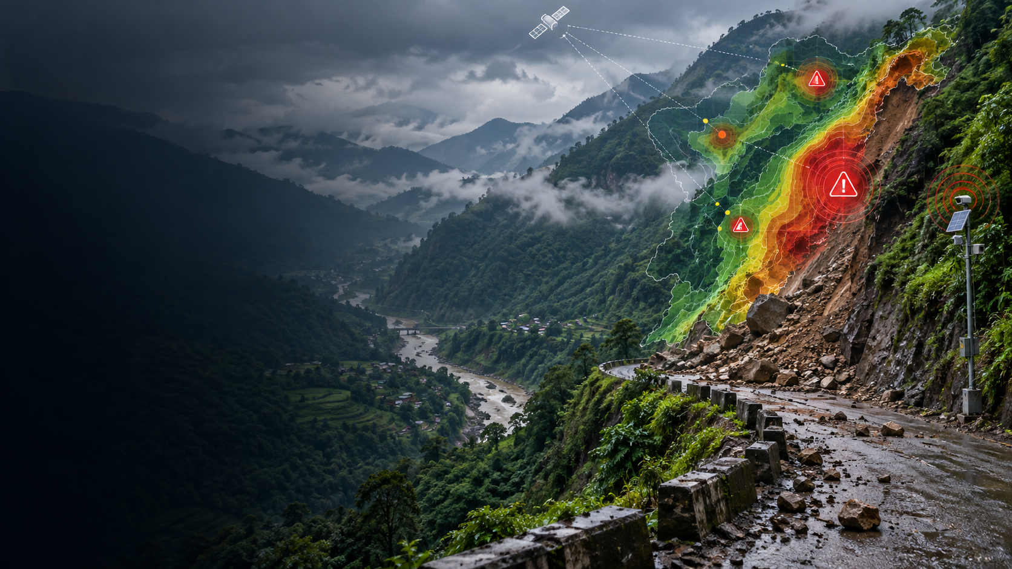
PRAHARI
Predictive Risk Assessment, Hazard Alert & Response Intelligence
AI-Based Early Warning and Landslide Risk Monitoring System in Northeast India
SIH26001
Disaster Management
Low-bandwidth ready
Research-backed • Explainable • Community-centred • Offline-capable
PRAHARI • SIH26001 • AI-Based Early Warning and Landslide Risk Monitoring System in NER
01

Slide 2
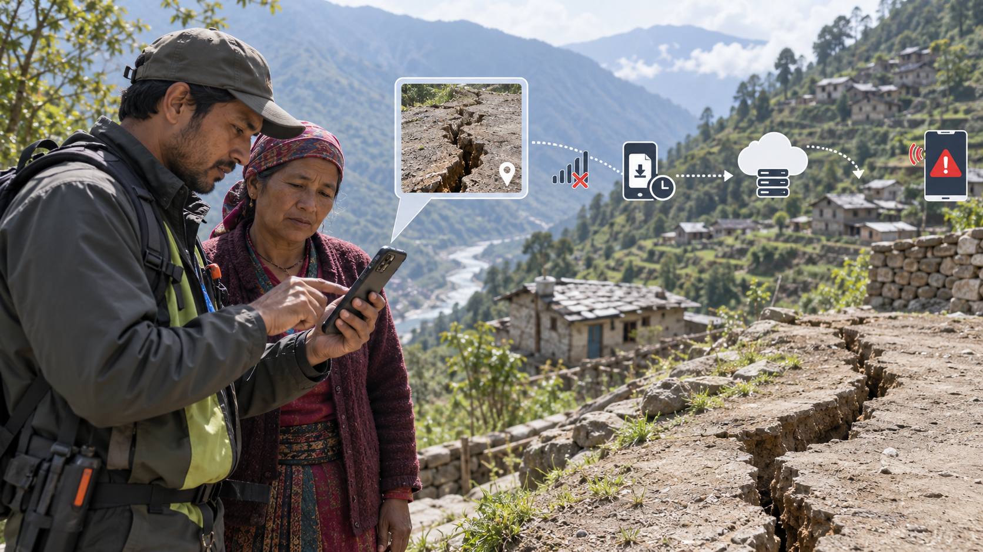
Problem: landslide risk is dynamic
The real challenge is not only where landslides happen, but when risk becomes actionable.
Why conventional systems fail
NER-specific pressure
Our response
Manual inspection is slow, satellite-only systems have latency, weather dashboards lack local impact, and many ML studies stop at susceptibility maps.
Steep terrain, intense rainfall, fragile geology, drainage disruption, road cuts and growing settlements create rapidly changing risk.
PRAHARI turns multi-source signals into risk, alert, geo-targeting and response planning.
4
warning pillars
8
monitored zones
3
map modes
0
live satellite dependency
PRAHARI • SIH26001 • AI-Based Early Warning and Landslide Risk Monitoring System in NER
02

Slide 3

Research gaps converted into features
PRAHARI v7 is designed from the gap between susceptibility research and operational warning.
Susceptibility papers
IoT papers
AI-EWS reviews
PRAHARI synthesis
Strong ML/GIS hazard science; often historical or static, less operational response.
Continuous sensing and edge processing; often limited spatial scale and fragmented dashboards.
Need responsible, people-centred warning chains across risk, monitoring, communication and preparedness.
Hybrid ML + community intelligence + geofencing + alerting + offline response plan.
PRAHARI • SIH26001 • AI-Based Early Warning and Landslide Risk Monitoring System in NER
03

Slide 4
PRAHARI system architecture
Data → Intelligence → Warning → Response
Data Inputs
Hybrid Risk Engine
Decision Layer
Action
Live/latest weather
Rainfall memory
Soil wetness proxy
Terrain baseline
Satellite context
Citizen precursors
IoT telemetry
XGBoost + LightGBM + Random Forest with rainfall memory, uncertainty, SHAP-style explanations and physics guardrail.
Hazard probability + impact priority + geo-fence + response checklist.
Alert, route, field verification and feedback loop.
→
→
→
Key design principle
The project separates physical hazard from impact. A slope above a road/village is treated differently from an isolated slope.
PRAHARI • SIH26001 • AI-Based Early Warning and Landslide Risk Monitoring System in NER
04

Slide 5
Research-mode risk engine
Prediction that is explainable, conservative and demo-stable
Static susceptibility
Dynamic trigger
Decision output
Slope, elevation, historical risk and vegetation baseline answer: how vulnerable is this terrain?
24h rain, 72h antecedent rain, 11-day effective rain, soil wetness, forecast rain and peak hourly rain answer: is failure pressure rising now?
Final probability, LOW/MODERATE/HIGH/CRITICAL, model votes, uncertainty, local factors and recommended action.
Risk thresholds: LOW <35% • MODERATE 35–60% • HIGH 60–80% • CRITICAL ≥80%
PRAHARI • SIH26001 • AI-Based Early Warning and Landslide Risk Monitoring System in NER
05

Slide 6
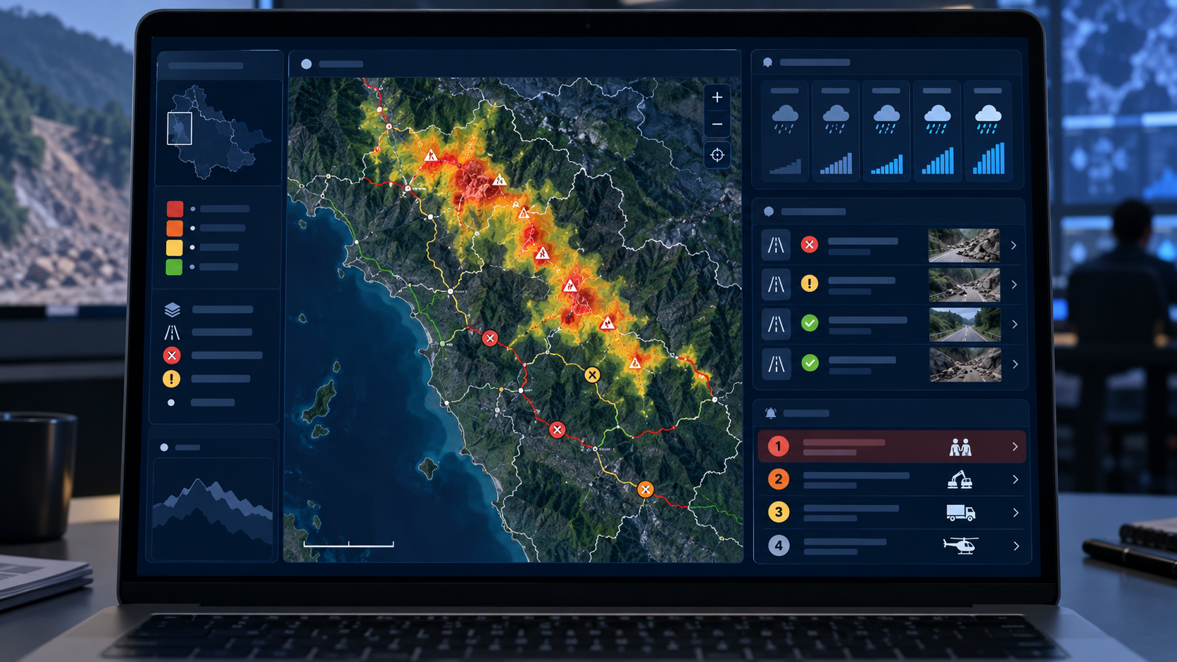
Backend and APIs are the product backbone
FastAPI connects all modules through clean, demo-ready endpoints.
Prediction APIs
Field intelligence
Response APIs
Low bandwidth
/api/predict-risk
/api/forecast-risk/{id}
/api/ml/status
/api/ml/feature-importance
/api/reports
/api/community/signal/{id}
/api/iot/telemetry
/api/geotech/factor-of-safety
/api/impact/{id}
/api/response/plan/{id}
/api/geofence/check
/api/alerts/feedback
/api/satellite/cache/status
/api/satellite/cache/warm
/api/satellite/tile/{z}/{y}/{x}.jpg
PRAHARI • SIH26001 • AI-Based Early Warning and Landslide Risk Monitoring System in NER
06

Slide 7
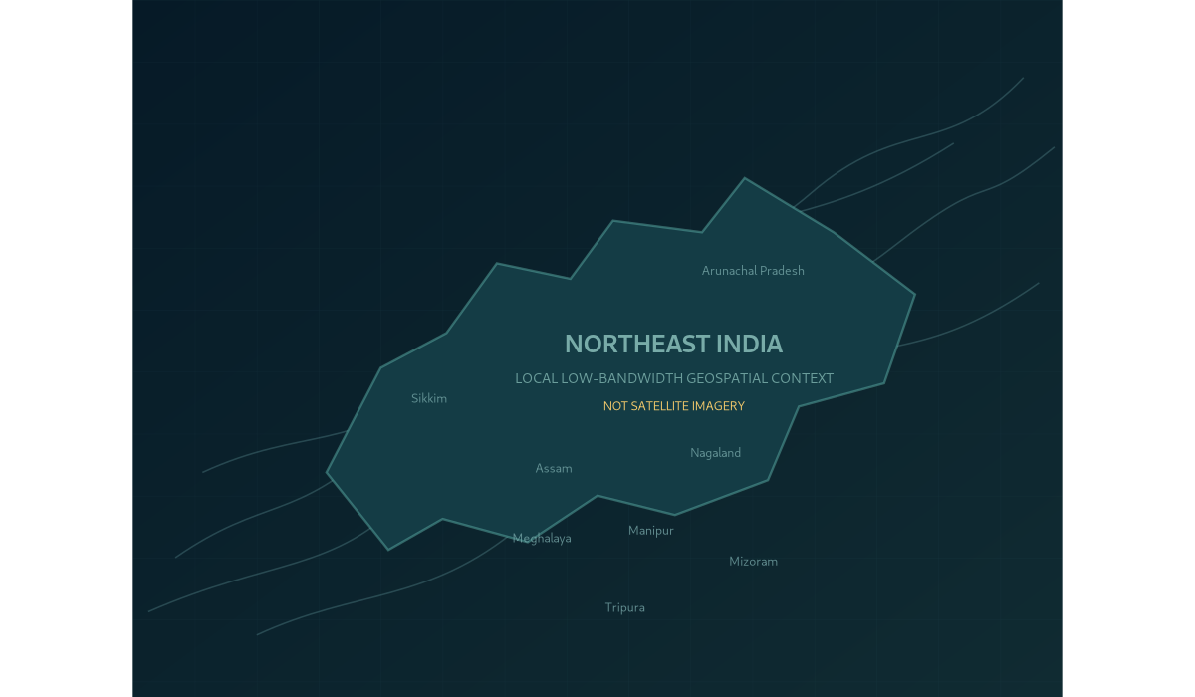
Satellite strategy that works on college internet
No more waiting for gray tiles during the judge demo.
1. Offline EO Lite
Bundled local map context loads instantly without internet. Clearly labelled NOT satellite imagery.
2. Cached NASA
Pre-warmed NASA GIBS NRT tiles are served from localhost by FastAPI during the demo.
3. NASA Live / Esri / Terrain
Kept as optional online layers only. Never depend on them in presentation.
Demo rule: open Offline EO Lite first, then Cached NASA only if cache is ready.
PRAHARI • SIH26001 • AI-Based Early Warning and Landslide Risk Monitoring System in NER
07

Slide 8
Community intelligence closes the warning gap
Citizen reports become corroborating evidence, not fake ML predictions.
Precursors captured
Corroboration score
Operational workflow
Surface cracks
Water seepage
Slope movement
Debris / rockfall
Blocked drainage
Leaning tree / pole
Unusual ground sound
Severity × precursor weight × distance × recency × verification status.
NEW → VERIFIED → DISPATCHED → RESOLVED
High/Critical reports can enter the alert pipeline for verification.
PRAHARI • SIH26001 • AI-Based Early Warning and Landslide Risk Monitoring System in NER
08

Slide 9
Impact-based warning: from probability to priority
PRAHARI asks: what will the hazard do?
Hazard
Exposure
Vulnerability
Impact priority
ML probability, dynamic trigger and susceptibility class.
Population, road corridor and nearby communities.
Critical assets and community precursor evidence.
ROUTINE / WATCH / HIGH / VERY HIGH / EMERGENCY
+
+
→
This is the difference between a normal ML dashboard and a disaster-response intelligence system.
PRAHARI • SIH26001 • AI-Based Early Warning and Landslide Risk Monitoring System in NER
09

Slide 10
Edge and IoT-ready design
Real sensors can be plugged into the same warning pipeline later.
Sensor packet
Edge rule
Truthful demo mode
Rainfall intensity
Soil moisture
Tilt angle
Ground vibration
Pore pressure
Displacement
Battery + quality
Local node can flag extreme wetness + rainfall + deformation before cloud inference.
Packets are labelled REAL_SENSOR, MANUAL_TEST or SIMULATED_HACKATHON so the presentation stays honest.
PRAHARI • SIH26001 • AI-Based Early Warning and Landslide Risk Monitoring System in NER
10

Slide 11
Alert and response loop
Warnings must be clear, geo-targeted and learn from field outcomes.
Alert creation
Communication
Geo-fencing
Feedback
HIGH/CRITICAL prediction, severe citizen report, edge telemetry, or emergency demo trigger.
In-app alerts, browser notification, siren simulation, multilingual warning text, acknowledgement.
My Area checks whether user is near a dangerous monitored zone.
CONFIRMED / FALSE ALARM / PARTIAL for calibration learning loop.
PRAHARI • SIH26001 • AI-Based Early Warning and Landslide Risk Monitoring System in NER
11

Slide 12
Offline response routing
Even with no internet, PRAHARI can show a prototype safer route.
CRITICAL warning
Route output
Honest limitation
↓
Safer assembly point
Path nodes
Distance
Route exposure index
Response checklist
Prototype warning label
Current safe points and routes are prototype. Production must use verified government road, closure and shelter GIS data.
Impact analysis
↓
Offline road graph
↓
Risk-weighted Dijkstra
PRAHARI • SIH26001 • AI-Based Early Warning and Landslide Risk Monitoring System in NER
12

Slide 13
Frontend experience: command-center, not college form
Eight screens tell one operational story.
• Overview: situation summary
• Risk Map: station + overlays
• Satellite: offline/cached/online modes
• AI Analysis: risk, votes, uncertainty
• Citizen Reports: GPS + photo evidence
• Alerts: acknowledgement and feedback
• Infrastructure: road/asset impact
• System: health, model card and data truth
Presentation experience
The dashboard is designed to let judges understand the full pipeline in under five minutes: observe → predict → warn → respond.
PRAHARI • SIH26001 • AI-Based Early Warning and Landslide Risk Monitoring System in NER
13

Slide 14
Data truth table
This protects the team from misinformation in viva.
Weather
Live/latest public model feed or fallback
Satellite
NRT/cached imagery, not live video
ML model
Bootstrap integration model, not field-validated accuracy
IoT sensors
API-ready; no physical hardware connected
Citizen reports
Real runtime input; verification workflow needed
SMS/WhatsApp
Integration-ready only
Routes/shelters
Prototype offline graph, not official evacuation plan
Best viva line: PRAHARI is a decision-support prototype that clearly marks data provenance and limitations.
PRAHARI • SIH26001 • AI-Based Early Warning and Landslide Risk Monitoring System in NER
14

Slide 15
Prize-winning demo path
No waiting, no fake claims, no broken dependencies.
1. Open Overview
2. Risk + Satellite
3. Trigger AI
4. Close loop
Frame the problem and show system readiness.
Use Offline EO Lite first, Cached NASA only if ready.
Run cloudburst scenario; show explanation and guardrail.
Alert → report → impact → response route → feedback.
PRAHARI • SIH26001 • AI-Based Early Warning and Landslide Risk Monitoring System in NER
15

Slide 16
Roadmap and closing
PRAHARI is already a working prototype; production makes it field-valid.
Next datasets
Next algorithms
Deployment
Validated landslide inventories
DEM-derived terrain
Lithology and lineaments
Real asset / shelter GIS
Field sensor telemetry
Spatial validation
Calibrated thresholds
InSAR deformation
Time-series forecasting
Digital twin / GNN research
PostGIS + cloud
RBAC authentication
CAP/SMS/WhatsApp gateways
Field pilots
Authority SOP integration
PRAHARI turns research-grade hazard intelligence into actionable, people-centred disaster response.
PRAHARI • SIH26001 • AI-Based Early Warning and Landslide Risk Monitoring System in NER
16

