Slide 1
Travel Insurance
TEAM X

Slide 2
Problem Statement
Every Insurance company worries about either rejecting a genuine claim or approving a fraudulent claim thereby incurring a loss.
As a data Scientist, if we could come up with a Model which could predict before-hand if the incoming claim is going to be a genuine or fraudulent this would save a lot for the company.
Notes:
Can we include some examples here?

Slide 3
Why solve this problem?
The major reason for any insurance company to solve this problem would be to avoid below situation:
If the company wrongly deny a genuine claim that could lead to lawsuits against them.
If a fraudulent claim is processed it will led to monitory loss for the company.
Knowing before hand about the claims could lead to a lot of benefits such as we would have an idea which factors are mainly considered for claim approval and fraudulent claim approval can be avoided, thus saving the company from major embarrassment or Monitory loss.

Slide 4
Data
The training dataset consists of data corresponding to 50553 customers and the test dataset consists of 12661 customers. Following are the features of the dataset
Target: Claim Status (Claim)
Name of agency (Agency)
Type of travel insurance agencies (Agency.Type)
Distribution channel of travel insurance agencies (Distribution.Channel)
Name of the travel insurance products (Product.Name)
Duration of travel (Duration)
Destination of travel (Destination)
Amount of sales of travel insurance policies (Net.Sales)
The commission received for travel insurance agency (Commission)
Gender of insured (Gender)
Age of insured (Age)
If you had the opportunity, what additional data you would love to have?
Date of Claim Approval, Prior Claim Info

Slide 5
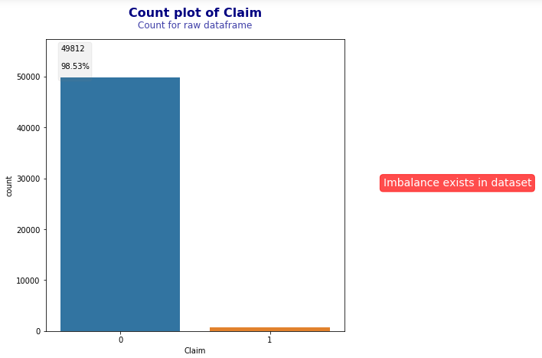
Exploratory Data Analysis

Slide 6
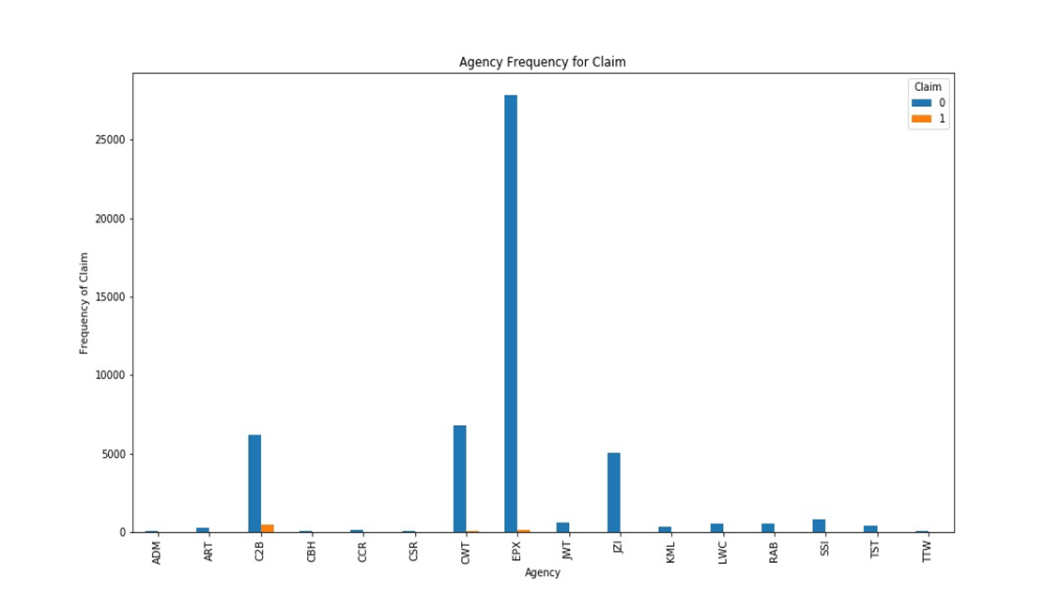

Slide 7
Feature Engineering
As observed, the dataset is highly imbalanced, wherein 98.53% of target variable contains 0 value. To overcome this we tried several sampling techniques like RandomOverSampling, RandomUnderSampling, SMOTE, TOMEK, SMOTEENN. And observed that SMOTEENN was giving the best result.
In the duration column there where few negative values, which we got rid off.
On analysing few travel insurance companies data, we found that all of them do not provide travel insurance greater for a period of more than 2 years, hence droped those records.
Also in the Age column, maximum age for the person was found 118 years, and that too for multiple record, which looks like outliers. So we replaced all such age values with the Median of the column.
There were 1475 records for which the Sales was 0, and amoungst these records for almost 1057 records we observed they had some commission value.

Slide 8
Models and Approaches
We tried Logistic Regression, Random Forest Classifier and Descision Treen with different sampling methods: RandomUnderSampling, RandomOverSampling, TOMEK, SMOTE etc.
At the end the best approach for us was Logistics Regression with SMOTEENN sampling. The SMOTEENN(SMOTE with ENN - Edited Nearest Neighbour) sampling applies both Under and over sampling technique and cleans the data further using ENN. Thus providing the best of both under and oversampling.
We also applied label encoding on all our categorical columns and dropped just the ID column.
 | Before Sampling | After SMOTEENN
0 values | 14084 | 11066
1 values | 516 | 12514
Total Records | 14600 | 23580

Slide 9
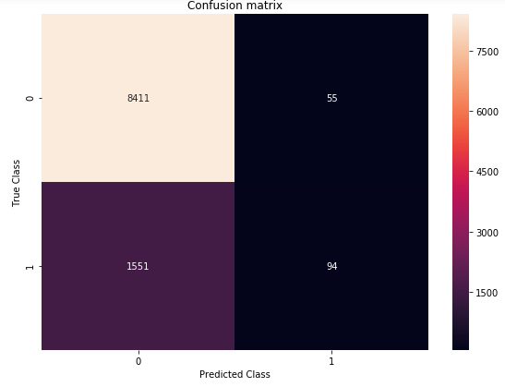
Evaluation & Results
We have selected our model based on the
highest Precision calculated using the Confusion Matrix.
Precision = True Positive/True Positive + False Positive
(Here : TP = Claim accept and genuine ,
FP = approving the wrong claim would lead to loss)
Precision indicates that how
often our predictions are correct.

Slide 10
Final Results
Model: Logistic Regression
Sampling Technique: SMOTEENN
Precision Score: 0.92
Recall: 0.06

Slide 11
Insights & Decisions
Sr. No. | Model Name | Accuracy | F1 Score | Precision Score | Recall Score
1 | Logistics Regression (Vanilla) | 83% | 10% | 63% | 6%
2 | Logistics Regression with SMOTEENN | 81% | 10% | 64% | 6%
3 | Logistics Regression with RandomOverSampler | 84% | 10% | 64% | 6%
4 | Logistics Regression with SMOTE | 85% | 11% | 60% | 6%
5 | Decision Tree with SMOTEENN | 73% | 7% | 70% | 4%
6 | SVC | 98% | 0% | 1% | 0%

Slide 12
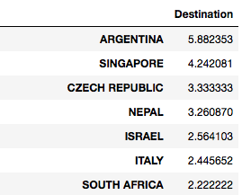
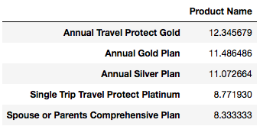
Insights & Decisions
On analyzing various plans that the company provides,
below is observed:
Claims coming from these countries are found to be more fraudulent then others.

Slide 13
Insights & Decisions
Maximum fraudulent claims come from people travelling to SINGAPORE, UNITED STATES and UNITED KINGDOM as compared to other countries.
Its observed that long term insurance has a higher probability of getting fraudulent claim.
The Annual plans has the highest probability of Claims getting fraudulent.

