Slide 1
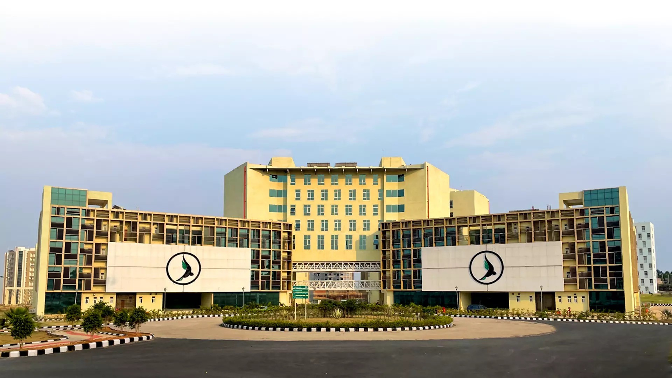
ResellHub: Platform Growth and Subsidy Targeting
EXECUTIVE CERTIFICATE PROGRAMME · BUSINESS ANALYTICS AND AI · I IM RANCHI
The growth team can subsidise one group of resellers. Is growth self reinforcing, and which segment and region should get the onboarding subsidy?
600
orders, Jan to Jun 2026
56
active resellers
149
active buyers
₹3,69,200
total order value
· Surya Shukla · Vishesh Verma · Pranjal Phanse · Amrutha Srikakula · Darshini Vishwanathan

Slide 2
Four connected steps, one fixed hand-off
1
2
3
4
Prepare
Power Query: tidy 13 region spellings
into 4, merge
names, extract month
Model
Star schema in Power BI, DAX measures, cards, slicers and charts
Analyse
Two-sided growth, correlation, Metcalfe's law, region supply
Decide
Read k-means segments, pick segment and region, set guardrails
Each step starts from the exact numbers of the one before. Every figure in this deck ties to the dashboard or the workbook.

Slide 3
Clean data, simple star schema
raw region spellings to regions, 15 resellers each. R001 is Anita Reddy after merging names.
Order value by region (₹ thousand)
13 → 4
102.6
95.7
92.7
78.2
orders
fact, 600 rows
many to one
resellers
dimension, 60 rows
10.9%
Margin %
14.5%
Return rate
₹3,29,127
Cost
East North West South
North's margin is 9.1%, below the 10% target. East is 11.0%, South and West 11.8%.

Slide 4
Both sides of the platform grow together
0.984
correlation of active resellers with active buyers
Monthly active buyers and resellers
93
81
74
56
48
38 → 141
network size n (resellers + buyers), Jan to Jun
40
38
34
27
16
10
4
13.8×
network value in June vs January (value
∝ n²)
Jan
Feb
Mar
Active buyers
Apr May
Active resellers
Jun
Six monthly points sharing one growth trend: consistent with a cross-side effect, not proof of it.

Slide 5
Three kinds of resellers (k = 3)
Premium low-frequency sellers
₹1016.2
margin per reseller
13 resellers, 5.0 orders each
₹1426.2 average order value 6.2% returns, 14.0% margin
High-volume workhorses
Casual small-basket sellers
₹1760.5
margin per reseller
8 resellers, 35.4 orders each
₹542.3 average order value 13.7% returns, 9.7% margin
₹365.1
margin per reseller
35 resellers, 7.2 orders each
₹535.3 average order value 17.7% returns, 9.8% margin
Silhouette peaks at k = 3 (0.581); the elbow bends at k = 3 to 4 (62.4 → 29.3 → 16.9). Subsidy candidate: high-volume workhorses.

Slide 6
Recommendation: workhorses in North
margin per reseller: 4.8× the casual sellers (₹365.1) and 1.7× premium (₹1016.2)
Orders per reseller by region
₹1760.5
14.4
10.1
13.7%
return rate, against 17.7% for casual sellers
8.5
7.0
14.4
orders per reseller in North, 2.1× South (7.0): the most under-supplied region
North
East
West
South
Subsidise onboarding of workhorse-profile resellers in North, paid out only when margin and return guardrails hold

Slide 7
Three platform moves, backed by numbers
14.4
orders per reseller in North vs 7.0 in South
Critical mass
Recruit resellers where demand outruns supply, starting in North.
14.5%
of orders are returned (18.0% in West)
Complementary services and lock-in
Add returns handling and seller tools so leaving the platform costs more.
13.8×
network value, June vs January
Platform data
Use segment profiles to target and monitor subsidies as the network grows.

Slide 8
monitoring and summary
Subsidy attracts low-margin sellers
Casual sellers earn 9.8% margin with 17.7% returns, and North's margin is 9.1% against the 10% target.
Correlation is not cause
The 0.984 rests on six months with one shared trend. June orders rose to 140, yet average order value fell from ₹633 to ₹556.
Monitor: margin % and return rate of subsidised resellers, every month.
Monitor: keep a comparison region unsubsidised; track orders per reseller and active buyers.
Review after two months against the comparison region
1
Pilot in North with workhorse-profile resellers
2
Set margin and return guardrails before any payout
3

