Slide 1

Knowledge Based Customer Churan Prediction For Telecom Services Using Python
Presented By
Under the Supervision of
PROF. ANUPAM MONDAL
Department of Computer Science and Engineering Institute of Engineering and Management
West Bengal, India
Name | Class Roll Number | University Roll Number
Partho Protim Sarkar | 180 – C5 | 10400116150
Pranjal Chowdhury | 178 – C5 | 10400116145

Slide 2
Problem Statement
Customer churn is a major problem and one of the most important concerns for large companies. Due to the direct effect on the revenues of the companies, especially in the telecom field, companies are seeking to develop means to predict potential customer to churn. Therefore, finding factors that increase customer churn is important to take necessary actions to reduce this
Churn. Churn prediction helps business to gain a better understanding of future expected revenue , allows to target individual in an attempt to prevent them from discontinuing their subscription with the company and helps to understand what preventative steps are necessary to ensure lost revenue is minimized.

Slide 3
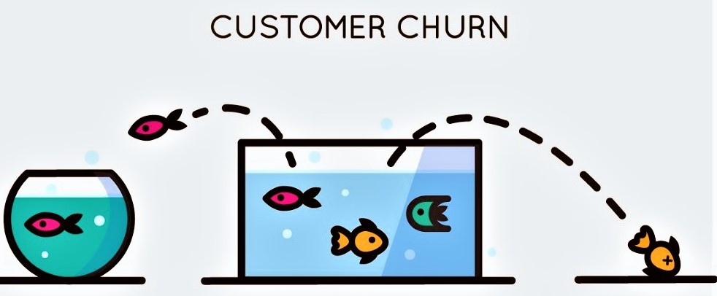
Introduction
Customer churn is defined as the loss of customers.
A “churn” with respect to the Telecom industry, is defined as the percentage of subscribers moving from a specific service or a service provider to another in a given period of time.
Churn prediction is the technique by which we can easily find out who is likely to churn in given time period.

Slide 4
Churn Rate Prediction With Machine Learning
Existing
Customers
Pattern
Recognition
Churned customer history
Predictive Model
Customers at risk of churn
Proactive
re-engagement
Happy customers

Slide 5
Related Work
SI NO. | AUTHOR NAME | PAPER NAME | CONTRIBUTION | CHALLENGES
1 | Nabgha Hashmi, Naveed Anwer Butt and Dr.Muddesar Iqbal | Customer Churn Prediction in Telecommunication : A Decade Review and Classification | Research make a contribution in the field of customer churn predictive modeling in telecommunication. Thus the paper draws a sketch line for the researchers for reviewing and accumulation of the trends about data mining applications in the field of telecommunication. | The classification techniques are good for analyzing qualitative and continuous data and afterwards interpreting results but these techniques do not guarantee the appropriable accuracy of prediction model for large enough, highly dimensional, non linear or time series datasets.
2 | IRFAN ULLAH , BASIT RAZA , AHMAD KAMRAN MALIK , MUHAMMAD IMRAN , SAIF UL ISLAM , AND SUNG WON KIM | A Churn Prediction Model Using Random Forest: Analysis of Machine Learning Techniques for Churn Prediction and Factor Identification in Telecom Sector | A customer churn model is provided for data analytics and validated through standard evaluation metrics. The obtained results show that our proposed churn model performed better by using machine learning techniques | Investigate eager leaning and lazy learning approaches for better churn prediction. The study can be further extended to explore the changing behavior patterns of churn customers by applying Artificial Intelligence techniques for predictions and trend analysis.

Slide 6
SI NO. | AUTHOR NAME | PAPER NAME | CONTRIBUTION | CHALLENGES
4 | Adnan Amin, Sajid Anwar, Awais Adnan,Muhammad Nawaz , Khalid Alwaif, Amir Hussain, Kaizhu Huang | Customer churn prediction in the telecommunication sector using a rough set approach | Proposed an intelligent rule-based decision-making technique, based on rough set theory (RST), to extract important decision rules related to customer churn and non-churn. The proposed approach performed classiﬁcation of churn from non-churn customers, along with prediction of those customers who will churn or may possibly churn in the near future. | In this study the proﬁles of predicted customer churns were not considered. churn datasets exhibit the class imbalance problem; whereby, the churn class contains fewer number of samples as compared to the non-churn class and eliminating and detecting of outliers would greatly contribute to providing better results.
2 | Georges D. Olle Olle and Shuqin Cai | A Hybrid Churn Prediction Model in Mobile Telecommunication Industry | Presented a new hybrid model for Churn prediction that predict customers with high propensity to churn, profiling the reason of churn and examining the gap between the churn decision and the deactivation time. In theory it contributes to the problem of increasing TP and decrease FP for more accuracy on the prediction by using a hybrid model. | The evaluation of the model shows that its accuracy is higher than when using single model and that the results could be ameliorate when the data distribution are less skewed.

Slide 7
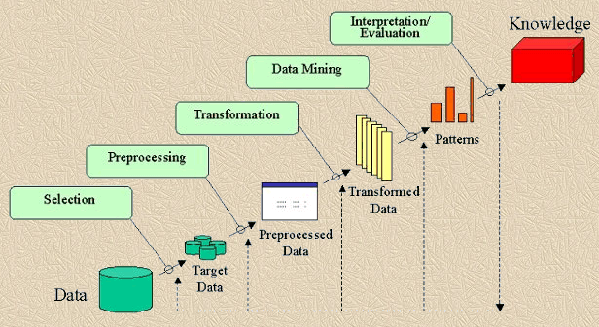
KDD(Knowledge Discovery in Database) PROCESS

Slide 8
Brief Description of KDD Process
Data Cleaning: Data cleaning is defined as removal of noisy and irrelevant data from collection.
Cleaning in case of Missing values.
Cleaning noisy data, where noise is a random or variance error.
Cleaning with Data discrepancy detection and Data transformation tools.
Data Integration: Data integration is defined as heterogeneous data from multiple sources combined in a common source(DataWarehouse).
Data integration using Data Migration tools.
Data integration using Data Synchronization tools.
Data integration using ETL(Extract-Load-Transformation) process.
Data Selection: Data selection is defined as the process where data relevant to the analysis is decided and retrieved from the data collection.
Data selection using Neural network.
Data selection using Decision Trees.
Data selection using SVM.
Data selection using Regression, etc.
Data Transformation: Data Transformation is defined as the process of transforming data into appropriate form required by mining procedure.Data Transformation is a two step process:
Data Mapping: Assigning elements from source base to destination to capture transformations.
Code generation: Creation of the actual transformation program.

Slide 9
5.Data Mining: Data mining is defined as clever techniques that are applied to extract patterns potentially useful.
Transforms task relevant data into patterns.
Decides purpose of model using classification or characterization.
6.Pattern Evaluation: Pattern Evaluation is defined as as identifying strictly increasing patterns representing knowledge based on given measures.
Find interestingness score of each pattern.
Uses summarization and Visualization to make data understandable by user.
7.Knowledge representation: Knowledge representation is defined as technique which utilizes visualization tools to represent data mining results.
Generate reports.
Generate tables.
Generate discriminant rules, classification rules, characterization rules, etc.

Slide 10
Results
Graphical Result
Dataset

Slide 11


