Slide 1
AcSIR Coursework
Computer applications & Informatics
Sept 3, 2025
Sherry Bhalla, PhD Scientist and Assistant Professor AcSIR
CSIR-Institute of Genomics and Integrative Biology (IGIB)
DBT/Wellcome Trust India Alliance Early Career Fellow

Slide 2
Computer Applications & Informatics
Bioinformatics databases and integrative extraction of information and compilation
Sequence alignments, multiple sequence alignments and phylogenetic analysis
Introduction to R, a programming and environment language for statistical computation and graphics
Reading and writing files, lists, dataframes and S4 objects
Random sampling, statistical tests and data visualisation

Slide 3
Programming: the universal bits
Data types: numbers, strings, logicals, dates
Variables & assignment
Data structures: vectors, lists, tables
Control flow: if/else, for/while, vectorized ops
Functions: inputs (args), outputs (return), scope
Packages & namespaces

Slide 4
What is R & why biologists use it
Open‑source language built for data analysis & stats
Rich ecosystem: CRAN/Bioconductor/Github
Excellent plotting (ggplot2) and data wrangling (dplyr, tidyr)
Reproducible workflows (RMarkdown, Quarto)
Notes:
Anchor examples in gene expression & single‑cell use cases.

Slide 5
Pseudo code
Pseudocode is a tool for conceptualizing and planning algorithms.
It bridges the gap between human understanding and programming implementation.
Clarity: Communicate algorithmic logic without being tied to a specific programming language.
Planning: Helps plan and structure code before actual implementation.

Slide 6
Pseudo code
The number whether it's even or odd.
Read a File
Pick a column
For each element in the column,
If num modulo 2 is equal to 0, then
Display "The number is even"
Else
Display "The number is odd"

Slide 7
# Read a file
data <- read.csv("your_file.csv")
# Pick a column column_name <- "your_column"
column <- data[,column_name]
# For each element
for (num in column) {
# If num modulo 2 is equal to 0
if (num %% 2 == 0) {
# Display "The number is even"
cat("The number", num, "is even\n")
} else {
# Display "The number is odd"
cat("The number", num, "is odd\n")
}
}

Slide 8
Example 2
Read a File
Pick a column
Initialize sum to 0
Calculate the total count of numbers (let's call it 'N')
Loop 'N' times
Input a number (let's call it 'num’
Add 'num' to the sum
Calculate the average by dividing the sum by 'N'
Display the average
# Input the total count of numbers
N <- as.numeric(readline("Enter the total count of numbers: "))
# Initialize sum
sum <- 0
# Loop 'N' times
for (i in 1:N) {
# Input a number
num <- as.numeric(readline(paste("Enter number", i, ": ")))
# Add 'num' to the sum
sum <- sum + num
}
# Calculate the average
average <- sum / N
# Display the average
print(paste("The average is:", average))

Slide 9
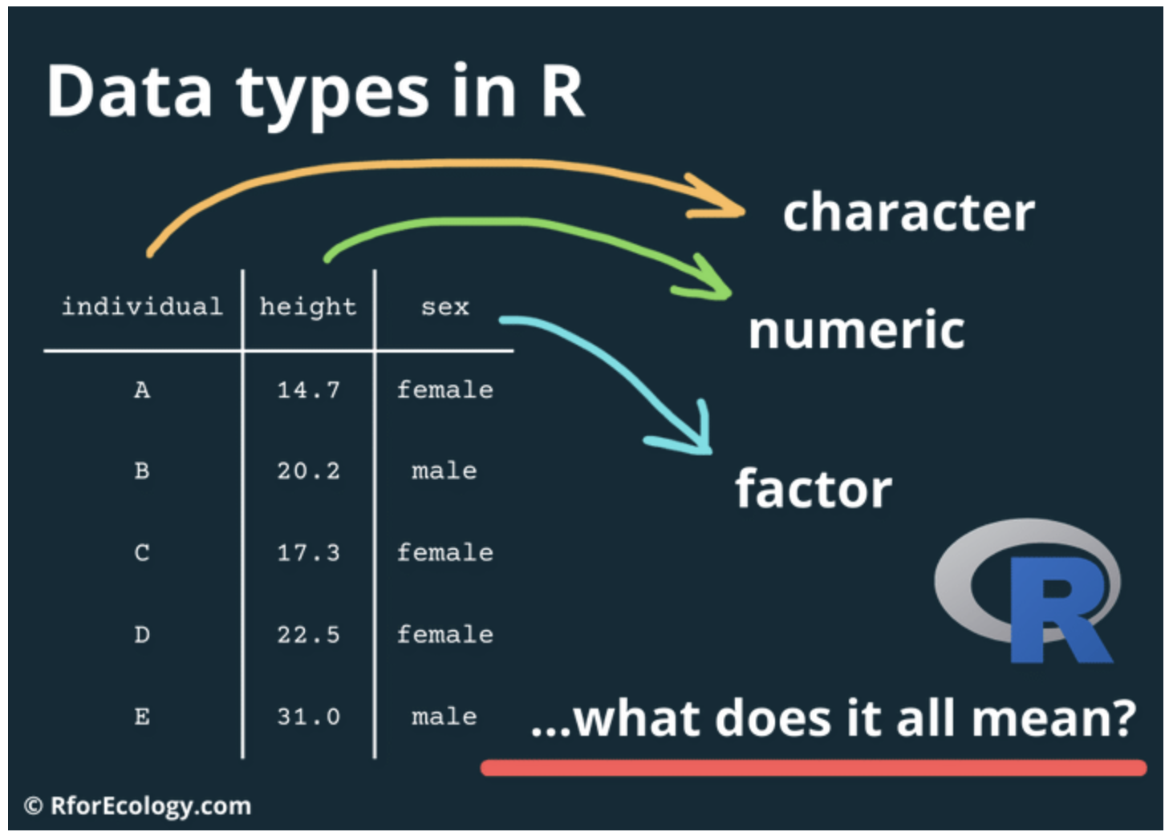
Data types
https://www.rforecology.com/post/data-types-in-r/

Slide 10
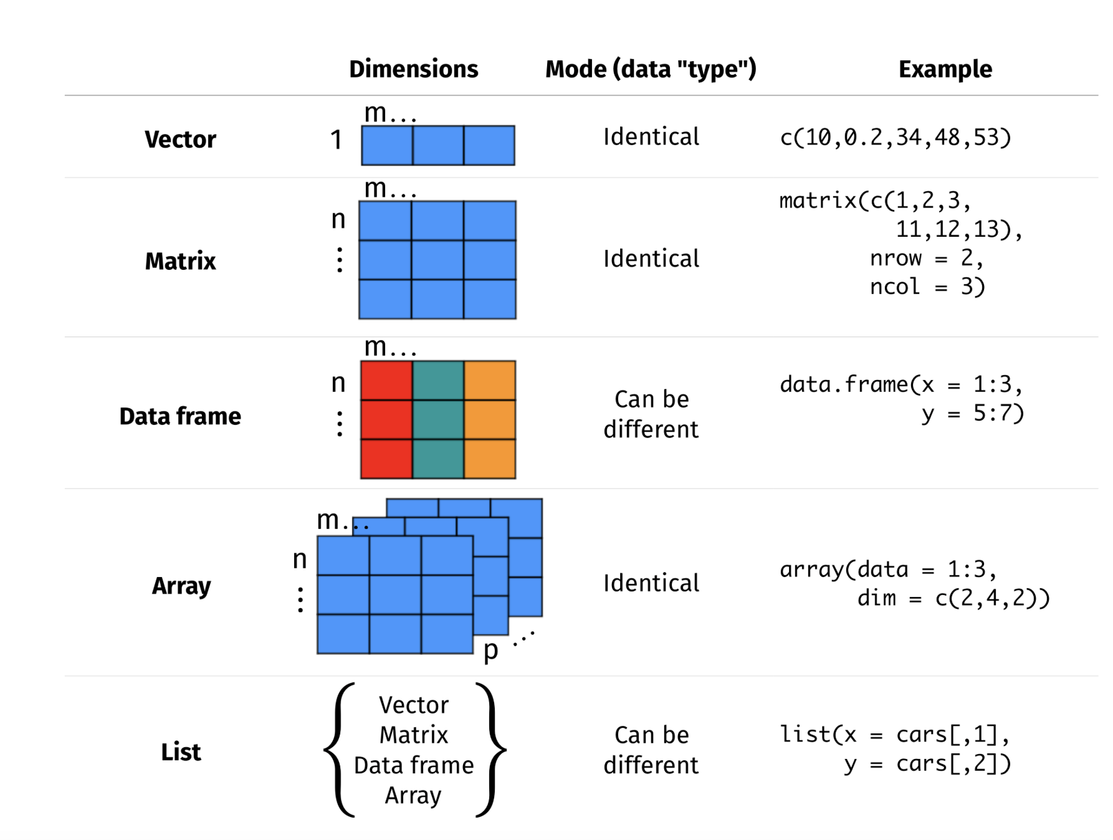
Data structures in R
https://r.qcbs.ca/workshop01/pres-en/workshop01-pres-en.html#100

Slide 11
Working with Lists and Data Frames
Access with [ ], [[ ]], and $
Naming list elements
Adding/removing columns in data frames
Merging and subsetting data

Slide 12
Installing packages in R
Installing R Packages from the CRAN Repository
install.packages('readr’)
install.packages(c('readr', 'ggplot2', 'tidyr’))
Installing R packages from GitHub
install.packages('devtools’)
devtools::install_github('rstudio/shiny’)
Install using bioconductor
if (!require("BiocManager", quietly = TRUE))
install.packages("BiocManager")
BiocManager::install(version = "3.18")
BiocManager::install(c("GenomicFeatures", "AnnotationDbi"))

Slide 13
R File Types Overview
R Script (.R)
Plain text with R code only
Run line by line or as batch
Best for pipelines & reusable functions
Output: console, not embedded
R Markdown (.Rmd)
Text + code chunks
Knit → produces static reports (HTML, PDF, Word, slides)
Inline outputs visible while working, but not formally saved
Best for reports, manuscripts, assignments
R Notebook (.Rmd in notebook mode)
Same syntax as R Markdown
Run chunks interactively, outputs appear inline
Outputs are saved into .nb.html (persist + shareable)
Best for teaching, exploration, reproducible notebooks
Quarto (.qmd)
Next-gen system (successor to R Markdown)
Supports R, Python, Julia (multi-language)
Can create reports, books, websites, dashboards
Best for modern, professional publishing

