Slide 1
An Empirical Study of Cross-Lingual Unsupervised Alignment Based on Syntactic Features
Project Presentation: CS498
Pranjal Singh
10511
spranjal@iitk.ac.in
Advisor: Prof. Amitabha Mukerjee

Slide 2
MOTIVATION
Ever increasing volume of text documents
Quite important to identify similar contents in two languages
Uses unsupervised learning which is less expensive as compared to fully supervised approach

Slide 3
OVERVIEW
Bag of Words Model with terms as features
Two Approaches:
PLSA
ADIOS

Slide 4
DataSet
Manually built corpus on Coal Scam in Hindi and English
English: ~52,000 tokens
Hindi: ~36,000 tokens
Notes:
Focused corpora

Slide 5
Sample text(English)
“The Supreme Court on Thursday expanded the scope of the coal scam investigations and issued notice to 7 states - Jharhand, Chhattisarh, Andhra Pradesh, Odisha, Madhya Pradesh and West Bengal.
While BJP also sought sacking of Law Minister Ashwani Kumar alleging his interference in preparation of CBI report to the Supreme Court on the coal scam, DMK sought resignation of P C Chacko as the Chairman of Joint”

Slide 6
Sample text(hindi)
“कोयला घोटाले में शीर्ष उद्योगपति कुमार मंगलम बिड़ला के खिलाफ एफआइआर दर्ज होने के बाद मामले की आंच प्रधानमंत्री मनमोहन सिंह तक आने के बाद पूरी सरकार उनके बचाव में उतर आई है। वहीं, कोयला मंत्री श्रीप्रकाश जायसवाल ने कहा है कि पीएम को किसी से ईमानदारी का प्रमाणपत्र लेने की जरूरत नहीं है।
सीबीआइ ने कोयला ब्लॉक आवंटन के मामले में 14वीं एफआइआर में कुमार मंगलम बिड़ला के खिलाफ मामला दर्ज किया है। प्रधानमंत्री के समर्थन में पूरी तरह उतरते हुए शर्मा ने कहा कि अगर इसी तरह सरकार के हर फैसले पर सवाल उठते रहे तो मंत्रियों और नौकरशाहों के लिए कोई भी निर्णय करना मुश्किल हो जाएगा।सीबीआइ की एफआइआर के अनुसार”

Slide 7
Methodology
Feature Extraction(PLSA)
Removed stop-words and symbols
Represented document as term by document matrix (Bag-of-Words Model)
E.g. document1 ={t₁,t₂,……..,t_{n}}
where t_{i}: term frequency in that document
Stemming NOT used

Slide 8
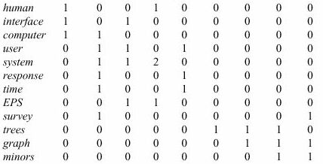
SAMPLE

Slide 9
PROBLEMS
Synonyms: separate words that have the same meaning.
E.g. ‘car’ & ‘automobile’
They tend to reduce recall
Polysems: words with multiple meanings
E.g. ‘saturn’
They tend to reduce precision
→ The problem is more general: there is a disconnect between topics and words

Slide 10
Philosophy
‘… a more appropriate model should consider some conceptual dimensions instead of words.’
(Gardenfors)

Slide 11
PLSA (Probabilistic latent semantic analysis)
To identify latent features
Find out topics from a collection of text documents
Creates clusters using probabilistic approach

Slide 12
PLSA
Latent variables z are introduced and relate to documents d
| z | << | d |, as the same z_{i} may be associated with more than one documents
z performs as a bottleneck and results in dimensionality reduction

Slide 13
PLSA
Doc
We know how to compute the parameter of this model, i.e., P(term_{t}|doc)
t1
t2
tT

Slide 14
PLSA
Now let us have K topics as well:
Doc
k1
k2
t1
t2
tT

Slide 15
PLSA
The parameters of this model are:
P(t|k)
P(k|doc)
It is possible to derive the equations for computing these parameters by Maximum Likelihood.
If we do so, what do we get?
P(t|k) for all t and k, is a term by topic matrix
(gives which terms make up a topic)
P(k|doc) for all k and doc, is a topic by document matrix
(gives which topics are in a document)

Slide 16
PLSA
The log likelihood of this model is the log probability of the entire collection:

Slide 17
Results(PLSA)
[कोयला, आवंटन, कोल, जिंदल, ब्लॉक, कंपनियों, कंपनी, हिंडाल्को, ब्लाक]
[coal, cbi, the, allocation, birla, fir, block, hindalco, alleged]
[कोयला, घोटाले, सीबीआई, दर्ज, सरकार, सीबीआइ, ब्लॉक, मामले, पूर्व]
[minister, coal, prime, bjp, the, scam, government, party, issue]
[जांच, कोर्ट, कोयला, सरकार, रिपोर्ट, सीबीआई, सुप्रीम, प्रधानमंत्री, मंत्री, घोटाले]
[cbi, coal, the, court, ministry, report, probe, files, agency, government]

Slide 18
ADIOS (Automatic Distillation of Structure)
ADIOS capable of learning complex syntax, generating grammatical novel sentences
Proving useful in other fields that call for structure discovery from raw data, such as bioinformatics
Composed of three main elements
A representational data structure
A segmentation criterion (MEX)
A generalization ability

Slide 19
ADIOS: the model
edge
node
(1)
where
101
cat
104
(2)
(5)
(1)
101
(2)
101
(3)
(4)
(6)
BEGIN
(1)
102
is
(2)
that
102
(3)
a
(4)
dog
(5)
102
?
(6)
END
103
(3)
(4)
104
(5)
(6)
(2)
103
(7)
(1)
(3)
(5)
and
104
horse
(6)
the
(4)
Is that a dog?

Slide 20
adios
Identifying patterns becomes easier on a graph
Sub-paths are automatically aligned

Slide 21
ADIOS
Once a pattern is identified as significant, the sub-paths it subsumes are merged into a new vertex and the graph is rewired accordingly. Repeating this process, leads to the formation of complex, hierarchically structured patterns.

Slide 22
ADIOS

Slide 23
Adios algorithm
Initialization – load data into pseudograph
Until no more patterns are found do
For each path detect all sub-paths that live up to the MEX criterion
Pick best pattern, add it to graph and rewire paths

Slide 24
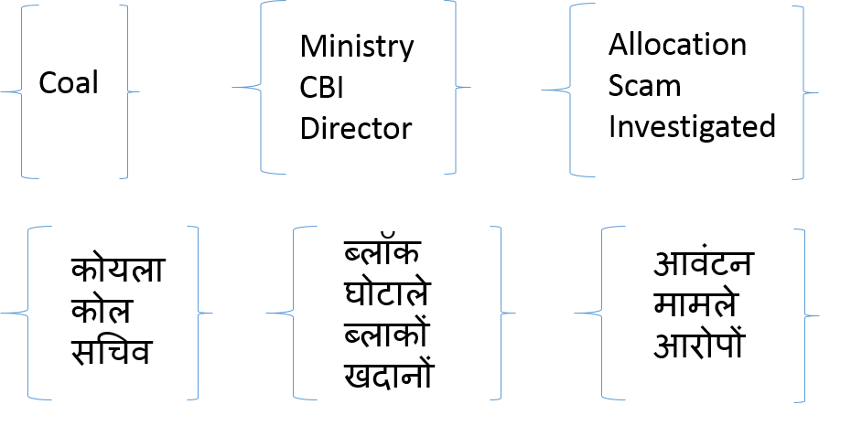
Results(ADIOS)

Slide 25
Future Work
Currently looked only at a focused corpus
To look at documents with multiple topics and then strengthen the alignment in the concerned languages with smaller alignments.
Look for n-gram clusters in the documents
Can be used to identify semantic relations between sentences in different languages
Notes:
with ADIOS and these clusters, we can simplify the documents
for the understanding of a child.

Slide 26
FUTURE WORK
Distributional Features are motivated by the so-called Distributional Hypothesis:
“The degree of semantic similarity between two linguistic expressions A and B is a function of the similarity of the linguistic contexts in which A and B can appear” **
Harris proposed the method of distributional analysis as a scientific methodology for linguistics:
introduced for phonology, then methodology for all linguistic levels.
**Z. Harris (1954) Distributional Structure

Slide 27
References
Thomas Hofmann. Unsupervised learning by probabilistic latent semantic analysis. Machine Learning, 42(1):177–196, 2001.
Heng Ji. Cross-lingual predicate cluster acquisition to improve bilingual event extraction by inductive learning. In Proceedings of the Workshop on Unsupervised and Minimally Supervised Learning of Lexical Semantics, UMSLLS ’09, pages 27–35, Stroudsburg, PA, USA, 2009. Association for Computational Linguistics.
Oscar Täckström, Ryan McDonald, and Jakob Uszkoreit. Cross-lingual word clusters for directtransfer of linguistic structure. In Proceedings of the 2012 Conference of the North American Chapter of the Association for Computational Linguistics: Human Language Technologies, NAACL HLT ’12, pages 477–487, Stroudsburg, PA, USA, 2012. Association for Computational Linguistics.
Zach Solan Thesis, Tel Aviv University, 2006

Slide 28
Thank You!!!

Slide 29
Motif extraction

Slide 30
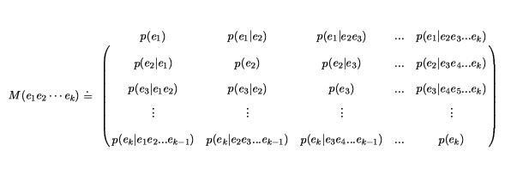
MARKOV MATRIX
The top right triangle defines the P_{L} probabilities, bottom left triangle the P_{R} probabilities
Matrix is path-dependent

Slide 31
Pattern selection?
Obviously, the more significant the pattern the better
Turns out it helps choosing longer patterns first when segmenting text
Lowers the probability for accidentally linking words
Also turns out it helps to gradually increase ALPHA

Slide 32
Context sensitive generalization
Slide a context window of size L across current search path
For each 1≤i≤L
look at all paths that are identical with the search path for 1≤k≤L, except for k=i
Define an equivalence class containing the nodes at index i for these paths
Replace i^{th} node with equivalence class
Find significant patterns using MEX criterion

Slide 33
ADIOS DRAWBACK
ADIOS is inherently a heuristic and greedy algorithm
Once a pattern is created it remains forever – errors conflate
Sentence ordering affects outcome
Running ADIOS with different orderings gives patterns that ‘cover’ different parts of the grammar

Slide 34
PLSA Algorithm
Inputs: term by document matrix X(t,d), t=1:T, d=1:N and the number K of topics sought
Initialise arrays P1 and P2 randomly with numbers between [0,1] and normalise them to sum to 1 along rows
Iterate until convergence
For d=1 to N, For t =1 to T, For k=1:K
Output: arrays P1 and P2, which hold the estimated parameters P(t|k) and P(k|d) respectively

Slide 35
DISTRIBUTIONAL SEMANTICS
Harris goes one step farther and claims that distributions should
be taken as an explanans for meaning itself
A distributional semantic model (DSM) is a co-occurrence matrix M where rows correspond to target terms and columns correspond to context or situations where the target terms appear.

