Slide 1
A Weakly-Supervised Approach to Argumentative Zoning of Scientific Documents
Paper Presentation: CS671
Yufan Guo
Anna Korhonen
Thierry Poibeau
Review By:
Pranjal Singh
10511

Slide 2
Overview
The paper talks about annotation of documents according to certain broad classes such as objective, methodology, results obtained, etc.
The paper basically investigates the performance of weakly-supervised learning for Argumentative Zoning(AZ) of scientific abstracts.
Uses weakly-supervised learning which is less expensive as compared to fully supervised approach.

Slide 3
What is Argumentative Zoning??
AZ is an approach to information structure which provides an analysis of the rhetorical progression of the scientific argument in a document (Teufel and Moens, 2002).
Because of the utility of this method in several domains (such as summarization, computational linguistics), weakly-supervised approach is much more practical.
Notes:
2nd point: Different domains have different zones

Slide 4
Architecture
Data
Guo et al. (2010) provide a corpus of 1000 biomedical abstracts (consisting of 7985 sentences and 225785 words) annotated according to three schemes of information structure(section names, AZ and Core Scientific Concepts)
The paper uses Argumentative Zoning (Mizuta et al., 2006)
According to Cohens kappa (Cohen, 1960) the inter-annotator agreement is relatively high: kappa(k) = 0.85.

Slide 5
Architecture
Methods
Comparison between supervised classifier (SVM and CRF) with four weakly supervised classifiers:
Two based on semi-supervised learning ( transductive SVM and semi-supervised CRF) and
Two on active learning (Active SVM alone and in combination with self-training).

Slide 6
Zones in AZ

Slide 7
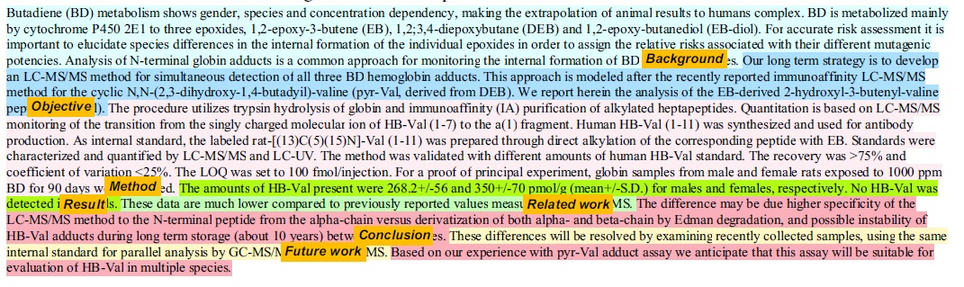
An example of an annotated abstract

Slide 8
Methodology
Feature Extraction
Documents were first identified by their features which included Zones (e.g. abstracts were divided into ten parts where zones typically occur)
Words, Bi-grams, Verbs, Verb Class, POS, Grammatical Relation, Subject & Object, Voice of Verbs.
These were extracted using tools such as tokenizer(detects boundaries in a sentence), C&C Tool(POS tagging, lemmatization and parsing), unsupervised spectral clustering method(to acquire verb classes).
The lemma output was used to create Word, Bi-gram and Verb features.

Slide 9
SVM(Support Vector Machine)
Supervised learning models with associated learning algorithms that analyze data and recognize patterns, used for classification and regression analysis
The basic SVM takes a set of input data and predicts, for each given input, which of two possible classes forms the output, making it a non-probabilistic binary linear classifier.

Slide 10
CRF(Conditional Random Field)
A form of discriminative modelling
Has been used successfully in various domains such as part of speech tagging and other Natural Language Processing tasks
Processes evidence bottom-up
Combines multiple features of the data
Builds the probability P( sequence | data)

Slide 11
Results
Only one method(ASVM) identifies six out of the seven possible categories. Other methods identify five categories.
RESULTS has the highest amount of data and OBJECTIVE has the minimum.
The LOCATION feature is found to be the most important feature for ASSVM.
Voice, Verb class and GR contribute to general performance.
Least helpful features are Word, Bi-gram and Verb because they suffer from sparse data problems.

Slide 12
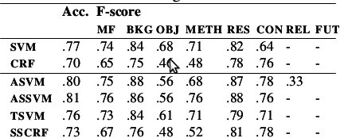
Results

Slide 13
References
Yufan Guo, Anna Korhonen, and Thierry Poibeau. A Weakly-Supervised Approach to Argumentative Zoning of Scientific Documents. In Proceedings of the Conference on Empirical Methods in Natural Language Processing, pages 273–283, 2011.
Simone Teufel and Marc Moens. Summarizing Scientific Articles: Experiments with Relevance and Rhetorical Status. Comput. Linguist., 28(4):409–445, December 2002.

Slide 14
Thank You!!!

Slide 15
Future Work
The approach to active learning could be improved in various ways by experimenting with more complex query strategies such as margin sampling algorithm by (Scheffer et al., 2001) and query-by-committee algorithm by (Seung et al., 1992).
Also, looking for other optimal features could improve the result a lot.
It could also be very interesting to evaluate the usefulness of weakly-supervised identification of information structure for NLP tasks such as summarization and information extraction and for practical tasks such as manual review of scientific papers for research purposes.

Slide 16
Maximum Margin
α
x
f
y^{est}
f(x,w,b) = sign(w. x - b)
denotes +1
denotes -1
The maximum margin linear classifier is the linear classifier with the, um, maximum margin.
This is the simplest kind of SVM (Called an LSVM)
Support Vectors are those datapoints that the margin pushes up against
Linear SVM

Slide 17
CRF(Conditional Random Field)
Each attribute of the data we are trying to model fits into a feature function that associates the attribute and a possible label
A positive value if the attribute appears in the data
A zero value if the attribute is not in the data
Each feature function carries a weight that gives the strength of that feature function for the proposed label
High positive weights indicate a good association between the feature and the proposed label
High negative weights indicate a negative association between the feature and the proposed label
Weights close to zero indicate the feature has little or no impact on the identity of the label

Slide 18
Discussion
Almost all the methods performed as they have been performing in other domains and on work done by other authors.
But TSVM did not perform better than SVM with the same amount of labelled data. This could be due to higher dimensional data in this work as compared to other works.
SSCRF did not perform as expected on the data may be due to less number of labelled and unlabelled instances.

Slide 19
Methodology
Machine Learning Methods
SVM and CRF were used as Supervised methods on the data obtained after feature extraction.
Active SVM: Starts with a small amount of labelled data, and iteratively chooses a proportion of unlabelled data for which SVM has less confidence to be labelled and used in the next round of learning,
Active SVM with self-training
Transductive SVM: Takes advantage of both labelled and unlabelled data
Semi-supervised CRF were used as Weakly-Supervised Methods.

Slide 20
Results
With 10% training data, ASSVM performs best with 81% accuracy and macro F-score of .76.
ASVM performs with accuracy of 80% and F-score of .75. Both of them outperform supervised SVM.
TSVM is the worst performing SVM-based method with an accuracy of 76% and F-score of .73 which is less than supervised SVM.
But it outperforms both CRF-based methods.

